Slide 1
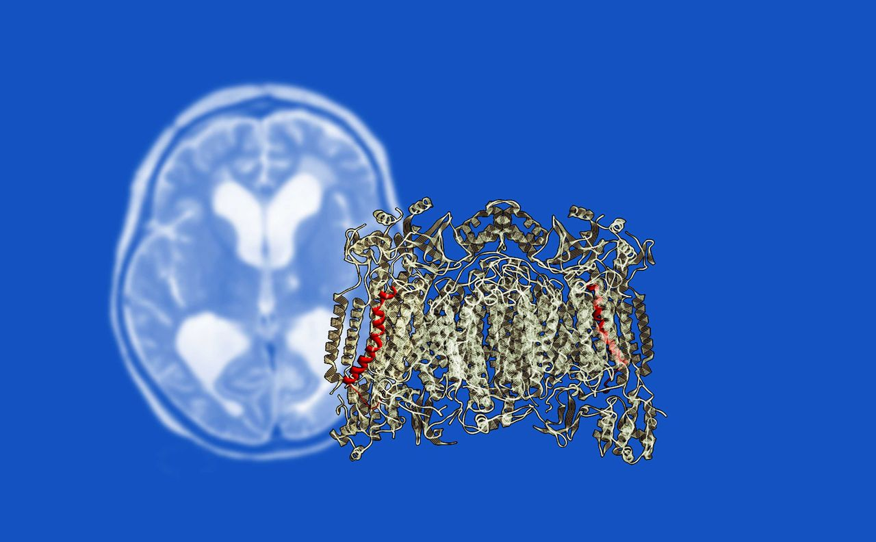
COX8A is the smallest subunit of cytochrome c oxidase, the terminal enzyme of the cellular respiration ...
Notes:
COX8A is the smallest subunit of cytochrome c oxidase, the terminal enzyme of the cellular respiration pathway. Hallmann et al. identify a homozygous splice-site mutation in COX8A in a patient with severe mitochondrial disease with leukodystrophy and epilepsy. Loss of wild-type COX8A reduces the stability of the entire enzyme complex.
Unless provided in the caption above, the following copyright applies to the content of this slide: © The Author (2015). Published by Oxford University Press on behalf of the Guarantors of Brain. All rights reserved. For Permissions, please email: journals.permissions@oup.com

Slide 2
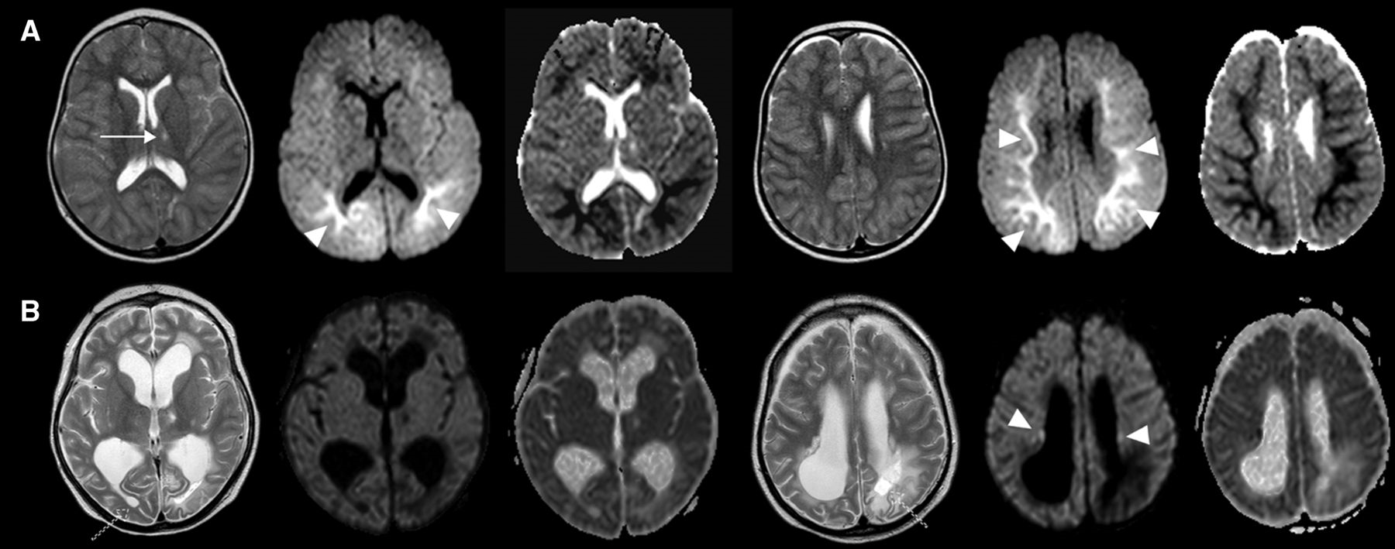
Figure 1 Brain MRI of the index patient at the ages of 8 and 12.5 years. From left to right: Axial T₂, ...
Notes:
Figure 1 Brain MRI of the index patient at the ages of 8 and 12.5 years. From left to right: Axial T2, apparent diffusion coefficient (ADC) and diffusion-weighted imaging (DWI) sequences (at two different layers, respectively). (A) Brain MRI at 8 years of age. Small lacunar thalamic lesion (arrow) without ADC reduction and without further basal ganglia or cortical signal alterations, T2-weighted sequences. Symmetric extent and diffuse signal increases of the white matter with periventricular predominance, DWI sequences. ADC maps show an ADC decrease in the corresponding white matter (arrowheads). (B) Brain MRI at 12.5 years of age. Biventricular ex vacuo hydrocephalus, brain atrophy with rarefication of the white matter, extent symmetric white matter signal changes most pronounced in periventricular areas and parietooccipital lobes, in part with cystic appearance on T2-weighted sequences (dashed arrows). Some patchy white matter areas show an increased signal in DWI sequences compatible with an ongoing process of white matter affection (arrowhead).
Unless provided in the caption above, the following copyright applies to the content of this slide: © The Author (2015). Published by Oxford University Press on behalf of the Guarantors of Brain. All rights reserved. For Permissions, please email: journals.permissions@oup.com

Slide 3
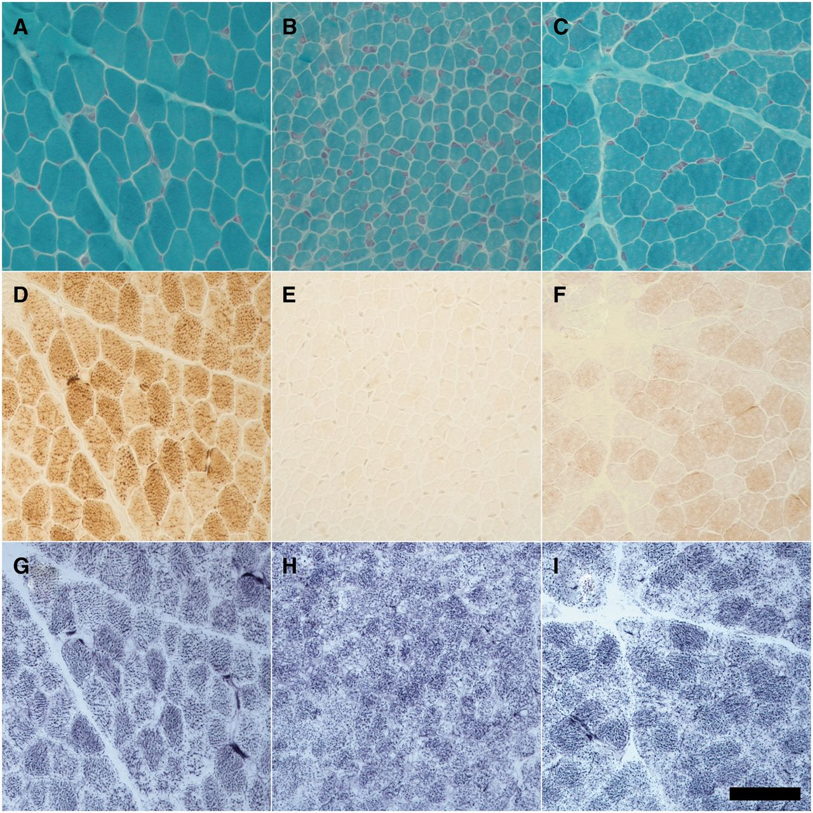
Figure 2 Decreased COX activity in skeletal muscle due to COX8A and SURF1 mutations. Muscle histochemistry from a ...
Notes:
Figure 2 Decreased COX activity in skeletal muscle due to COX8A and SURF1 mutations. Muscle histochemistry from a control subject (A, D and G), the COX8A patient (B, E and H) and a patient harbouring the homozygous c.845_846delCT SURF1 mutation (C, F and I). (A–C) Gomori’s trichrome; (D–F) cytochrome c oxidase; (G–I) succinate dehydrogenase. Scale bar = 50 µm.
Unless provided in the caption above, the following copyright applies to the content of this slide: © The Author (2015). Published by Oxford University Press on behalf of the Guarantors of Brain. All rights reserved. For Permissions, please email: journals.permissions@oup.com

Slide 4
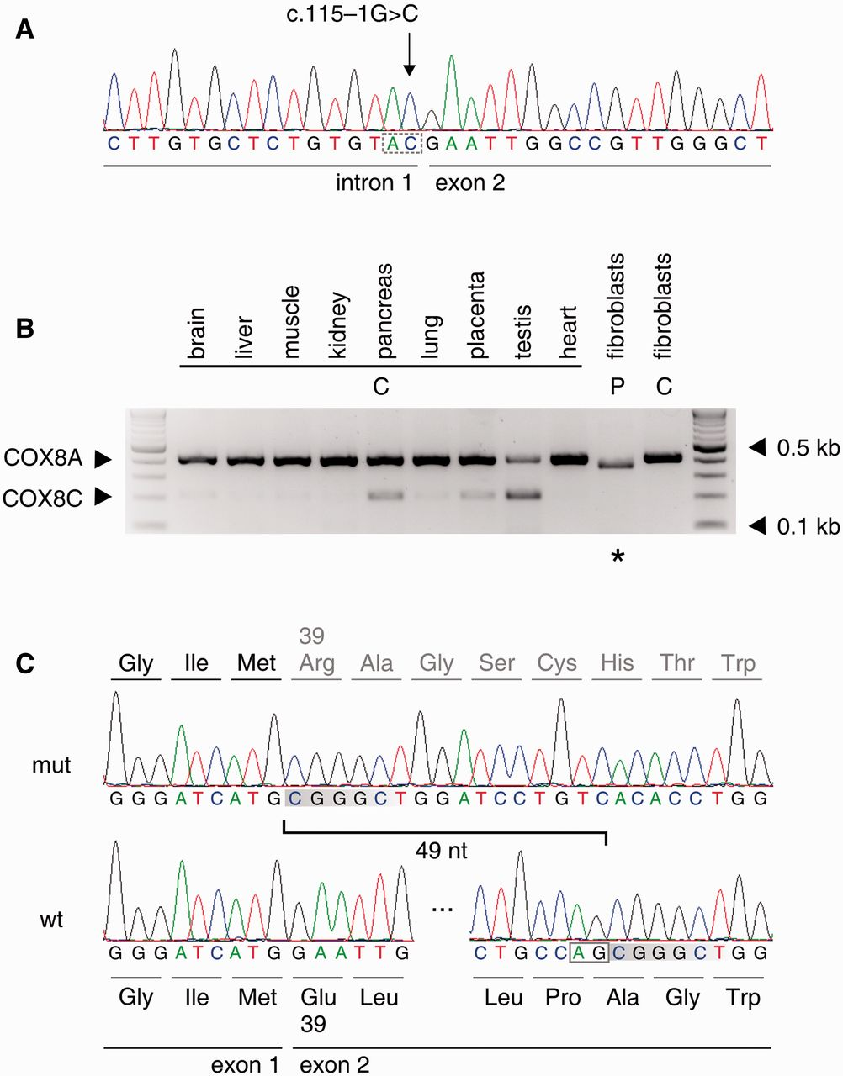
Figure 3 Consequences of the c.115-1G>C splice site mutation on mRNA level. (A) Confirmation of the homozygous ...
Notes:
Figure 3 Consequences of the c.115-1G>C splice site mutation on mRNA level. (A) Confirmation of the homozygous c.115-1G>C COX8A splice acceptor site mutation by conventional Sanger sequencing. The disrupted acceptor motive is indicated by the dashed box. (B) Multiplex PCR detection of COX8A and COX8C expression in different tissues. The upper band represents the COX8A transcript, the lower band the COX8C transcript. The asterisk indicates the shorter COX8A transcript in the fibroblasts of the COX8A patient. From left to right: molecular weight marker, brain, liver, skeletal muscle, kidney, pancreas, lung, placenta, testis, heart, fibroblasts from the COX8A patient, control fibroblasts, molecular weight marker. (C) Sequence of the COX8A cDNA from the index patient (mut, upper sequence) and of a control (wt, lower sequence). The loss of 49 nucleotides by aberrant splicing at a downstream cryptic AG splice acceptor site is indicated.
Unless provided in the caption above, the following copyright applies to the content of this slide: © The Author (2015). Published by Oxford University Press on behalf of the Guarantors of Brain. All rights reserved. For Permissions, please email: journals.permissions@oup.com

Slide 5
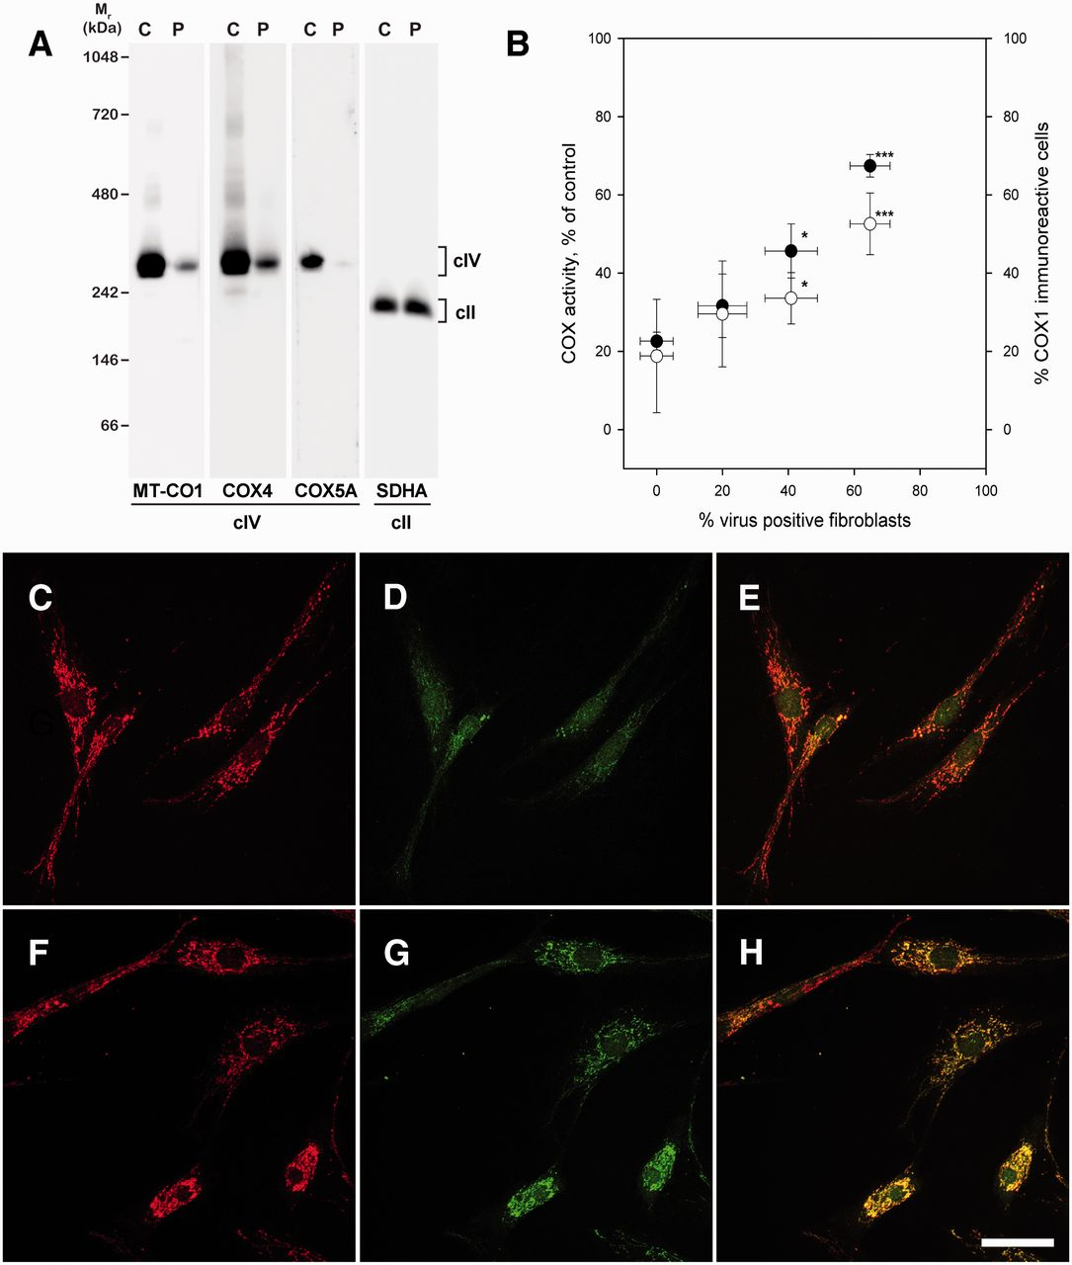
Figure 4 Blue native PAGE of mitochondrial fractions from patient’s skeletal muscle (A) and lentiviral rescue of COX ...
Notes:
Figure 4 Blue native PAGE of mitochondrial fractions from patient’s skeletal muscle (A) and lentiviral rescue of COX immunoreactivity (C–H) and activity (B) in the patient’s fibroblasts. (A) Western blots of blue native PAGEs from mitochondrial fractions of a control muscle biopsy (C) and the patient’s muscle biopsy (P) developed with antibodies against MT-CO1, COX4, COX5A and SDHA. The quantification of ratios of band intensities for MT-CO1 and SDHA from SDS PAGEs revealed in the patient’s muscle 15.9 ± 1.2% of intensities of control muscle (n = 3). (B) Rescue of COX activity by lentiviral expression of wild-type COX8A in the patient’s fibroblasts. Filled circles = COX activity (in per cent of activity in control fibroblasts) plotted versus percentage of transduced cells as estimated by DDK immunoreactivity. Open circles = MT-CO1 immunoreactivity plotted versus percentage of transduced cells as estimated by DDK immunoreactivity. The transduction of control fibroblasts with the COX8A-containing virus had no significant effect on COX activity, as the activity of control cells was 98 ± 17 mU/mg protein, and that of COX8A containing virus transduced cells 119 ± 31 mU/mg protein (average of two independent transductions of two control fibroblast lines). *P < 0.05 versus cell transduced with a control virus; ***P < 0.001 versus cell transduced with a control virus (t-test). (C–E) Index patient’s fibroblasts transduced with a control virus. (F–H) Index patient’s fibroblasts transduced with a wild-type COX8A containing virus. (C and F) NDUFS5 (complex I) immunoreactivity (red); (D and G) MT-CO1 (COX) immunoreactivity (green); (E and H) overlay of left and middle panels. Scale bar = 50 µm.
Unless provided in the caption above, the following copyright applies to the content of this slide: © The Author (2015). Published by Oxford University Press on behalf of the Guarantors of Brain. All rights reserved. For Permissions, please email: journals.permissions@oup.com

