Slide 1
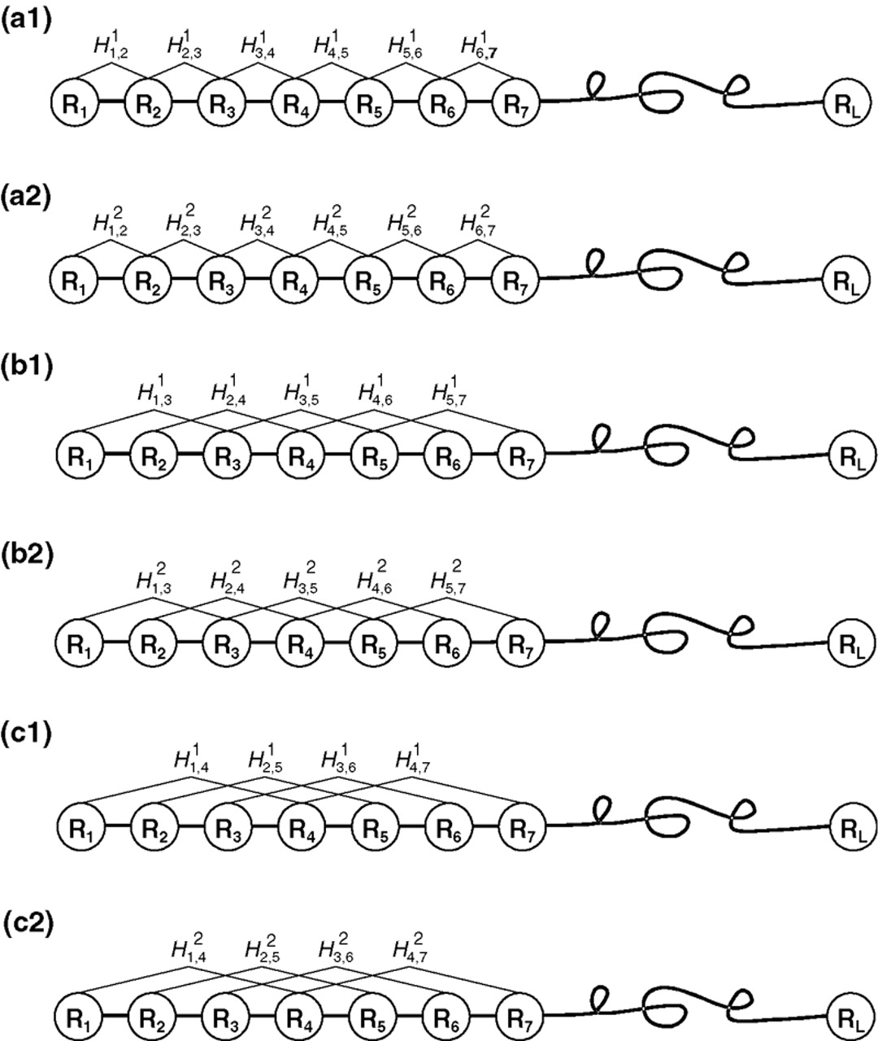
Fig. 1 A schematic diagram to show (a1/a2) the first-rank, (b1/b2) the second-rank and (c1/c2) the third-rank ...
Notes:
Fig. 1 A schematic diagram to show (a1/a2) the first-rank, (b1/b2) the second-rank and (c1/c2) the third-rank sequence-order-coupling mode along a protein sequence through a hydrophobicity/hydrophilicity correlation function, where \batchmode \documentclass[fleqn,10pt,legalpaper]{article} \usepackage{amssymb} \usepackage{amsfonts} \usepackage{amsmath} \pagestyle{empty} \begin{document} \({H}_{i,j}^{1}\) \end{document} and \batchmode \documentclass[fleqn,10pt,legalpaper]{article} \usepackage{amssymb} \usepackage{amsfonts} \usepackage{amsmath} \pagestyle{empty} \begin{document} \({H}_{i,j}^{2}\) \end{document} are given by Equation (3). Panel (a1/a2) reflects the coupling mode between all the most contiguous residues, panel (b1/b2) that between all the second-most contiguous residues and panel (c1/c2) that between all the third-most contiguous residues.
Unless provided in the caption above, the following copyright applies to the content of this slide: Bioinformatics vol. 21 issue 1 © Oxford University Press 2005; all rights reserved.

Slide 2
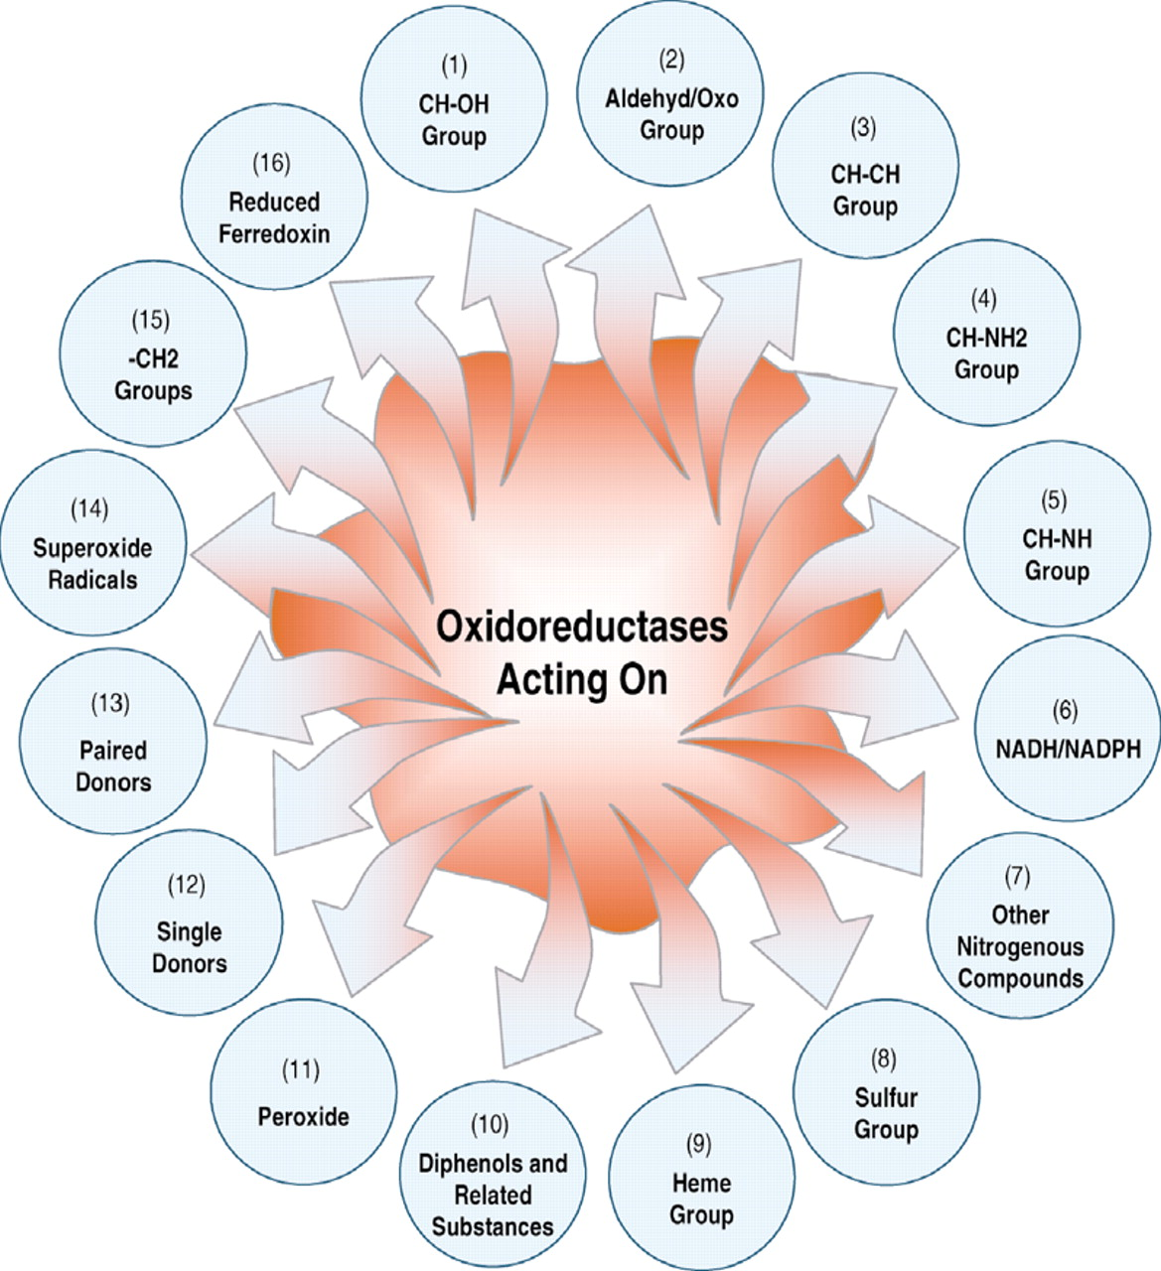
Fig. 2 A schematic diagram to show the 16 classes of oxidoreductases classified according to different groups acted ...
Notes:
Fig. 2 A schematic diagram to show the 16 classes of oxidoreductases classified according to different groups acted by the enzyme.
Unless provided in the caption above, the following copyright applies to the content of this slide: Bioinformatics vol. 21 issue 1 © Oxford University Press 2005; all rights reserved.

