Slide 1
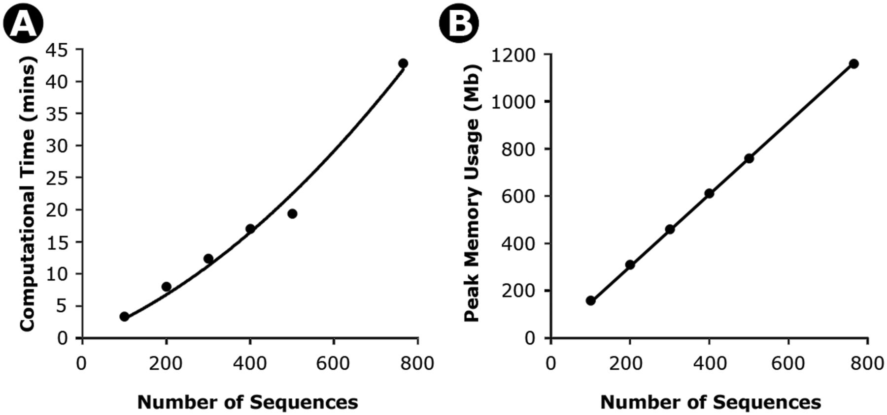
Fig. 1. Time (A) and memory (B) needed for increasingly larger data sets for timetree calculations in MEGA6. Results ...
Notes:
Fig. 1. Time (A) and memory (B) needed for increasingly larger data sets for timetree calculations in MEGA6. Results shown are from an analysis of a nucleotide sequence alignment of 765 sequences and 2,000 bp. An increasingly larger number of sequences were sampled from this alignment to obtain the computational time (minutes) and computer memory (Megabytes, Mb). The time taken increases polynomially with the number of sequences (4 × 10−05x2 + 2.64 ×10−2x; R2 = 0.99), where x is the number of sequences. However, a linear regression also fits well (0.048x; R2 = 0.93). Similarly, the memory required increases linearly with the number of sequences (1.52x, R2 = 0.99). All calculations were performed on the same computer with an Intel Xeon E5-2665 CPU, 128 GB RAM, and running Windows Server 2012 64-bit edition.
Unless provided in the caption above, the following copyright applies to the content of this slide: © The Author 2013. Published by Oxford University Press on behalf of the Society for Molecular Biology and Evolution. All rights reserved. For permissions, please e-mail: journals.permissions@oup.com

Slide 2
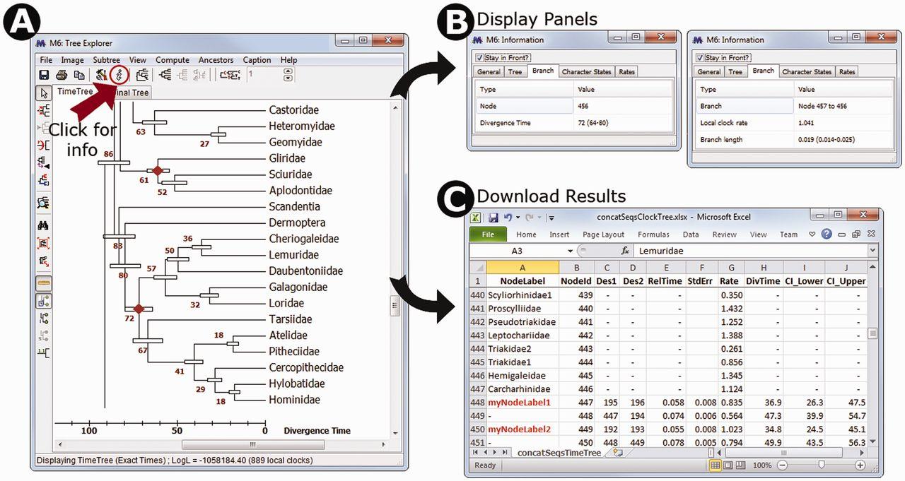
Fig. 2. (A) Timetree inferred in MEGA6 and shown in the Tree Explorer, where it is displayed with divergence times ...
Notes:
Fig. 2. (A) Timetree inferred in MEGA6 and shown in the Tree Explorer, where it is displayed with divergence times and their respective 95% confidence intervals. A scale bar for absolute divergence times is shown. (B) An information panel that can be made visible by pressing the icon marked with an “i”. When focused on a tree node (left side), it shows the internal node identifier, and absolute or relative divergence time as appropriate; when focused on a branch (right side), it displays the local clock rate as well as the relative branch length. (C) A timetable exported using the displayed timetree, which shows the ancestor–descendant relationship along with relative node times, relative branch rates, absolute divergence times, and confidence intervals. Users can display internal node identifiers in the Tree Explorer as well as internal node names, which can be provided in the input topology file. On pressing the “Caption” in the Tree Explorer menu bar, MEGA produces the following text to inform the user about the methods, choices, and data used. Caption: The timetree shown was generated using the RelTime method. Divergence times for all branching points in the user-supplied topology were calculated using the Maximum Likelihood method based on the General Time Reversible model. Relative times were optimized and converted to absolute divergence times (shown next to branching points) based on user-supplied calibration constraints. Bars around each node represent 95% confidence intervals which were computed using the method described in Tamura et al. (2013). The estimated log likelihood value of the topology shown is −247671.60. A discrete Gamma distribution was used to model evolutionary rate differences among sites (4 categories, +G, parameter = 38.07). The tree is drawn to scale, with branch lengths measured in the relative number of substitutions per site. The analysis involved 446 nucleotide sequences. All positions with less than 95% site coverage were eliminated. That is, fewer than 5% alignment gaps, missing data, and ambiguous bases were allowed at any position. There were a total of 1,048 positions in the final data set. Evolutionary analyses were conducted in MEGA6 (Tamura et al. 2013).
Unless provided in the caption above, the following copyright applies to the content of this slide: © The Author 2013. Published by Oxford University Press on behalf of the Society for Molecular Biology and Evolution. All rights reserved. For permissions, please e-mail: journals.permissions@oup.com

Slide 3
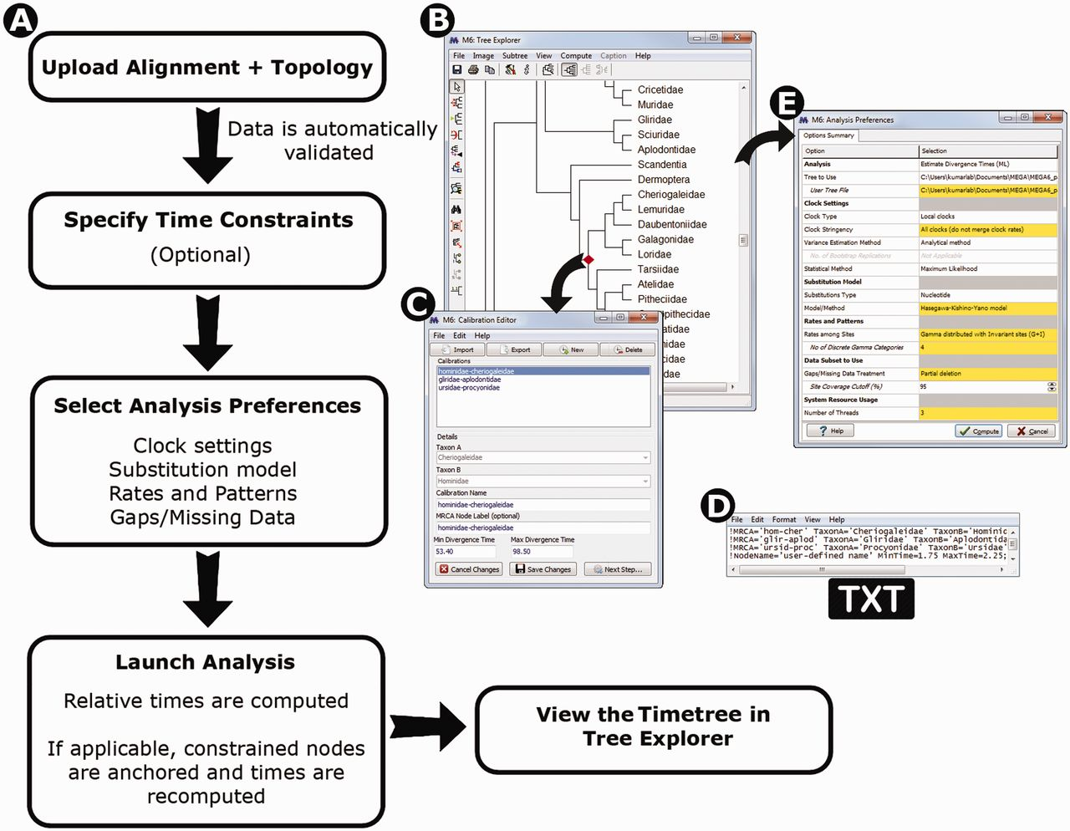
Fig. 3. (A) The flowchart of the Timetree Wizard. When launching the timetree analysis, a user first provides a data ...
Notes:
Fig. 3. (A) The flowchart of the Timetree Wizard. When launching the timetree analysis, a user first provides a data file containing a sequence alignment and another file containing a phylogeny (topology). (B) The Calibration Editor is invoked when the user needs to specify calibration constraints, which contains facilities to mark calibrations on top of the user-specified topology. (C) Users may also specify calibrations selecting two sequence names whose most recent common ancestor (MRCA) points to the node to use for calibration. (D) The user may also upload constraints via formatted text files for which two types of formats are supported. In one, the calibration time constraints and the names of two taxa whose MRCA is the node to calibrate are given (panel C style). In the second, a node name in addition to the time constraints is given and this node name matches an internal node label that is included in the Newick tree file that contains the topology that is used for the timetree analysis. (E) Analysis Preferences Dialog enables the user to select methods, models, and data subset options.
Unless provided in the caption above, the following copyright applies to the content of this slide: © The Author 2013. Published by Oxford University Press on behalf of the Society for Molecular Biology and Evolution. All rights reserved. For permissions, please e-mail: journals.permissions@oup.com

