Slide 1
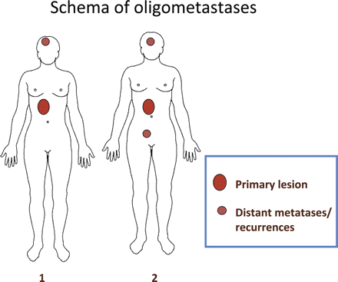
Figure 1. This is a schema of oligometastases. Schema 1 shows one distant metastasis/recurrence with a primary lesion. ...
Notes:
Figure 1. This is a schema of oligometastases. Schema 1 shows one distant metastasis/recurrence with a primary lesion. Schema 2 shows two distant metastases/recurrences with a primary lesion.
Unless provided in the caption above, the following copyright applies to the content of this slide: © 2010 The Author(s)This is an Open Access article distributed under the terms of the Creative Commons Attribution Non-Commercial License (http://creativecommons.org/licenses/by-nc/2.5/uk/) which permits unrestricted non-commercial use, distribution, and reproduction in any medium, provided the original work is properly cited.

Slide 2
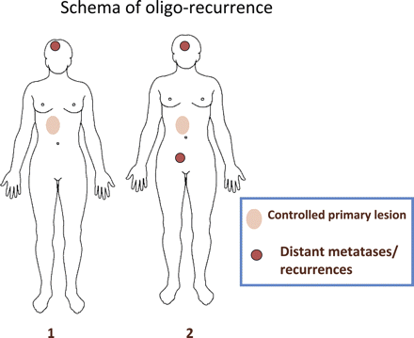
Figure 2. This is a schema of oligo-recurrence. Schema 1 shows one distant metastasis/recurrence with a controlled ...
Notes:
Figure 2. This is a schema of oligo-recurrence. Schema 1 shows one distant metastasis/recurrence with a controlled primary lesion. Schema 2 shows two distant metastases/recurrences with a controlled primary lesion. The biggest difference between oligometastases and oligo-recurrences lies in the uncontrolled or controlled primary lesion. Oligo-recurrence requires a controlled primary lesion.
Unless provided in the caption above, the following copyright applies to the content of this slide: © 2010 The Author(s)This is an Open Access article distributed under the terms of the Creative Commons Attribution Non-Commercial License (http://creativecommons.org/licenses/by-nc/2.5/uk/) which permits unrestricted non-commercial use, distribution, and reproduction in any medium, provided the original work is properly cited.

Slide 3
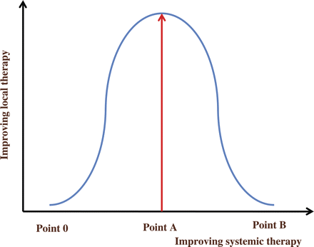
Figure 3. This shows correlations between systemic and local therapies. Until point A, the role of local therapy ...
Notes:
Figure 3. This shows correlations between systemic and local therapies. Until point A, the role of local therapy increases as systemic therapy improves. However, after point A, the role of local therapy decreases as systemic therapy improves, as all cancerous lesions can be cured by systemic therapy at point B.
Unless provided in the caption above, the following copyright applies to the content of this slide: © 2010 The Author(s)This is an Open Access article distributed under the terms of the Creative Commons Attribution Non-Commercial License (http://creativecommons.org/licenses/by-nc/2.5/uk/) which permits unrestricted non-commercial use, distribution, and reproduction in any medium, provided the original work is properly cited.

