Slide 1
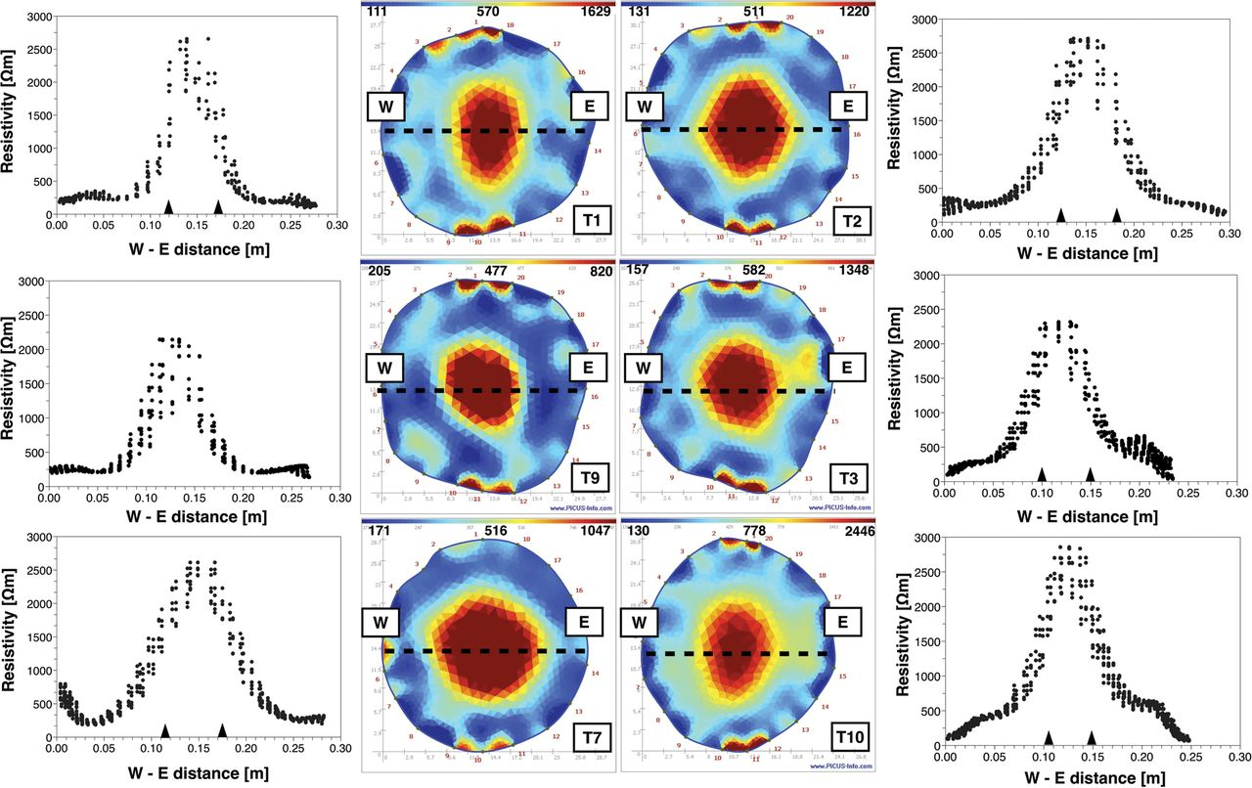
Figure 1. Electrical resistivity tomographs for the 10 trees. West to east profiles (from W to E) are plotted next to ...
Notes:
Figure 1. Electrical resistivity tomographs for the 10 trees. West to east profiles (from W to E) are plotted next to the tomographs. Dashed line shows the profile on the tomographs. Measured location of SW–HW boundaries are indicated by triangles on the x-axis of the profiles.
Unless provided in the caption above, the following copyright applies to the content of this slide: © The Author 2013. Published by Oxford University Press. All rights reserved. For Permissions, please email: journals.permissions@oup.com

Slide 2
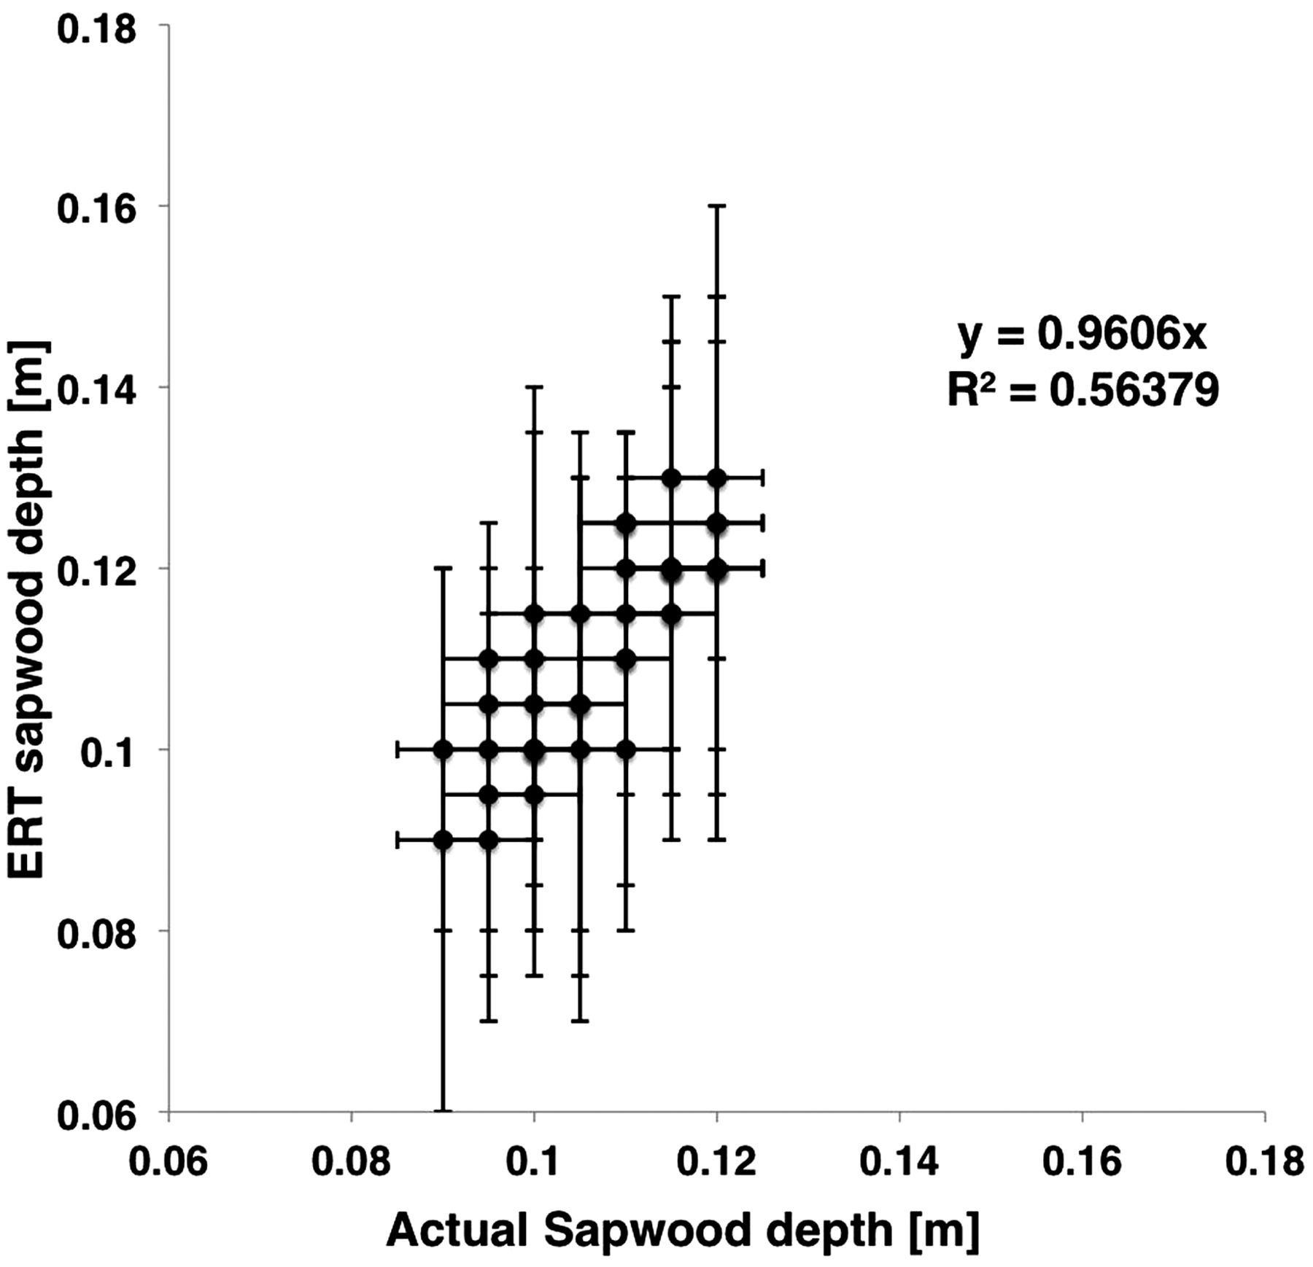
Figure 2. Linear regression of the ERT SW depth (m) versus the actual SW depth (m) for northern, southern, western and ...
Notes:
Figure 2. Linear regression of the ERT SW depth (m) versus the actual SW depth (m) for northern, southern, western and eastern profiles.
Unless provided in the caption above, the following copyright applies to the content of this slide: © The Author 2013. Published by Oxford University Press. All rights reserved. For Permissions, please email: journals.permissions@oup.com

Slide 3
Figure 3. Quartiles of the mean wood moisture content m_{c} (g g⁻¹) and wood dry density ...
Notes:
Figure 3. Quartiles of the mean wood moisture content mc (g g−1) and wood dry density ρb (−) for T1 to T4 versus distance from the cambium. C represents the centre of the tree section.
Unless provided in the caption above, the following copyright applies to the content of this slide: © The Author 2013. Published by Oxford University Press. All rights reserved. For Permissions, please email: journals.permissions@oup.com

Slide 4
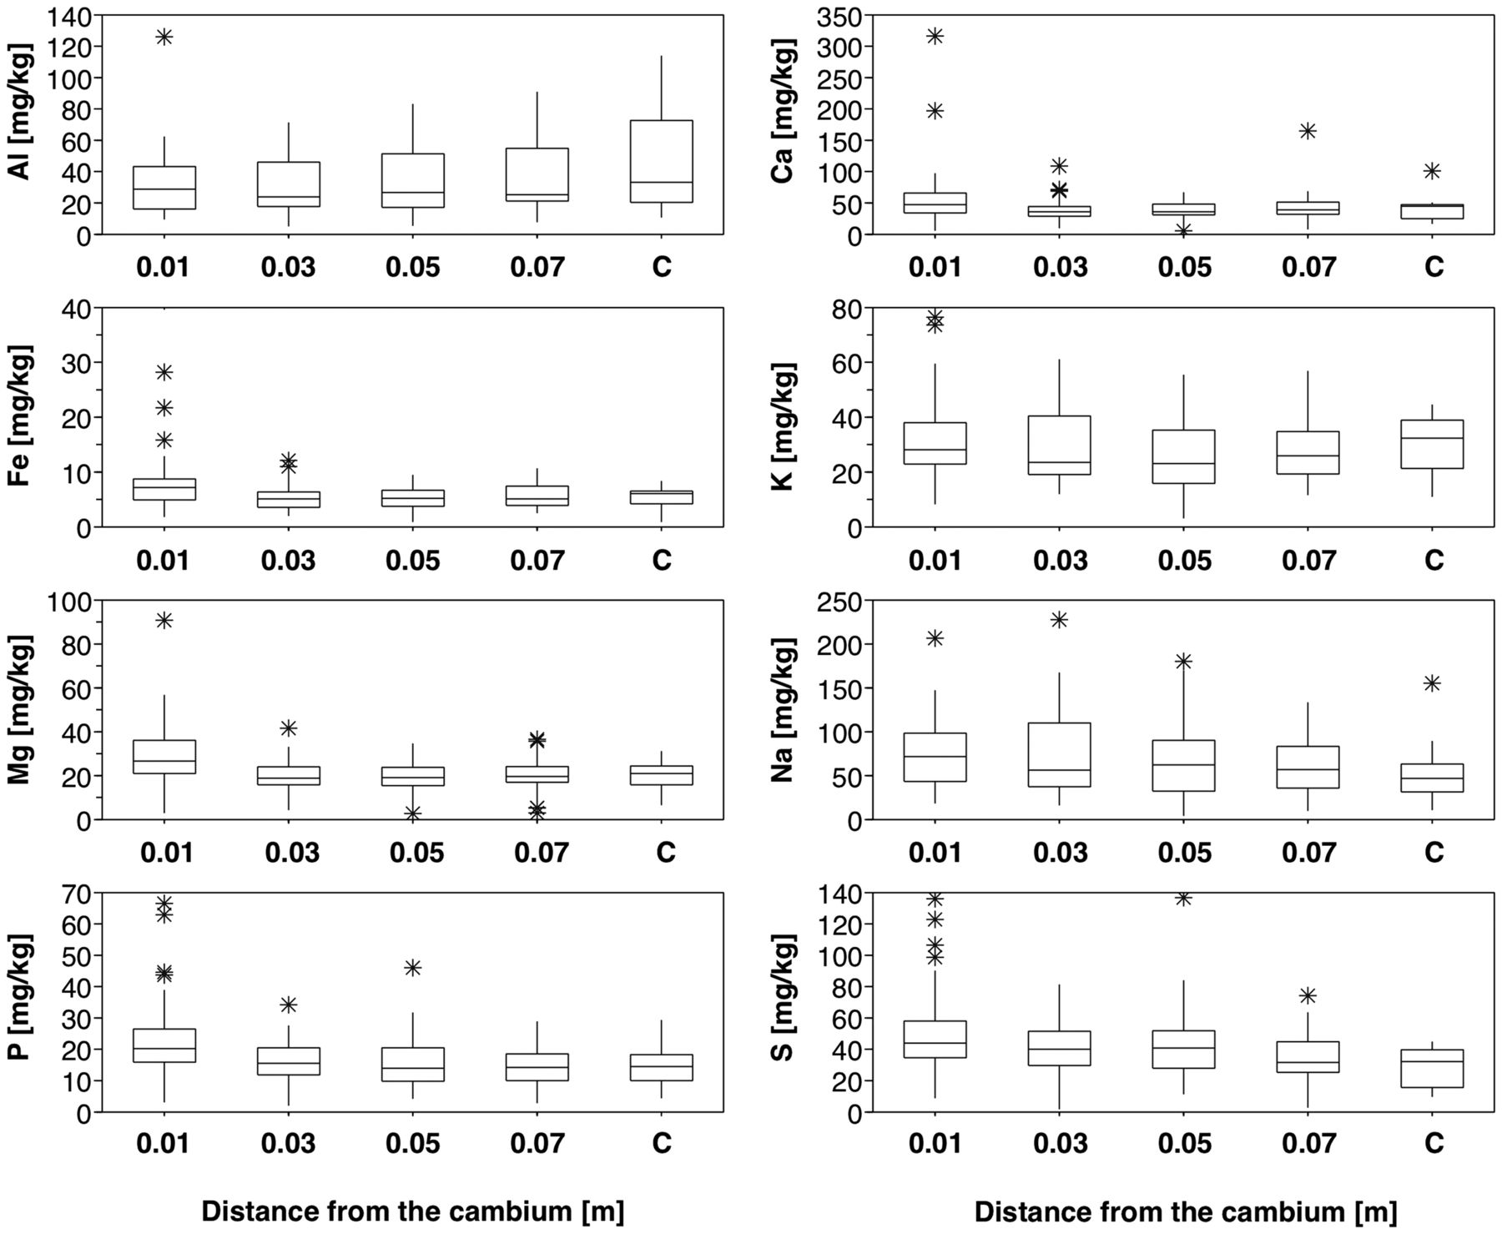
Figure 4. Quartiles of the mean sap electrolyte concentrations (Al, Ca, Fe, K, Mg, Na, P and S (mg kg⁻¹)) ...
Notes:
Figure 4. Quartiles of the mean sap electrolyte concentrations (Al, Ca, Fe, K, Mg, Na, P and S (mg kg−1)) for T1 to T10 versus distance from the cambium. C represents the centre of the tree section.
Unless provided in the caption above, the following copyright applies to the content of this slide: © The Author 2013. Published by Oxford University Press. All rights reserved. For Permissions, please email: journals.permissions@oup.com

Slide 5
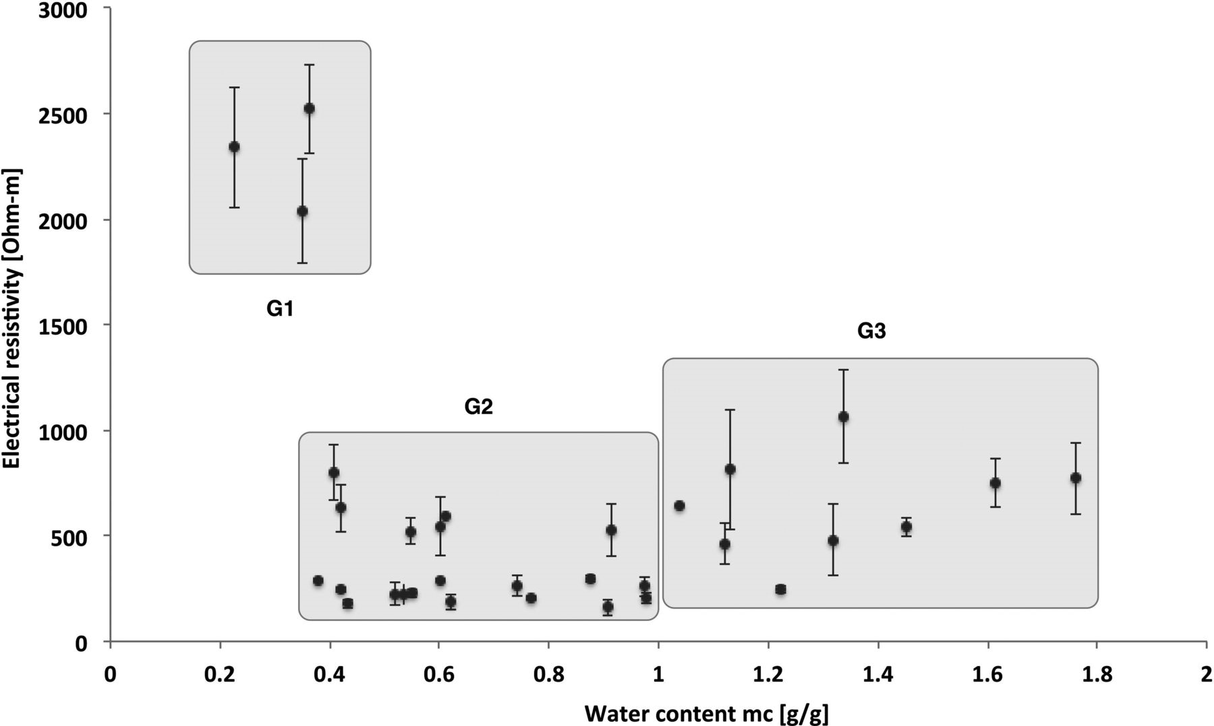
Figure 5. Measured electrical resistivity (Ω m) versus measured wood moisture content (g g⁻¹). G1, G2 and G3 ...
Notes:
Figure 5. Measured electrical resistivity (Ω m) versus measured wood moisture content (g g−1). G1, G2 and G3 represent clusters of data that have been arbitrary defined to help the discussion.
Unless provided in the caption above, the following copyright applies to the content of this slide: © The Author 2013. Published by Oxford University Press. All rights reserved. For Permissions, please email: journals.permissions@oup.com

