Slide 1
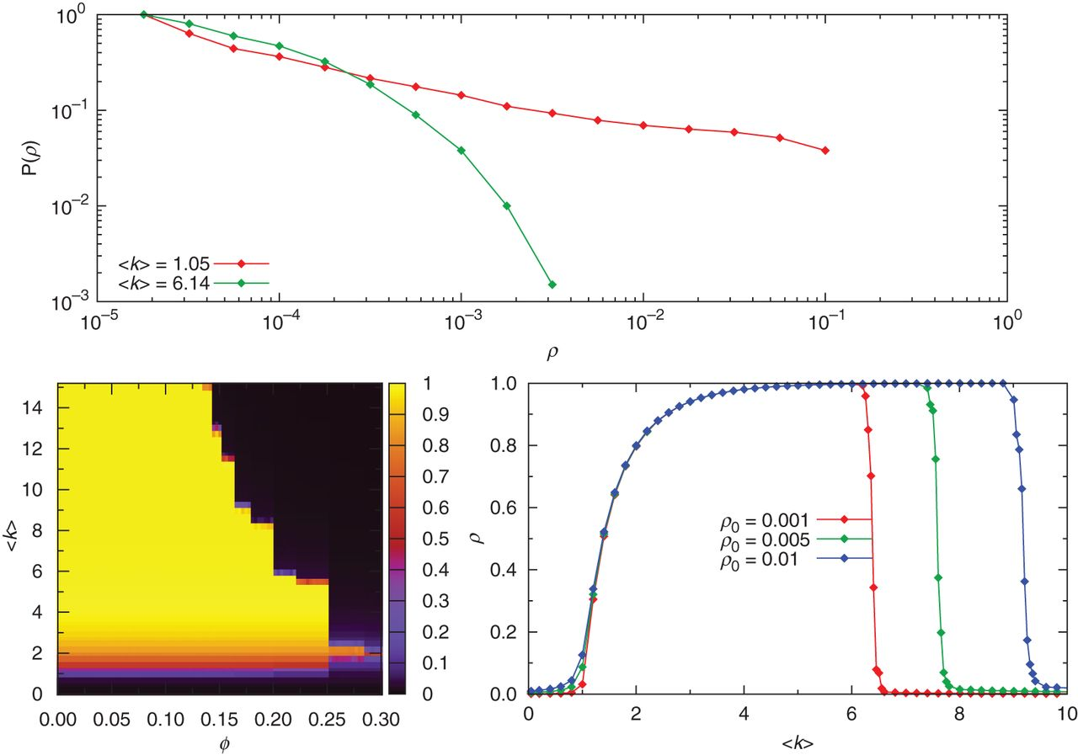
Figure 1. Top panel: Cumulative distributions of cascade sizes ρ for a Poisson undirected random graph of ...
Notes:
Figure 1. Top panel: Cumulative distributions of cascade sizes ρ for a Poisson undirected random graph of N=105 nodes and a single early adopter, with mean degrees at the lower (〈k〉=1.05) and upper (〈k〉=6.14) critical points. Cascades at the lower critical point are power-law distributed. Bottom left panel: Average cascade size ρ (colour-coded) as a function of the constant threshold ϕ, and the average degree 〈k〉, for a seed fraction of ρ0=0.01. Bottom right panel: Values of ρ at ϕ=0.18 and different values of seed fractions. Numerical simulations have been averaged over 100 randomizations (each realization consisting of a randomly generated network and a set of ρ0 randomly selected early adopters).
Unless provided in the caption above, the following copyright applies to the content of this slide: © The Authors 2013. Published by Oxford University Press.This is an Open Access article distributed under the terms of the Creative Commons Attribution License (http://creativecommons.org/licenses/by-nc/3.0/), which permits non-commercial reuse, distribution, and reproduction in any medium, provided the original work is properly cited. For commercial re-use, please contact journals.permissions@oup.com

Slide 2
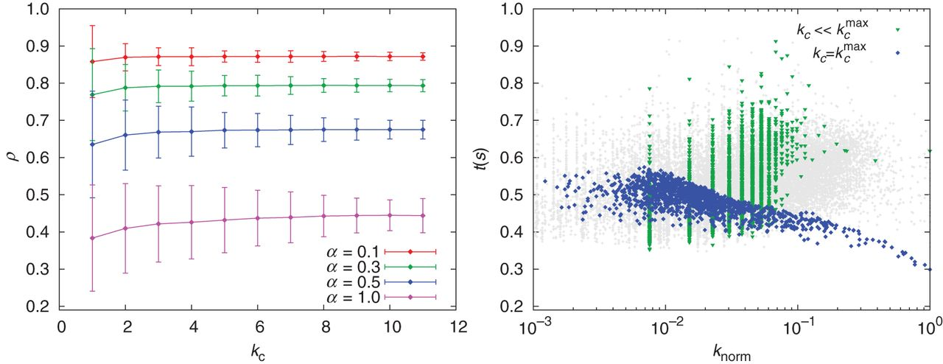
Figure 2. Left: Average stifler density ρ for a rumour process triggered at nodes with k-core k_{c} on an ...
Notes:
Figure 2. Left: Average stifler density ρ for a rumour process triggered at nodes with k-core kc on an e-mail network. Different conditions were tested, and yet no correlation is observed between ρ and the initiator’s centrality, i.e. absence of influential spreaders in rumour dynamics. Right: central nodes (those in $k_{c}^{\mathrm {max}}$, blue dots) acting as firewalls of the rumour spreading: these nodes are among the first to become stiflers (time-to-stifler t(s) is low), thus acting as topological barriers for the dynamics. For these central nodes, the time it takes them to turn into stiflers is even lower for those with the highest degree (normalized in the x-axis by the kmax within a k-shell). The contrast is clear if compared with lower cores (red circles) or, in general, to the rest of the network (gray dots). Adapted from 56.
Unless provided in the caption above, the following copyright applies to the content of this slide: © The Authors 2013. Published by Oxford University Press.This is an Open Access article distributed under the terms of the Creative Commons Attribution License (http://creativecommons.org/licenses/by-nc/3.0/), which permits non-commercial reuse, distribution, and reproduction in any medium, provided the original work is properly cited. For commercial re-use, please contact journals.permissions@oup.com

Slide 3
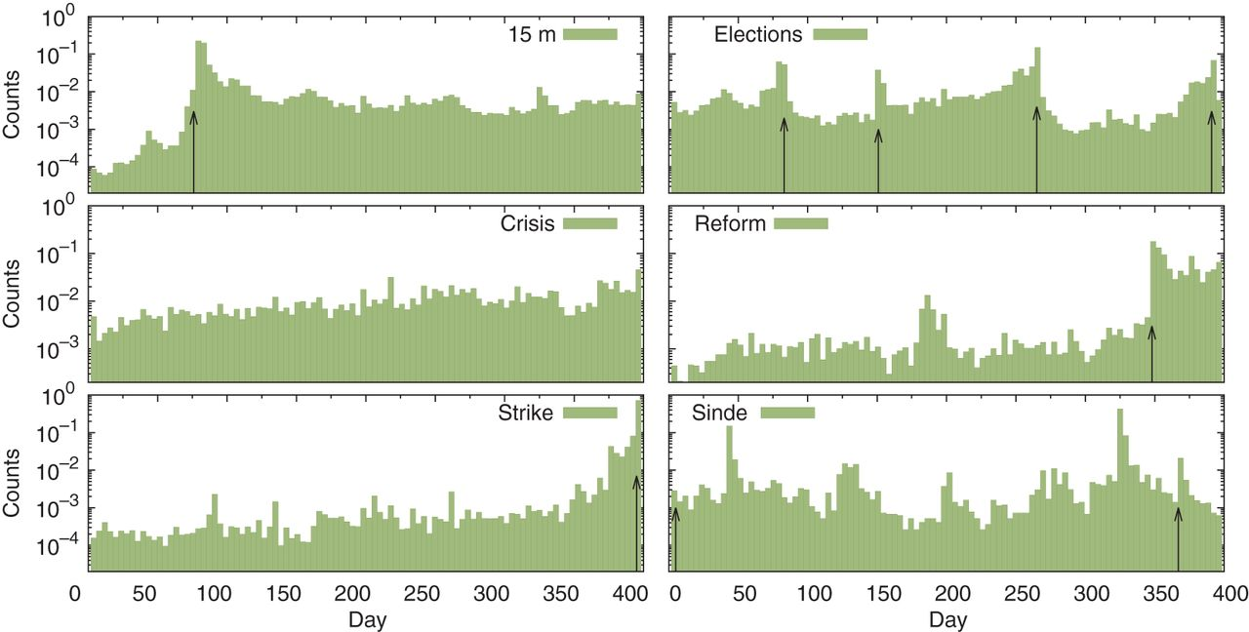
Figure 3. Activity time series for six political and economic topics in Twitter (a topic is in this case all those ...
Notes:
Figure 3. Activity time series for six political and economic topics in Twitter (a topic is in this case all those tweets containing at least one hashtag from an arbitrary, predefined closed list). All but one topic (‘crisis’) exhibit spiky behaviour due to key dates in which exogenous, real-world events triggered activity—demonstrations, election day, etc. These dates are highlighted with black arrows. The topic ‘crisis’, instead, shows a rather constant—chatter-like 64—pattern, because it is a rather daily topic—since 2008 at least. How these different trends affect contagion mechanisms—and therefore research approaches to cascading events—is not clear.
Unless provided in the caption above, the following copyright applies to the content of this slide: © The Authors 2013. Published by Oxford University Press.This is an Open Access article distributed under the terms of the Creative Commons Attribution License (http://creativecommons.org/licenses/by-nc/3.0/), which permits non-commercial reuse, distribution, and reproduction in any medium, provided the original work is properly cited. For commercial re-use, please contact journals.permissions@oup.com

Slide 4
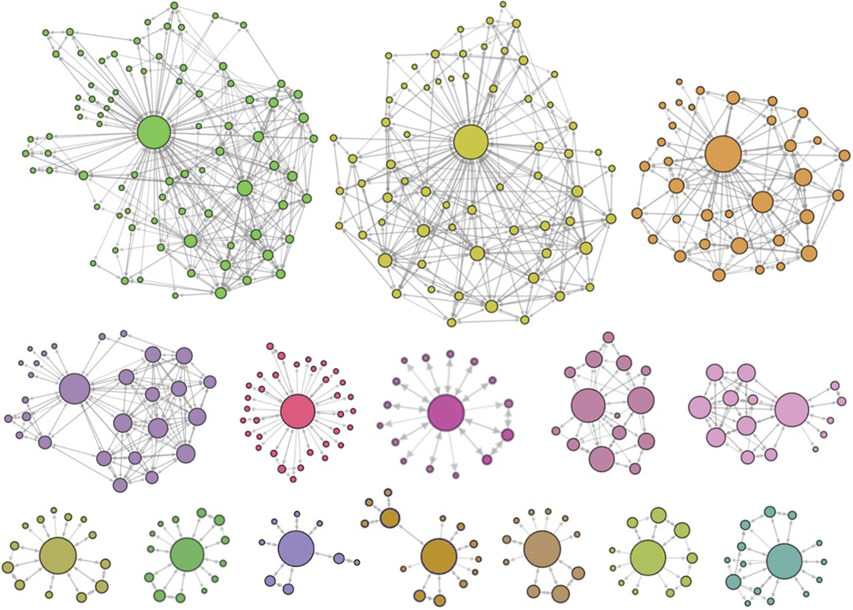
Figure 4. Different structures of real cascades occurred on Twitter. Node sizes are proportional to the node degree and ...
Notes:
Figure 4. Different structures of real cascades occurred on Twitter. Node sizes are proportional to the node degree and links represent the follower relationship between users.
Unless provided in the caption above, the following copyright applies to the content of this slide: © The Authors 2013. Published by Oxford University Press.This is an Open Access article distributed under the terms of the Creative Commons Attribution License (http://creativecommons.org/licenses/by-nc/3.0/), which permits non-commercial reuse, distribution, and reproduction in any medium, provided the original work is properly cited. For commercial re-use, please contact journals.permissions@oup.com

Slide 5
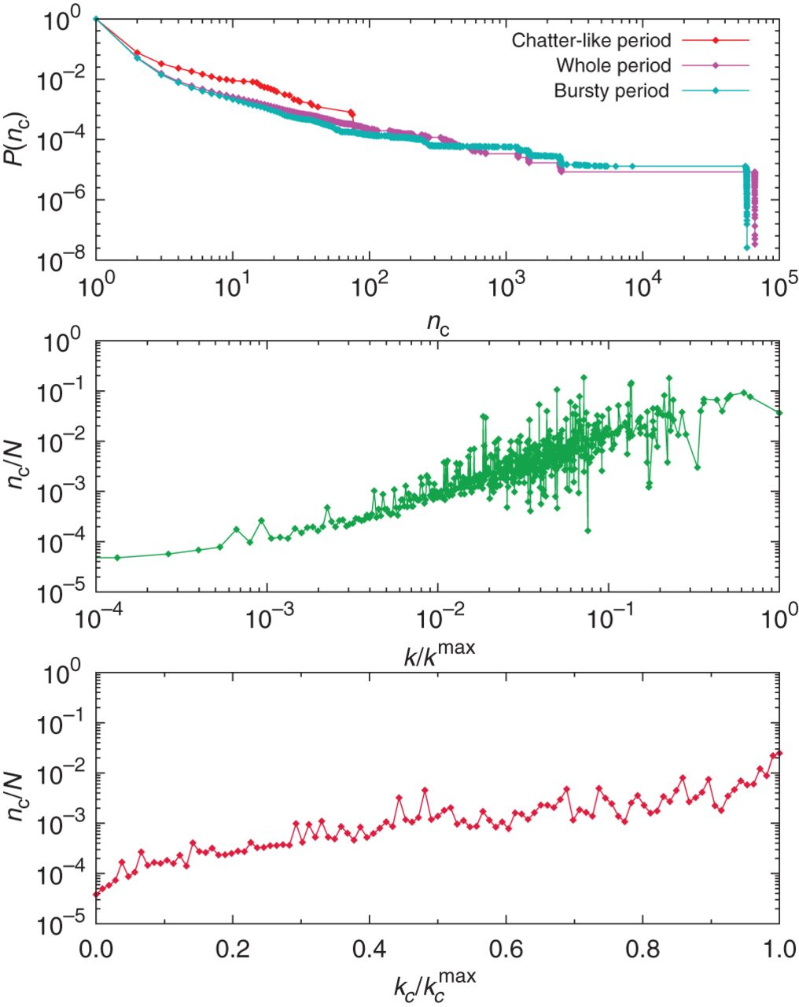
Figure 5. Top: distribution of cascade sizes (n_{c}) suggests that only a few cascades percolate to affect most ...
Notes:
Figure 5. Top: distribution of cascade sizes (nc) suggests that only a few cascades percolate to affect most users, and that the vast majority die in the early stages of diffusion. This result is robust across SNSs and for different Δτ –in the case of time-constrained cascades. It is also robust to different activity regimes–low, non-spiky period or bursty ones. Middle and bottom: we can observe a positive correlation between normalized cascade sizes nc/N and network connectivity—middle—and centrality (measured by the classification of nodes in k-cores)—bottom—respectively, suggesting that well-connected users suffice to release global chains of information diffusion. Adapted from 87.
Unless provided in the caption above, the following copyright applies to the content of this slide: © The Authors 2013. Published by Oxford University Press.This is an Open Access article distributed under the terms of the Creative Commons Attribution License (http://creativecommons.org/licenses/by-nc/3.0/), which permits non-commercial reuse, distribution, and reproduction in any medium, provided the original work is properly cited. For commercial re-use, please contact journals.permissions@oup.com

Slide 6
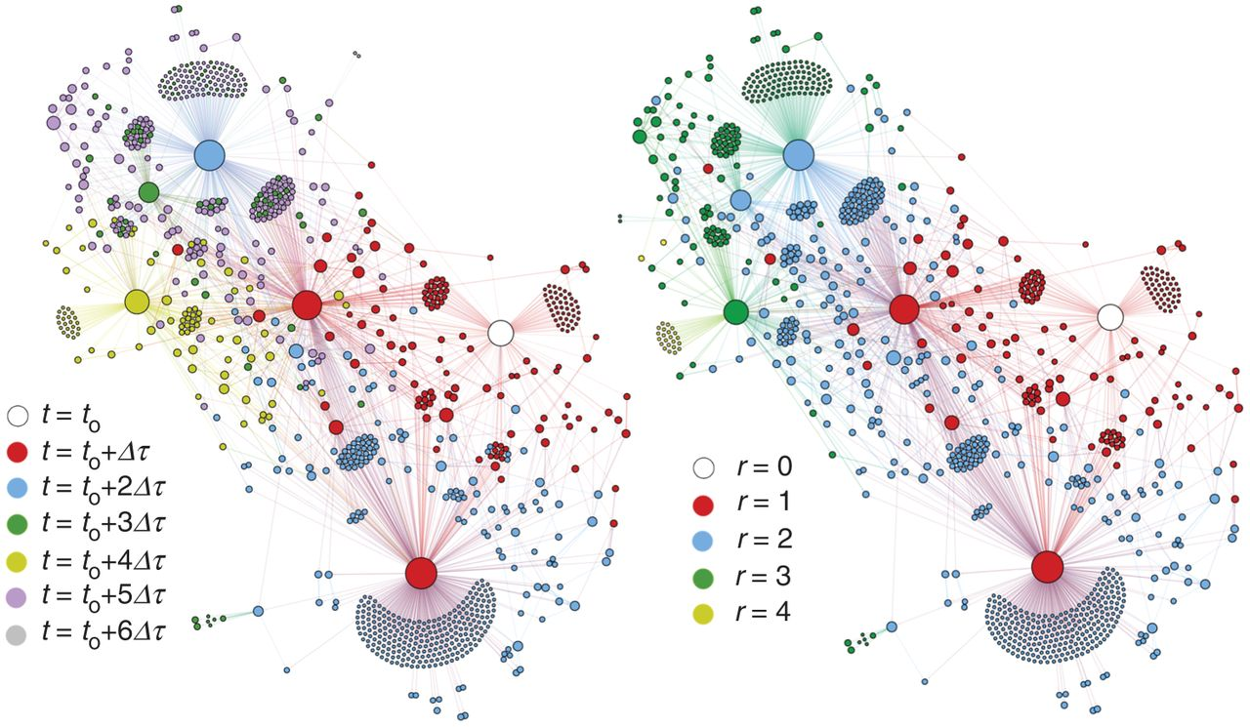
Figure 6. Structure of a real cascade of duration Δt=6τ and maximum topological penetration of Δr=4. The initial seed ...
Notes:
Figure 6. Structure of a real cascade of duration Δt=6τ and maximum topological penetration of Δr=4. The initial seed (white node) emitted a message at time t0 that was spread over a subgraph of the network and reached 966 different users. Colours indicate the instant when nodes first listened to the message (left), or their distance (shortest path length) to the initial seed (right).
Unless provided in the caption above, the following copyright applies to the content of this slide: © The Authors 2013. Published by Oxford University Press.This is an Open Access article distributed under the terms of the Creative Commons Attribution License (http://creativecommons.org/licenses/by-nc/3.0/), which permits non-commercial reuse, distribution, and reproduction in any medium, provided the original work is properly cited. For commercial re-use, please contact journals.permissions@oup.com

Slide 7
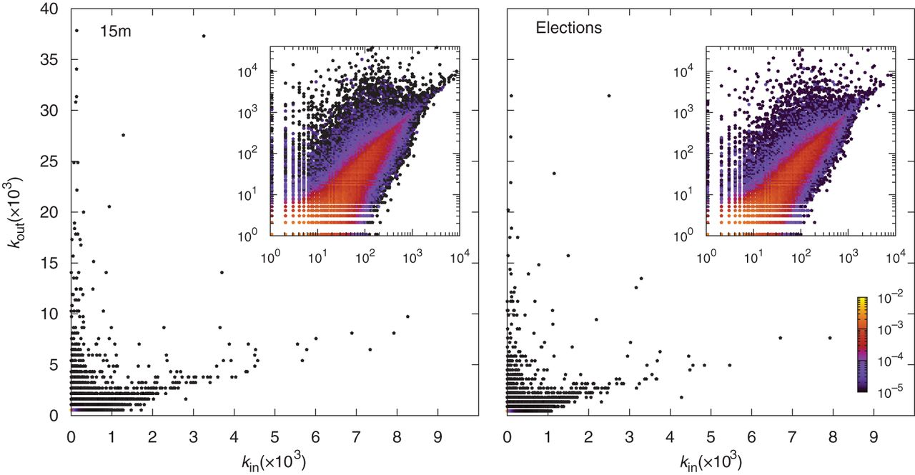
Figure 7. Twitter follower vs. friend scatter plot, for two topic-constrained datasets. The observed trends suggest ...
Notes:
Figure 7. Twitter follower vs. friend scatter plot, for two topic-constrained datasets. The observed trends suggest that the huge amount of attention some users receive—those with many more followers than friends—causes these nodes to display a dual behaviour, i.e. as effective spreaders, but also as firewalls.
Unless provided in the caption above, the following copyright applies to the content of this slide: © The Authors 2013. Published by Oxford University Press.This is an Open Access article distributed under the terms of the Creative Commons Attribution License (http://creativecommons.org/licenses/by-nc/3.0/), which permits non-commercial reuse, distribution, and reproduction in any medium, provided the original work is properly cited. For commercial re-use, please contact journals.permissions@oup.com

