Slide 1
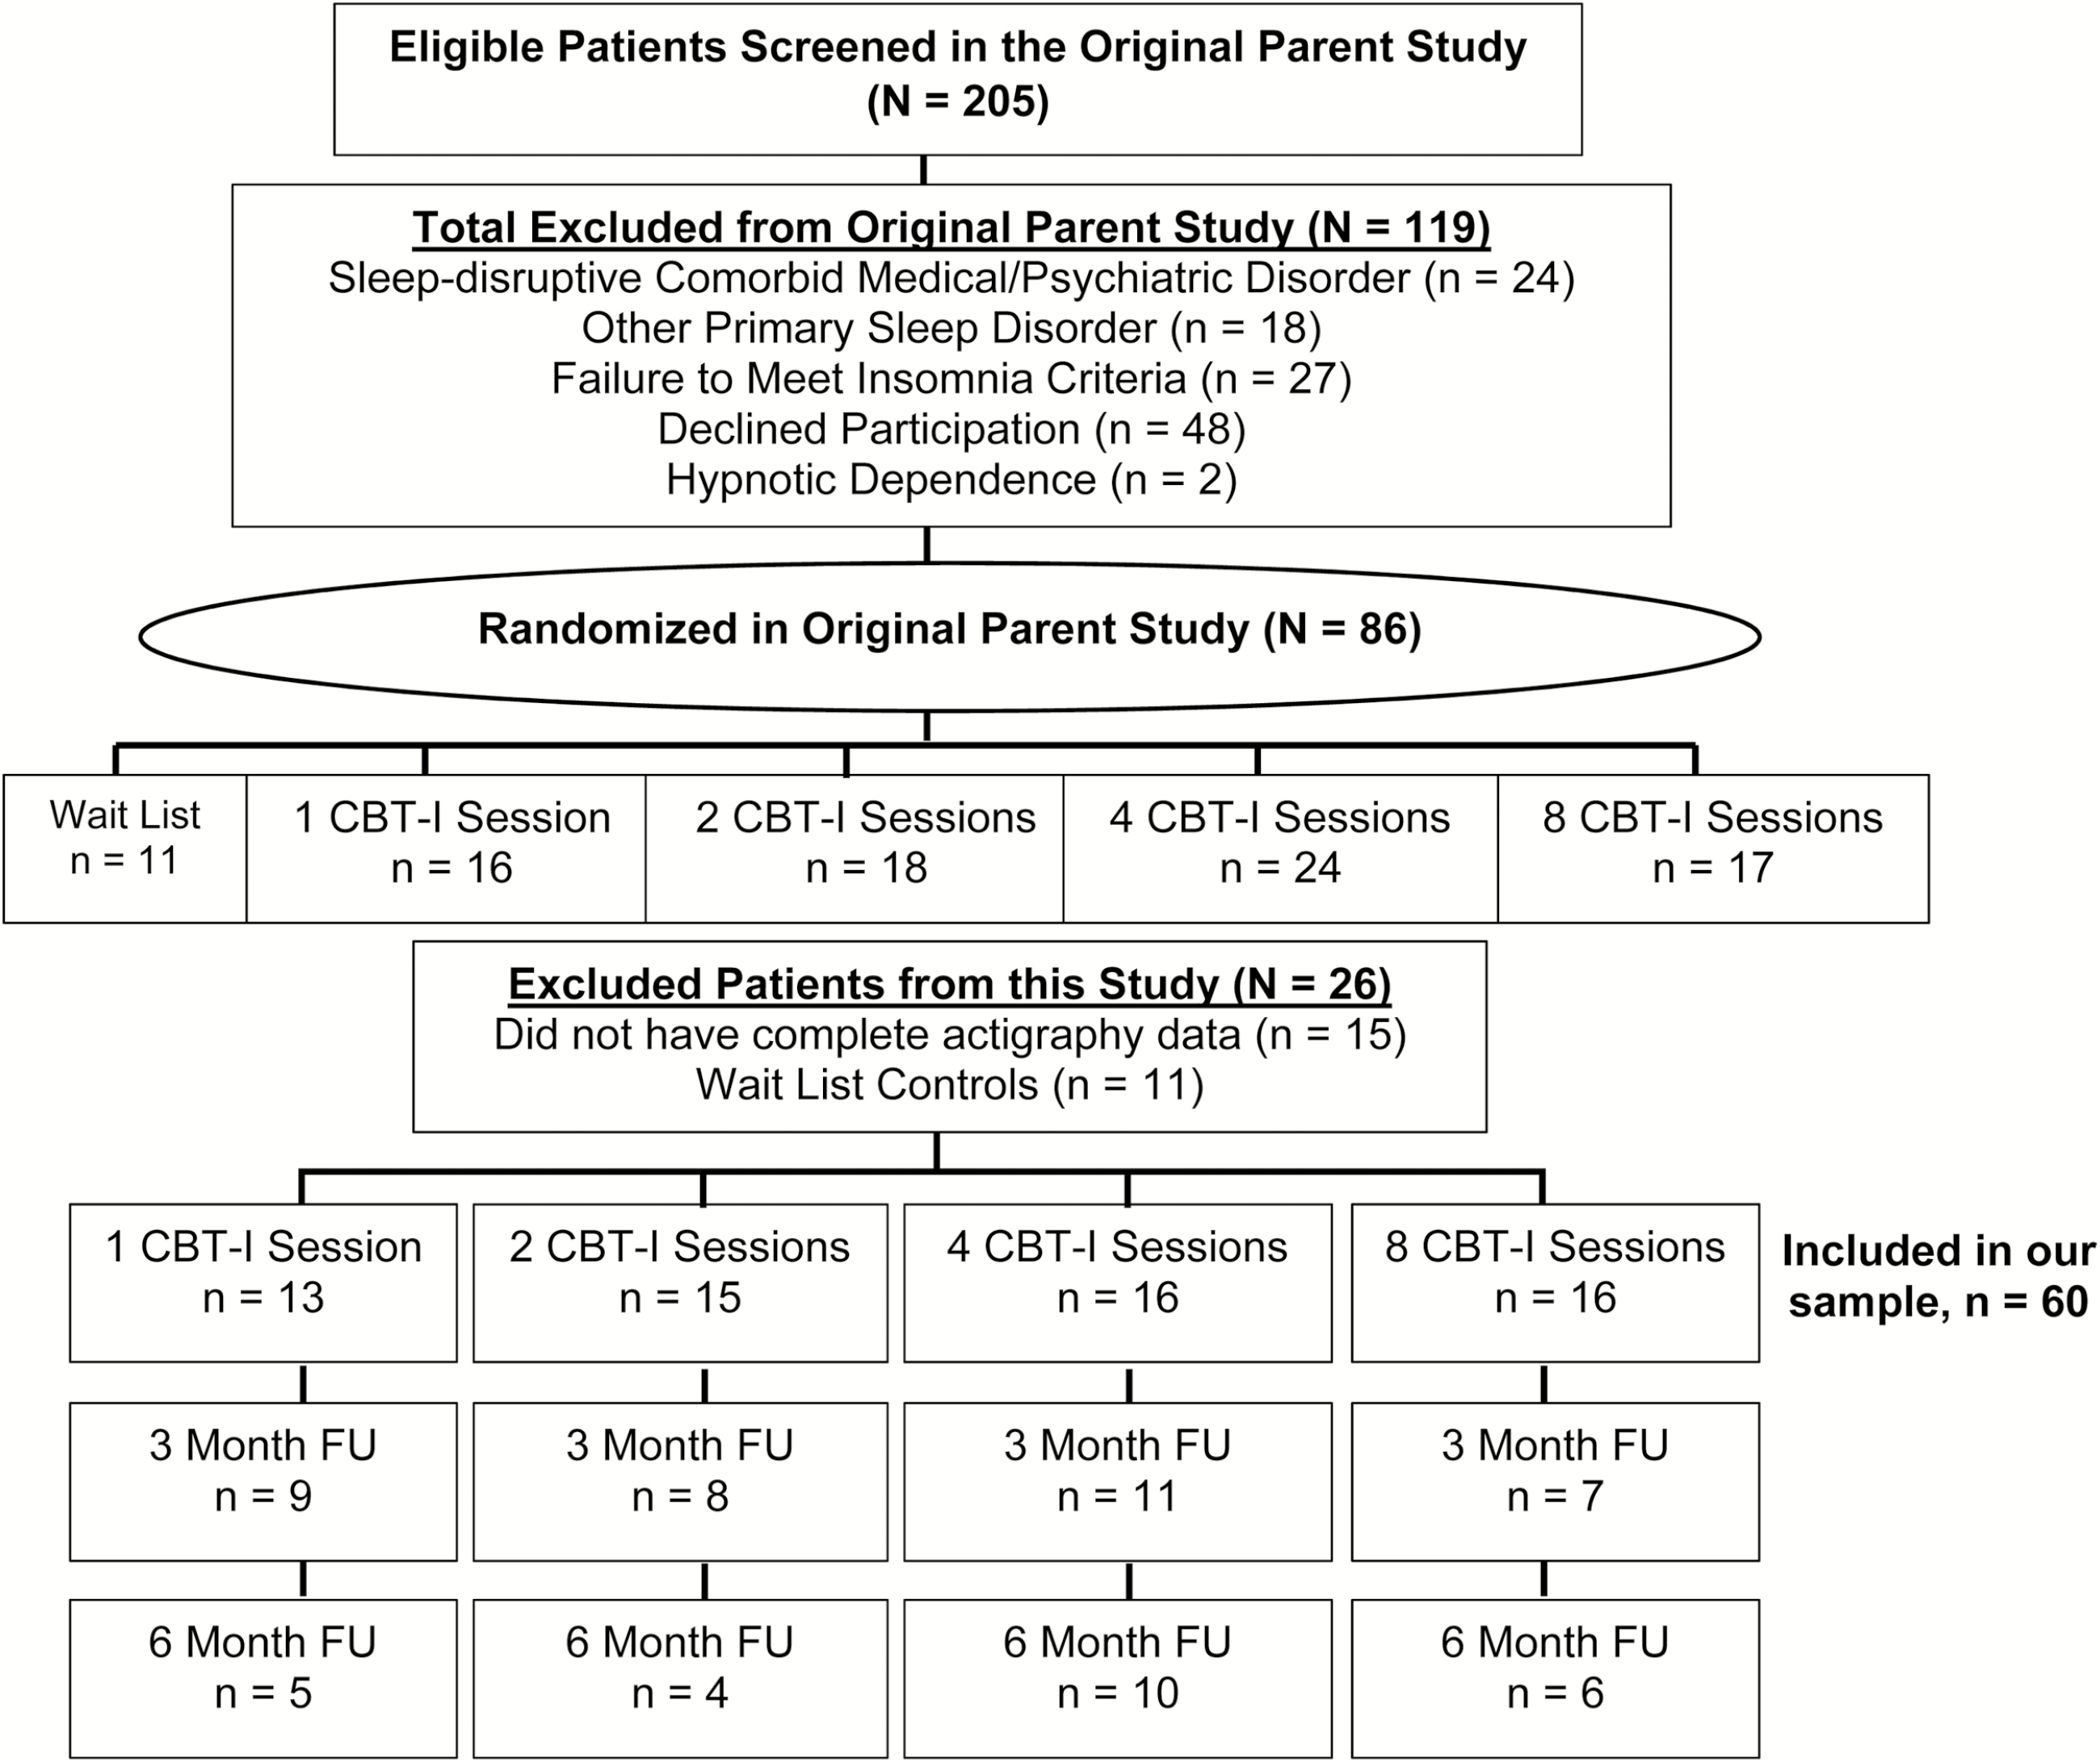
Figure 1 Study flowchart.
Notes:
Figure 1 Study flowchart.
Unless provided in the caption above, the following copyright applies to the content of this slide: © Sleep Research Society 2016. Published by Oxford University Press on behalf of the Sleep Research Society. All rights reserved. For permissions, please e-mail journals.permissions@oup.com.

Slide 2
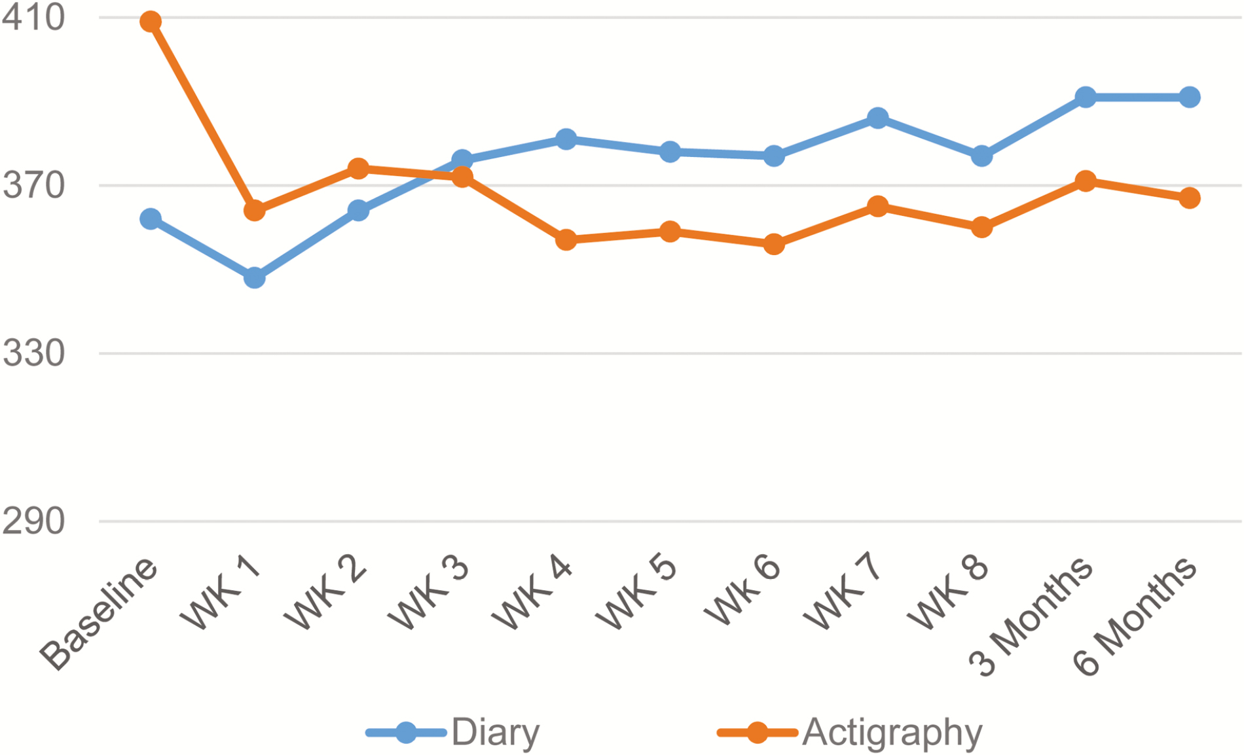
Figure 5 Sleep diary and actigraphy TST difference: Normal sleep duration group.
Notes:
Figure 5 Sleep diary and actigraphy TST difference: Normal sleep duration group.
Unless provided in the caption above, the following copyright applies to the content of this slide: © Sleep Research Society 2016. Published by Oxford University Press on behalf of the Sleep Research Society. All rights reserved. For permissions, please e-mail journals.permissions@oup.com.

Slide 3
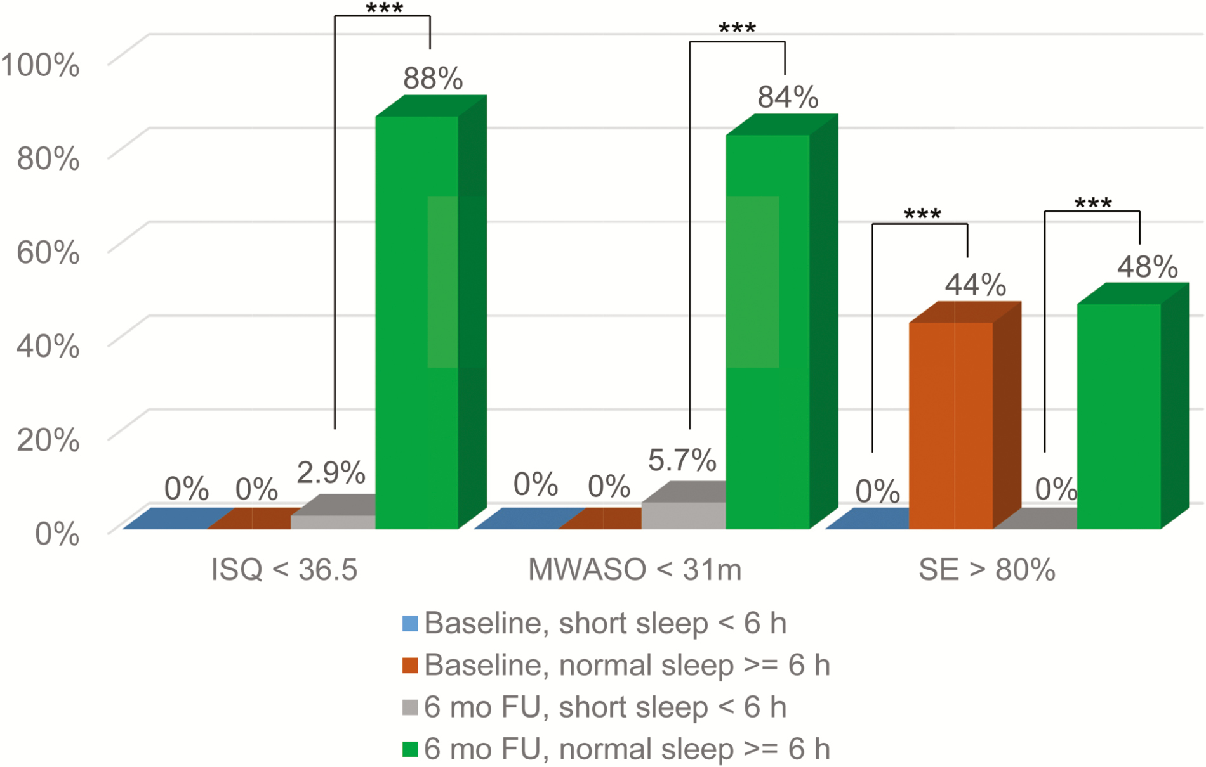
Figure 2 Baseline and 6-month follow-up clinical improvements by sleep duration group. ISQ, Insomnia Symptom ...
Notes:
Figure 2 Baseline and 6-month follow-up clinical improvements by sleep duration group. ISQ, Insomnia Symptom Questionnaire; SE, sleep efficiency, MWASO, middle of the night wake after sleep onset. ***p < .0001.
Unless provided in the caption above, the following copyright applies to the content of this slide: © Sleep Research Society 2016. Published by Oxford University Press on behalf of the Sleep Research Society. All rights reserved. For permissions, please e-mail journals.permissions@oup.com.

Slide 4
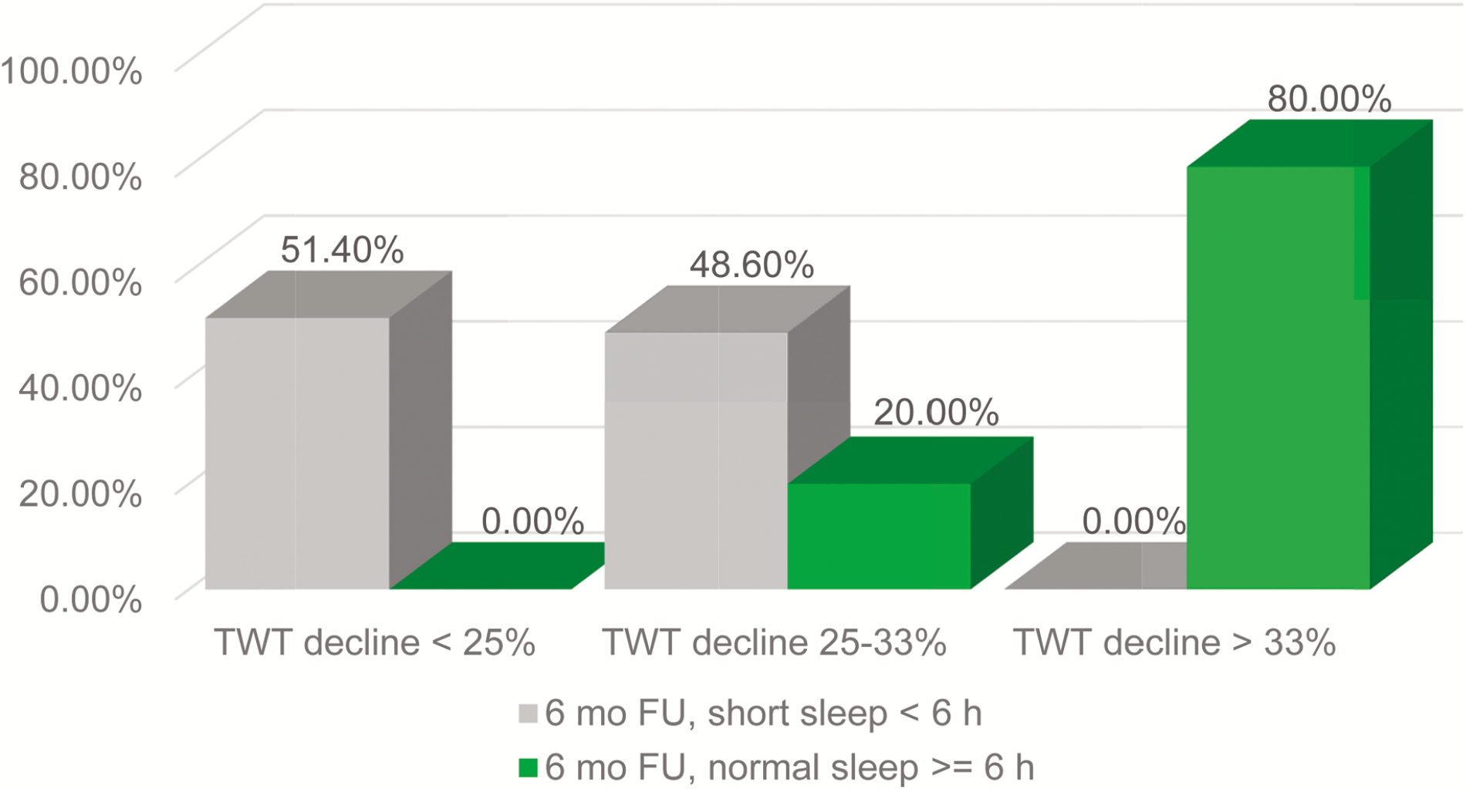
Figure 3 Percentage of decline in total wake time at the 6-Month follow-up by sleep duration group.
Notes:
Figure 3 Percentage of decline in total wake time at the 6-Month follow-up by sleep duration group.
Unless provided in the caption above, the following copyright applies to the content of this slide: © Sleep Research Society 2016. Published by Oxford University Press on behalf of the Sleep Research Society. All rights reserved. For permissions, please e-mail journals.permissions@oup.com.

Slide 5
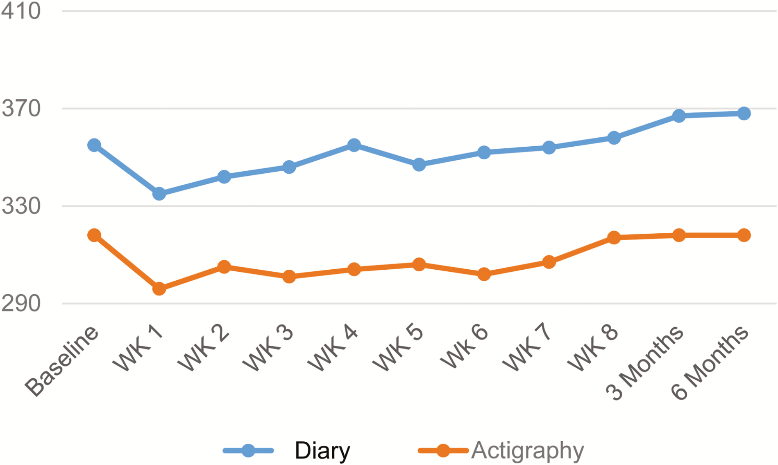
Figure 4 Sleep diary and actigraphy TST difference: Short sleep duration group.
Notes:
Figure 4 Sleep diary and actigraphy TST difference: Short sleep duration group.
Unless provided in the caption above, the following copyright applies to the content of this slide: © Sleep Research Society 2016. Published by Oxford University Press on behalf of the Sleep Research Society. All rights reserved. For permissions, please e-mail journals.permissions@oup.com.

