Slide 1
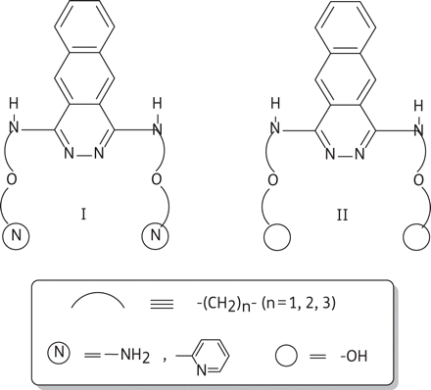
Figure 1. Schematic models of 1,4-bis(alkylamino)benzo[g]phthalazine derivatives functionalized with amino, pyridine or ...
Notes:
Figure 1. Schematic models of 1,4-bis(alkylamino)benzo[g]phthalazine derivatives functionalized with amino, pyridine or hydroxy groups at the end of the side chains.
Unless provided in the caption above, the following copyright applies to the content of this slide: © The Author 2011. Published by Oxford University Press on behalf of the British Society for Antimicrobial Chemotherapy. All rights reserved. For Permissions, please e-mail: journals.permissions@oup.com

Slide 2
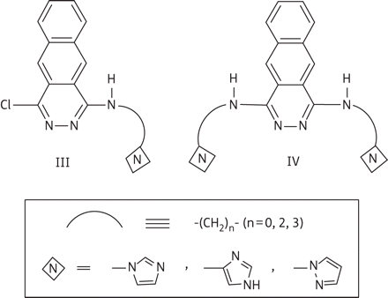
Figure 2. Schematic models of 1-alkylamino-4-chloro- and 1,4-bis(alkylamino)benzo[g]phthalazine derivatives ...
Notes:
Figure 2. Schematic models of 1-alkylamino-4-chloro- and 1,4-bis(alkylamino)benzo[g]phthalazine derivatives functionalized with imidazole or pyrazole rings at the end of the side chains.
Unless provided in the caption above, the following copyright applies to the content of this slide: © The Author 2011. Published by Oxford University Press on behalf of the British Society for Antimicrobial Chemotherapy. All rights reserved. For Permissions, please e-mail: journals.permissions@oup.com

Slide 3
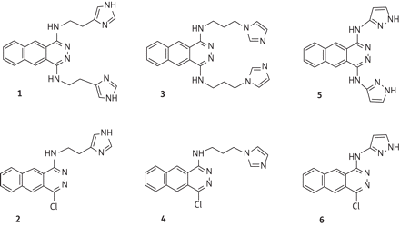
Figure 3. Benzo[g]phthalazine derivatives tested against Leishmania infantum and Leishmania braziliensis in this ...
Notes:
Figure 3. Benzo[g]phthalazine derivatives tested against Leishmania infantum and Leishmania braziliensis in this study.
Unless provided in the caption above, the following copyright applies to the content of this slide: © The Author 2011. Published by Oxford University Press on behalf of the British Society for Antimicrobial Chemotherapy. All rights reserved. For Permissions, please e-mail: journals.permissions@oup.com

Slide 4
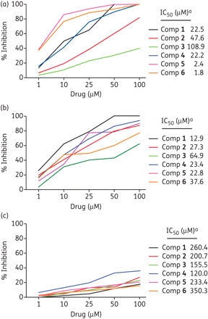
Figure 4. In vitro inhibition (%) of Fe-SOD in (a) Leishmania infantum and (b) Leishmania braziliensis promastigotes ...
Notes:
Figure 4. In vitro inhibition (%) of Fe-SOD in (a) Leishmania infantum and (b) Leishmania braziliensis promastigotes for compounds 1–6. (c) In vitro inhibition of CuZn-SOD in human erythrocytes for compounds 1–6. Values are means of three separate determinations. Differences between the activities of the control homogenate and those incubated with compounds 1–6 were analysed with the Newman–Keuls test. aIC50 was calculated by linear regression analysis from the Kc values at the concentrations employed (1, 10, 25, 50 and 100 μM).
Unless provided in the caption above, the following copyright applies to the content of this slide: © The Author 2011. Published by Oxford University Press on behalf of the British Society for Antimicrobial Chemotherapy. All rights reserved. For Permissions, please e-mail: journals.permissions@oup.com

Slide 5
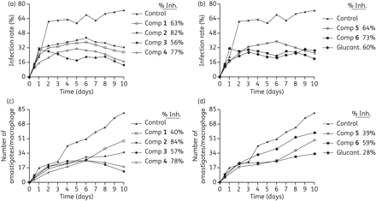
Figure 5. Effects of the imidazole-based (1–4) and pyrazole-based (5–6) benzo[g]phthalazine derivatives on the ...
Notes:
Figure 5. Effects of the imidazole-based (1–4) and pyrazole-based (5–6) benzo[g]phthalazine derivatives on the infection and growth rates of Leishmania spp. (a, b) Rate of infection of L. infantum. (c, d) Mean number of amastigotes per infected J774 A.2 macrophage for L. infantum (at IC25). Values are means of three separate experiments. Glucant., Glucantime (meglumine antimoniate).
Unless provided in the caption above, the following copyright applies to the content of this slide: © The Author 2011. Published by Oxford University Press on behalf of the British Society for Antimicrobial Chemotherapy. All rights reserved. For Permissions, please e-mail: journals.permissions@oup.com

Slide 6
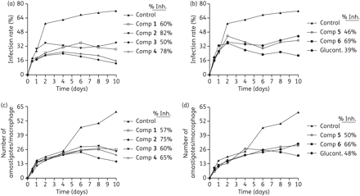
Figure 6. Effects of the imidazole-based (1–4) and pyrazole-based (5–6) benzo[g]phthalazine derivatives on the ...
Notes:
Figure 6. Effects of the imidazole-based (1–4) and pyrazole-based (5–6) benzo[g]phthalazine derivatives on the infection and growth rates of Leishmania spp. (a, b) Rate of infection of L. braziliensis. (c, d) Mean number of amastigotes per infected J774 A.2 macrophage for L. braziliensis (at IC25). Values are means of three separate experiments. Glucant., Glucantime (meglumine antimoniate).
Unless provided in the caption above, the following copyright applies to the content of this slide: © The Author 2011. Published by Oxford University Press on behalf of the British Society for Antimicrobial Chemotherapy. All rights reserved. For Permissions, please e-mail: journals.permissions@oup.com

Slide 7
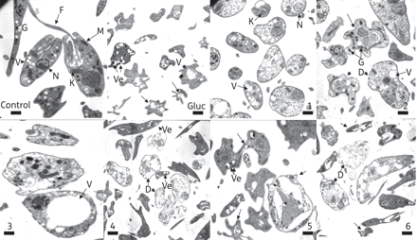
Figure 7. Ultrastructural alterations observed by TEM in L. infantum treated with meglumine antimoniate and compounds ...
Notes:
Figure 7. Ultrastructural alterations observed by TEM in L. infantum treated with meglumine antimoniate and compounds 1–6. Control, control parasite (bar 1 μm); Gluc, modifications after treatment with meglumine antimoniate (Glucantime) (bar 2.33 μm). 1, 2, 3 (bar 1 μm), 4 (bar 2.33 μm), 5 (bar 1 μm) and 6 (bar 1.59 μm), promastigotes treated with the respective compounds. N, nucleus; M, mitochondrion; V, vacuole; F, flagellum; G, glycosome; K, kinetoplast; D, dead parasites; Ve, electron-dense vesicles. Single arrows indicate distorted promastigotes.
Unless provided in the caption above, the following copyright applies to the content of this slide: © The Author 2011. Published by Oxford University Press on behalf of the British Society for Antimicrobial Chemotherapy. All rights reserved. For Permissions, please e-mail: journals.permissions@oup.com

Slide 8
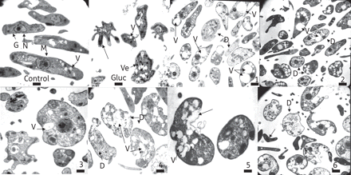
Figure 8. Ultrastructural alterations observed by TEM in L. braziliensis treated with meglumine antimoniate and ...
Notes:
Figure 8. Ultrastructural alterations observed by TEM in L. braziliensis treated with meglumine antimoniate and compounds 1–6. Control, control parasite (bar 1 μm); Gluc, modifications after treatment with meglumine antimoniate (Glucantime) (bar 1.59 μm). 1 and 2 (bar 2.33 μm), 3, 4 and 5 (bar 1 μm) and 6 (bar 1.59 μm), promastigotes treated with the respective compounds. N, nucleus; M, mitochondrion; V, vacuole; F, flagellum; G, glycosome; K, kinetoplast; D, dead parasites; Ve, electron-dense vesicles. Single arrows indicate distorted promastigotes.
Unless provided in the caption above, the following copyright applies to the content of this slide: © The Author 2011. Published by Oxford University Press on behalf of the British Society for Antimicrobial Chemotherapy. All rights reserved. For Permissions, please e-mail: journals.permissions@oup.com

