Slide 1
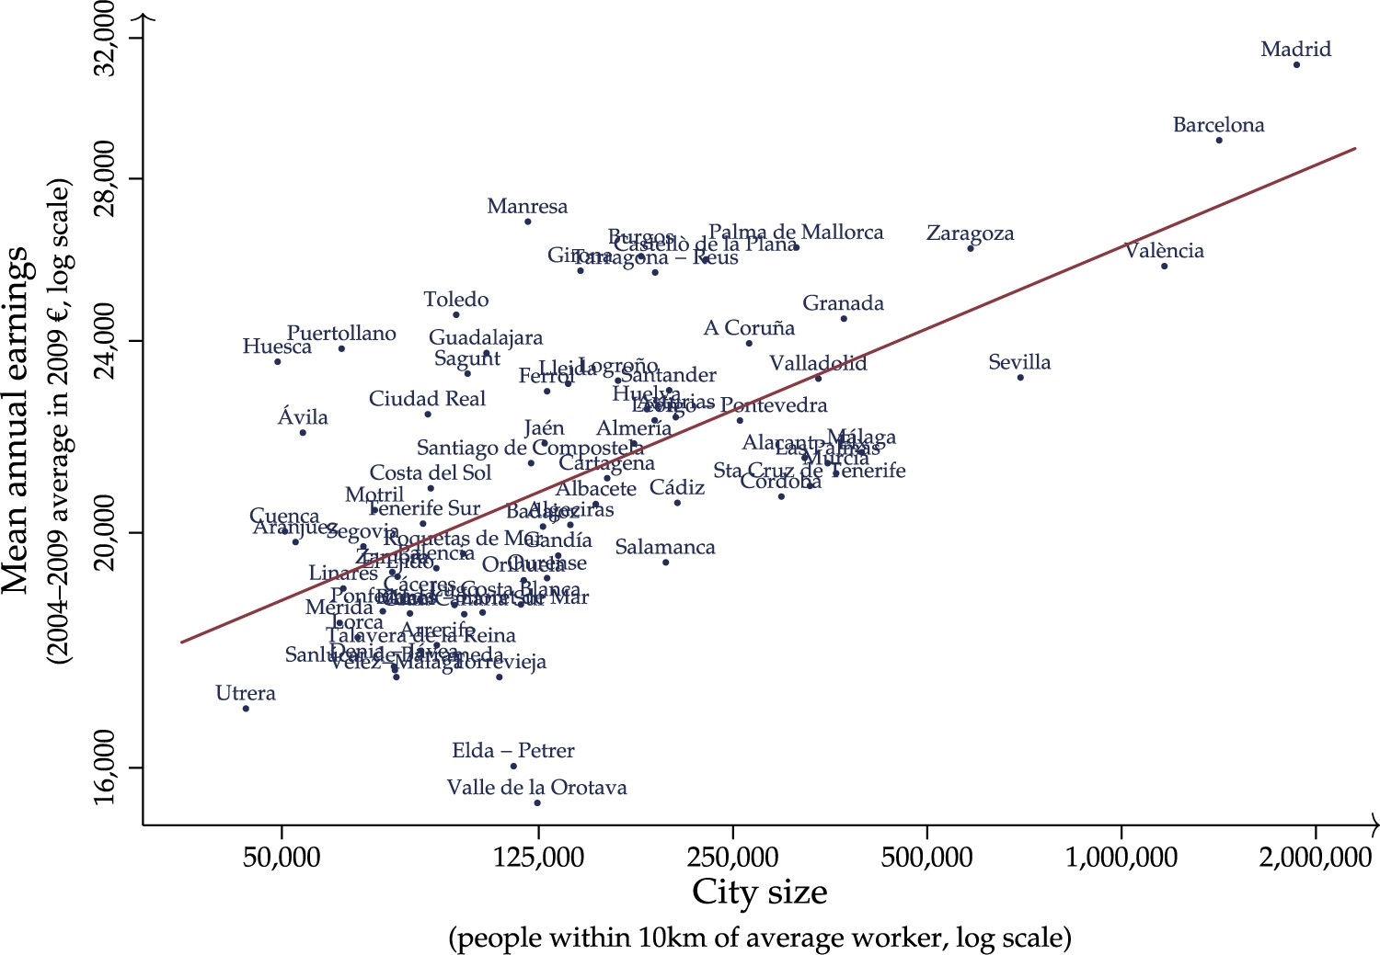
Figure 1. Mean earnings and city size
Notes:
Figure 1. Mean earnings and city size
Unless provided in the caption above, the following copyright applies to the content of this slide: © The Author 2016. Published by Oxford University Press on behalf of The Review of Economic Studies Limited.This is an Open Access article distributed under the terms of the Creative Commons Attribution Non-Commercial License (http://creativecommons.org/licenses/by-nc/4.0/), which permits non-commercial re-use, distribution, and reproduction in any medium, provided the original work is properly cited. For commercial re-use, please contact journals.permissions@oup.com

Slide 2
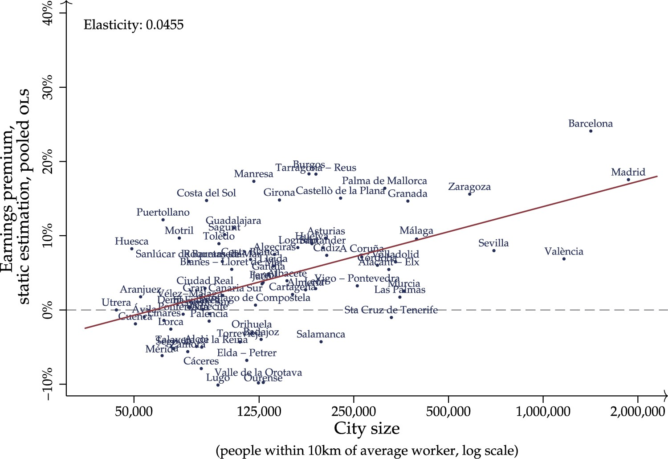
Figure 2. Static OLS estimation of the city size premium
Notes:
Figure 2. Static OLS estimation of the city size premium
Unless provided in the caption above, the following copyright applies to the content of this slide: © The Author 2016. Published by Oxford University Press on behalf of The Review of Economic Studies Limited.This is an Open Access article distributed under the terms of the Creative Commons Attribution Non-Commercial License (http://creativecommons.org/licenses/by-nc/4.0/), which permits non-commercial re-use, distribution, and reproduction in any medium, provided the original work is properly cited. For commercial re-use, please contact journals.permissions@oup.com

Slide 3
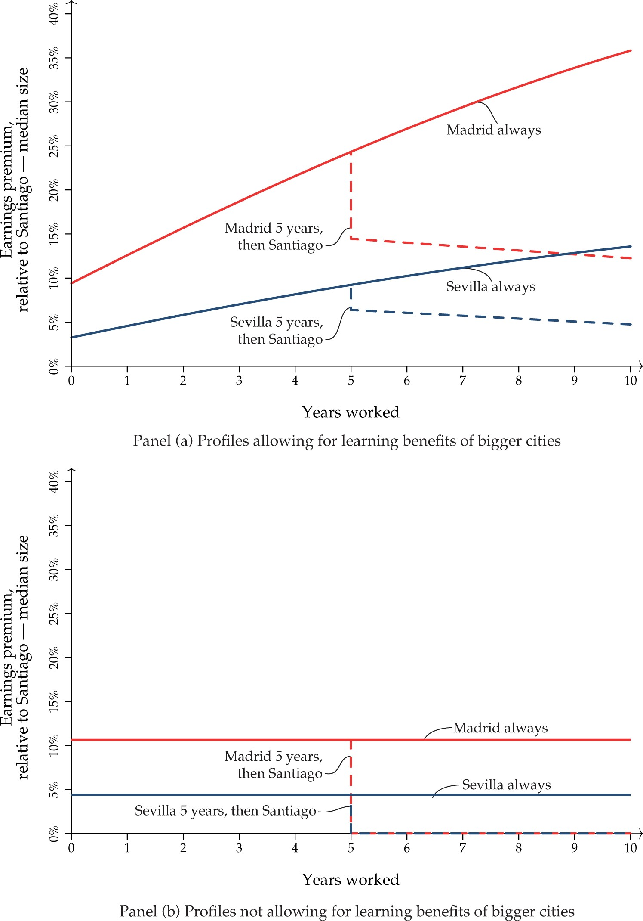
Figure 3. Earnings profiles relative to median-sized city
Notes:
Figure 3. Earnings profiles relative to median-sized city
Unless provided in the caption above, the following copyright applies to the content of this slide: © The Author 2016. Published by Oxford University Press on behalf of The Review of Economic Studies Limited.This is an Open Access article distributed under the terms of the Creative Commons Attribution Non-Commercial License (http://creativecommons.org/licenses/by-nc/4.0/), which permits non-commercial re-use, distribution, and reproduction in any medium, provided the original work is properly cited. For commercial re-use, please contact journals.permissions@oup.com

Slide 4
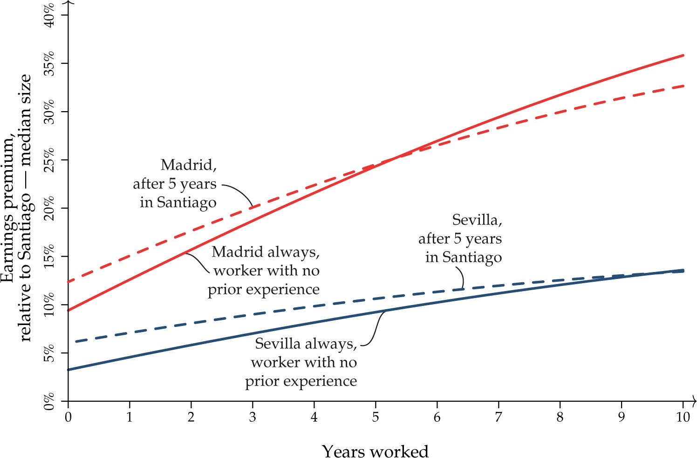
Figure 4. Earnings profiles relative to median-sized city, worker with and without prior experience
Notes:
Figure 4. Earnings profiles relative to median-sized city, worker with and without prior experience
Unless provided in the caption above, the following copyright applies to the content of this slide: © The Author 2016. Published by Oxford University Press on behalf of The Review of Economic Studies Limited.This is an Open Access article distributed under the terms of the Creative Commons Attribution Non-Commercial License (http://creativecommons.org/licenses/by-nc/4.0/), which permits non-commercial re-use, distribution, and reproduction in any medium, provided the original work is properly cited. For commercial re-use, please contact journals.permissions@oup.com

Slide 5
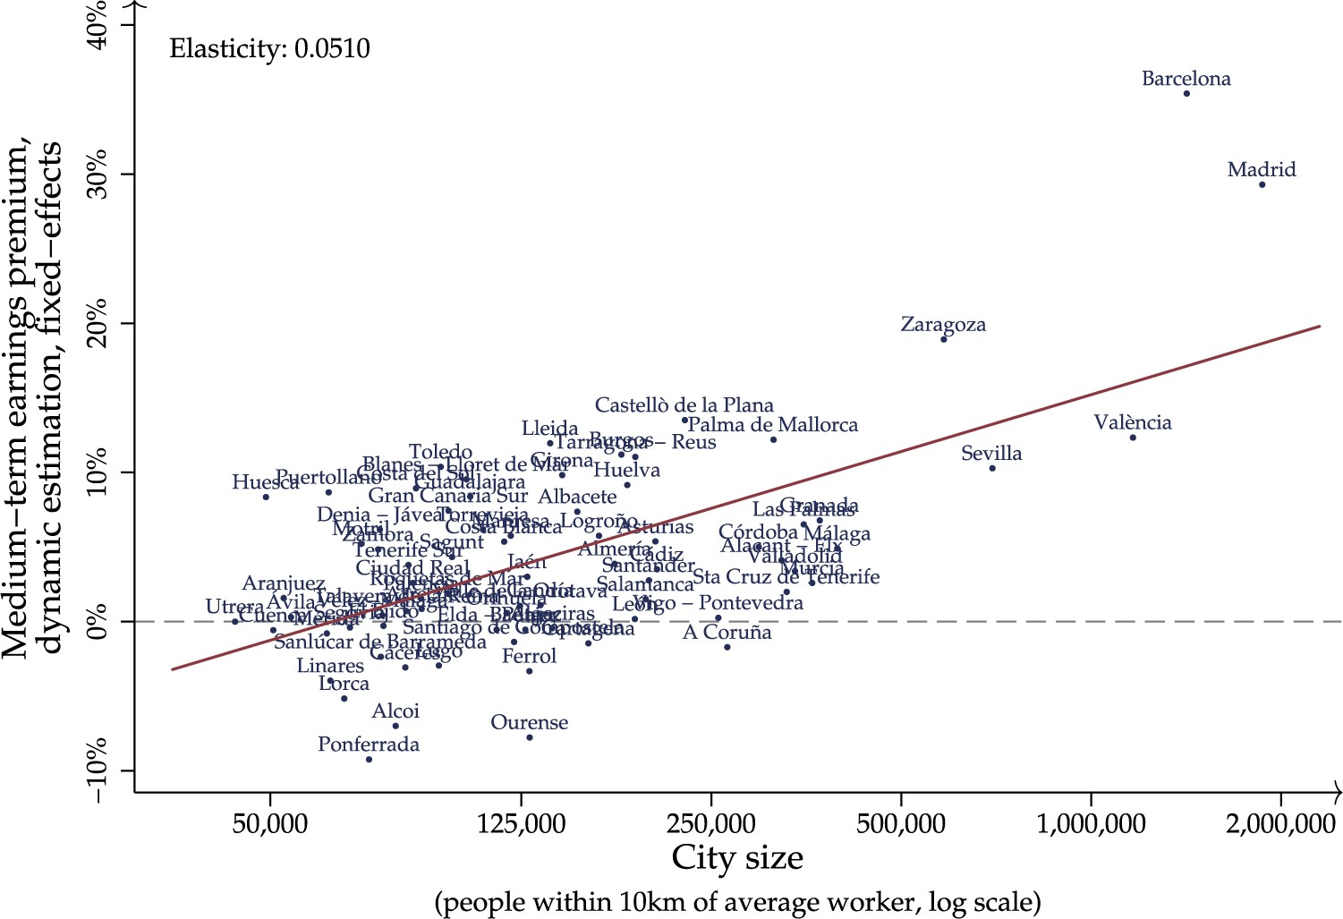
Figure 5. Dynamic fixed-effects estimation of the medium-term city size premium
Notes:
Figure 5. Dynamic fixed-effects estimation of the medium-term city size premium
Unless provided in the caption above, the following copyright applies to the content of this slide: © The Author 2016. Published by Oxford University Press on behalf of The Review of Economic Studies Limited.This is an Open Access article distributed under the terms of the Creative Commons Attribution Non-Commercial License (http://creativecommons.org/licenses/by-nc/4.0/), which permits non-commercial re-use, distribution, and reproduction in any medium, provided the original work is properly cited. For commercial re-use, please contact journals.permissions@oup.com

Slide 6
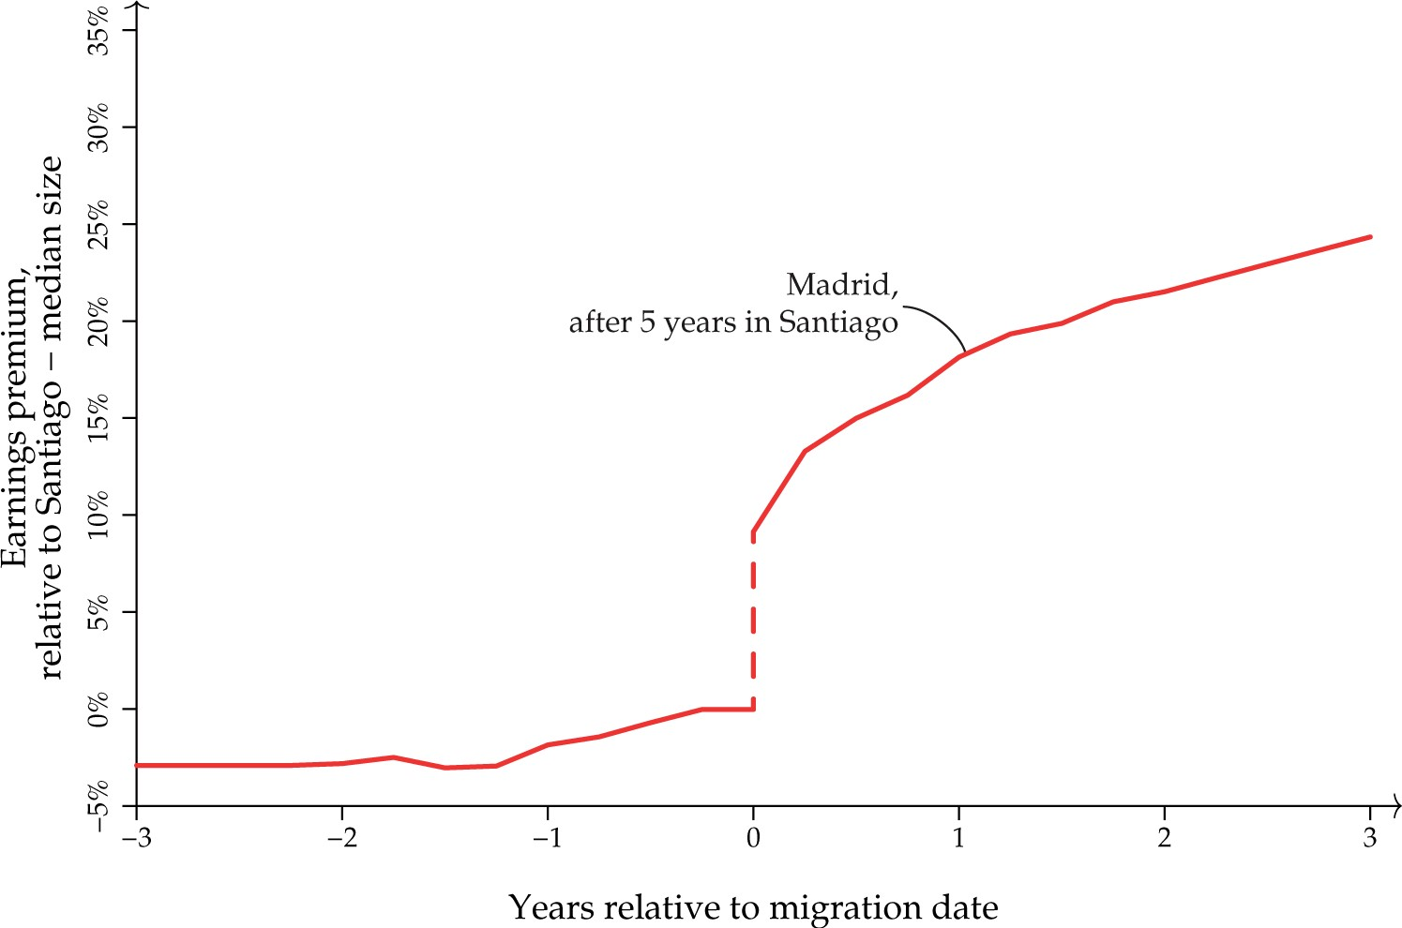
Figure 6. Non-parametric pre- and post-migration earnings profile relative to median-sized city
Notes:
Figure 6. Non-parametric pre- and post-migration earnings profile relative to median-sized city
Unless provided in the caption above, the following copyright applies to the content of this slide: © The Author 2016. Published by Oxford University Press on behalf of The Review of Economic Studies Limited.This is an Open Access article distributed under the terms of the Creative Commons Attribution Non-Commercial License (http://creativecommons.org/licenses/by-nc/4.0/), which permits non-commercial re-use, distribution, and reproduction in any medium, provided the original work is properly cited. For commercial re-use, please contact journals.permissions@oup.com

Slide 7
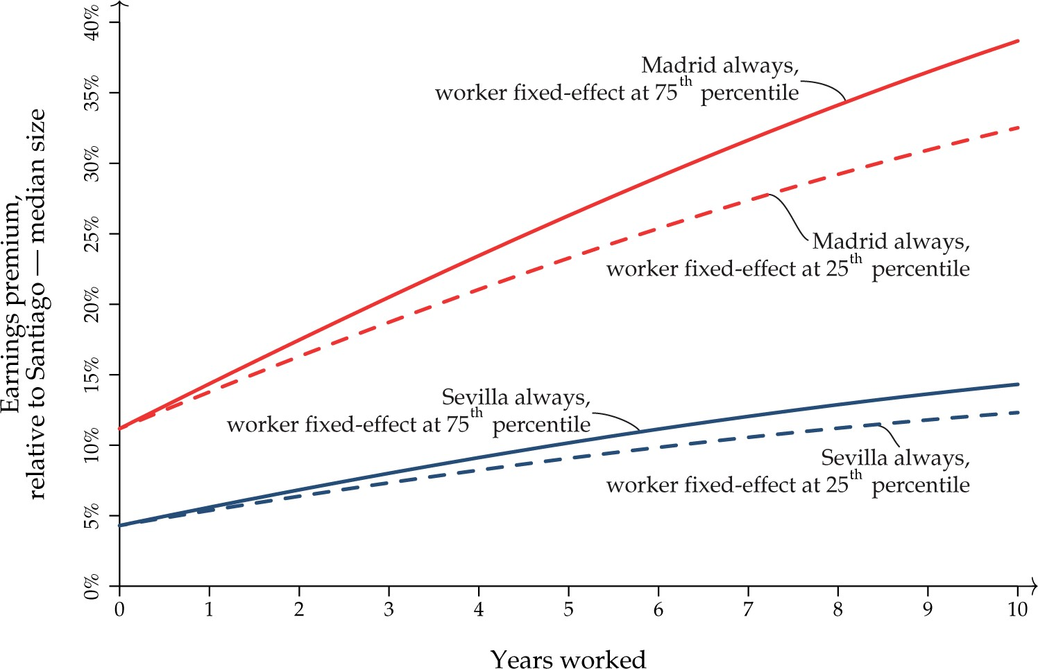
Figure 7. Earnings profiles relative to median-sized city, high- and low-ability worker
Notes:
Figure 7. Earnings profiles relative to median-sized city, high- and low-ability worker
Unless provided in the caption above, the following copyright applies to the content of this slide: © The Author 2016. Published by Oxford University Press on behalf of The Review of Economic Studies Limited.This is an Open Access article distributed under the terms of the Creative Commons Attribution Non-Commercial License (http://creativecommons.org/licenses/by-nc/4.0/), which permits non-commercial re-use, distribution, and reproduction in any medium, provided the original work is properly cited. For commercial re-use, please contact journals.permissions@oup.com

Slide 8
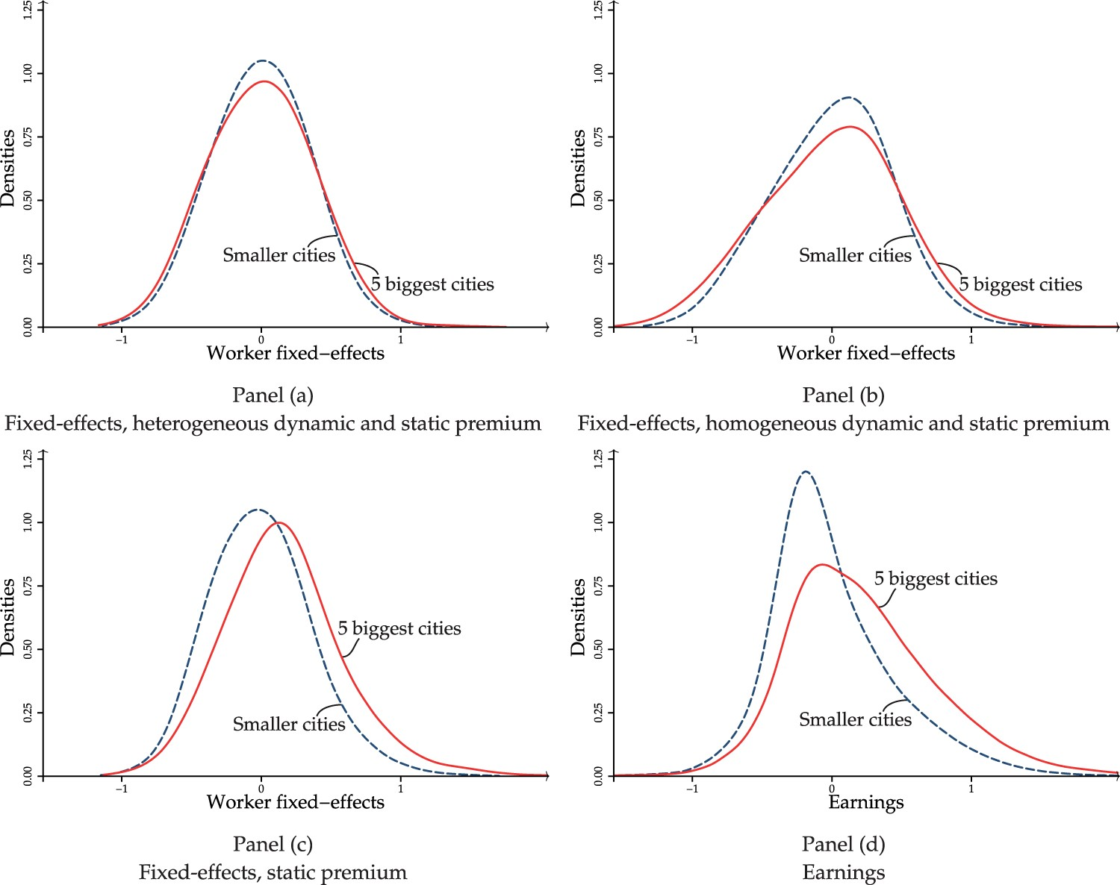
Figure 8. Comparisons of worker fixed-effects distributions across cities
Notes:
Figure 8. Comparisons of worker fixed-effects distributions across cities
Unless provided in the caption above, the following copyright applies to the content of this slide: © The Author 2016. Published by Oxford University Press on behalf of The Review of Economic Studies Limited.This is an Open Access article distributed under the terms of the Creative Commons Attribution Non-Commercial License (http://creativecommons.org/licenses/by-nc/4.0/), which permits non-commercial re-use, distribution, and reproduction in any medium, provided the original work is properly cited. For commercial re-use, please contact journals.permissions@oup.com

