Slide 1
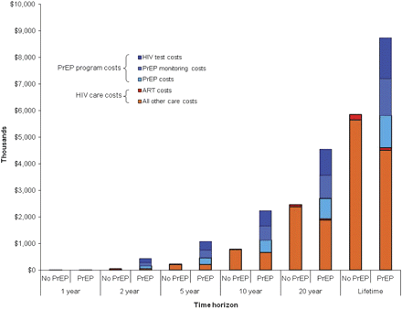
Figure 3. Projected costs per woman over time, without and with pre-exposure prophylaxis (PrEP). This figure presents ...
Notes:
Figure 3. Projected costs per woman over time, without and with pre-exposure prophylaxis (PrEP). This figure presents the components of the cumulative costs at 1, 2, 5, 10, and 20 years and over a woman’s lifetime, with No PrEP and PrEP availability. PrEP costs (shaded blue) are divided by their components, including drug costs only, PrEP monitoring costs (chemistry panels), and human immunodeficiency virus (HIV) testing costs. HIV care costs for those who became infected (shaded orange) include the costs for HIV-related care and antiretroviral therapy (ART; shaded red). Costs are scaled per 1000 people and reported in thousands (2010 US dollars).
Unless provided in the caption above, the following copyright applies to the content of this slide: © The Author 2012. Published by Oxford University Press on behalf of the Infectious Diseases Society of America. All rights reserved. For Permissions, please e-mail: journals.permissions@oup.com

Slide 2
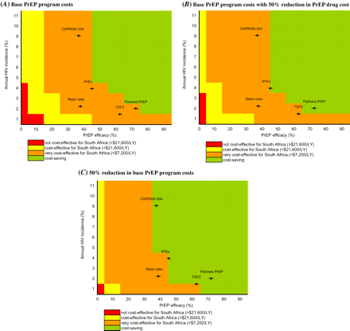
Figure 2. Multiway sensitivity analyses: incremental cost-effectiveness of pre-exposure prophylaxis (PrEP). This figure ...
Notes:
Figure 2. Multiway sensitivity analyses: incremental cost-effectiveness of pre-exposure prophylaxis (PrEP). This figure reports the ranges of incremental cost-effectiveness ratios for PrEP as a function of the 3 most influential parameters identified in Figure 1: human immunodeficiency virus (HIV) infection incidence of 1%–11% annually (vertical axis), PrEP efficacy of 0%–95% (horizontal axis), and PrEP program cost (the 3 vertical panels). The color indicates the incremental cost-effectiveness ratio achieved by each combination of parameters, ranging from not cost-effective in red (ratio >$21 600 per year of life saved [YLS]), to cost-effective in yellow ($7200–21,600/YLS), to very cost-effective in orange (<$7200/YLS), to cost saving in green. A, Base PrEP program costs. B, Base PrEP program costs with 50% reduction in PrEP drug cost (from $55/year to $28/year). C, 50% reduction in base PrEP program costs (from $188/year to $94/year). The base case and CAPRISA 004, iPrEX, TDF2 and Partners PrEP trial point estimates are indicated in each panel by the (+).
Unless provided in the caption above, the following copyright applies to the content of this slide: © The Author 2012. Published by Oxford University Press on behalf of the Infectious Diseases Society of America. All rights reserved. For Permissions, please e-mail: journals.permissions@oup.com

Slide 3
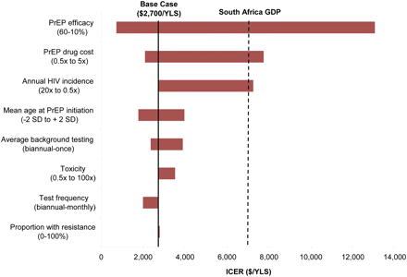
Figure 1. One-way sensitivity analyses: incremental cost-effectiveness of pre-exposure prophylaxis (PrEP). This tornado ...
Notes:
Figure 1. One-way sensitivity analyses: incremental cost-effectiveness of pre-exposure prophylaxis (PrEP). This tornado diagram summarizes the results of multiple 1-way sensitivity analyses on the incremental cost-effectiveness of PrEP. Each horizontal bar represents the range of incremental cost-effectiveness ratios (ICERs) resulting from variations of a given model parameter across its plausible range, as indicated at opposite ends of each bar. The range for each bar is reported in the direction of the ICER for that bar. For example, higher human immunodeficiency virus (HIV) infection incidences and higher PrEP efficacies result in lower PrEP ICERs and are therefore reported from high to low as the bar moves from left to right. The bold vertical line indicates the base case ICER ($2700 per year of life saved). A bar reaching zero on the left would indicate cost saving (none of the bars reach that benchmark). The dashed vertical line represents the per capita gross domestic product (GDP) for South Africa, a threshold denoting a very cost-effective use of resources, by international standards [18–20].
Unless provided in the caption above, the following copyright applies to the content of this slide: © The Author 2012. Published by Oxford University Press on behalf of the Infectious Diseases Society of America. All rights reserved. For Permissions, please e-mail: journals.permissions@oup.com

