Slide 1
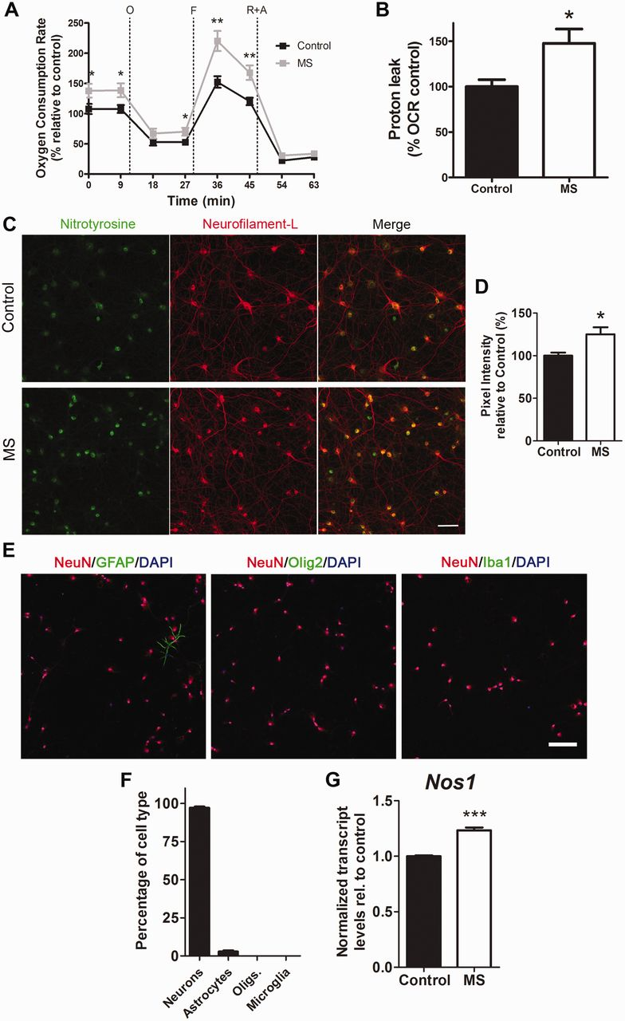
Figure 1 Oxidative damage induced in rat cultured neurons by exposure to the CSF of patients with multiple sclerosis. ...
Notes:
Figure 1 Oxidative damage induced in rat cultured neurons by exposure to the CSF of patients with multiple sclerosis. (A) Primary rat hippocampal neurons were incubated for 24 h with the CSF from patients with multiple sclerosis (MS) or from neurological controls and the neuronal profile was measured using a Seahorse Analyzer. Oxygen consumption rate (OCR) was measured as an indicator of mitochondrial respiratory function under basal conditions and during the sequential addition of 2 µM oligomycin (O), 4 µM FCCP (F), 0.5 µM rotenone and 4 µM antimycin (R+A). Data represent the mean ± SEM of the oxygen consumption rate levels relative to basal respiration levels from control CSF samples. (B) Proton leak levels were determined as readout of the bioenergetic analysis. Data are expressed as percentage relative to the oxygen consumption rate measured in cultured neurons exposed to CSF. (C) Confocal images of cultured neurons incubated for 24 h with CSF from control (n = 7) or patients with multiple sclerosis (n = 8) and stained with antibodies specific for nitrotyrosine (green) and NF-L (red) to assess oxidative damage. Scale bar = 50 µm. (D) Quantification of nitrotyrosine pixel intensity levels from three random regions (n = ∼80 cells per region) for each CSF sample and represented as the mean ± SEM relative to control CSF samples. (E) Immunocytochemistry of neuronal cultures with antibodies for NeuN (red) to label neurons, GFAP (green) for astrocytes, Olig2 (green) for oligodendrocytes and Iba1 (green) for microglia. DAPI (blue) was used as nuclear counterstain. Scale bar = 100 µm. (F) Quantification of the different cell types according to the immunostaining shown in E. (G) Transcripts levels of Nos1 in cultures treated with CSF from controls or patients with multiple sclerosis was assessed by RNA-Seq and data are shown relative to samples with control CSF after global median normalization. Statistical differences for A, B and D were determined using two-tailed independent t-test, *P < 0.05, **P < 0.01. Significance in G was determined by multiple comparison analysis, ***FDR < 0.001.
Unless provided in the caption above, the following copyright applies to the content of this slide: © The Author (2014). Published by Oxford University Press on behalf of the Guarantors of Brain. All rights reserved. For Permissions, please email: journals.permissions@oup.com

Slide 2
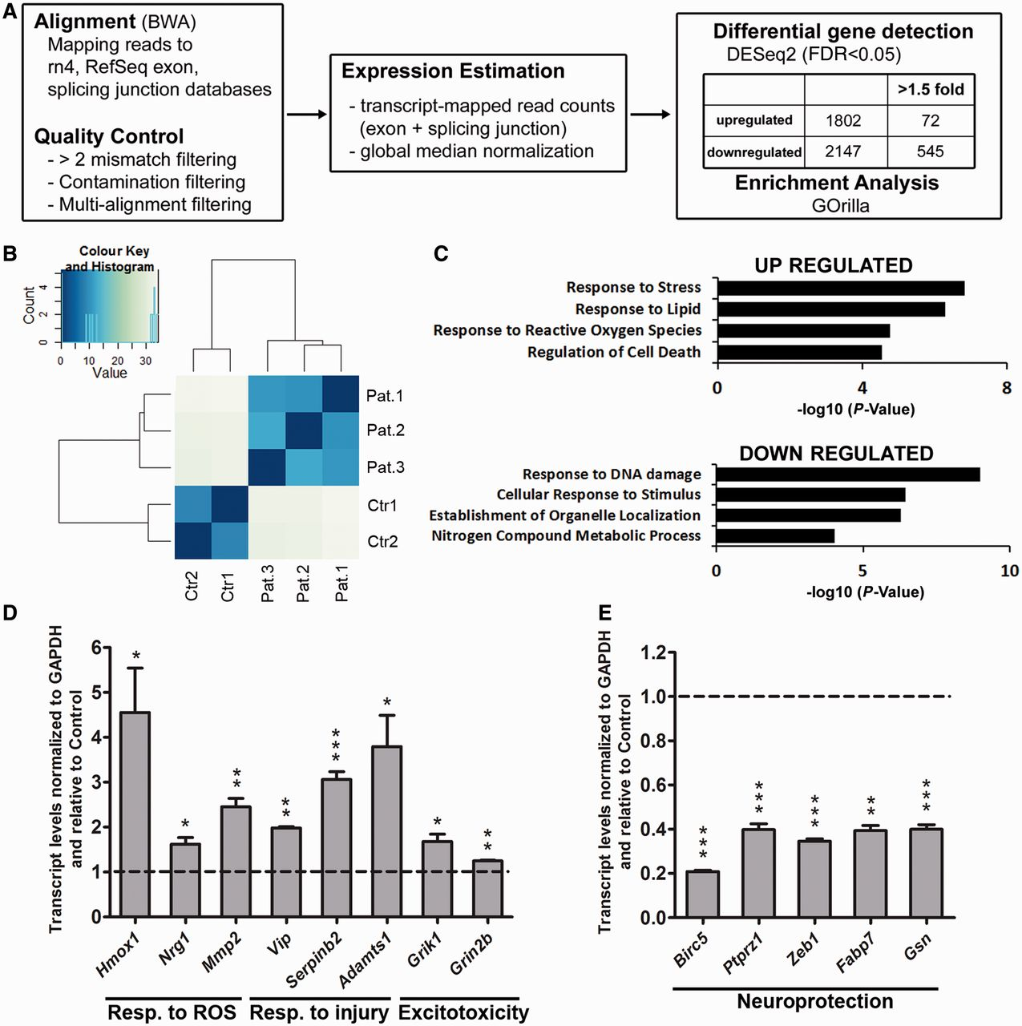
Figure 2 Unbiased genome-wide transcriptomic analysis of neurons exposed to CSF reveals a signature of gene expression ...
Notes:
Figure 2 Unbiased genome-wide transcriptomic analysis of neurons exposed to CSF reveals a signature of gene expression that is consistent with the impaired bioenergetic function. (A) Flowchart of the RNA-Seq analysis performed in neurons incubated with CSF from patients with multiple sclerosis or controls for 24 h. (B) Principle component analysis was used to determine data clustering. Note the segregation between the transcriptional changes induced in neurons by the CSF of patients with multiple sclerosis compared to those induced by the CSF from controls. (C) Gene ontology analysis revealed that the functional categories associated with elevated transcripts induced by multiple sclerosis CSF were related to response to stress, generation of reactive oxygen species (ROS) and cell death, whereas the downregulated ones included response to DNA damage and neuroprotection. (D and E) Validation of the transcriptional changes detected by RNA-Seq. RNA was isolated from cultured neurons incubated with CSF from controls or patients with multiple sclerosis and processed for quantitative real-time PCR. Values were normalized to GAPDH levels and referred as fold increase (D) or decrease (E) relative to the values measured in neurons treated with control CSF. Statistical differences for D and E were determined using two-tailed independent t-test, *P < 0.05, **P < 0.01, ***P < 0.001.
Unless provided in the caption above, the following copyright applies to the content of this slide: © The Author (2014). Published by Oxford University Press on behalf of the Guarantors of Brain. All rights reserved. For Permissions, please email: journals.permissions@oup.com

Slide 3
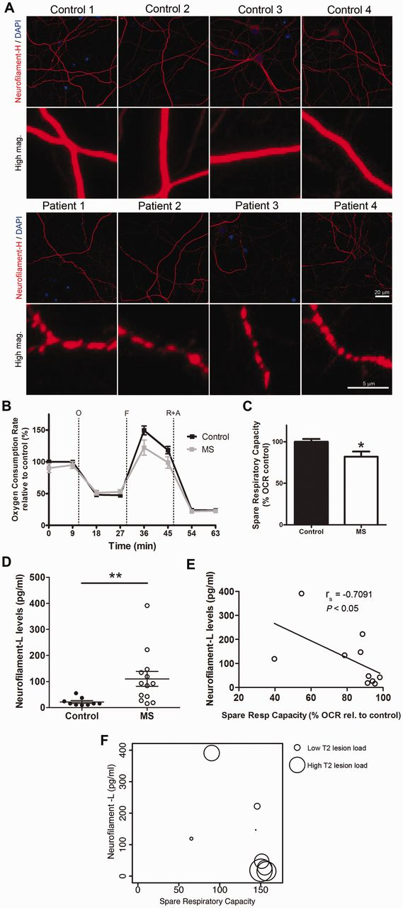
Figure 3 CSF from patients with multiple sclerosis (MS) induces axonal damage and mitochondrial dysfunction in ...
Notes:
Figure 3 CSF from patients with multiple sclerosis (MS) induces axonal damage and mitochondrial dysfunction in chronically stressed neurons and correlates with NF-L levels. (A) Hippocampal neurons were cultured in mild oxidative stress conditions for 17 days and then incubated with CSF from control subjects or patients with multiple sclerosis for 24 h. Representative confocal images after immunocytochemical analysis with antibodies specific for neurofilament heavy chain (red) to visualize neurites and DAPI (blue) to label nuclei. Scale bar = 20 µm. High magnification shows axonal beading, a sign of axonal damage, in cultures incubated with CSF from patients with multiple sclerosis. Scale bar = 5 µm (B) Bioenergetic analysis was performed using a Seahorse Analyzer. Oxygen consumption rate (OCR) was measured as an indicator of mitochondrial respiratory function under basal conditions and during the sequential addition of 2 µM oligomycin (O), 4 µM FCCP (F), 0.5 µM rotenone and 4 µM antimycin A (R+A). Data represent the mean ± SEM of the oxygen consumption rate levels relative to basal respiration levels from control CSF samples. (C) Spare respiratory capacity levels of the cultures based on the results obtained from the bioenergetic analysis. Data are expressed as the percentage of the oxygen consumption rate from cultures incubated with control CSF samples. (D) NF-L levels were measured on the CSF samples from control and patients with multiple sclerosis using an ELISA method. The scatter plot shows the individual measurement of each sample and the mean ± SEM for each group. (E) Scatter plot indicating the correlation between the levels of NF-L in the CSF and the spare respiratory capacity measured in the neuronal cultures incubated with the same CSF. Correlation assessed by the Spearman's rank test; rho coefficient is shown. (F) Lesion volume on T2-weighted MRI (circle diameter) was determined from patients with multiple sclerosis and correlated with NF-L levels in CSF samples (y-axis) and spare respiratory capacity induced in the neuronal cultures (x-axis). Statistical differences for C and D were determined using two-tailed independent t-test, *P < 0.05, **P < 0.01.
Unless provided in the caption above, the following copyright applies to the content of this slide: © The Author (2014). Published by Oxford University Press on behalf of the Guarantors of Brain. All rights reserved. For Permissions, please email: journals.permissions@oup.com

Slide 4
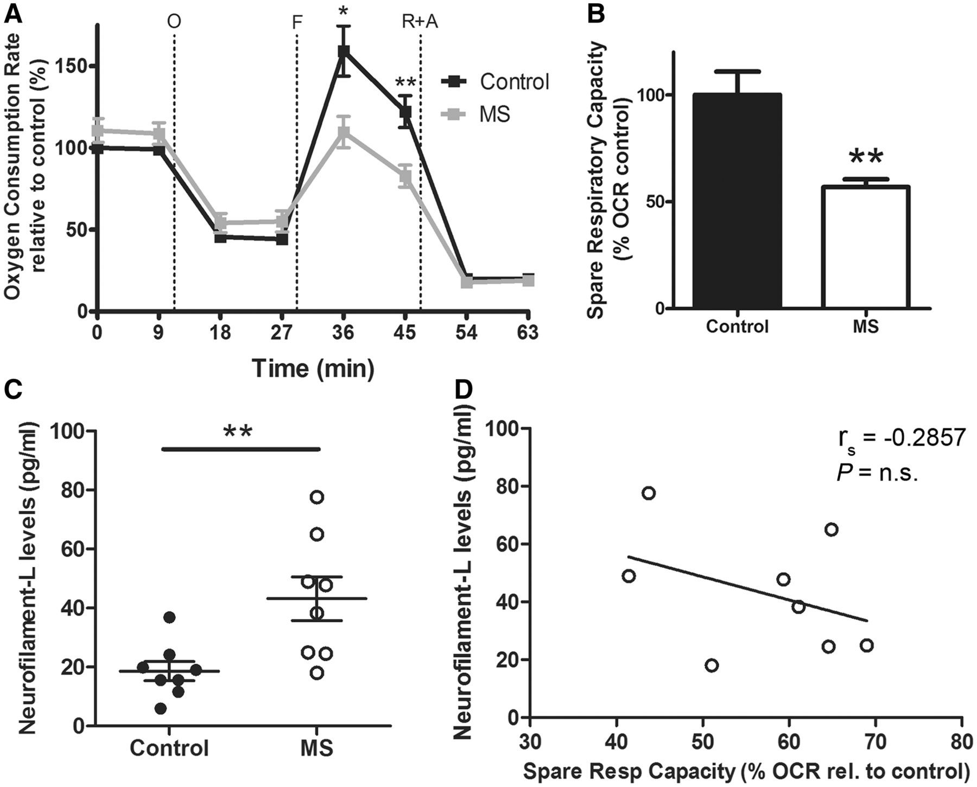
Figure 4 Independent validation of the effect of CSF from patients with multiple sclerosis (MS) on cultured neurons. ...
Notes:
Figure 4 Independent validation of the effect of CSF from patients with multiple sclerosis (MS) on cultured neurons. (A) Hippocampal neurons were cultured in the presence of oxidative stimulus (30 µM H2O2) for 17 days in vitro and a bioenergetic analysis was performed using a Seahorse Analyzer after a 24 h incubation with CSF from control or patients with multiple sclerosis. Oxygen consumption rate (OCR) was measured as an indicator of mitochondrial respiratory function under basal conditions and during the sequential addition of 2 µM oligomycin (O), 4 µM FCCP (F), 0.5 µM rotenone and 4 µM antimycin A (R+A). Data represent the mean ± SEM of the oxygen consumption rate levels relative to basal respiration levels from control CSF samples. (B) Spare respiratory capacity levels of the cultures based on the results obtained from the bioenergetic analysis. Data are expressed as the percentage of the oxygen consumption rate from cultures incubated with control CSF samples. (C) NF-L levels were measured on the CSF samples from control and patients with multiple sclerosis using an ELISA method. The scatter plot shows the individual measure of each sample and the mean ± SEM of each group. (D) Scatter plot showing the correlation between NF-L in the CSF samples and the spare respiratory capacity induced in the neuronal cultures after incubation with CSF from patients with multiple sclerosis. Correlation was assessed by the Spearman’s rank test and rho coefficient is shown. Statistical differences for A–C were determined using two-tailed independent t-test, *P < 0.05, **P < 0.01. n.s. = not significant.
Unless provided in the caption above, the following copyright applies to the content of this slide: © The Author (2014). Published by Oxford University Press on behalf of the Guarantors of Brain. All rights reserved. For Permissions, please email: journals.permissions@oup.com

Slide 5
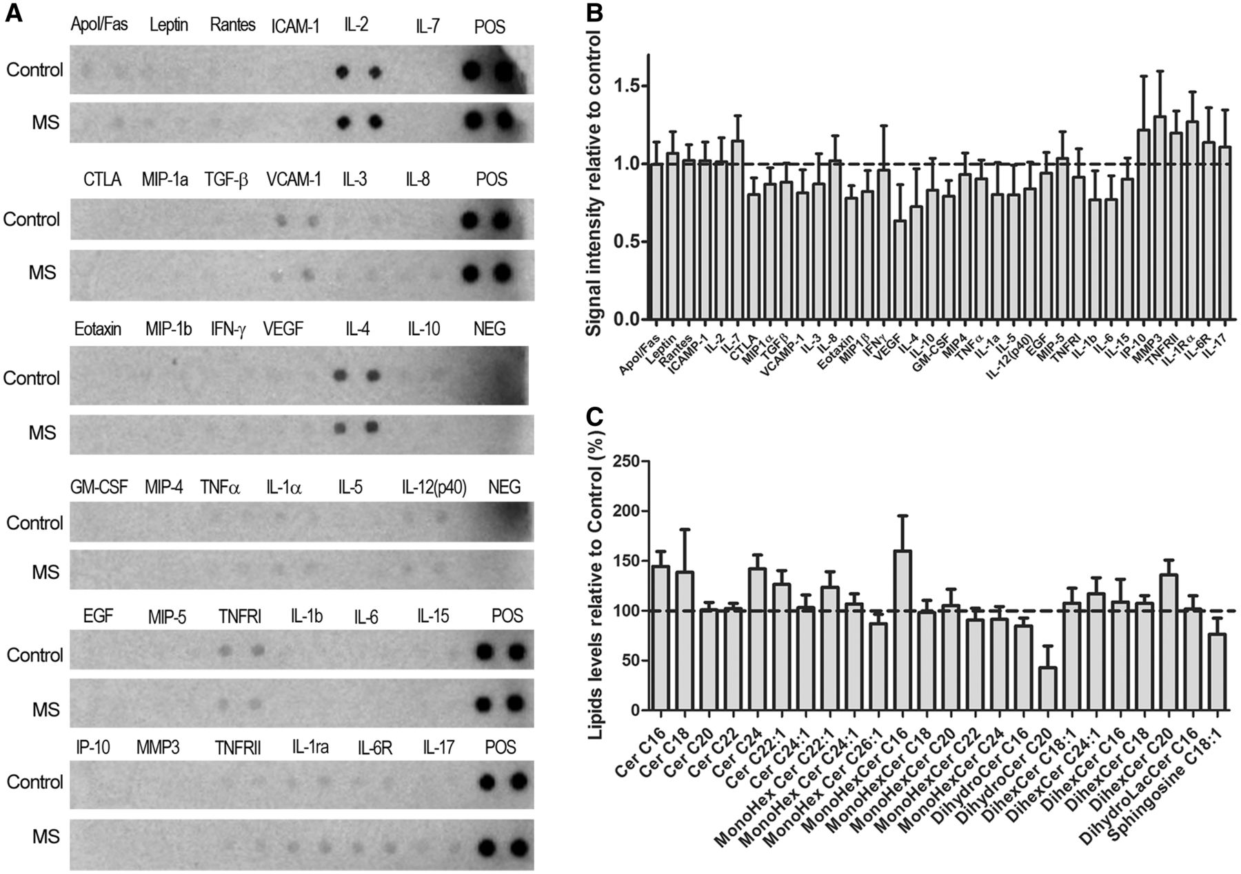
Figure 5 The search for diffusible factors distinguishing the composition of CSF samples from multiple sclerosis ...
Notes:
Figure 5 The search for diffusible factors distinguishing the composition of CSF samples from multiple sclerosis subjects compared with controls, revealed elevated ceramide species. (A) Levels of cytokines in CSF samples were assessed by ELISA. (B) Quantification of the cytokine arrays relative to control CSF samples. (C) Lipid profile on CSF samples from control subjects and patients with multiple sclerosis was performed using mass spectrometry and values are represented as relative to those measured in control samples. See also Table 4.
Unless provided in the caption above, the following copyright applies to the content of this slide: © The Author (2014). Published by Oxford University Press on behalf of the Guarantors of Brain. All rights reserved. For Permissions, please email: journals.permissions@oup.com

Slide 6
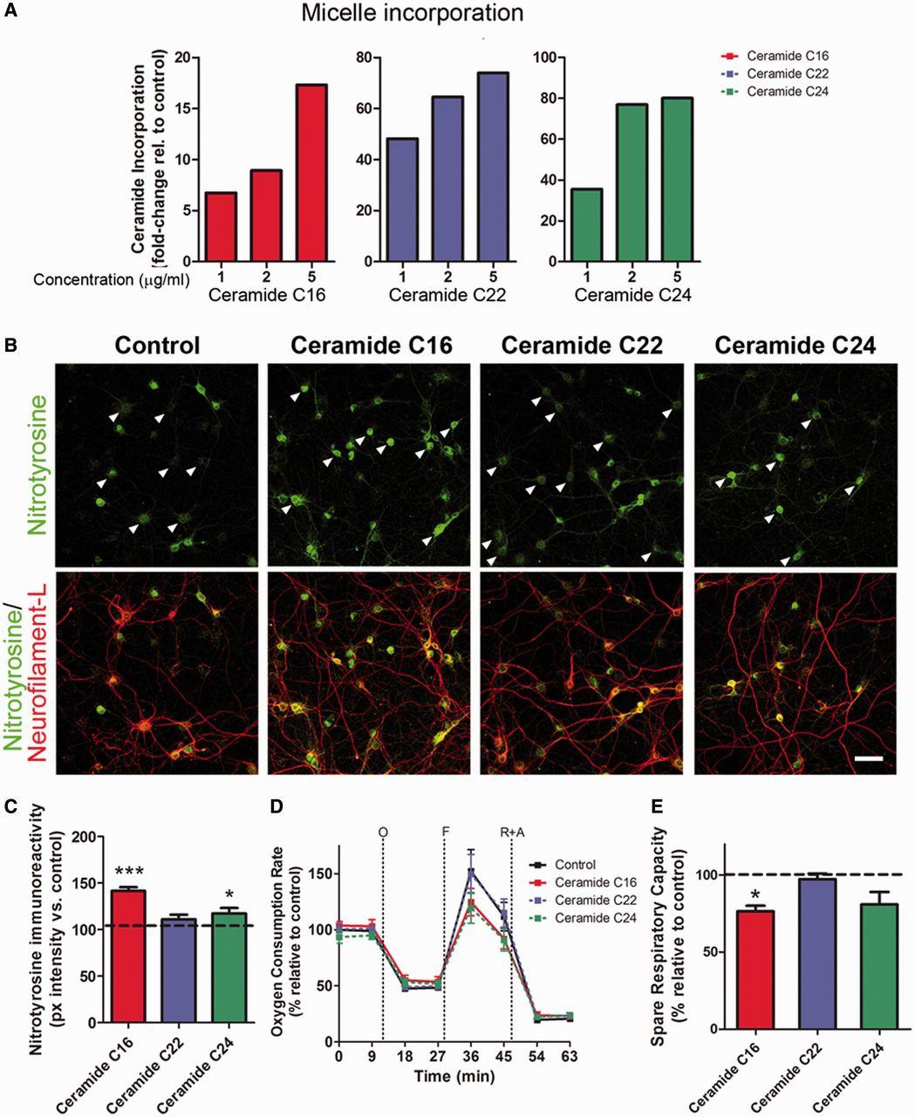
Figure 6 Incubation of neurons only with micelles containing ceramide species increased in the CSF of patients with ...
Notes:
Figure 6 Incubation of neurons only with micelles containing ceramide species increased in the CSF of patients with multiple sclerosis affects mitochondrial bioenergetics and oxidative damage. (A) Lipid incorporation measured by mass spectrometry in cultured neurons that had been incubated for 24 h with micelles containing the same ceramide species detected in the CSF of patients with multiple sclerosis. (B) Immunocytochemistry of neuronal cultures after 24-h treatment with micelles composed of the indicated ceramide species and then stained with antibodies for nitrotyrosine (green) and NeuN (red) to assess oxidative damage. Arrowheads indicate differences in nitrotyrosine staining intensity in the different conditions. Scale bar = 50 µm. (C) Quantification of nitrotyrosine pixel intensity levels represented as the mean ± SEM relative to control levels. *P < 0.05, ***P < 0.001. (D) Bioenergetic analysis of neurons exposed to chronic oxidative stress and then treated with micelles for 24 h was performed using a Seahorse Analyzer. Data represent the mean ± SEM of the oxygen consumption rate levels relative to basal respiration levels measured in neurons treated with control micelles, containing ceramide species found in the CSF of controls. (E) Spare respiratory capacity levels calculated from the results of the bioenergetic analysis. Data are expressed as the percentage of the oxygen consumption rate from cultures incubated with control micelles sample. Statistical differences for C and E were determined using one-way ANOVA with Dunnett’s multiple comparison test. *P < 0.05, ***P < 0.001 versus control.
Unless provided in the caption above, the following copyright applies to the content of this slide: © The Author (2014). Published by Oxford University Press on behalf of the Guarantors of Brain. All rights reserved. For Permissions, please email: journals.permissions@oup.com

