Slide 1
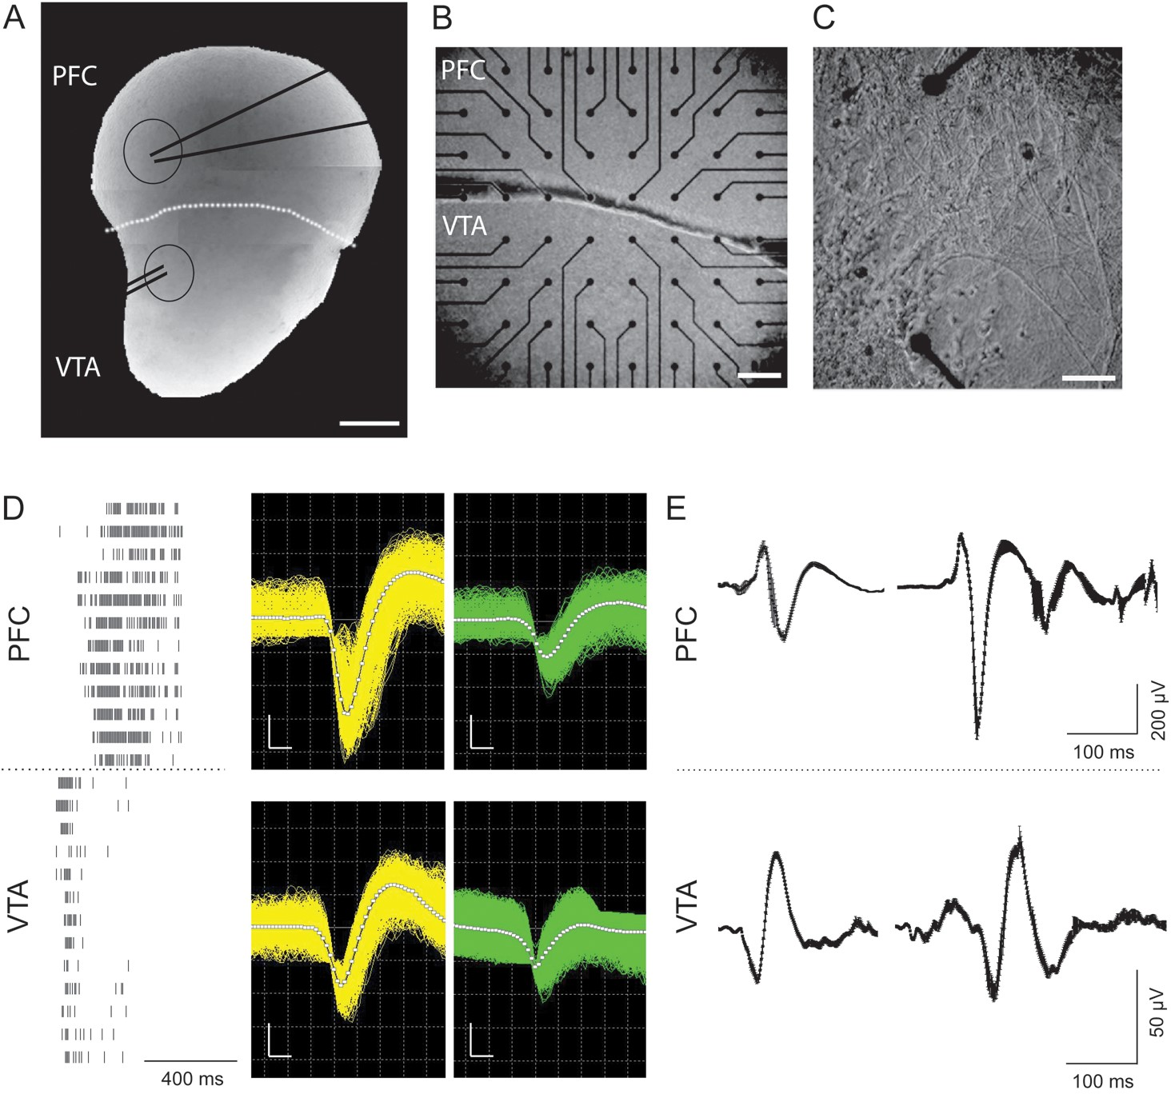
Figure 1. Schematic of the organotypic coculture preparation (P1–3 mice) and types of activity recorded from VTA/SN-PFC ...
Notes:
Figure 1. Schematic of the organotypic coculture preparation (P1–3 mice) and types of activity recorded from VTA/SN-PFC cocultures. (A) Picture of a VTA/SN-PFC coculture on a semiporous membrane at 1 DIV (day in vitro). The white dashed line indicates the border between VTA/SN complex and PFC. The 2 black circles indicate the VTA region and the medial PFC (mPFC), where the stimulation for patch-clamp recordings is applied (parallel black lines) and the single-cell recording is performed (convergent black lines), respectively. (B) Picture of a VTA/SN-PFC coculture on multielectrode arrays with an interelectrode distance of 200 μm, taken at 1 DIV. (C) The border region between VTA/SN complex and PFC at 7 DIV is shown and it is possible to notice the newborn projections grown between the 2 areas of the coculture. Scale bars: (A) 400 μm; (B) 200 μm; (C) 100 μm. (D, left) Example of a burst of action potentials recorded from a coculture at 5 DIV. Each row shows the activity of a neuron, while each vertical line represents the timestamp of an action potential; the dashed line separates neurons belonging to the VTA (n = 13, bottom) from those belonging to the PFC (n = 13, upper part). (D, right) Exemplary superimposed spikes recorded from one electrode under the PFC (upper panels) and from one electrode under the VTA/SN complex (lower panels) of a coculture. The different colors (yellow and green) indicate spikes of different amplitudes, which have been sorted into different units using a mixed amplitude-duration criterion (see Methods section). The white squares line represents the average waveforms of each unit. (Scale bars: x-axis, 200 μs; y-axis, 90 μV). (E) Example of local field potentials recorded from the VTA/SN complex (bottom) and the PFC (upper). The waveforms shown in the graphs are as average ± SEM of 900 s recordings.
Unless provided in the caption above, the following copyright applies to the content of this slide: © The Author 2012. Published by Oxford University Press. All rights reserved. For Permissions, please e-mail: journals.permissions@oup.com

Slide 2
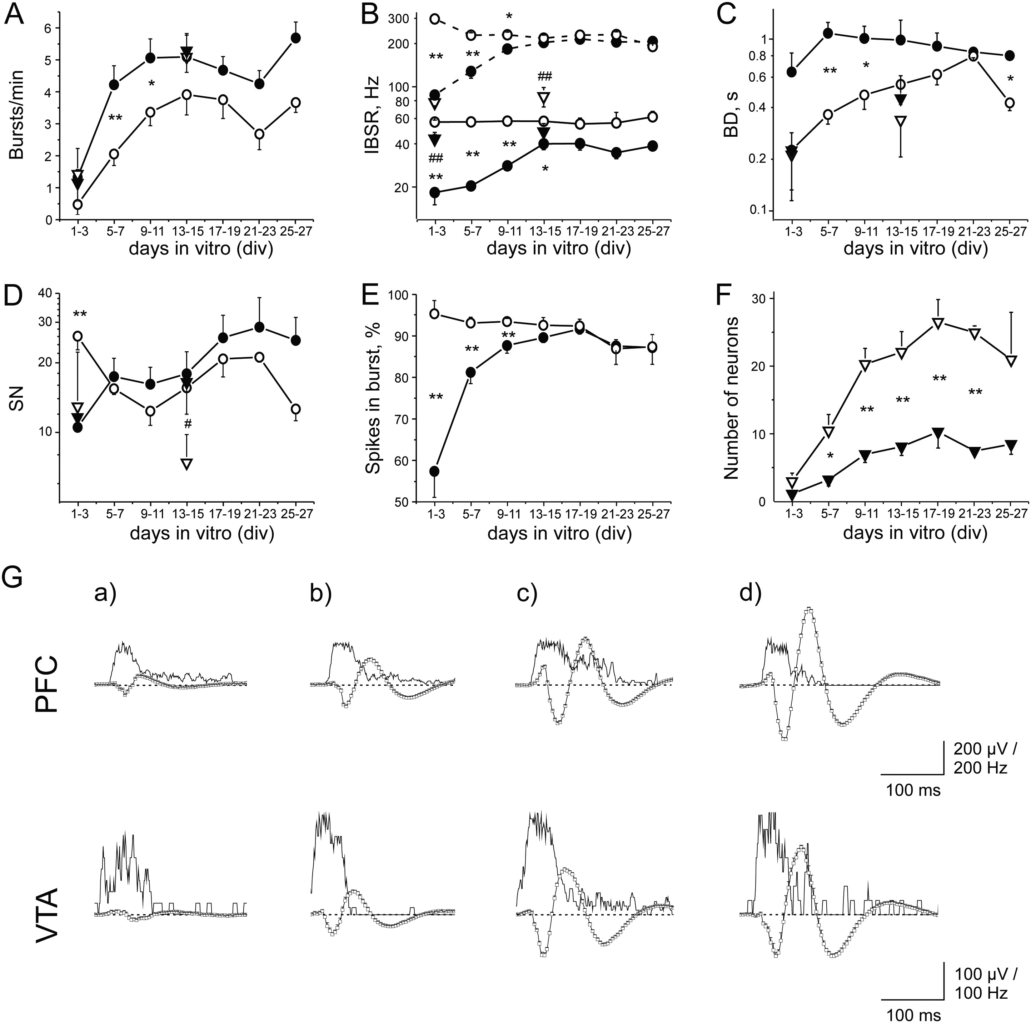
Figure 2. Characterization of the developmental features of the VTA/SN-PFC cocultures. In A-F, the developmental ...
Notes:
Figure 2. Characterization of the developmental features of the VTA/SN-PFC cocultures. In A-F, the developmental profile of different parameters which characterize the activity of PFC (black line with empty circles) and VTA/SN complex (black line with filled circles) of the cocultures is shown. For the excitatory and inhibitory neurons identified from the PFC, in Figure 2 (A–D), the white empty and the black filled triangles indicate their values of the parameters at 1–3 DIV (early development) and 13–15 DIV (late development), respectively. In all the graphs, data are obtained following the development of 10 cocultures. (A) Plot of burst rate (BR, bursts/min) developmental profile. Developmental profile statistical significance (PFC: 1–3 vs. 13–15 and 17–19, P < 0.01; 1–3 vs. 9–11, P < 0.05. VTA/SN complex: 1–3 vs. 9–11 and 13–15, P < 0.01; 1–3 vs. 17–19 and 25–27, P < 0.05). (B) Intraburst spike rate (IBSR, Hz; continuous lines) and peak IBSR (pIBSR; dashed lines). Statistical significance of IBSR developmental profile of VTA/SN complex (1–3 vs. 13–15, 17–19 and 5–7 vs. 13–15, 17–19, P < 0.01). Excitatory and inhibitory neurons statistical significance (hash) was between 1–3 and 13–15 DIV. Statistical significance of pIBSR developmental profile (PFC: 1–3 vs. 13–15 and 25–27 with P < 0.05. VTA/SN complex: 1–3 vs. 9–11, 13–15, 17–19, 21–23, 25–27 and 5–7 vs. 13–15, 17–19 with P < 0.01; 5–7 vs. 9–11 with P < 0.05). (C) Burst duration (BD, s). (D) Number of spikes in burst (SN). Excitatory and inhibitory neurons statistical significance (hash) at 13–15 DIV. (E) Percentage of spikes in burst, on the total number of spikes recorded from the VTA/SN complex and the PFC during development. Developmental profile statistical significance of the VTA/SN complex (1–3 vs. 5–7, 9–11, 13–15, 17–19, 21–23, 25–27 with P < 0.01). (F) Average number of excitatory (white triangles) and inhibitory (black triangles) neurons recorded from the PFC during the development. These values indicate an excitatory/inhibitory neuron ratio of about 3. Statistical significance has been observed also in the developmental profile of both excitatory and inhibitory neuron number (Excitatory neurons: 1–3 vs. 9–11, 13–15, 17–19, 21–23 and 5–7 vs. 17–19 DIV with P < 0.01; 5–7 vs. 13–15 with P < 0.05. Inhibitory neurons: 1–3 vs. 17–19 with P < 0.01; 1–3 vs. 13–15 and 5–7 vs. 17–19 with P < 0.05). The data shown in A-F clearly indicate that during the development of the cocultures the VTA/SN complex and the PFC go towards a similar mature condition with comparable firing properties, due to the progressive growth of new projections, which are able to link the 2 areas and allow a continuous communication. (G) Developmental changes of local field potentials. Exemplificative average waveforms recorded from a VTA/SN-PFC coculture (LFPs from the PFC in the first row and those from the VTA/SN complex in the second row) during the development in vitro. The white squares lines represent the average waveform (mean + upward error bars) of a 900 s recording period at 6 (a), 10 (b), 14 (c) and 17 (d) DIV, while the thin black lines show the corresponding spike rate histograms (bin = 0,001 s). LFP sampling rate: 1000 Hz; in the LFP graphs, 4 skipped points. The dashed line indicates the zero level.
Unless provided in the caption above, the following copyright applies to the content of this slide: © The Author 2012. Published by Oxford University Press. All rights reserved. For Permissions, please e-mail: journals.permissions@oup.com

Slide 3
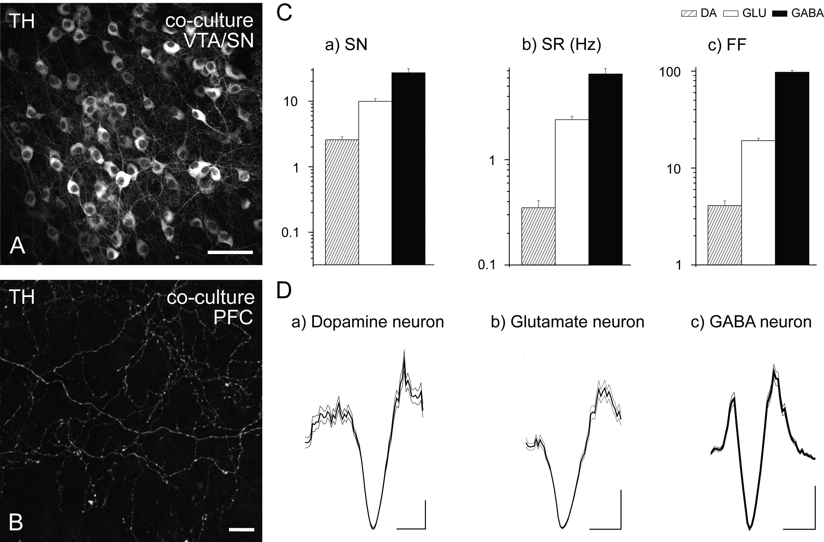
Figure 3. Characterization of VTA/SN neuronal populations. (A and B) Confocal images of the DAergic marker TH in the ...
Notes:
Figure 3. Characterization of VTA/SN neuronal populations. (A and B) Confocal images of the DAergic marker TH in the VTA/SN complex (A) and the PFC (B). It is possible to note the presence of DAergic neurons in the VTA/SN complex, while in the PFC TH-positive fibers are labeled. (C) Properties of the 3 neuronal populations (putative DAergic, Glutamatergic and GABAergic neurons, represented as striped, white and black histograms, respectively) identified electrophysiologically on the basis of the extracellular activity in the VTA/SN complex of an exemplificative coculture at 14 DIV: spike number (SN, a), SR (in Hz, b) and Fano Factor (FF, c) (Total recorded neurons from the VTA/SN complex: 75; putative DAergic 42, glutamatergic 14, GABAergic 19). (D) Exemplificative spike waveforms from a putatively identified DAergic (a), Glutamatergic (b) and GABAergic (c) neuron of the VTA/SN complex. The thick black lines represent the average of 200 recorded spikes, while the thin black lines indicate ± SEM. (Scale bars: A, 50 μm; B, 10 μm; D, a–c, 500 ms, 20μV).
Unless provided in the caption above, the following copyright applies to the content of this slide: © The Author 2012. Published by Oxford University Press. All rights reserved. For Permissions, please e-mail: journals.permissions@oup.com

Slide 4
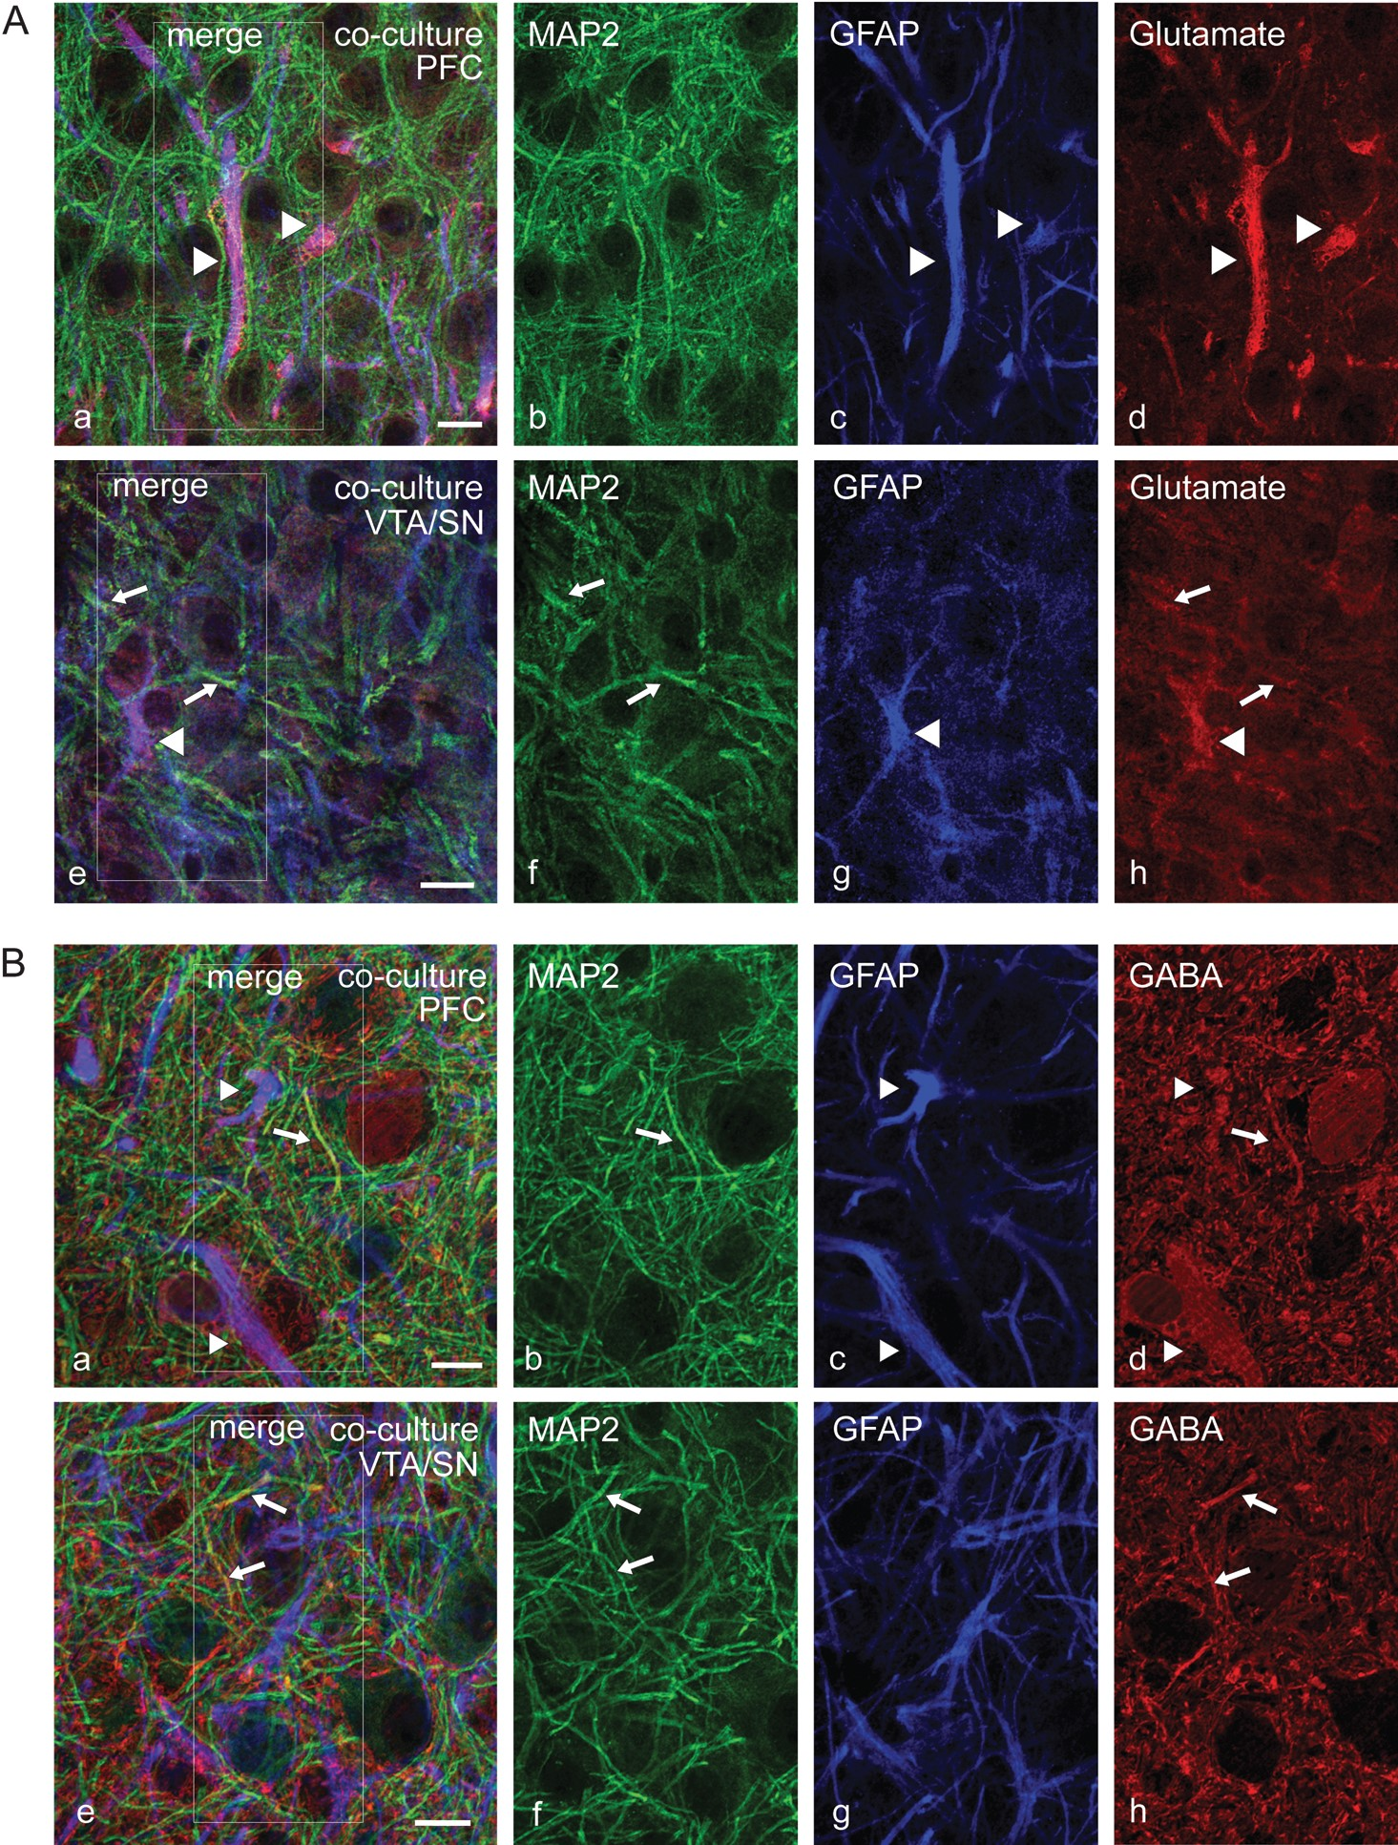
Figure 4. Confocal images of multiple immunofluorescence labeling studies to characterize the expression of inhibitory ...
Notes:
Figure 4. Confocal images of multiple immunofluorescence labeling studies to characterize the expression of inhibitory and excitatory neurotransmitters in the dopaminergic VTA/SN-PFC coculture system (12–14 DIV). (A) Confocal images of the neuronal marker microtubule-associated protein-2 (MAP2), the astroglial marker GFAP and glutamate in the PFC (a–d) and the VTA/SN complex (e–h), whereas the inset in (a) and (e) represents details of the labeling exposed in (b–d) and (f–h), respectively. The immunoreactivity for MAP2 (b,f), GFAP (c,g) and glutamate (d,h) in both regions are shown. Moreover, the expression of glutamate-positive structures on neuronal fibers (arrow) and on glial fibers (arrowhead) is illustrated (Scale bars a–h: 10 µm). (B) Characterization of MAP2 and GFAP in combination with γ-aminobutyric acid (GABA) in the PFC (a–d) and the VTA/SN complex (e–h). The inset in (a) and (e) represents details of the labeling shown in (b–d) and (f–h), respectively. A positive labeling for MAP2 (b,f), GFAP (c,g) and GABA (d,h) was observed, whereas a localization of GABA-positive structures on neuronal fibers (arrow) as well as on glial fibers (arrowhead) is demonstrated (Scale bars a–h: 10 µm).
Unless provided in the caption above, the following copyright applies to the content of this slide: © The Author 2012. Published by Oxford University Press. All rights reserved. For Permissions, please e-mail: journals.permissions@oup.com

Slide 5
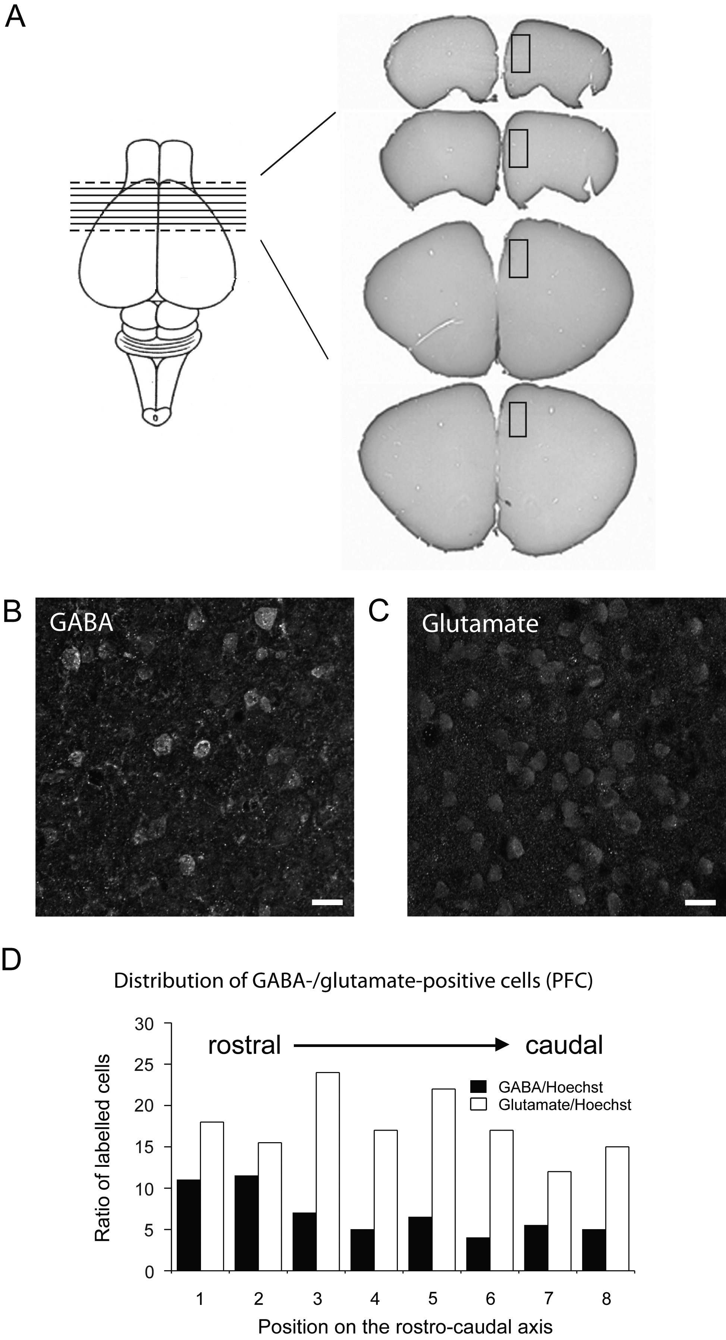
Figure 5. Quantification of excitatory and inhibitory neurons in the PFC of CD1® mice. (A) On the left, schematic ...
Notes:
Figure 5. Quantification of excitatory and inhibitory neurons in the PFC of CD1® mice. (A) On the left, schematic illustration of the preparation of brain slices for the quantification of GABA- and glutamate-positive cells in the PFC. Examples of the brain slices containing the PFC are shown on the right. The highlighted small squares within the coronal brain sections indicate the area used for cell counting. (B–D) Quantification of GABA- and glutamate-positive cells in the PFC of CD1® mice (14 days old). Exemplary confocal microscopy images of GABA- (B) and glutamate- (C) positive cells are shown (Scale bars in B and C: 20 μm). The number of stained cells divided by the number of Hoechst stained nuclei is shown in (D) for the different slices quantified. Bar charts represent mean values for the proportion of GABA- or glutamate-positive cells respectively.
Unless provided in the caption above, the following copyright applies to the content of this slide: © The Author 2012. Published by Oxford University Press. All rights reserved. For Permissions, please e-mail: journals.permissions@oup.com

Slide 6
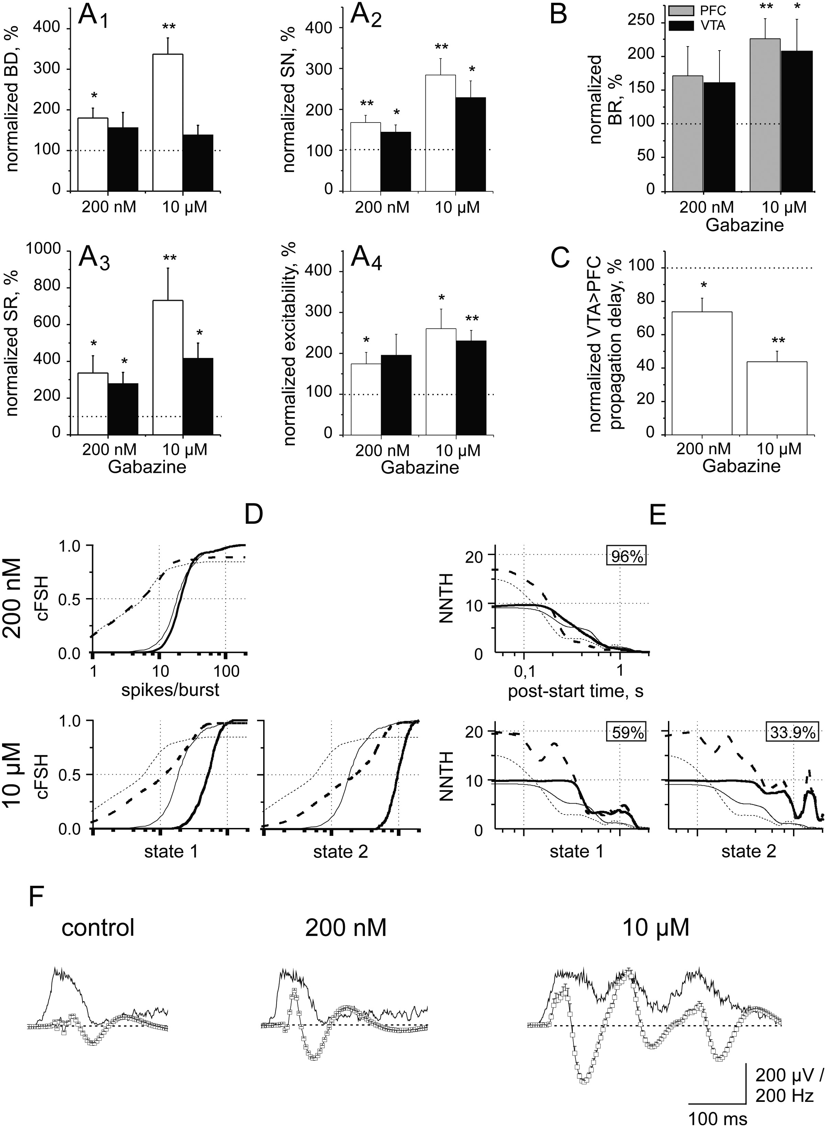
Figure 9. Network disinhibition by gabazine (GZ). (A) Plots of percentage increase, with respect to control, of BD ...
Notes:
Figure 9. Network disinhibition by gabazine (GZ). (A) Plots of percentage increase, with respect to control, of BD (A1), SN (A2), SR (A3) and excitability (A4) for excitatory (white) and inhibitory (black) clusters of PFC during application of 200 nM or 10 μM GZ. Excitatory and inhibitory neurons were 263 and 93 (5 experiments). Statistical significance in: A1: excitatory neurons at 200 nM vs. 10 μM GZ, P < 0.05; at 10 μM, excitatory vs. inhibitory neurons, P < 0.01; A2: excitatory neurons at 200 nM vs. 10 μM, P < 0.05. (B) Plots of percentage increase, with respect to control, of BR recorded in the PFC (grey) and in the VTA (black) during application of 200 nM or 10 μM GZ. Same experiments as in A. (C) Plots of percentage increase, with respect to control, of propagation delay of VTA-to-PFC bursts during application of 200 nM or 10 μM GZ. Same experiments as in A. Statistical significance: 200 nM vs. 10 µM, P < 0.05. All the data (mean ± SEM) shown in A–C are obtained normalizing all the values of 5 experiments to the value found in the control condition of each experiment and then averaging the normalized values. (D) For PFC, plot of cFSHs of identified network states in 200 nM and 10 μM GZ for excitatory (thick dashed lines) and inhibitory (thick continuous lines) neurons; the thin dashed and continuous lines indicate excitatory and inhibitory neuron control data, respectively. Left and right plots report data of state 1 and 2, respectively (1 exemplary experiment, 46 excitatory and 11 inhibitory neurons). (E) Same as D but for time histograms NNTHs. Upper-right legends indicate percentage occupation of states (see Methods). (F) Effect of GZ on exemplary LFPs recorded from a PFC electrode containing 2 units. The open squares indicate the average LFP waveforms (+ upward error bars) recorded in 900 s. Number of bursts for the averaged waveforms: control: 35; 200 nM GZ: 25; 10 μM GZ: 30. LFP data graphs: 4 skipped points. The superimposed upward-going thin black lines show the average spike rate increase during bursts. Notice at 10 μM an oscillatory activity. The dashed line indicates the zero level.
Unless provided in the caption above, the following copyright applies to the content of this slide: © The Author 2012. Published by Oxford University Press. All rights reserved. For Permissions, please e-mail: journals.permissions@oup.com

Slide 7
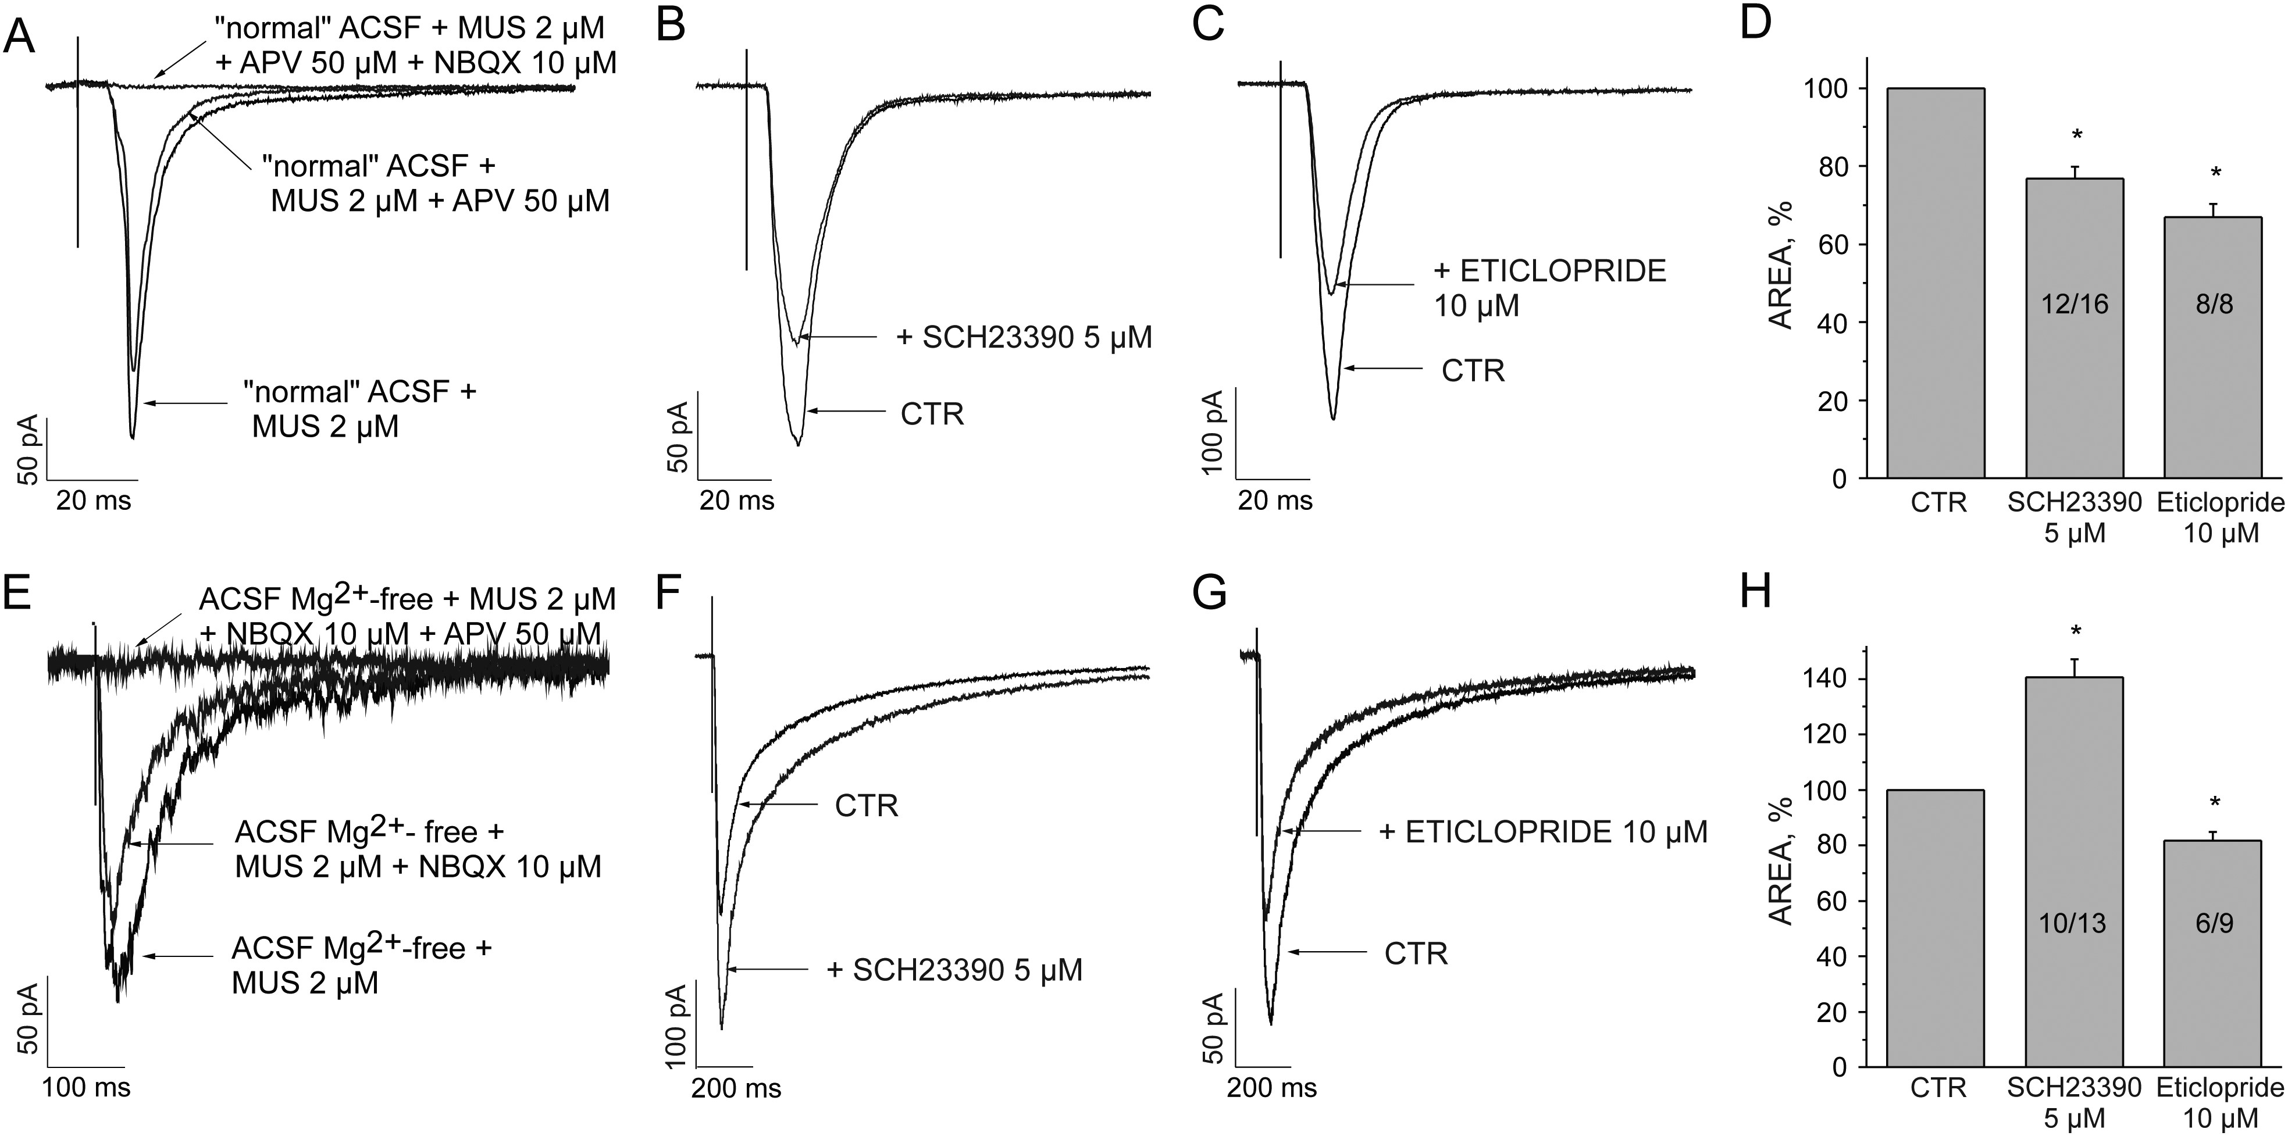
Figure 10. Procedure used in patch-clamp experiments and effect of D1 and D2 receptor antagonist on AMPA and NMDA ...
Notes:
Figure 10. Procedure used in patch-clamp experiments and effect of D1 and D2 receptor antagonist on AMPA and NMDA currents. Data in A–D and E–H are from AMPA (NBQX-sensitive) and NMDA (APV-sensitive) evoked currents (average of 10 traces), respectively. Data in B,F and C,G were obtained by using SCH23390 and eticlopride, respectively. (A) Superimposed currents: average of 6 VTA-evoked synaptic currents recorded in a representative PFC pyramidal neuron after 10min of application of MUS 2 µM in “normal” ACSF, after 10min of an additional application of APV 50 µM and after 10min of a further application of NBQX 10 µM. (B) Superimposed synaptic currents recorded in a representative PFC pyramidal neuron after 10min of CTR condition and, in the same cell, after 10min of additional application of D1 receptor antagonist SCH23390 5 µM. (C) Superimposed synaptic currents recorded in a representative PFC pyramidal neuron after 10min of CTR condition and in the same cell after 10min of additional application of D2 receptor antagonist eticlopride 10 µM. (D) The plot summarizes the effect of the D1 and D2 receptor antagonist application on VTA-evoked AMPA currents. (E) Superimposed currents: average of 6 VTA-evoked synaptic currents recorded in a representative PFC pyramidal neuron after 10min of application of MUS 2 µM in ACSF Mg2+-free, after 10min of an additional application of NBQX 10 µM and after 10min of a further application of APV 50 µM. (F) Superimposed synaptic currents recorded in a representative PFC pyramidal neuron after 10min of CTR condition and in the same cell after 10min of additional application of D1 receptor antagonist SCH23390 5 µM. (G) Superimposed synaptic currents recorded in a representative PFC pyramidal neuron after 10min of CTR condition and in the same cell after 10min of an additional application of D2 receptor antagonist eticlopride 10 µM. (H) The plot summarizes the effect of the D1 and D2 receptor antagonist application on VTA-evoked NMDA currents.
Unless provided in the caption above, the following copyright applies to the content of this slide: © The Author 2012. Published by Oxford University Press. All rights reserved. For Permissions, please e-mail: journals.permissions@oup.com

Slide 8
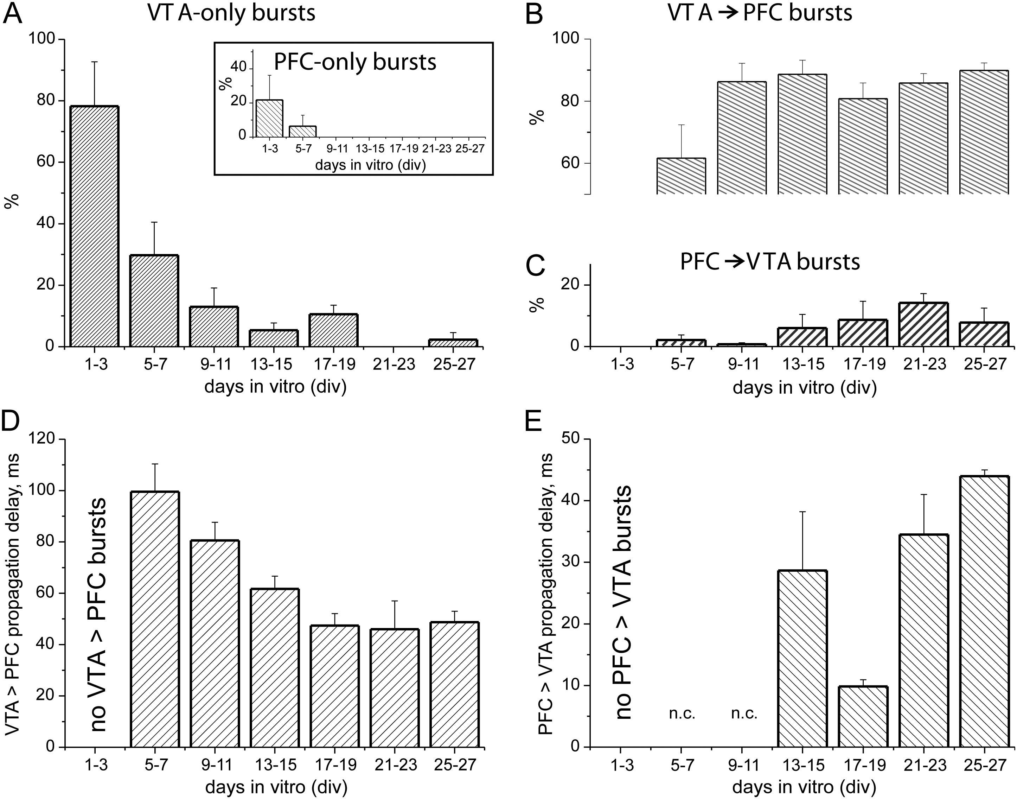
Figure 6. Delays and directional properties of bursting during development. (A) Percentage incidence of different ...
Notes:
Figure 6. Delays and directional properties of bursting during development. (A) Percentage incidence of different patterns of activity recorded during the development of the cocultures (n = 10): bursts restricted to the VTA/SN complex (VTA-only bursts) or to the PFC (PFC-only bursts, inset). Developmental profile statistical significance of VTA-only bursts (1–3 vs. 5–7, 9–11, 13–15, 17–19, 21–23, 25–27, P < 0.01). (B) Same as A but bursts originating in the VTA/SN complex and propagating to the PFC (VTA-to-PFC bursts). Statistical significance (1–3 vs. 5–7, 9–11, 13–15, 17–19, 21–23, 25–27, P < 0.01). (C) Same as A but bursts starting in the PFC and back-propagating to the VTA/SN complex (PFC-to-VTA bursts). (D and E) Propagation delays of VTA-to-PFC (D) and PFC-to-VTA (E) bursts during the development of the cocultures (n = 10). At 5–7 and 9–11 DIV the percentage of PFC-to-VTA bursts is too low to allow the computation of the average delay (n.c. = not calculated). Statistical significance of the developmental profile of VTA-to-PFC delay (5–7 vs. 21–23, 25–27, P < 0.01; 5–7 vs. 13–15, 17–19 and 9–11 vs. 17–19, P < 0.05) and of PFC-to-VTA delay (13–15 vs. 17–19 and 17–19 vs. 21–23, 25–27, P < 0.01).
Unless provided in the caption above, the following copyright applies to the content of this slide: © The Author 2012. Published by Oxford University Press. All rights reserved. For Permissions, please e-mail: journals.permissions@oup.com

Slide 9
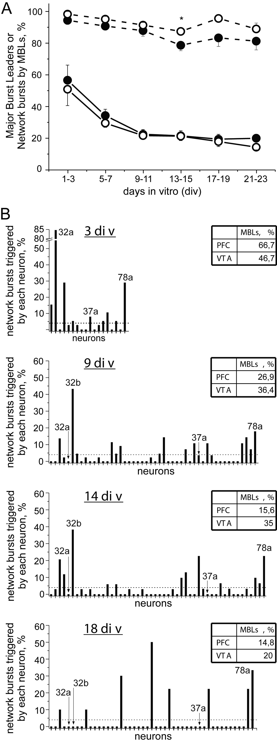
Figure 7. Is the functional role of burst-leader neurons changing during development? (A) Percentage of Major Burst ...
Notes:
Figure 7. Is the functional role of burst-leader neurons changing during development? (A) Percentage of Major Burst Leaders (MBLs, continuous line) and percentage of network bursts triggered by MBLs (dashed line) during the development of the VTA/SN complex (black filled circles) and the PFC (black empty circles; n = 10). Statistical significance of MBL developmental profile (PFC: 1–3 vs. 5–7, 9–11, 13–15, 17–19, 21–23, P < 0.01; 5–7 vs. 17–19, P < 0.05. VTA/SN complex: 1–3 vs. 9–11, 13–15, 17–19, 21–23, P < 0.01; 1–3 vs. 5–7, P < 0.05). (B) Histograms of the percentage of network bursts leaded by each neuron recorded at different stages of the development (3, 9, 14 and 18 DIV) for one representative VTA/SN-PFC coculture. The neurons indicated on the x-axis include those belonging both to the VTA/SN complex and the PFC. The dotted line in each of the 4 graphs represents the threshold for a neuron to be considered a MBL (≥4% of the network bursts leaded). The insets (top right of each graph) indicate the percentage of MBLs in the VTA/SN complex and in the PFC at each time point. It is possible to note that neurons can have different behaviors during development: they can act as MBLs only during the early stage of development (see neurons 32a and 37a in the graphs) or in the central phase of the maturation of the cocultures (like neuron 32b) or they can have a very predominant role in triggering activity steadily during the development (as neuron 78a).
Unless provided in the caption above, the following copyright applies to the content of this slide: © The Author 2012. Published by Oxford University Press. All rights reserved. For Permissions, please e-mail: journals.permissions@oup.com

Slide 10
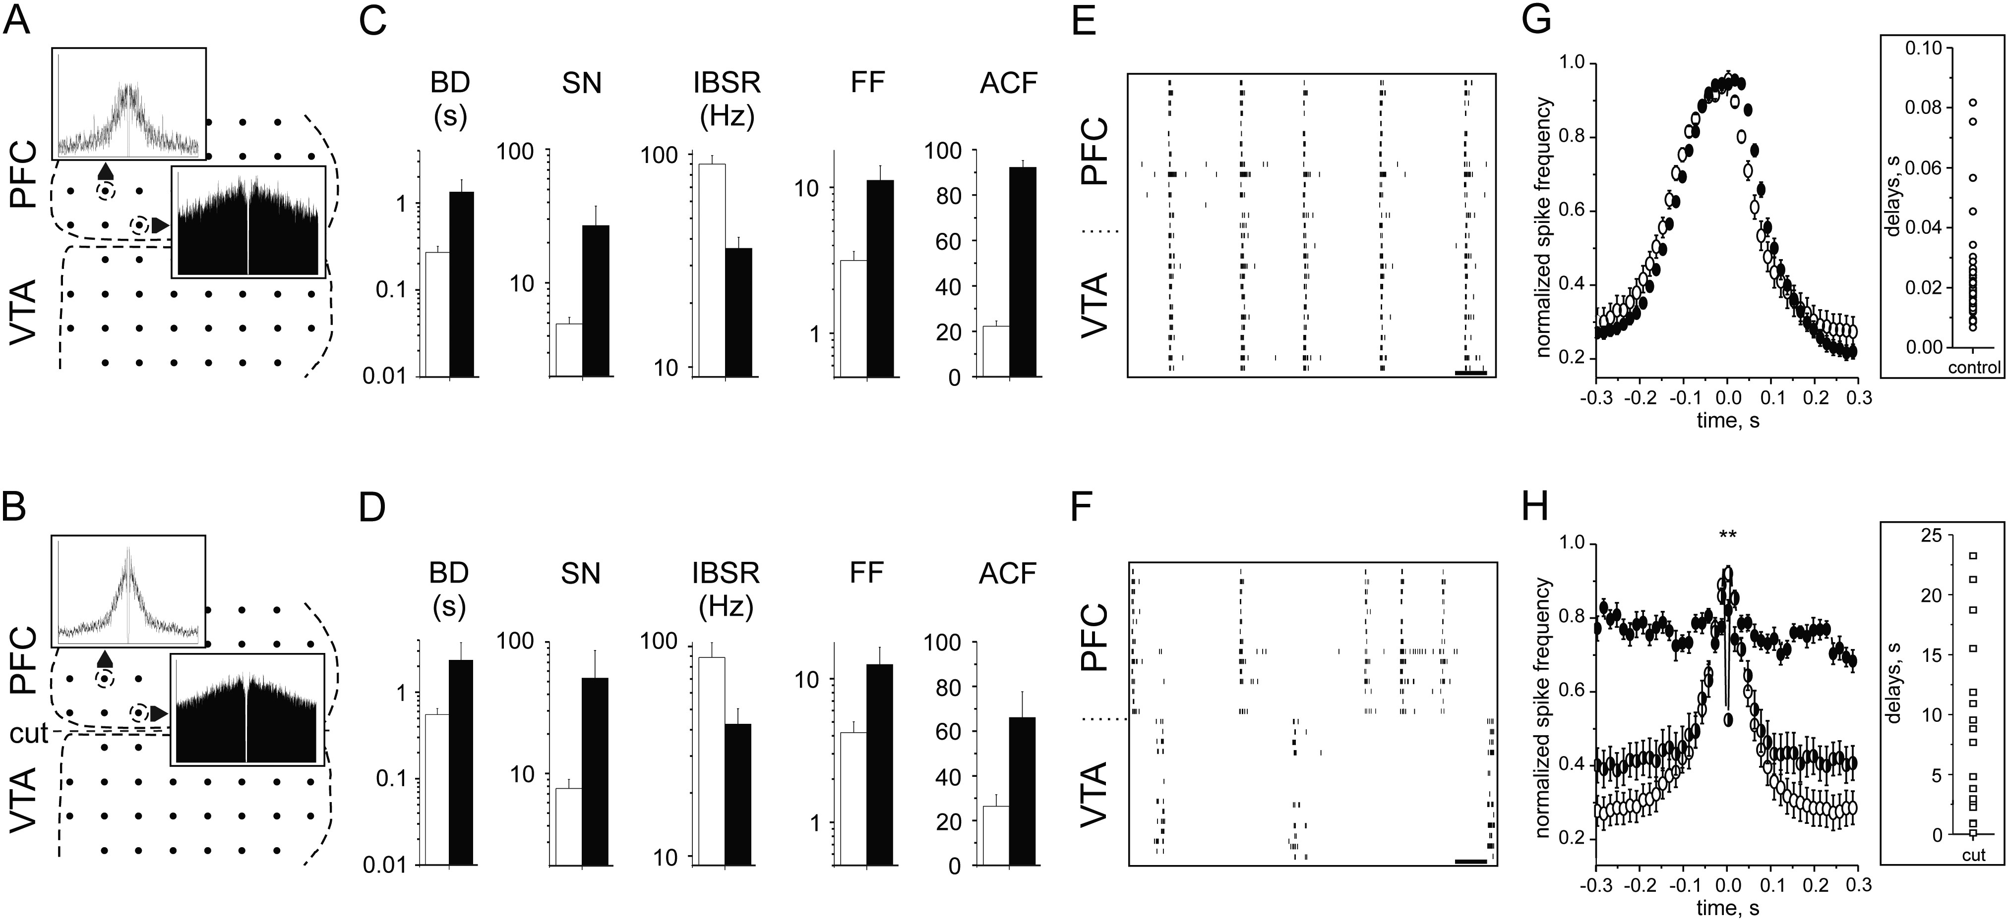
Figure 8. Functional role of the newborn projections for the correlated activity between the VTA/SN complex and the ...
Notes:
Figure 8. Functional role of the newborn projections for the correlated activity between the VTA/SN complex and the PFC. (A and B) Exemplificative autocorrelograms of an excitatory (white) and an inhibitory (black) neuron, recorded from the electrodes indicated by the dashed circles, are shown in control condition (A) and after the cut of the projections (B; the dashed line between the VTA/SN complex and the PFC indicates the cut). Each plot has the same x-axis of ± 200 ms and the y-axis (spikes/s) has a maximum value of 50 (Time bin for autocorrelograms: 1 ms). (C and D) BD, SN, IBSR, FF and ACF of the PFC excitatory (white) and inhibitory (black) neuron clusters before (C) and after (D) cut. (E and F) Raster plots of the activity of neurons belonging to the VTA/SN complex (n = 14) and the PFC (n = 15) in presence of intact (E) and disrupted (F) projections. (Scale bar: 1 s). (G) Cross-correlograms of the activity (normalized data) in the VTA/SN complex (black filled circles) and in the PFC (black empty circles), computed using a neuron of the PFC as the reference, before the cut. Inset: the distribution of the propagation delays (absolute values) between synchronous bursts before the cut. (H) Same as in G (black empty and filled circles) but after the cut. The half-filled circles show the ACF of VTA/SN complex neurons shown in G but after the cut. Inset: same as in G but notice that the y-scales differed by 3 orders of magnitude. In G and H, time bin for cross-correlograms: 5 ms; in the graphs: 3 skipped points.
Unless provided in the caption above, the following copyright applies to the content of this slide: © The Author 2012. Published by Oxford University Press. All rights reserved. For Permissions, please e-mail: journals.permissions@oup.com

