Slide 1
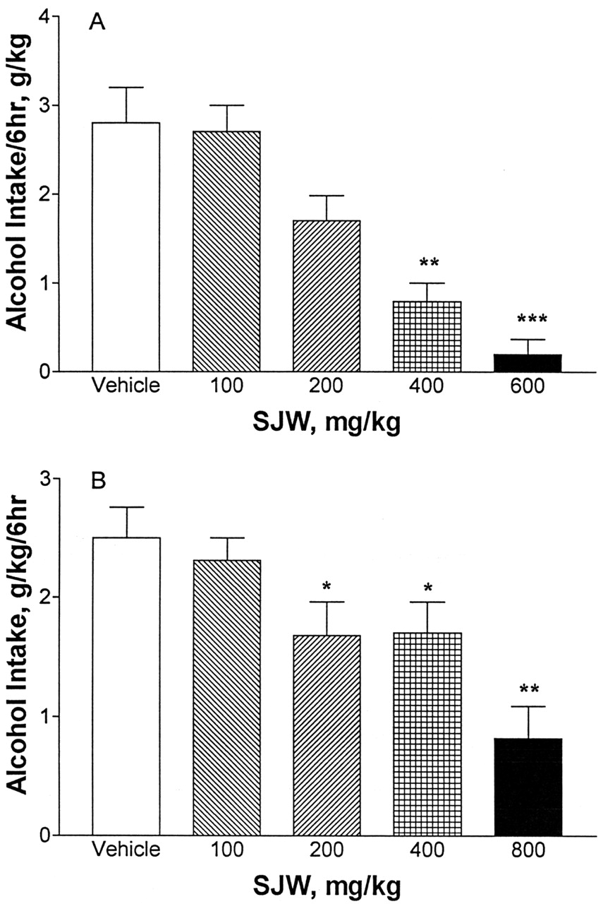
Fig. 1. Effects of acute oral administration of vehicle and different doses of St John's wort (SJW) extract on the ...
Notes:
Fig. 1. Effects of acute oral administration of vehicle and different doses of St John's wort (SJW) extract on the 6-h intake of 10% (v/v) alcohol in high-alcohol drinking (HAD) and fawn-hooded (FH) rats. Data are means ± SEM [n = 8 for HAD (A) and 8–10 for FH (B) rats]. F(4,36) = 9.0, P < 0.0001 for FH rats and F(4, 28) = 18, P < 0.0001 for HAD rats. *P < 0.05, **P < 0.01 vs vehicle.
Unless provided in the caption above, the following copyright applies to the content of this slide: © 1999 Medical Council on Alcoholism

Slide 2
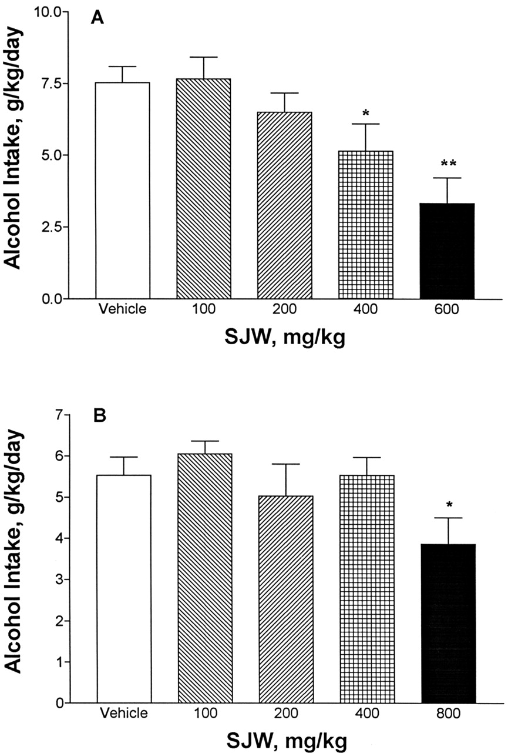
Fig. 2. Effects of acute oral administration of vehicle and different doses of St John's wort (SJW) extract on the ...
Notes:
Fig. 2. Effects of acute oral administration of vehicle and different doses of St John's wort (SJW) extract on the daily intake of 10% (v/v) alcohol in high-alcohol drinking (HAD) and fawn-hooded (FH) rats. Data are means ± SEM [n = 8 for HAD (A) and 8–10 for FH (B) rats]. F(4,28) = 7, P < 0.0005 for HAD rats and F(4,36) = 2.7, P < 0.04 for FH rats. *P < 0.05, **P < 0.02, vs vehicle.
Unless provided in the caption above, the following copyright applies to the content of this slide: © 1999 Medical Council on Alcoholism

Slide 3
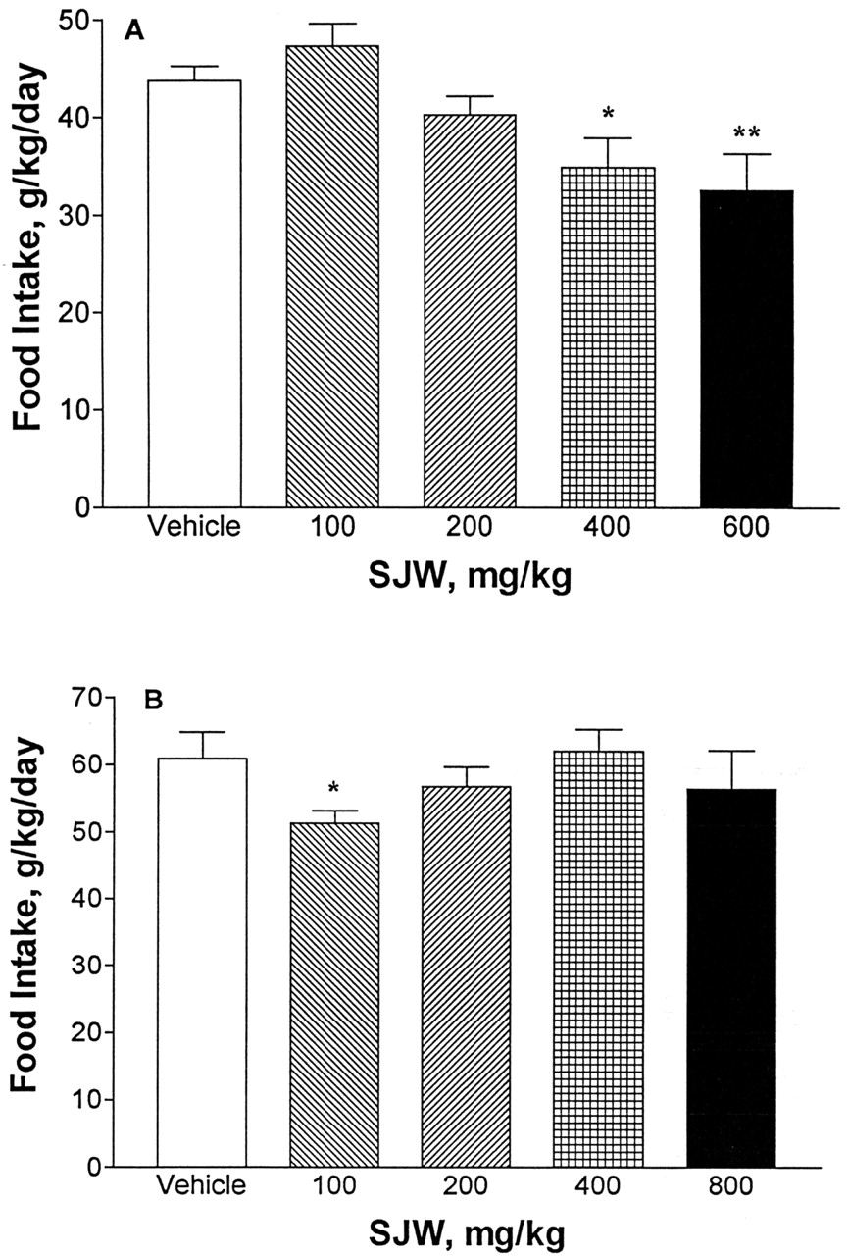
Fig. 3. Effects of acute oral administration of vehicle and different doses of St John's wort (SJW) extract on the ...
Notes:
Fig. 3. Effects of acute oral administration of vehicle and different doses of St John's wort (SJW) extract on the daily food intake in high-alcohol drinking (HAD) and fawn-hooded (FH) rats. Data are means ± SEM [n = 9 for FH (B) and 8 for HAD (A) rats]. F(4,36) = 1.76, P = 0.15 for FH rats and F(4,28) = 6.0, P < 0.001 for HAD rats. *P < 0.05, **P < 0.01, vs vehicle.
Unless provided in the caption above, the following copyright applies to the content of this slide: © 1999 Medical Council on Alcoholism

Slide 4
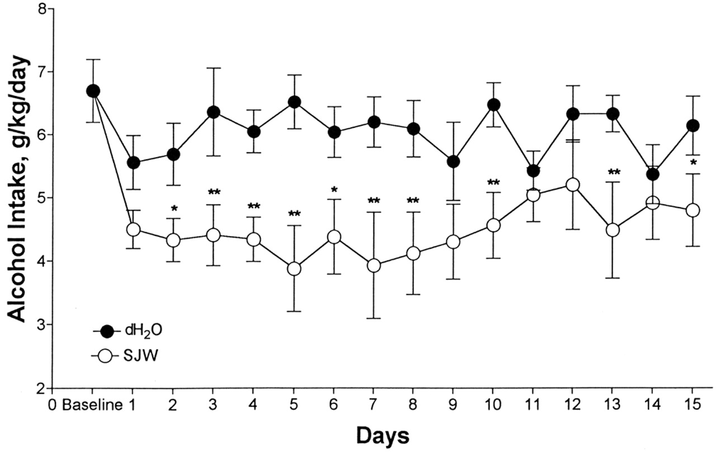
Fig. 4. Effects of repeated oral administration of St John's wort (SJW) extract on daily alcohol intake in ...
Notes:
Fig. 4. Effects of repeated oral administration of St John's wort (SJW) extract on daily alcohol intake in fawn-hooded rats. SJW extract (400 mg/kg) or vehicle was administered once daily for 15 consecutive days by gavage. Data are means ± SEM (n = 9). F(1,17) = 16.2, P = 0.001. *P < 0.05, **P < 0.01 vs vehicle.
Unless provided in the caption above, the following copyright applies to the content of this slide: © 1999 Medical Council on Alcoholism

Slide 5
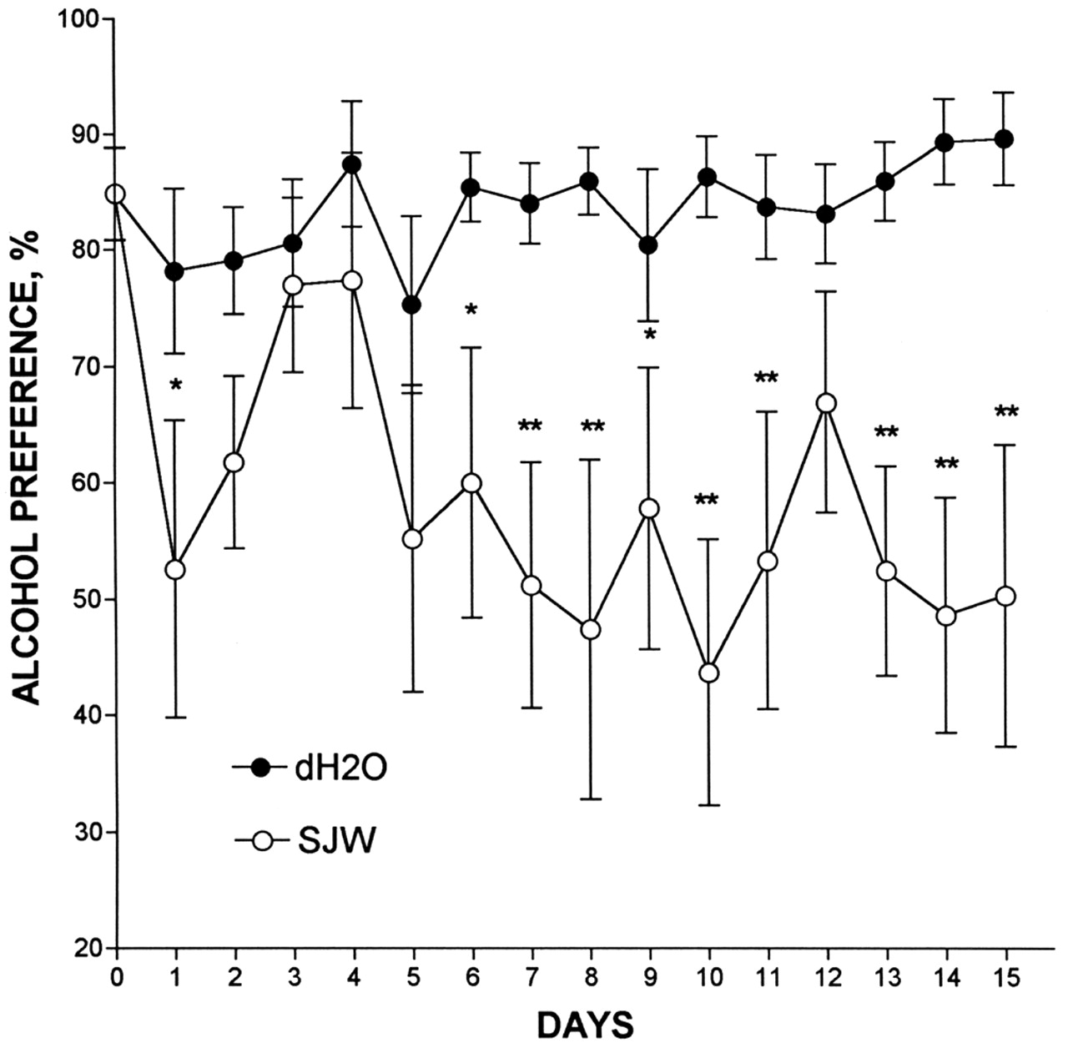
Fig. 5. Effects of repeated oral administration of St John's wort (SJW) extract on alcohol preference at 6 h in ...
Notes:
Fig. 5. Effects of repeated oral administration of St John's wort (SJW) extract on alcohol preference at 6 h in fawn-hooded rats. Details are as described in Fig. 4. Data are means ± SEM (n = 9). F(1,17) = 2.7, P = 0.0002. *P < 0.05, **P < 0.01.
Unless provided in the caption above, the following copyright applies to the content of this slide: © 1999 Medical Council on Alcoholism

