Slide 1
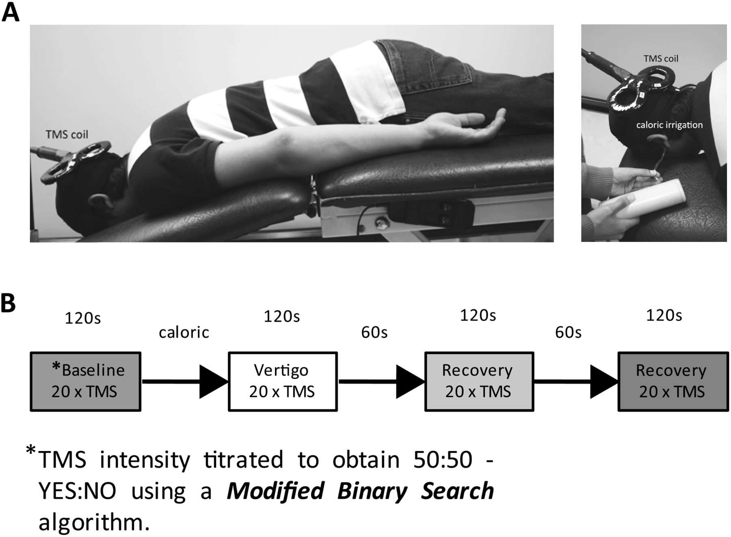
Figure 1. Apparatus and experimental protocol. (A) Apparatus. Subjects lay prone to facilitate TMS access to the ...
Notes:
Figure 1. Apparatus and experimental protocol. (A) Apparatus. Subjects lay prone to facilitate TMS access to the occiput. The subjects placed their face in an aperture that allowed free breathing and comfortable placement of a blindfold. This configuration also meant that the subject's head was stabilized within the aperture and thus restricted any head movement as a consequence of the elicited vestibular-colic response. The figure also shows the water irrigation tube inserted into the external auditory meatus. The water outflow was captured by a semirigid channel that sat below the pinna. The water-capture channel and coil holder are not shown for clarity. (B) Protocol. A single experimental RUN, consisting of 4 phases, is shown schematically. Each volunteer was subject to 4 RUNS. The entire experiment was conducted in low ambient light and with the subjects' eyes blindfolded. Phosphene threshold in terms of percentage of maximal TMS stimulator output was obtained prior to each “run” using a modified binary staircase algorithm (Mobs—Tyrell and Owens 1988). The average TMS threshold intensity obtained from 2 Mobs trials was then used for obtaining baseline responses (i.e., no vestibular activation) during which 20 TMS pulses were applied at threshold level at 6 s intervals. “Subjects' report of phosphene presence”—subjects were instructed to answer “yes” or “no” according to whether they perceived a phosphene immediately after each TMS pulse. The Mobs thresholding was repeated if the number of “yes” responses did not fall between the range 8–12 (inclusive) for 20 TMS pulses during the baseline. The TMS intensity was then kept constant for a given run. On average, each run took 20 min (including Mobs thresholding), with each run followed by a 10 min break. All subjects had both hemispheres and both ears irrigated (4 runs). The order of the ear/hemisphere sequence was balanced across 12 subjects. “Subjects' phosphene SIZE and INTENSITY reporting”—after every successful baseline sequence (of 20 TMS pulses), subjects were told to apply a subjective average rating of 3/5 for phosphene size and intensity elicited during the baseline. Immediately following each of the postbaseline phases, each with 20 TMS pulses (i.e., vestibular activation and 2 recovery phases), subjects were asked to rate phosphene size and intensity out of 5 as compared with the baseline rating of 3/5. This rating was updated for each new baseline for each of the 4 “runs.” Consistent with the literature, V1 phosphenes tended to be small and point like lying near or across the midline. In contrast, V5/MT phosphenes were usually large, for example, pizza wedges, and peripheral.
Unless provided in the caption above, the following copyright applies to the content of this slide: © The Authors 2012. Published by Oxford University Press.This is an Open Access article distributed under the terms of the Creative Commons Attribution Non-Commercial License (http://creativecommons.org/licenses/by-nc/3.0), which permits unrestricted non-commercial use, distribution, and reproduction in any medium, provided the original work is properly cited.

Slide 2
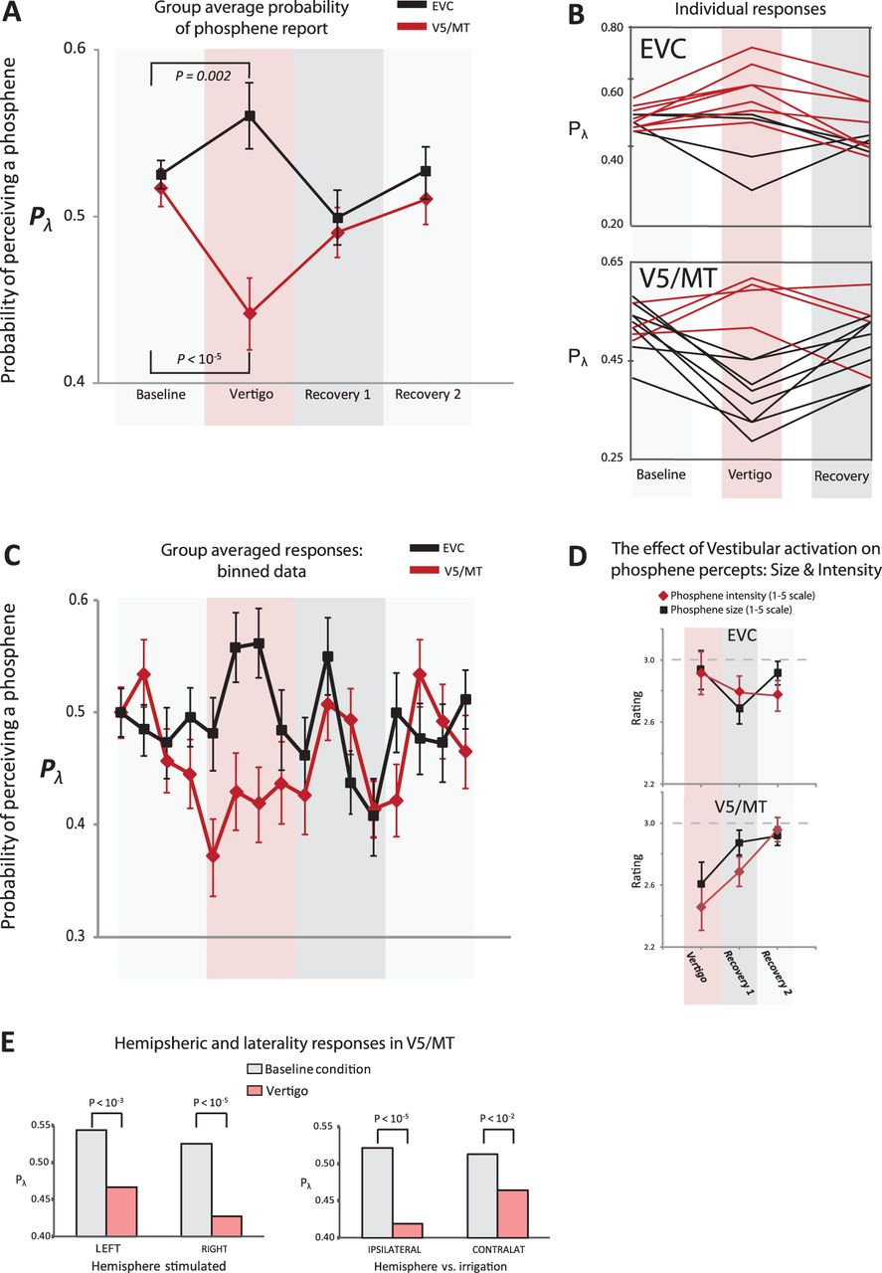
Figure 2. The effect of vestibular activation on perceiving phosphenes. (A) The group effect of vestibular activation ...
Notes:
Figure 2. The effect of vestibular activation on perceiving phosphenes. (A) The group effect of vestibular activation (via caloric irrigation) on EVC (black) and V5/MT (red). The probability of perceiving a phosphene (Pλ) was assessed during vestibular activation. Note that Pλ for baseline was purposefully titrated close to 0.5. The standard errors were obtained by taking the average of the probability scores for each subject for all of the phases (n = 12). Significance compared with baseline was assessed via the binomial test corrected for multiple comparisons (Bonferroni corrected significance of P < 0.016). (B) The panels show individual Pλ responses (baseline and vestibular activation) for EVC and V5 (as labeled). Here, red lines show increases and black lines decreases, in Pλ. (C) The time course of the effect of vestibular activation on Pλ (group data) for EVC (black) and V5 (red). The binary data (yes/no) was binned to produce yes probability scores (±1 standard error) for every 5 TMS pulses (viz. each score was out of 5). To aid comparison between EVC and V5 responses over time, the displayed probability for the first bin (at baseline) was normalized to a score of 0.5 for both EVC and V5. (D) Vestibular activation systematically reduced SIZE and INTENSITY of reported phosphenes at V5/MT but not EVC. (E) The left panel shows the effects of vestibular activation (pink bars) versus baseline (gray) for left and right hemispheres (labeled) irrespective of side of caloric irrigation. Although both hemispheres showed an effect, there was a more prominent inhibitory effect observed for right V5 phosphenes. A more prominent inhibitory effect was also noted for the ipsilateral condition (i.e. right hemisphere and right caloric irrigation or left hemisphere and left caloric irrigation) compared to the contralateral condition.
Unless provided in the caption above, the following copyright applies to the content of this slide: © The Authors 2012. Published by Oxford University Press.This is an Open Access article distributed under the terms of the Creative Commons Attribution Non-Commercial License (http://creativecommons.org/licenses/by-nc/3.0), which permits unrestricted non-commercial use, distribution, and reproduction in any medium, provided the original work is properly cited.

Slide 3
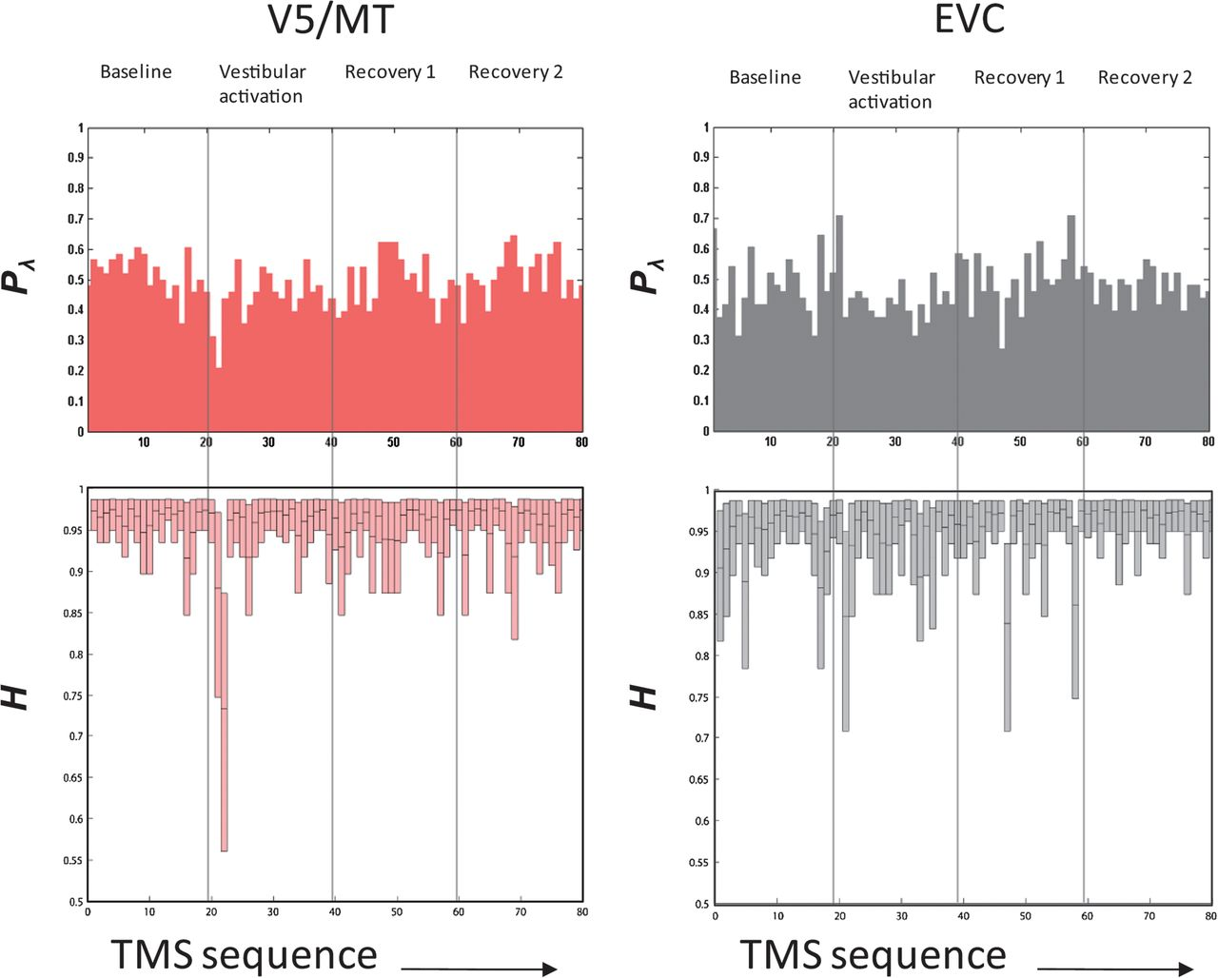
Figure 3. Response entropy. The 4 panels (V5/MT on the left and EVC on the right) relate to response data pooled from ...
Notes:
Figure 3. Response entropy. The 4 panels (V5/MT on the left and EVC on the right) relate to response data pooled from the subjects for each TMS stimulus in a run and ordered in the sequence of presentation; that is, each run consisted of 4 phases and 20 stimuli/phase so there were 80 TMS pulses per run (x-axis of panels = 1–80). The top panels show the pooled Pλ (probability of seeing a phosphene), and the bottom panels show information entropy (H). For V5/MT, the baseline entropy is stable but a clear decline in H occurs with vestibular activation. In contrast, for EVC, the moderate decline in H with vestibular activation is comparable to the entropy spikes that seem to occur spontaneously throughout the record.
Unless provided in the caption above, the following copyright applies to the content of this slide: © The Authors 2012. Published by Oxford University Press.This is an Open Access article distributed under the terms of the Creative Commons Attribution Non-Commercial License (http://creativecommons.org/licenses/by-nc/3.0), which permits unrestricted non-commercial use, distribution, and reproduction in any medium, provided the original work is properly cited.

