Slide 1
Figure 1. Atlas-based temporal coherence analysis. Interregional correlation matrices (Fisher z-transformed) for (a) ...
Notes:
Figure 1. Atlas-based temporal coherence analysis. Interregional correlation matrices (Fisher z-transformed) for (a) controls (n = 20) and (b) autism subjects (n = 19). The correlation matrix can be divided into conventional connection families as shown in (c). Both group matrices show essentially identical patterns of correlation, reflected in the low residuals of the difference matrix. Strong homotopic correlations are evident in both cortical and subcortical sub-matrices. No individual pair-wise comparisons survived FDR control (q = 0.05). Note that these matrices are upper triangle symmetric. (a and b) are shown with identical scale limits. The row ordering within each hemisphere for the correlation matrices follows the surface-lobe hierarchy of the Harvard-Oxford atlas. Non-gray matter regions (white matter, CSF) and the brain stem are excluded from the subcortical regions.
Unless provided in the caption above, the following copyright applies to the content of this slide: © The Author 2013. Published by Oxford University Press. All rights reserved. For Permissions, please e-mail: journals.permissions@oup.com

Slide 2
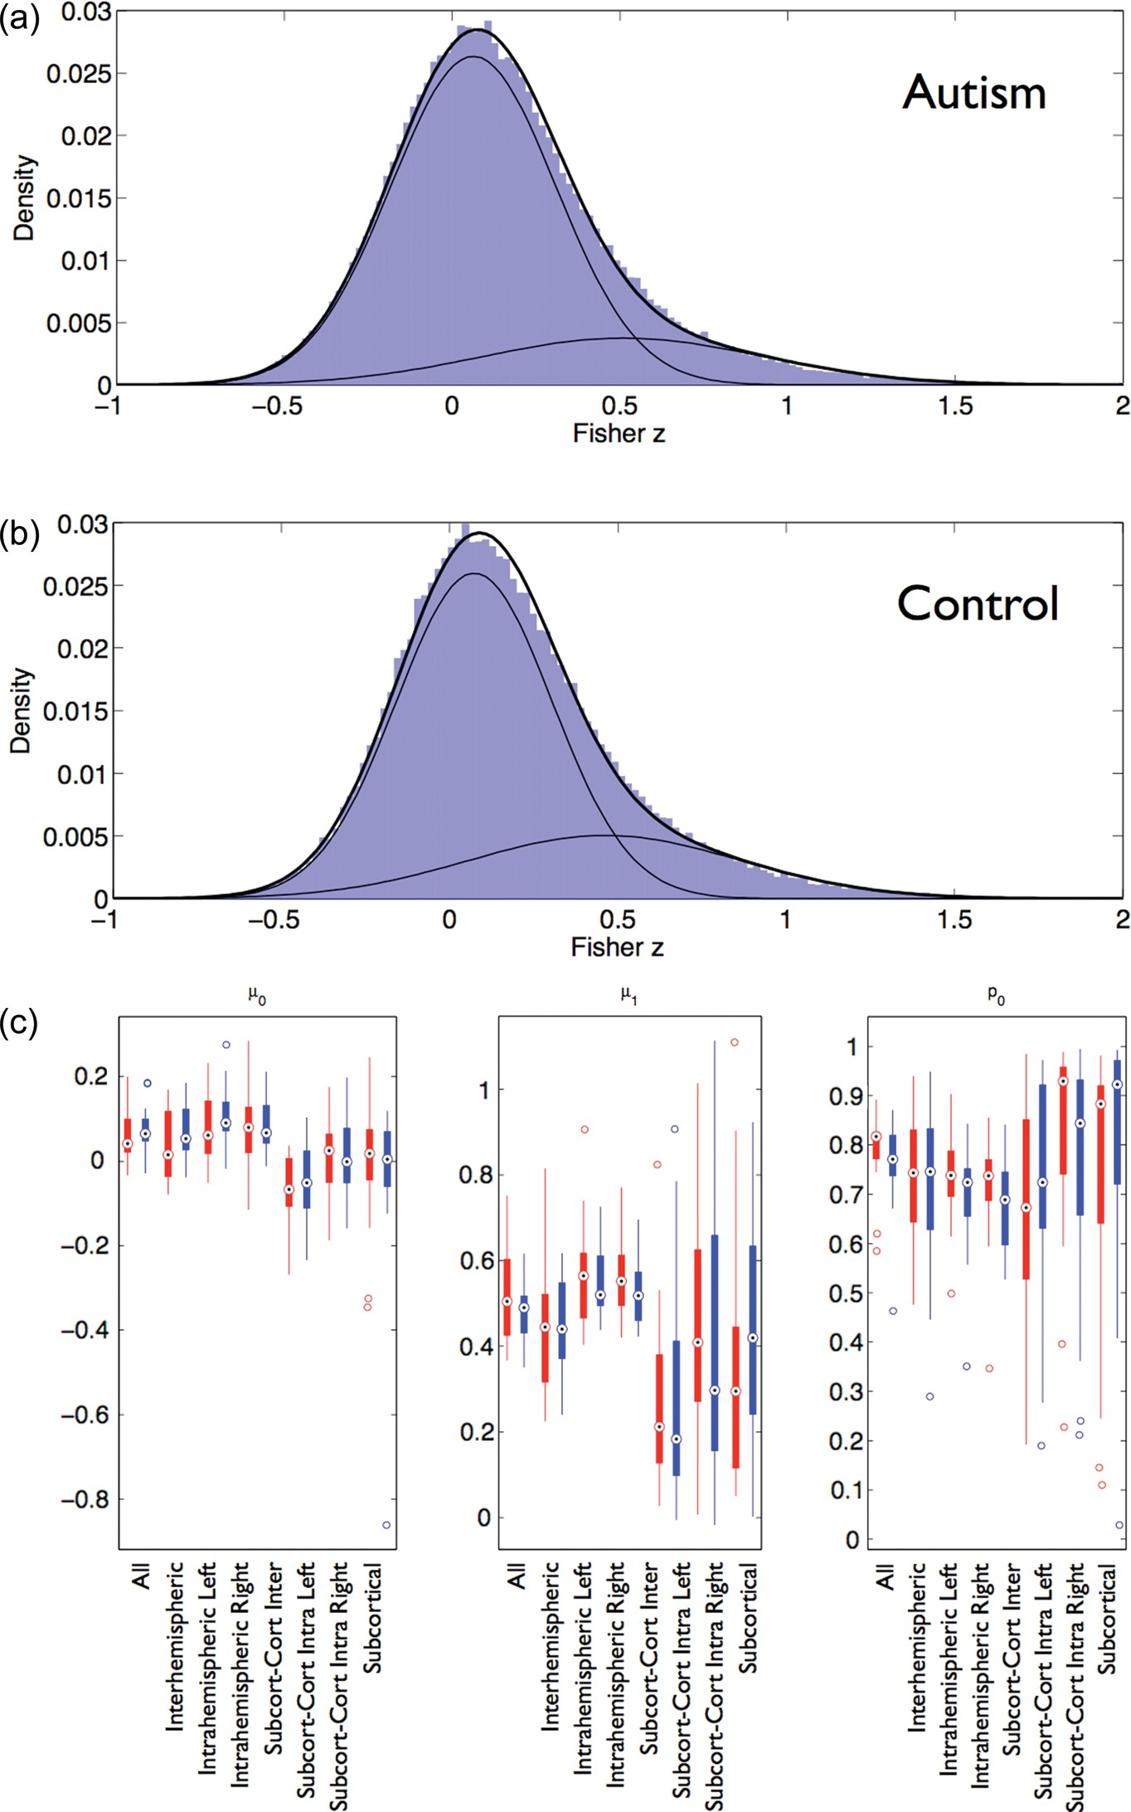
Figure 2. Two-component Gaussian mixture modeling example for all correlation matrix elements in (a) the control and ...
Notes:
Figure 2. Two-component Gaussian mixture modeling example for all correlation matrix elements in (a) the control and (b) autism groups. (c) Comparison of mixture model means (μ0, μ1) and proportion (p0) between autism (red) and controls (blue). No group differences survived FDR control (q = 0.05).
Unless provided in the caption above, the following copyright applies to the content of this slide: © The Author 2013. Published by Oxford University Press. All rights reserved. For Permissions, please e-mail: journals.permissions@oup.com

Slide 3
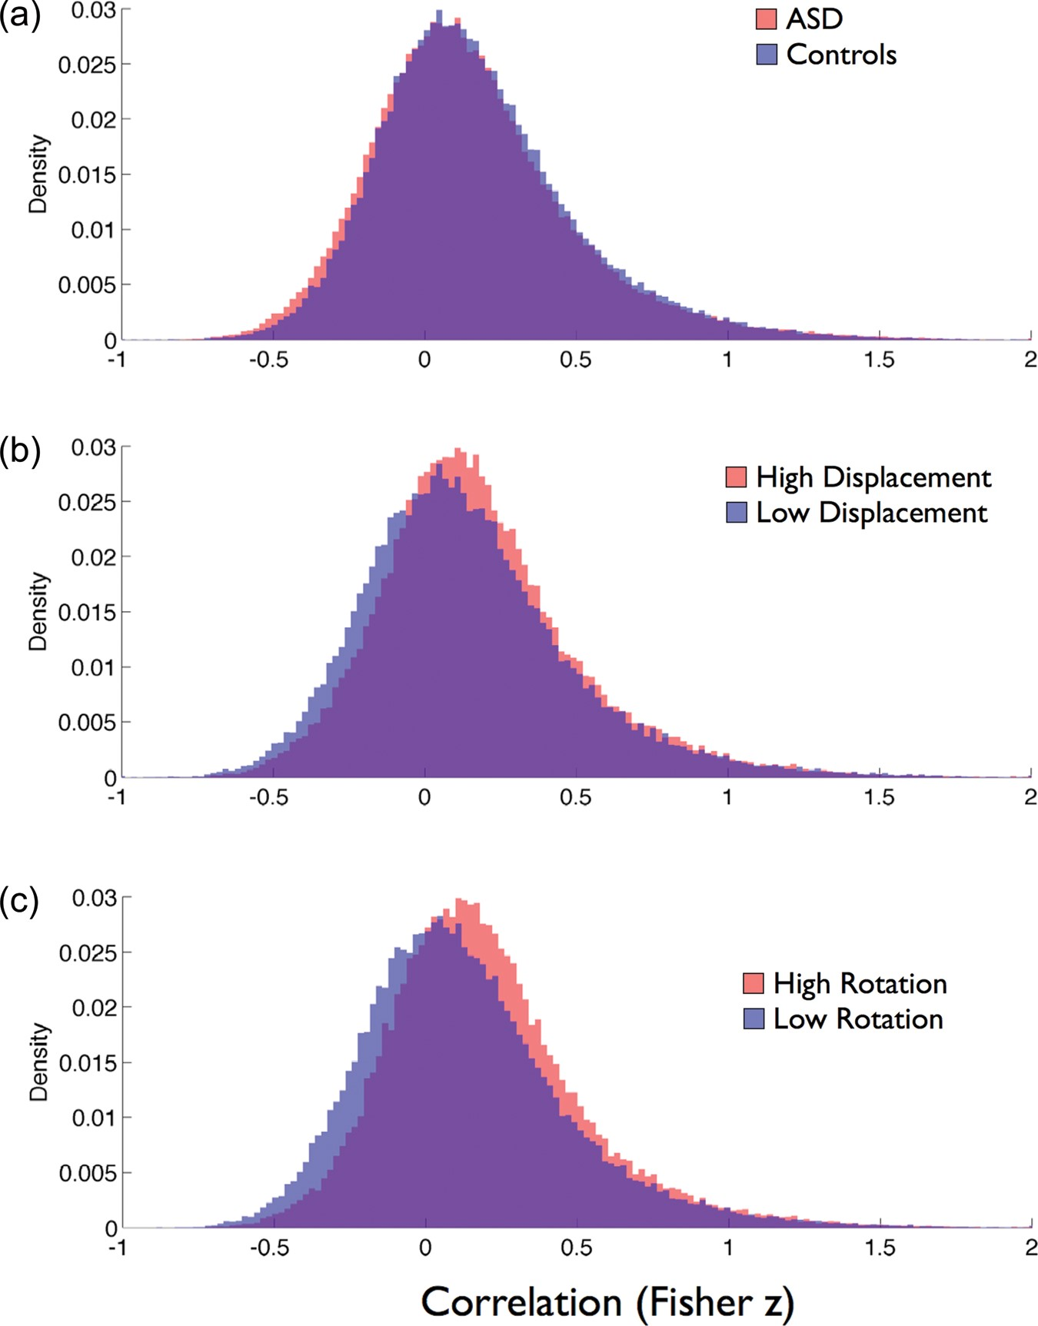
Figure 3. Normalized histograms of all correlations for (a) autism (red) versus controls (blue), (b) high (red) versus ...
Notes:
Figure 3. Normalized histograms of all correlations for (a) autism (red) versus controls (blue), (b) high (red) versus low (blue) translational motion groups and (c) high (red) and low (blue) angular motion groups. An equal number of autism and control subjects were included in each of the motion groups.
Unless provided in the caption above, the following copyright applies to the content of this slide: © The Author 2013. Published by Oxford University Press. All rights reserved. For Permissions, please e-mail: journals.permissions@oup.com

Slide 4
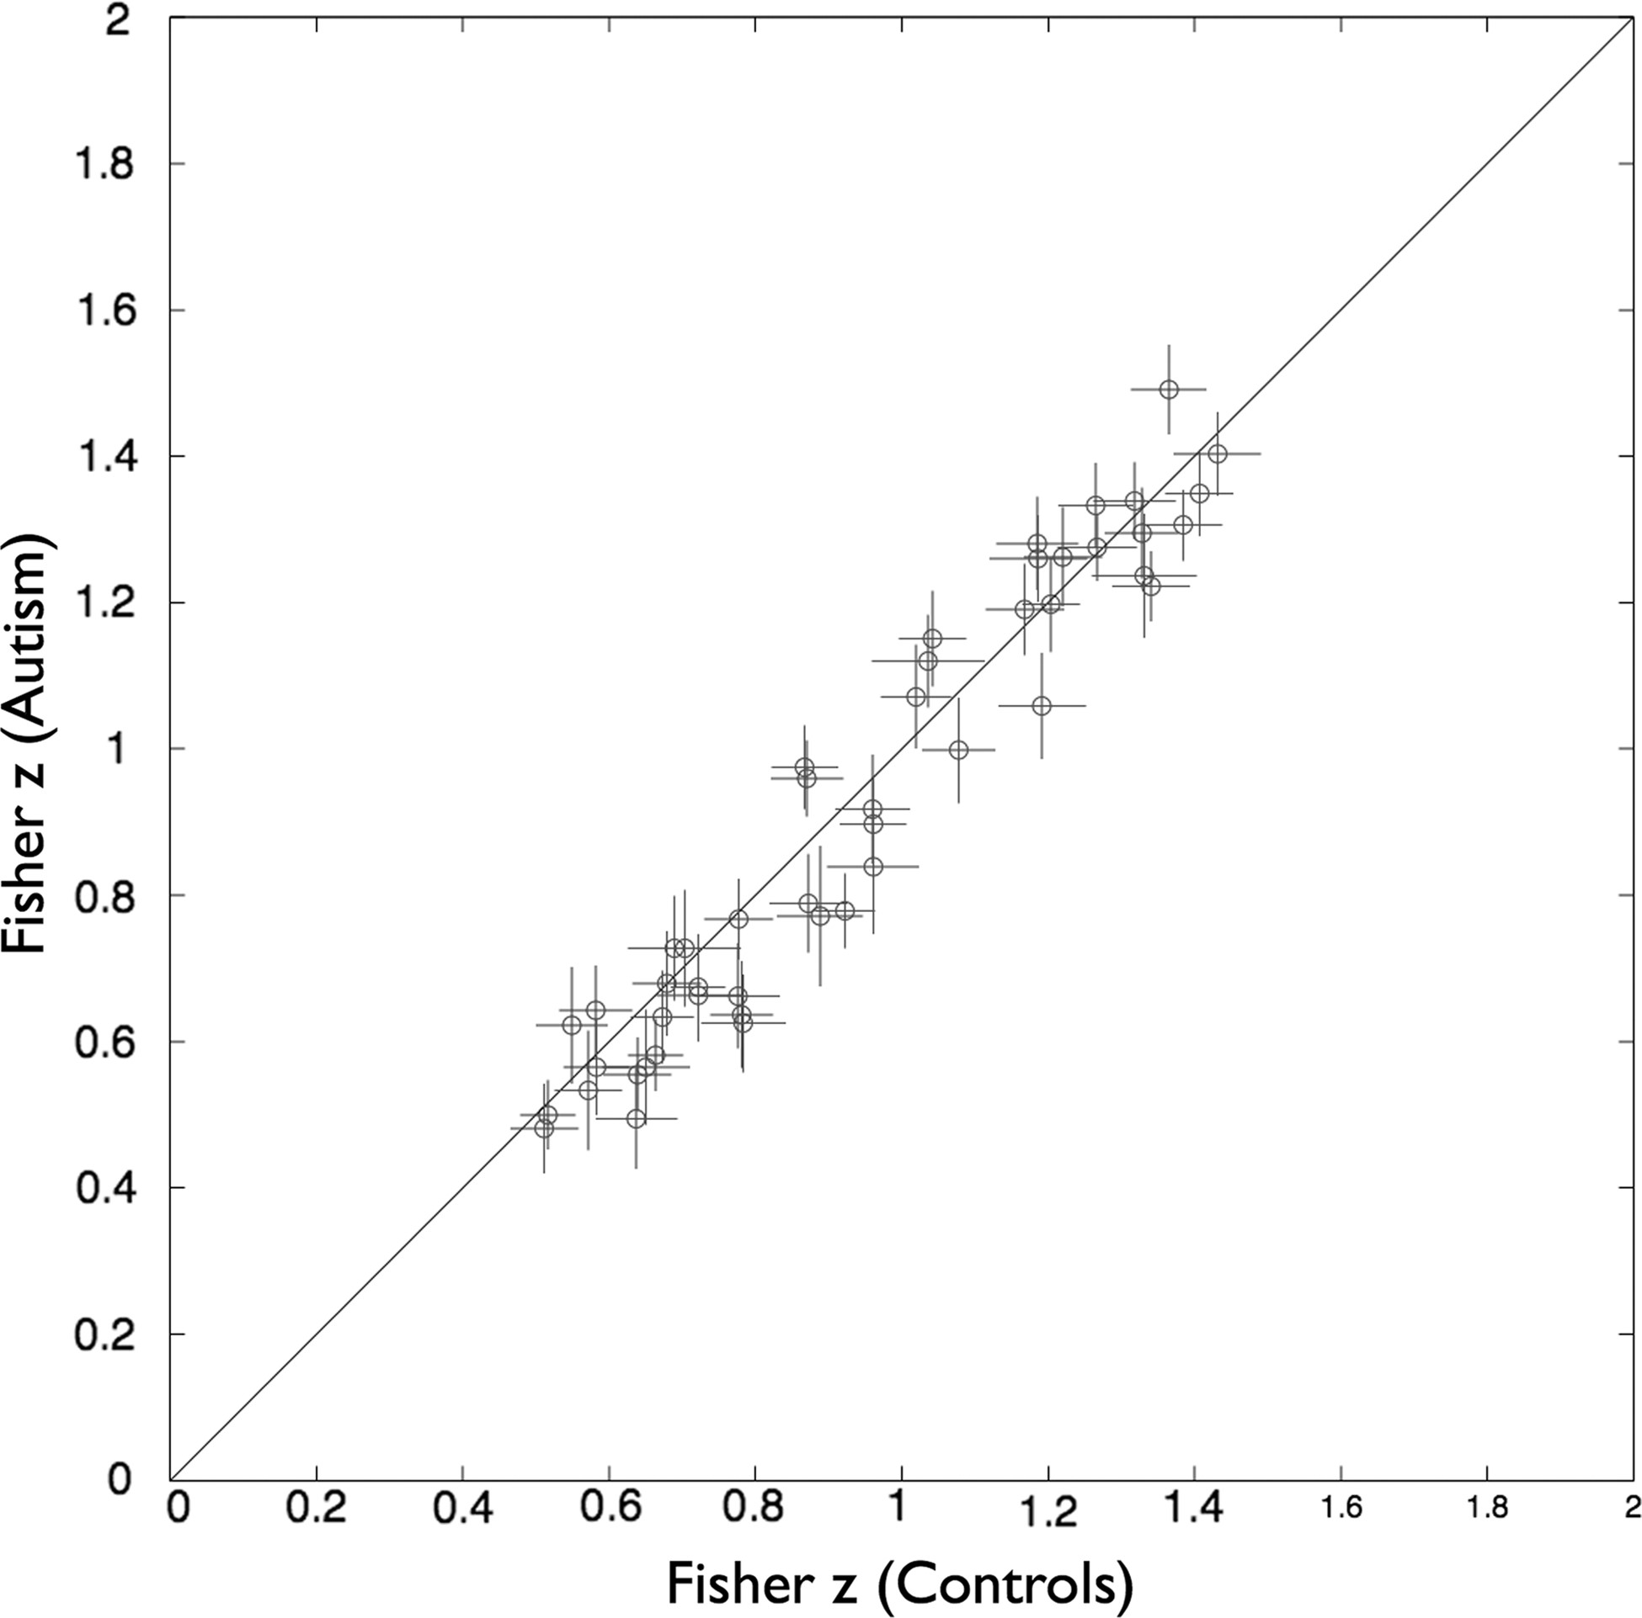
Figure 4. Scatterplot of homotopic z-transformed correlations for control and autism groups across all 48 regions. No ...
Notes:
Figure 4. Scatterplot of homotopic z-transformed correlations for control and autism groups across all 48 regions. No significant between-group differences were observed following correction for multiple comparisons. Crosses indicate standard errors of the means for each group (control horizontal, autism vertical).
Unless provided in the caption above, the following copyright applies to the content of this slide: © The Author 2013. Published by Oxford University Press. All rights reserved. For Permissions, please e-mail: journals.permissions@oup.com

Slide 5
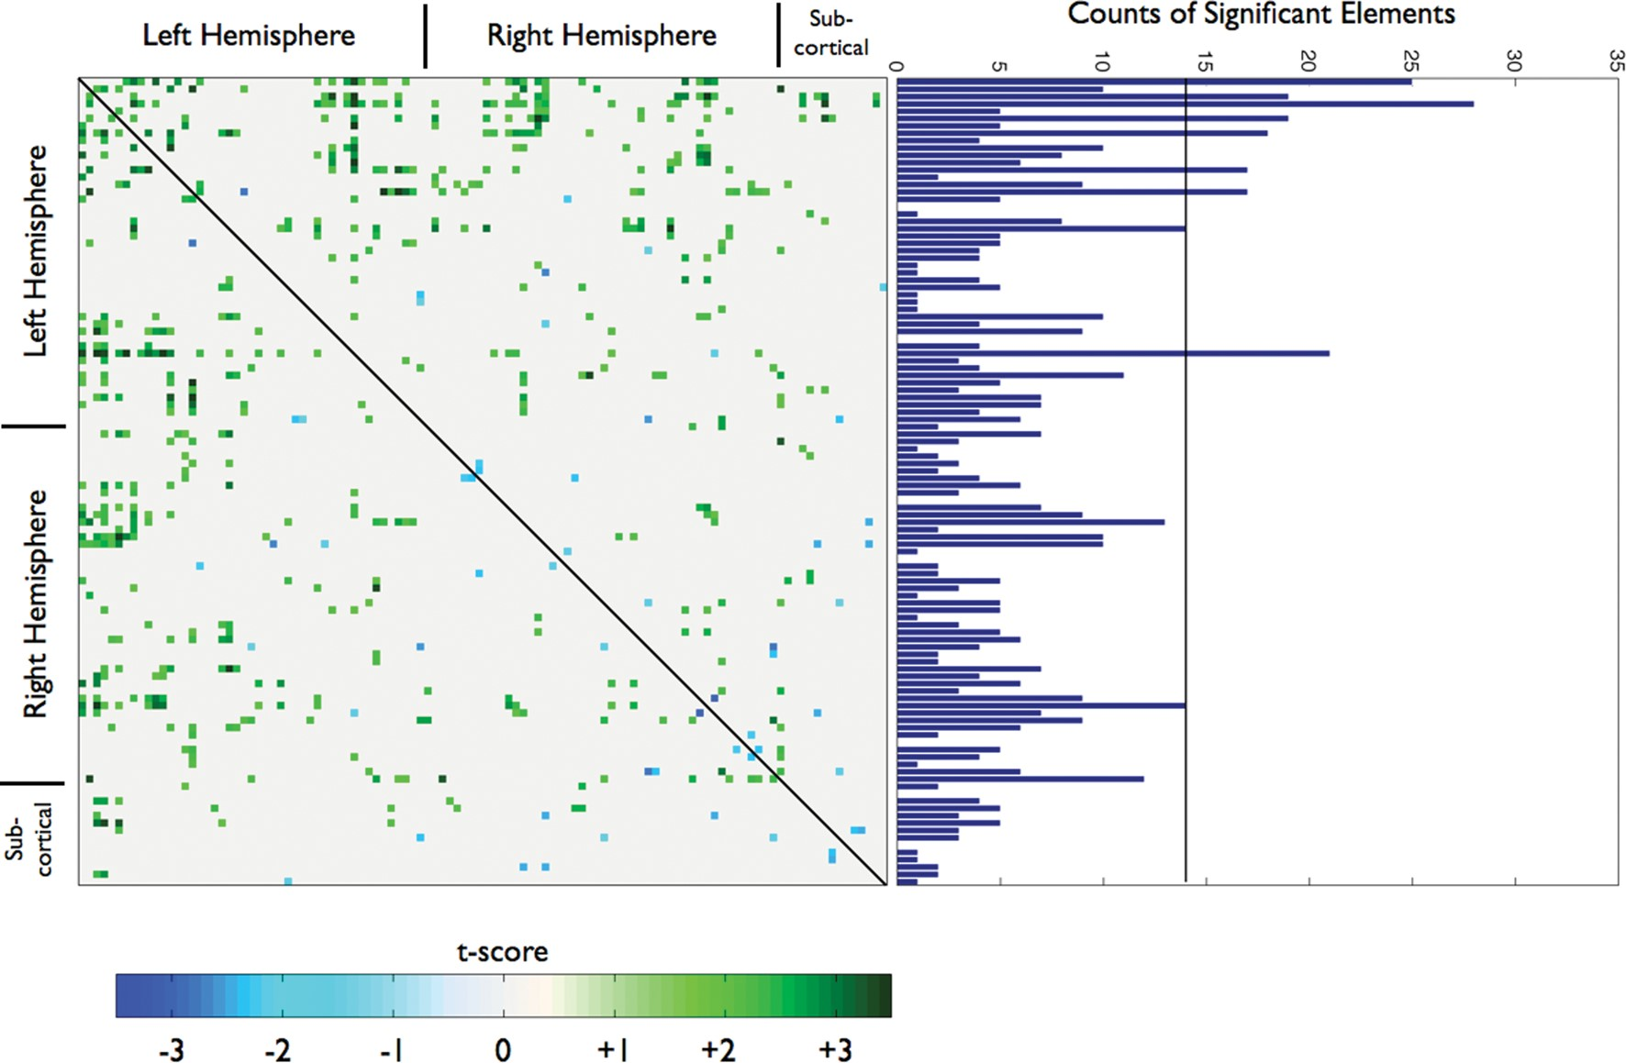
Figure 5. Thresholded t-map of regions that have significantly different pair-wise correlation between autism and ...
Notes:
Figure 5. Thresholded t-map of regions that have significantly different pair-wise correlation between autism and control groups. The threshold is P autism and blue indicating autism > controls. The graph at right shows the total count of significantly positive group differences (control > autism) in each row of the correlation matrix. A region is identified as abnormal if the number of significantly different pair-wise correlations exceeds a Bonferroni-corrected threshold of 14 (P control) in each row were observed.
Unless provided in the caption above, the following copyright applies to the content of this slide: © The Author 2013. Published by Oxford University Press. All rights reserved. For Permissions, please e-mail: journals.permissions@oup.com

Slide 6
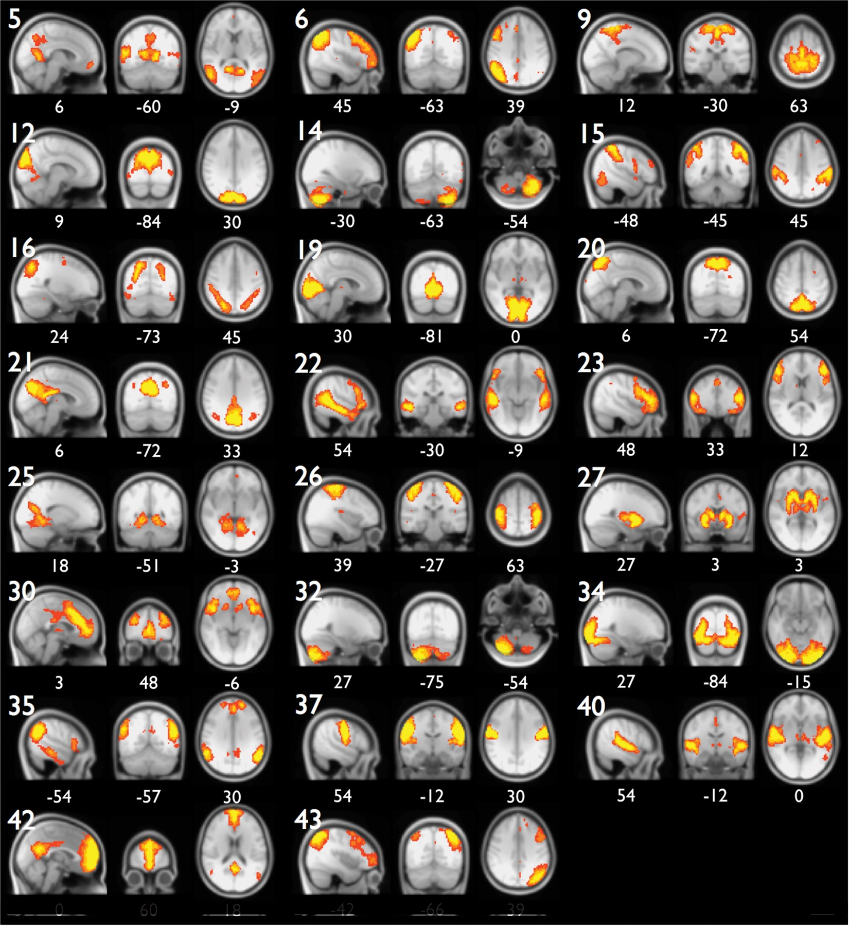
Figure 6. Spatial modes of the grand ICA over all subjects rank ordered by explained variance. Only neuronal ICs are ...
Notes:
Figure 6. Spatial modes of the grand ICA over all subjects rank ordered by explained variance. Only neuronal ICs are shown for clarity. Tentative assignments for each spatial mode are listed in Table 2. MNI slice coordinates in mm are indicated below each image; sagittal slices with negative coordinates are within the left hemisphere.
Unless provided in the caption above, the following copyright applies to the content of this slide: © The Author 2013. Published by Oxford University Press. All rights reserved. For Permissions, please e-mail: journals.permissions@oup.com

Slide 7
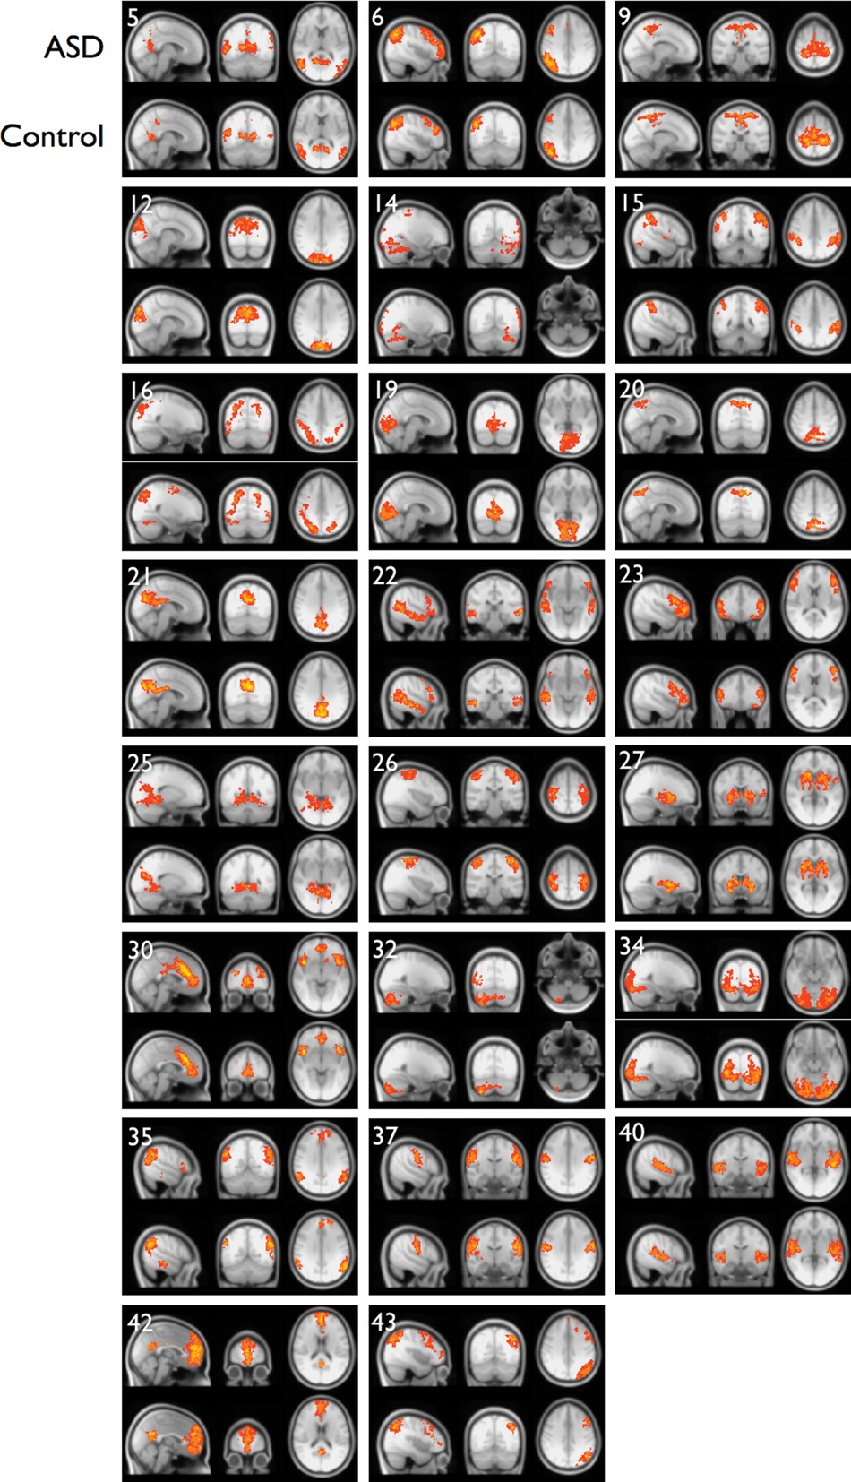
Figure 7. Group mean spatial maps for dual-regression of the 23 grand ICs to individual subjects demonstrating the ...
Notes:
Figure 7. Group mean spatial maps for dual-regression of the 23 grand ICs to individual subjects demonstrating the between-group similarities. No meaningful between-group differences were observed for any grand IC. Slice locations for each IC are identical to those in Figure 6.
Unless provided in the caption above, the following copyright applies to the content of this slide: © The Author 2013. Published by Oxford University Press. All rights reserved. For Permissions, please e-mail: journals.permissions@oup.com

