Slide 1
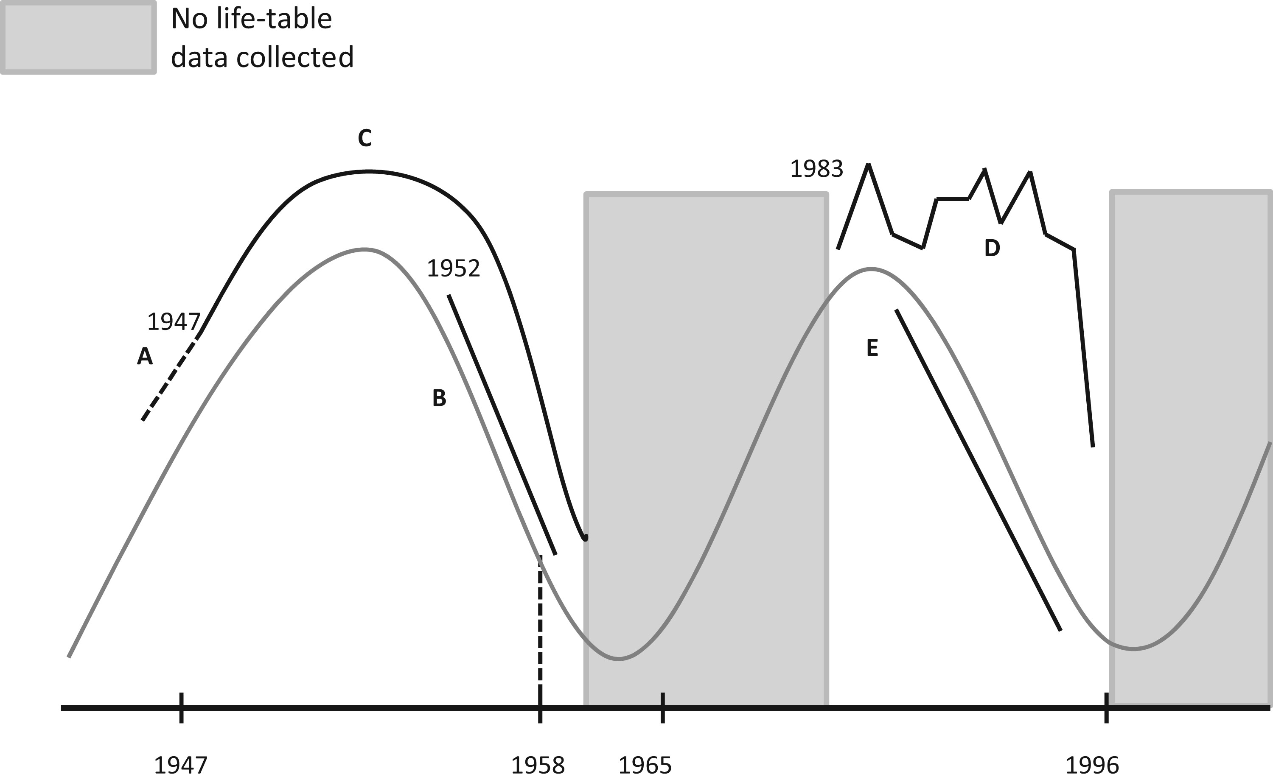
Fig. 1. General trend in spruce budworm density (light line), expressed on a log scale, and timeline of spruce ...
Notes:
Fig. 1. General trend in spruce budworm density (light line), expressed on a log scale, and timeline of spruce budworm research (dark lines) conducted during the last two spruce budworm outbreaks. A, B, and C: Data from Green River study (Morris 1963a). A: Indirect estimates from 1945 and 1946 of eggs and pupae (this study measured only old larvae and therefore had no estimates of stage-specific mortality). B: K1 and K2 plots. C: G4 and G5 plots (Royama 1984). D: Black Sturgeon Lake (Nealis and Régnière 2004a,b). E: New Brunswick studies (Eveleigh et al. 2007, Royama et al. 2005). Black Sturgeon Lake is considerably west of all other study areas, near the Ontario-Manitoba border.
Unless provided in the caption above, the following copyright applies to the content of this slide: © The Authors 2016. Published by Oxford University Press on behalf of Entomological Society of America. All rights reserved. For Permissions, please email: journals.permissions@oup.com

Slide 2
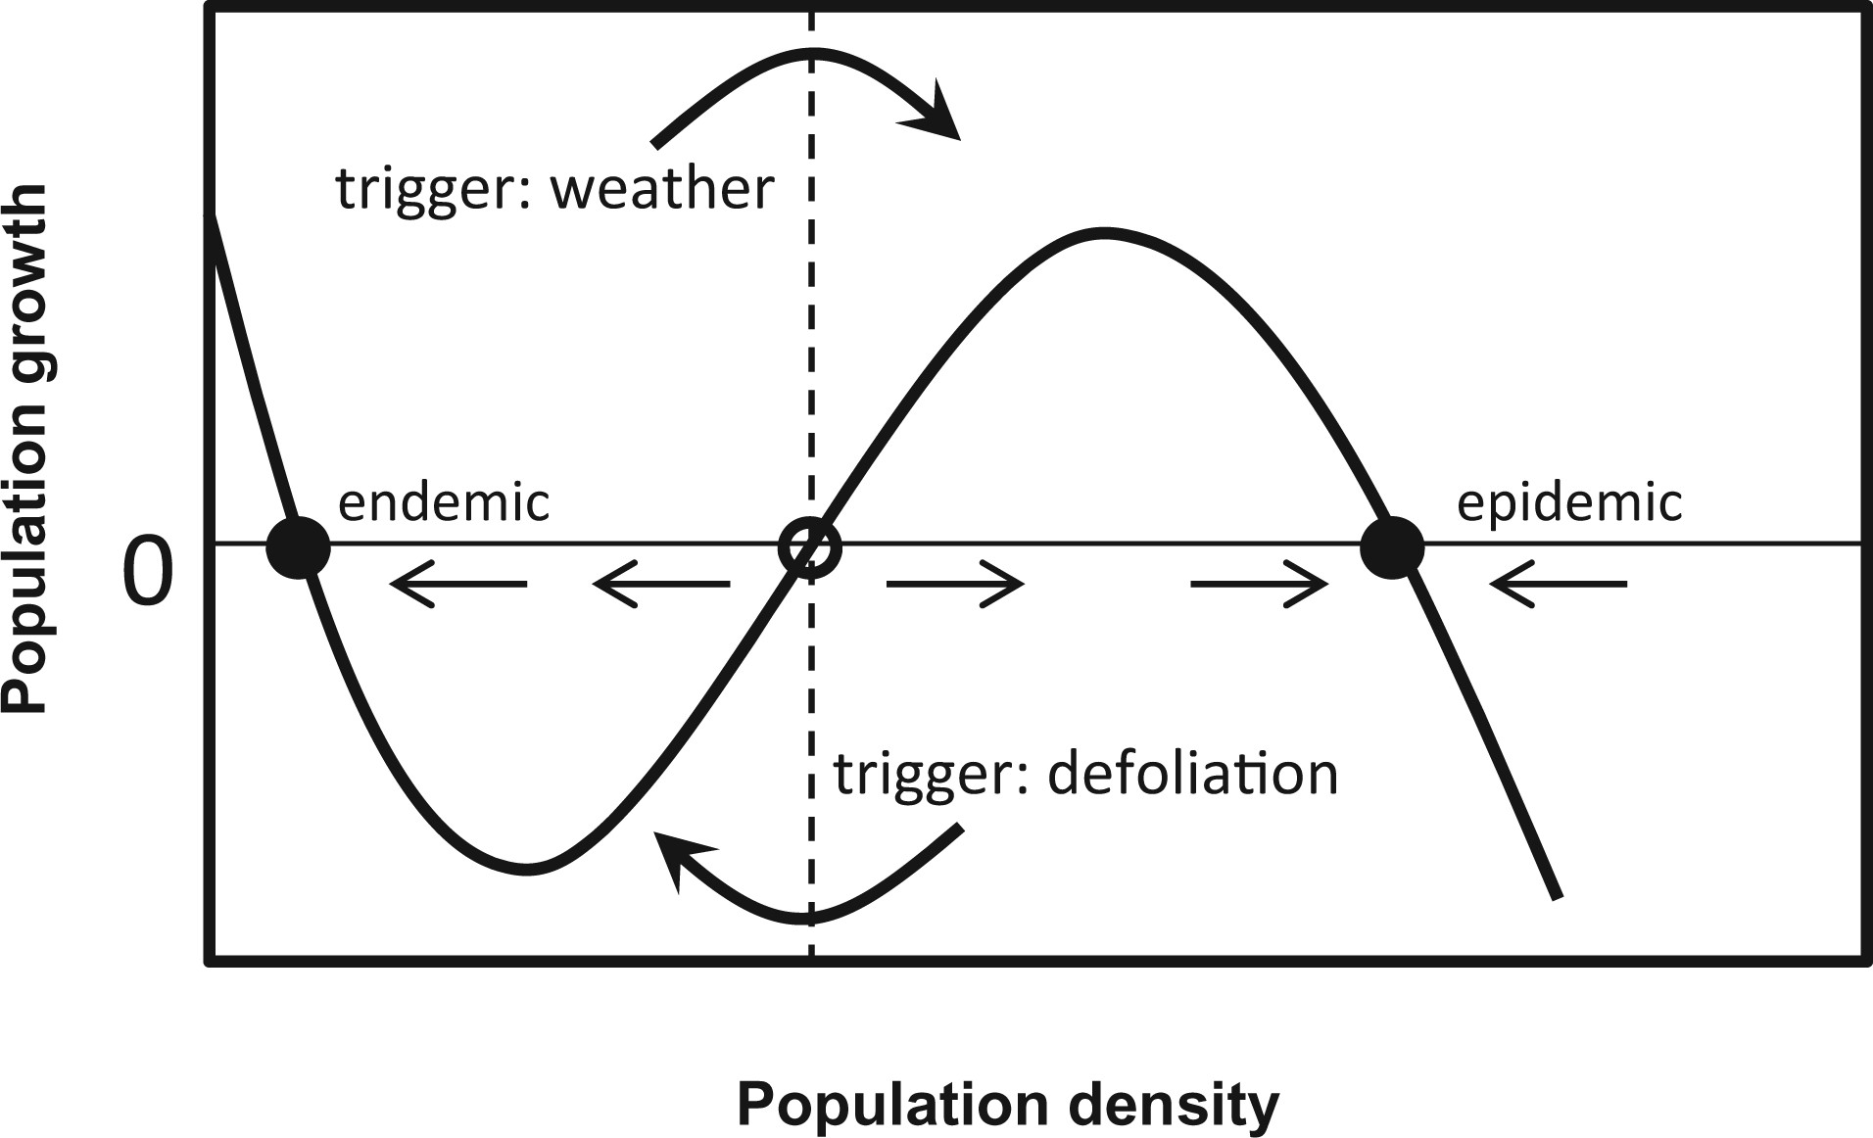
Fig. 2. Population dynamics under the Multiple Equilibria Hypothesis. Dots indicate equilibrium points: the hollow ...
Notes:
Fig. 2. Population dynamics under the Multiple Equilibria Hypothesis. Dots indicate equilibrium points: the hollow dot is an unstable equilibrium, while the others are locally stable. Straight arrows indicate expected population growth, and the dashed line divides the basins of attraction for the two equilibria. Curved arrows indicate triggers that take the system across the dashed line and thus from one equilibrium to the other.
Unless provided in the caption above, the following copyright applies to the content of this slide: © The Authors 2016. Published by Oxford University Press on behalf of Entomological Society of America. All rights reserved. For Permissions, please email: journals.permissions@oup.com

Slide 3
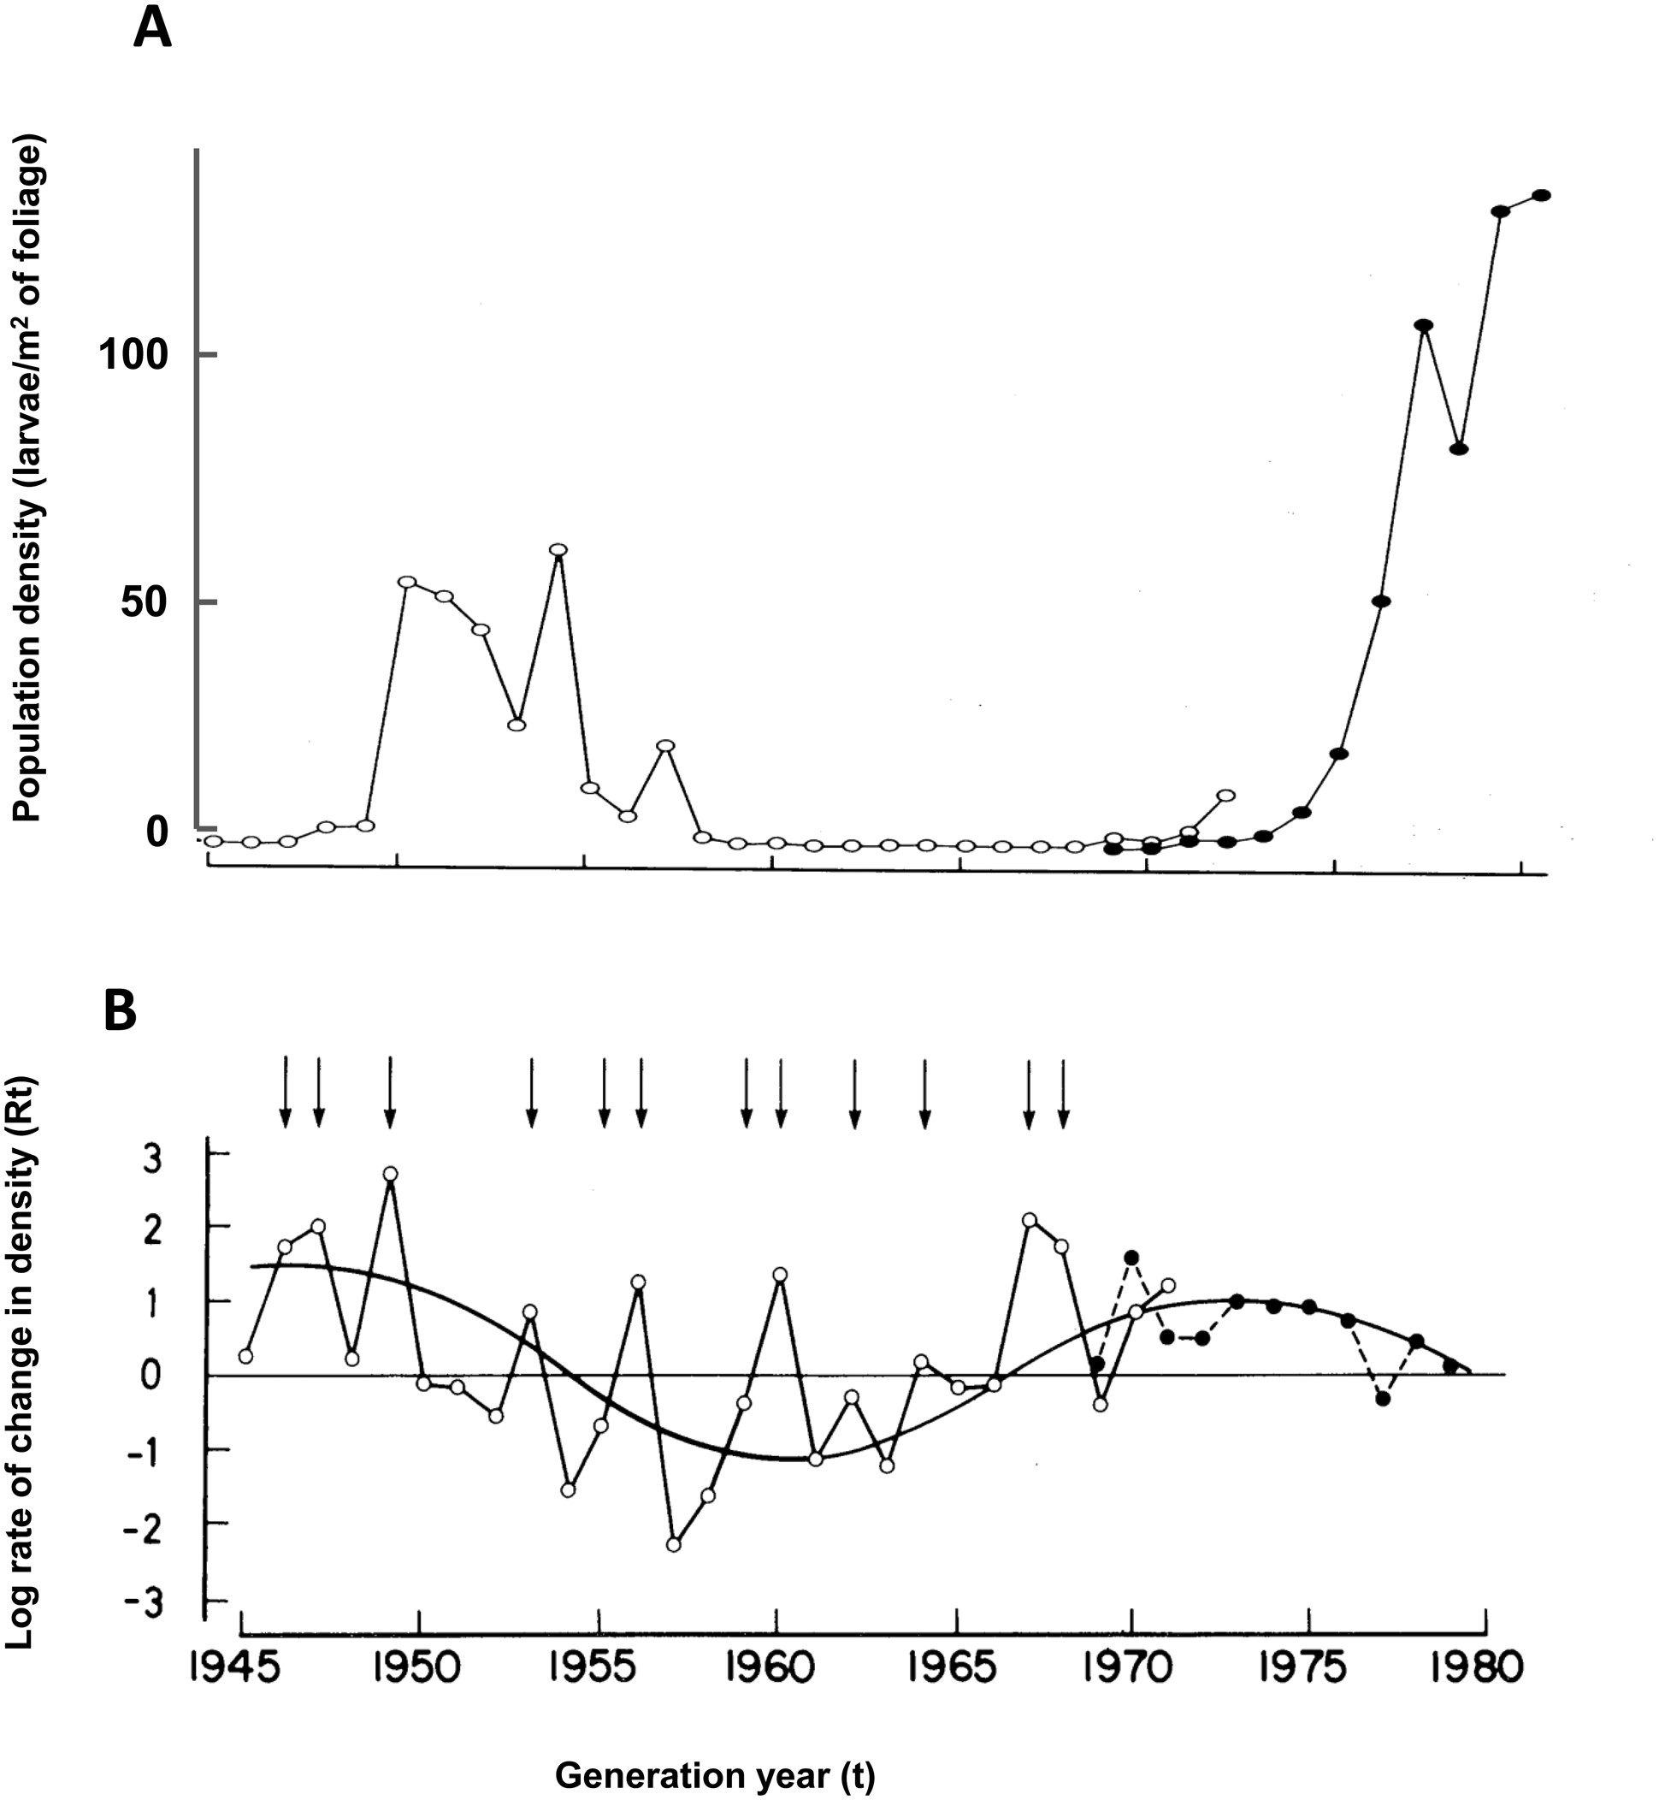
Fig. 3. Budworm population trends at Green River (from Royama 1984). (A) Raw population density, on a linear scale. ...
Notes:
Fig. 3. Budworm population trends at Green River (from Royama 1984). (A) Raw population density, on a linear scale. (B) Log rate of change from generation t to generation t + 1 for the time series in (A). Hollow dots are densities of third-instar larvae; solid dots are densities of egg masses. The smooth curve in (B) is drawn by eye. Arrows indicate years of moth immigration.
Unless provided in the caption above, the following copyright applies to the content of this slide: © The Authors 2016. Published by Oxford University Press on behalf of Entomological Society of America. All rights reserved. For Permissions, please email: journals.permissions@oup.com

Slide 4
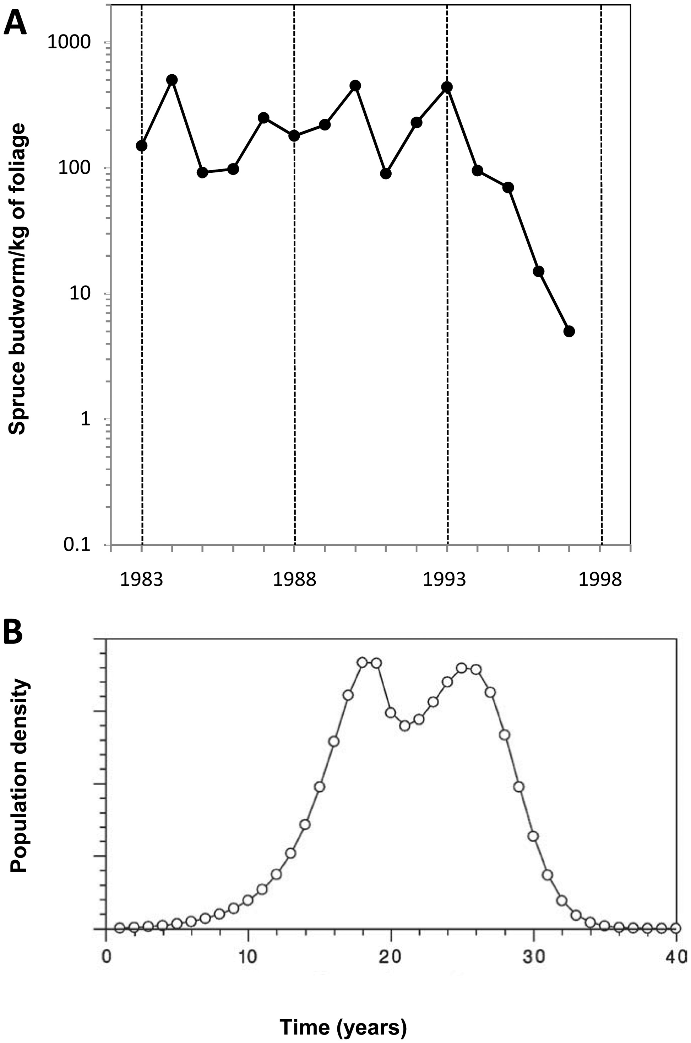
Fig. 4. Idealized representation of spruce budworm outbreak dynamics as a second-order density-dependent process ...
Notes:
Fig. 4. Idealized representation of spruce budworm outbreak dynamics as a second-order density-dependent process (from Régnière and Nealis 2007). (A) Field estimates of budworm density during peak and early decline; note the strong dips in 1985 and 1991, with subsequent recovery. (B) Simulated outbreak cycle, incorporating defoliation effects but with no stochastic perturbation. The dip during the peak is the result of incorporating defoliation.
Unless provided in the caption above, the following copyright applies to the content of this slide: © The Authors 2016. Published by Oxford University Press on behalf of Entomological Society of America. All rights reserved. For Permissions, please email: journals.permissions@oup.com

Slide 5
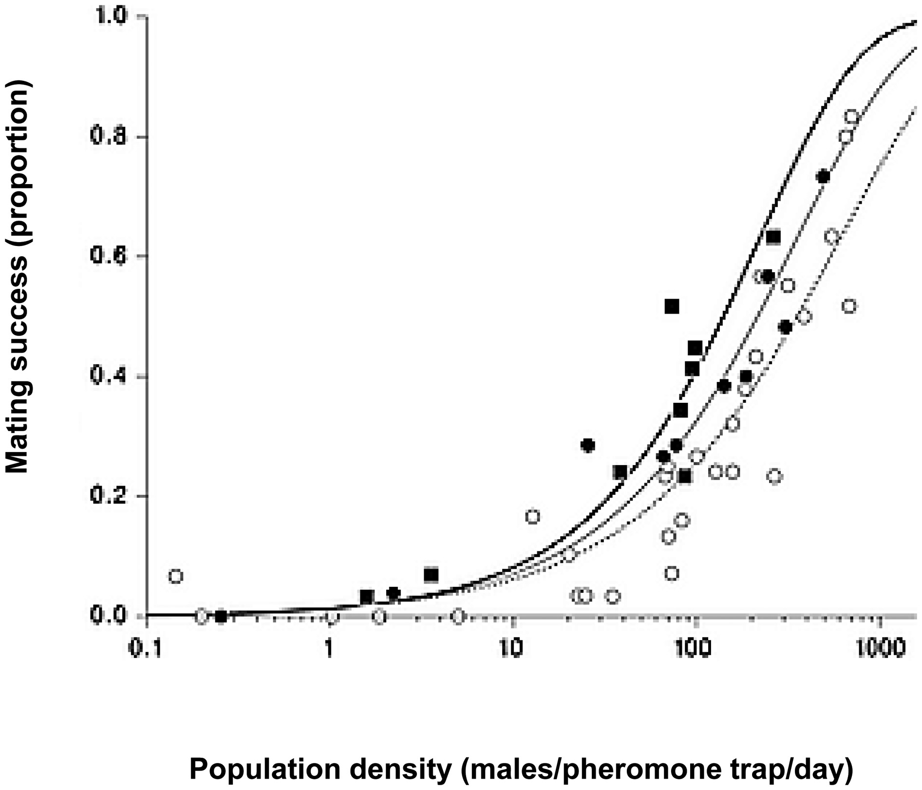
Fig. 5. Relationship between male moth density and female mating success (from Régnière et al. 2013). Hollow dots and ...
Notes:
Fig. 5. Relationship between male moth density and female mating success (from Régnière et al. 2013). Hollow dots and dotted line, solid dots and thin line, and solid squares and thick line represent early, mid, and late season trapping periods, respectively, during the 2009 mating season.
Unless provided in the caption above, the following copyright applies to the content of this slide: © The Authors 2016. Published by Oxford University Press on behalf of Entomological Society of America. All rights reserved. For Permissions, please email: journals.permissions@oup.com

