Slide 1
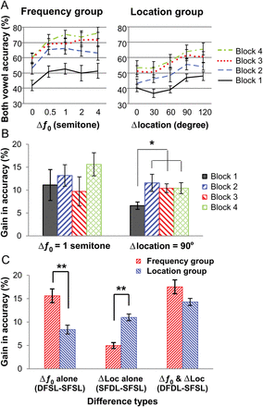
Figure 1. Behavioral performance during training and MEG recording. (A) Group mean accuracy for identifying both vowels ...
Notes:
Figure 1. Behavioral performance during training and MEG recording. (A) Group mean accuracy for identifying both vowels during training is plotted as a function of Δƒ0 or Δlocation. (B) Group mean gain in accuracy when Δƒ0 was 1 semitone or Δlocation was 90° during training. *P < 0.05 by paired t-tests. (C) Group mean gain in accuracy for Δƒ0 alone, Δlocation alone, and both Δƒ0 and Δlocation during MEG recording. **P < 0.001 by independent-sample t-tests. The error bars represent the standard error of the mean.
Unless provided in the caption above, the following copyright applies to the content of this slide: © The Author 2013. Published by Oxford University Press. All rights reserved. For Permissions, please e-mail: journals.permissions@oup.com

Slide 2
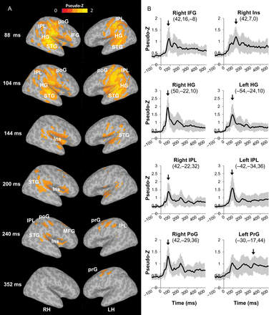
Figure 2. Grand mean ER-SAM maps and source waveforms during the double-vowel task. (A) ER-SAM maps averaged across all ...
Notes:
Figure 2. Grand mean ER-SAM maps and source waveforms during the double-vowel task. (A) ER-SAM maps averaged across all participants and all stimulus types at selected latencies are thresholded at pseudo-Z >0.9 and overlaid onto a template brain. (B) MEG source waveforms averaged across all participants and all stimulus types at selected peak voxel in ER-SAM maps. The error bars represent the standard error of the mean. The arrows indicate the latency when the chosen voxel was defined as local maxima. HG, Heschl's gyrus; IFG, inferior frontal gyrus; Ins, insula; MFG, middle frontal gyrus; IPL, inferior parietal lobule; poG, postcentral gyrus; prG, precentral gyrus; STG, superior temporal gyrus.
Unless provided in the caption above, the following copyright applies to the content of this slide: © The Author 2013. Published by Oxford University Press. All rights reserved. For Permissions, please e-mail: journals.permissions@oup.com

Slide 3
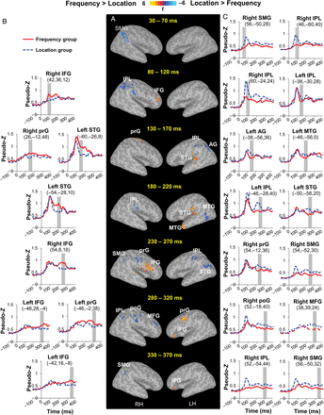
Figure 3. Activation maps and source waveforms showing the feature-specific training effect. (A) Contrast maps of the ...
Notes:
Figure 3. Activation maps and source waveforms showing the feature-specific training effect. (A) Contrast maps of the MEG source activity between the 2 groups across stimulus types for six 40-ms intervals are overlaid on a template brain. All activations are significant at corrected P 1088 μL. (B and C) Group mean MEG source waveforms at selected clusters exhibiting remarkable group differences, (B) Frequency group > Location group; (C) Location group > Frequency group. The numbers below each cluster label show the Talairach coordinates of the peak voxel. The gray bars indicate the 40-ms interval showing a significant group difference. AG, angular gyrus; IFG, inferior frontal gyrus; IPL, inferior parietal lobule; MFG, middle frontal gyrus; MTG, middle temporal gyrus; poG, postcentral gyrus; prG, precentral gyrus; SMG, supramarginal gyrus; STG, superior temporal gyrus.
Unless provided in the caption above, the following copyright applies to the content of this slide: © The Author 2013. Published by Oxford University Press. All rights reserved. For Permissions, please e-mail: journals.permissions@oup.com

Slide 4
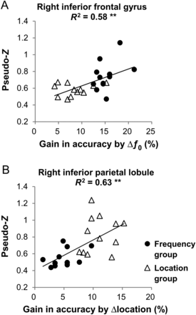
Figure 4. Brain-behavior correlation. Individuals' mean source activity in the right inferior frontal gyrus (A) and in ...
Notes:
Figure 4. Brain-behavior correlation. Individuals' mean source activity in the right inferior frontal gyrus (A) and in the right inferior parietal lobule (B) during the 80–120 ms interval from both the Frequency (filled circles) and Location groups (open triangles) are plotted against the listeners' gain in accuracy for Δƒ0 cue alone and Δlocation cue alone, respectively. The 2 regions were chosen as showing a significant (corrected P < 0.05) group difference in source activity. **P < 0.01 by Pearson correlation.
Unless provided in the caption above, the following copyright applies to the content of this slide: © The Author 2013. Published by Oxford University Press. All rights reserved. For Permissions, please e-mail: journals.permissions@oup.com

