Slide 1
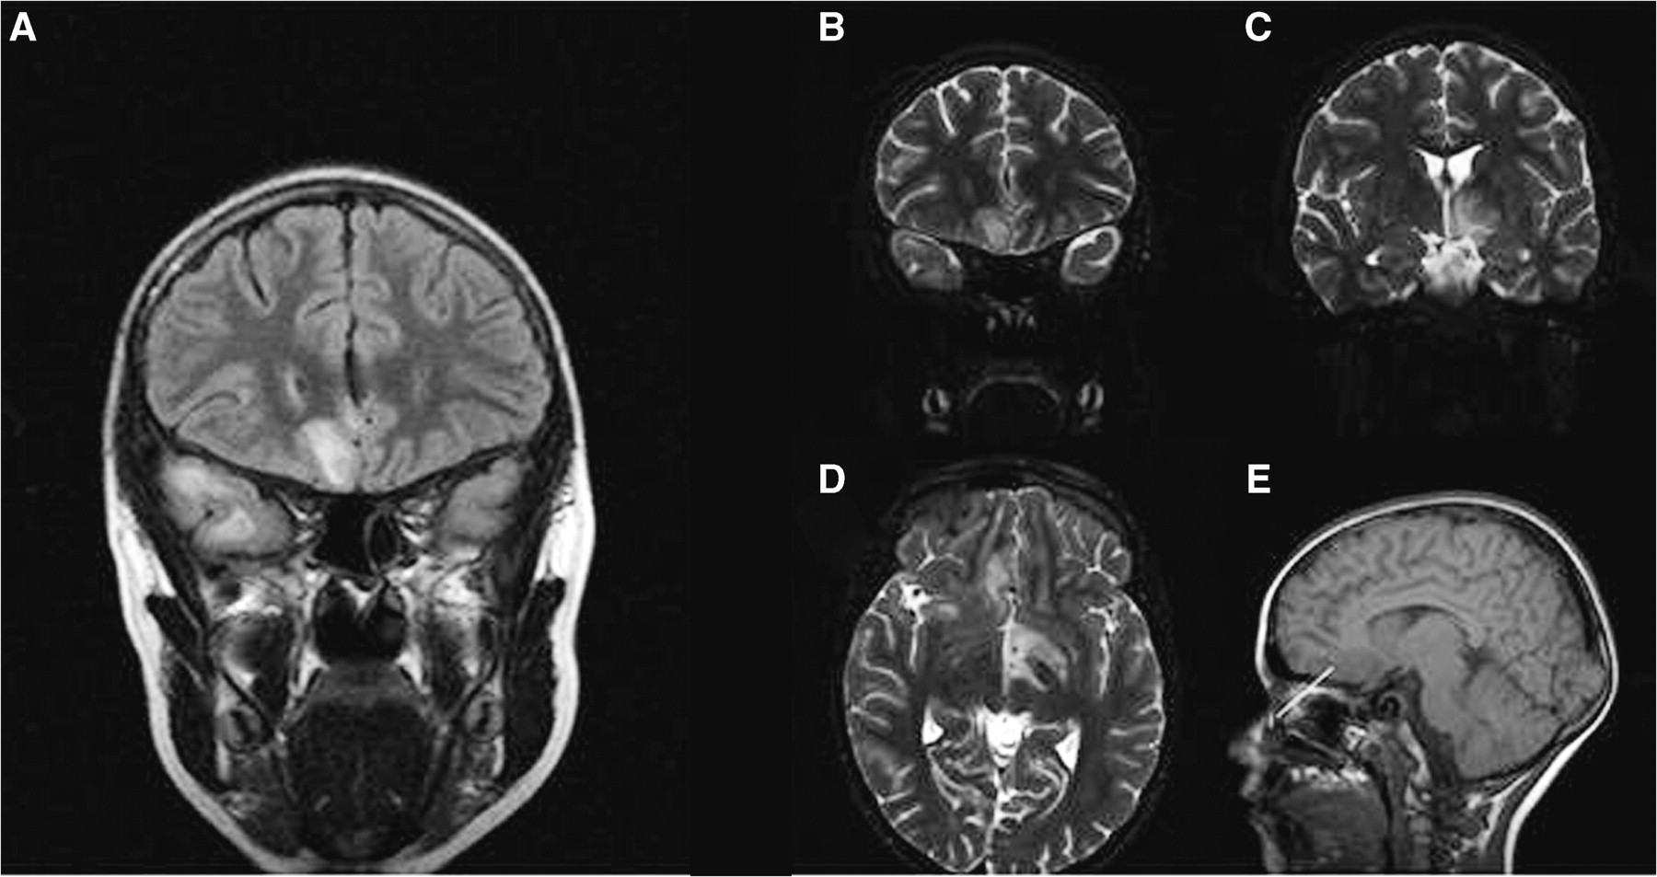
Fig. 1 MRI of Patient 2, ∼10 weeks after initial presentation, to show the extent of signal change, which appears ...
Notes:
Fig. 1 MRI of Patient 2, ∼10 weeks after initial presentation, to show the extent of signal change, which appears contiguous. (A) Coronal FLAIR imaging through anterior temporal lobes just anterior to chiasm. (B–D) T2 fat-saturation sequences. B is at same level as A. C is just posterior to the chiasm. (E) T1 weighted image showing area of signal change and approximate biopsy site (indicated by an arrow).
Unless provided in the caption above, the following copyright applies to the content of this slide: © The Author 2010. Published by Oxford University Press on behalf of the British Society for Rheumatology. All rights reserved. For Permissions, please email: journals.permissions@oxfordjournals.org

