Slide 1
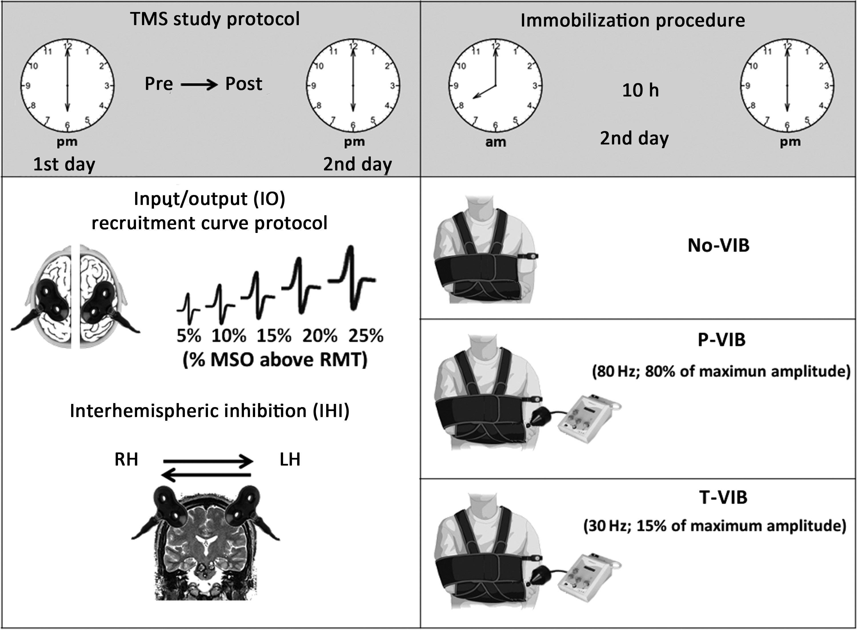
Figure 1. Experimental protocol. The right arm of all subjects was immobilized, and they were instructed not to move ...
Notes:
Figure 1. Experimental protocol. The right arm of all subjects was immobilized, and they were instructed not to move their right hand for 10 h from the morning (8:00 AM) to the evening (6:00 PM). To prevent any right hand movement, subjects wore a dorsal wrist-hand-fingers orthosis. In all subjects, physical activity duration of the left arm was quantitatively monitored by means of an accelerometer set up in a multisensor actigraph for 10 h in 2 different days, 1 day before and during the immobilization period, from ∼8:00 AM to 6:00 PM every day. We tested cortical excitability of left and right M1s by means of input/output recruitment curve (IO) and interhemispheric communication between the 2 M1s assessing interhemispheric inhibition (IHI). TMS procedure was performed 1 day before (PRE) and immediately after 10 h of hand nonuse (POST), always at ∼6:00 PM. In the vibration groups (proprioceptive vibration group: P-VIB; tactile vibration group: T-VIB), during the immobilization, the first dorsal interosseus muscle (FDI) of the right immobilized hand was vibrated through a vibrator with an head of about 5 mm diameter for about 10 min every hour. For the sake of clearness, in the figure, the hand was not hidden from sight to show the position where the vibration was administered. However, during the immobilization protocol the hand was completely immobilized.
Unless provided in the caption above, the following copyright applies to the content of this slide: © The Author 2013. Published by Oxford University Press. All rights reserved. For Permissions, please e-mail: journals.permissions@oup.com

Slide 2
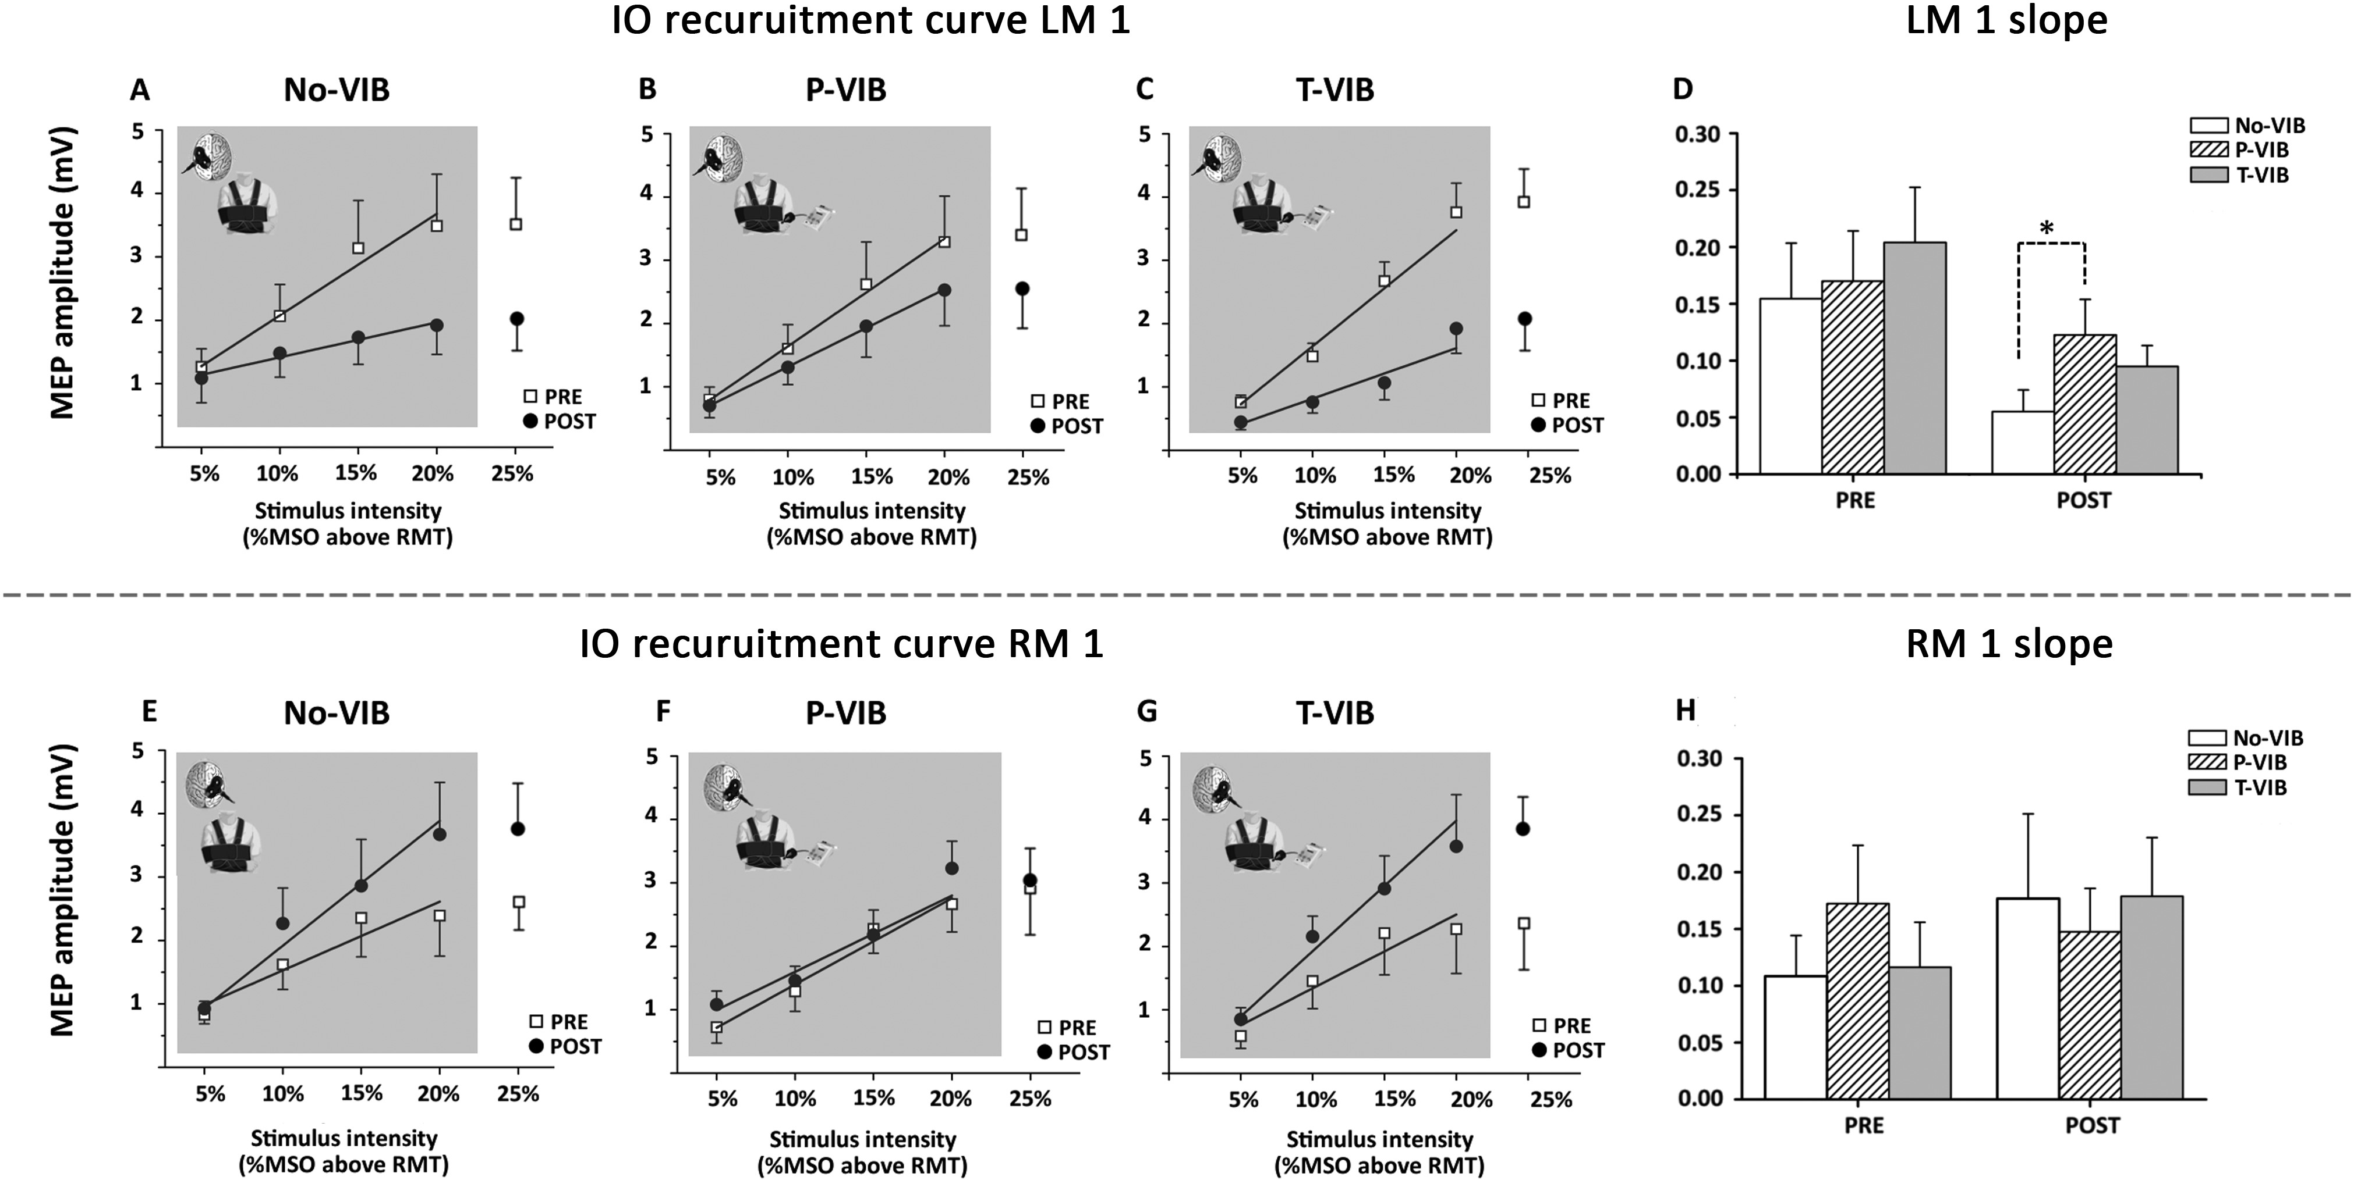
Figure 2. IO curves of the no-vibration and the vibration groups (proprioceptive vibration group: P-VIB; tactile ...
Notes:
Figure 2. IO curves of the no-vibration and the vibration groups (proprioceptive vibration group: P-VIB; tactile vibration group: T-VIB) showing mean MEP amplitudes before (PRE) and after 10 h of immobilization (POST). In the superior panel (A–D), data of left primary motor cortex (LM1), contralateral to the immobilized hand are reported. In the inferior panel (E–H), data of the right primary motor cortex (RM1), ipsilateral to the immobilized hand are reported. On the abscissa, the stimulus intensities are shown (5%, 10%, 15%, 20%, and 25% of MSO above RMT), whereas on the ordinate the peak-to-peak MEP amplitude (in mV) is shown. Trend lines indicate the linear fit applied to the range from 5% to 20% of maximal stimulator output (MSO) above RMT, as indicated by the shaded area. Mean values of the IO curve slopes measured before (PRE) and after 10 h immobilization (POST) are also graphically reported. Asterisk indicates that, in the LM1, after immobilization, the slope value was significantly different between No-VIB and P-VIB groups (*P < 0.05). Vertical bars indicate SE.
Unless provided in the caption above, the following copyright applies to the content of this slide: © The Author 2013. Published by Oxford University Press. All rights reserved. For Permissions, please e-mail: journals.permissions@oup.com

Slide 3
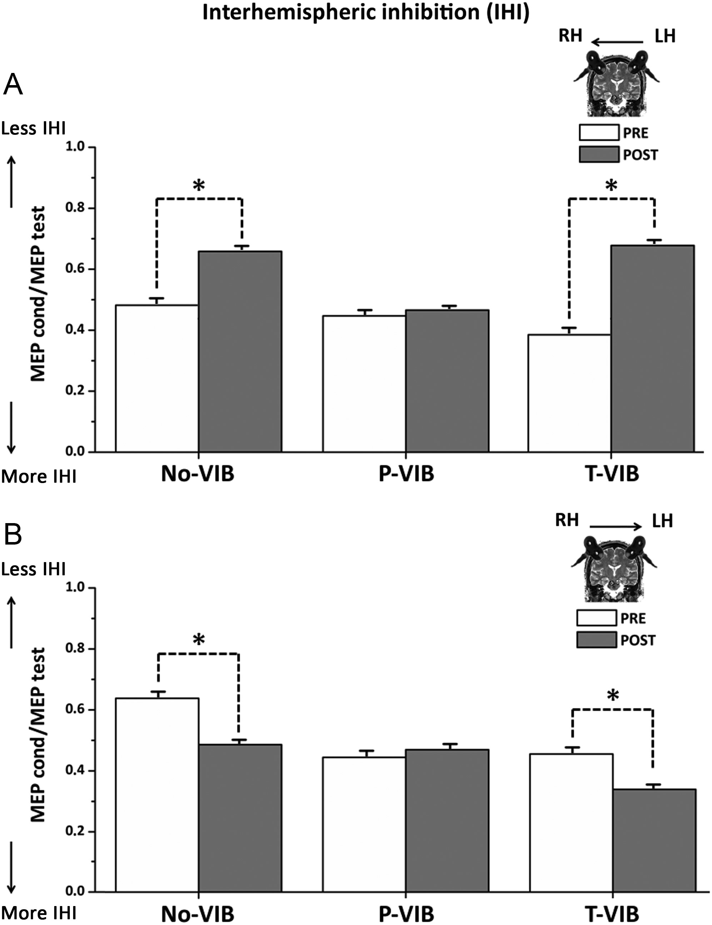
Figure 3. Mean values of IHI in the no-vibration and the vibration groups (proprioceptive vibration group: P-VIB; ...
Notes:
Figure 3. Mean values of IHI in the no-vibration and the vibration groups (proprioceptive vibration group: P-VIB; tactile vibration group: T-VIB), before (PRE, white columns) and after immobilization (POST, gray columns) are shown. IHI from LtoR (A) and RtoL (B) hemispheres is expressed as the ratio between the mean peak-to-peak MEP amplitude in conditioned versus unconditioned trials (MEPcond/MEPtest). Asterisks indicate significant difference between PRE and POST values when interaction of TIME*GROUP was statistically significant (*P < 0.05, **P < 0.01). Vertical bars indicate SE.
Unless provided in the caption above, the following copyright applies to the content of this slide: © The Author 2013. Published by Oxford University Press. All rights reserved. For Permissions, please e-mail: journals.permissions@oup.com

