Slide 1
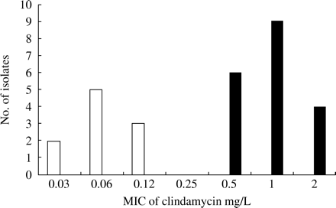
Figure 1. Distribution of MICs of clindamycin for S. agalactiae isolates susceptible to clindamycin (white bars) and ...
Notes:
Figure 1. Distribution of MICs of clindamycin for S. agalactiae isolates susceptible to clindamycin (white bars) and with the LSA phenotype (black bars).
Unless provided in the caption above, the following copyright applies to the content of this slide: JAC vol.54 no.6 © The British Society for Antimicrobial Chemotherapy 2004; all rights reserved

Slide 2
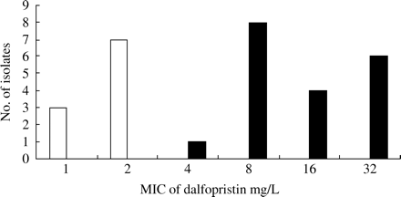
Figure 2. Distribution of MICs of dalfopristin for S. agalactiae isolates susceptible to dalfopristin (white bars) and ...
Notes:
Figure 2. Distribution of MICs of dalfopristin for S. agalactiae isolates susceptible to dalfopristin (white bars) and with the LSA phenotype (black bars).
Unless provided in the caption above, the following copyright applies to the content of this slide: JAC vol.54 no.6 © The British Society for Antimicrobial Chemotherapy 2004; all rights reserved

Slide 3
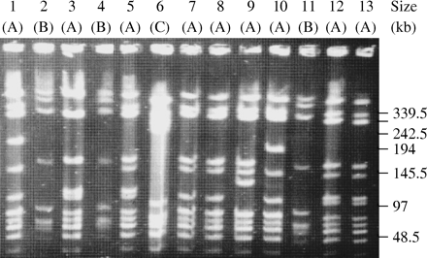
Figure 3. PFGE patterns for some of the S. agalactiae isolates with the LSA phenotype. Total DNA from 13 S. agalactiae ...
Notes:
Figure 3. PFGE patterns for some of the S. agalactiae isolates with the LSA phenotype. Total DNA from 13 S. agalactiae isolates (1–13) was digested with the SmaI restriction enzyme and submitted to PFGE. The characterized genotypes are indicated in parentheses.
Unless provided in the caption above, the following copyright applies to the content of this slide: JAC vol.54 no.6 © The British Society for Antimicrobial Chemotherapy 2004; all rights reserved

