Slide 1
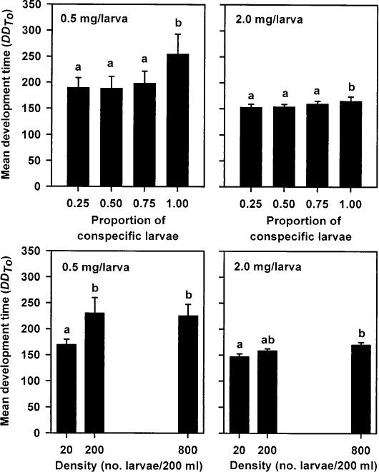
Fig. 1 Effects of conspecific larval density (n = 8) and the proportion of conspecific density and heterospecific ...
Notes:
Fig. 1 Effects of conspecific larval density (n = 8) and the proportion of conspecific density and heterospecific larval density (n = 6) on larval development time in degree-days (DD8.8) for Ae. albopictus at a low and high per capita food ration. Means for each food ration within each level of each variable followed by the same letter are not significantly different at P = 0.05 by an LSD test. Bars are 1 SE of mean DD8.8
Unless provided in the caption above, the following copyright applies to the content of this slide: © 2000 Entomological Society of America

Slide 2
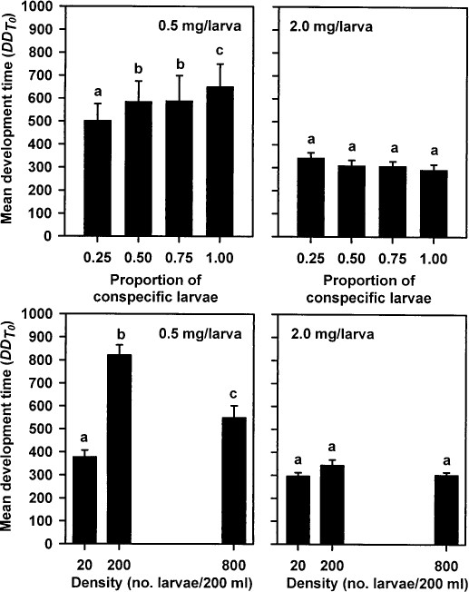
Fig. 2 Effects of conspecific larval density (n = 8) and the proportion of conspecific density and heterospecific ...
Notes:
Fig. 2 Effects of conspecific larval density (n = 8) and the proportion of conspecific density and heterospecific larval density (n = 6) on larval development time in degree-days (DD5.3) for Ae. triseriatus at a low and high per capita food ration. Means for each food ration within each level of each variable followed by the same letter are not significantly different at P = 0.05 by an LSD test. Bars are 1 SE of mean DD5.3
Unless provided in the caption above, the following copyright applies to the content of this slide: © 2000 Entomological Society of America

Slide 3
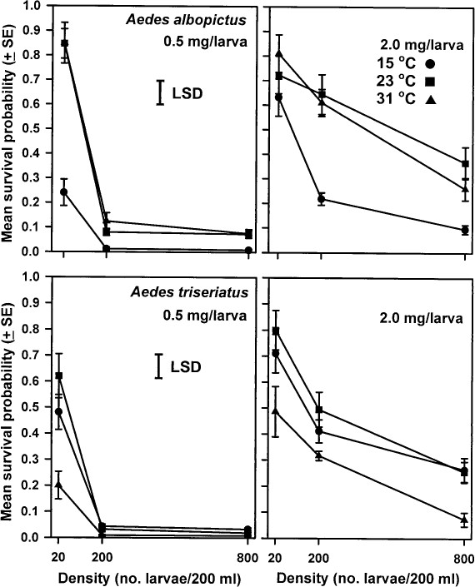
Fig. 3 Effects of larval density and food ration on the temperature-dependent survivorship of Ae. albopictus and Ae. ...
Notes:
Fig. 3 Effects of larval density and food ration on the temperature-dependent survivorship of Ae. albopictus and Ae. triseriatus immatures. Survival probabilities were subjected to an arcsine=y transformation before data were analyzed. Means are back-transformed.
Unless provided in the caption above, the following copyright applies to the content of this slide: © 2000 Entomological Society of America

Slide 4
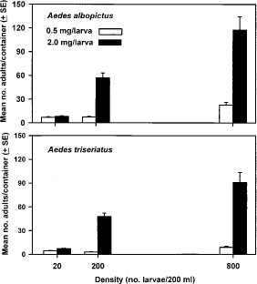
Fig. 4 Effects of density and food ration on the standing crop production of adult Ae. albopictus and Ae. ...
Notes:
Fig. 4 Effects of density and food ration on the standing crop production of adult Ae. albopictus and Ae. triseriatus.
Unless provided in the caption above, the following copyright applies to the content of this slide: © 2000 Entomological Society of America

Slide 5
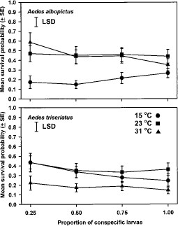
Fig. 5 Effects of the proportion of conspecific larvae on the temperature-dependent survivorship of Ae. albopictus ...
Notes:
Fig. 5 Effects of the proportion of conspecific larvae on the temperature-dependent survivorship of Ae. albopictus and Ae. triseriatus immatures. Survival probabilities were subjected to an arcsine=y transformation before data were analyzed. Means are back-transformed.
Unless provided in the caption above, the following copyright applies to the content of this slide: © 2000 Entomological Society of America

Slide 6
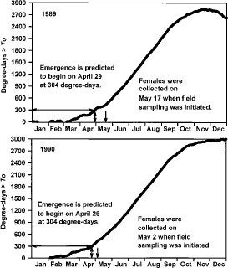
Fig. 6 Accumulated degree-days that exceed the threshold temperature for initiation of development (T₀ = ...
Notes:
Fig. 6 Accumulated degree-days that exceed the threshold temperature for initiation of development (T0 = 5.3°C) of Ae. triseriatus larvae. Ae. triseriatus females are predicted to first emerge on 29 April 1989 and 26 April 1990, based on a development time of 304 DD5.3. Females were reported by Szumlas et al. (1996a) to have been collected on 17 May 1989 and 2 May 1990.
Unless provided in the caption above, the following copyright applies to the content of this slide: © 2000 Entomological Society of America

Slide 7
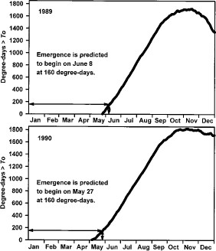
Fig. 7 Accumulated degree-days that exceed the threshold temperature for initiation of development (T₀ = ...
Notes:
Fig. 7 Accumulated degree-days that exceed the threshold temperature for initiation of development (T0 = 8.8°C) of Ae. albopictus larvae. Ae. albopictus females are predicted to 1st emerge on 8 June 1989 and 27 May 1990, based on a development time of 160 DD8.8.
Unless provided in the caption above, the following copyright applies to the content of this slide: © 2000 Entomological Society of America

