Slide 1
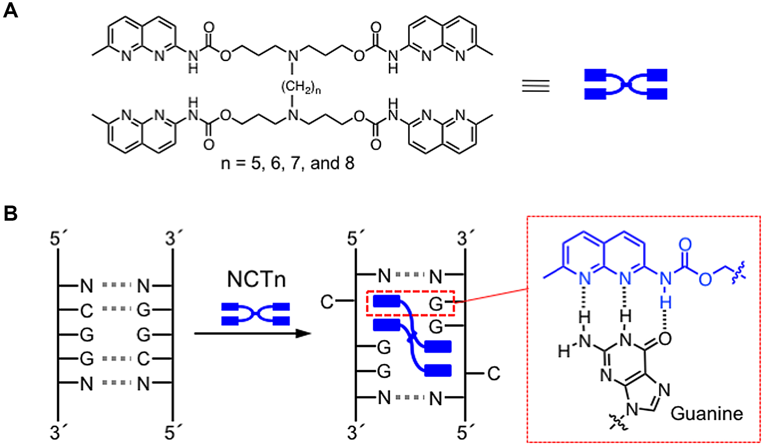
Figure 1. Chemical structure and binding mode of NCTn. (A) Chemical structures of naphthyridine carbamate tetramers ...
Notes:
Figure 1. Chemical structure and binding mode of NCTn. (A) Chemical structures of naphthyridine carbamate tetramers (NCTn, n = 5, 6, 7 and 8). (B) Schematic of the proposed NCTn-CGG/CGG complex. Blue rectangles: 2-amino-1,8-naphthyridine. Dashed box shows the hydrogen-bonding between the N-alkoxycarbonyl-1,8-naphthyridine unit and guanine.
Unless provided in the caption above, the following copyright applies to the content of this slide: © The Author(s) 2018. Published by Oxford University Press on behalf of Nucleic Acids Research.This is an Open Access article distributed under the terms of the Creative Commons Attribution Non-Commercial License (http://creativecommons.org/licenses/by-nc/4.0/), which permits non-commercial re-use, distribution, and reproduction in any medium, provided the original work is properly cited. For commercial re-use, please contact journals.permissions@oup.com

Slide 2
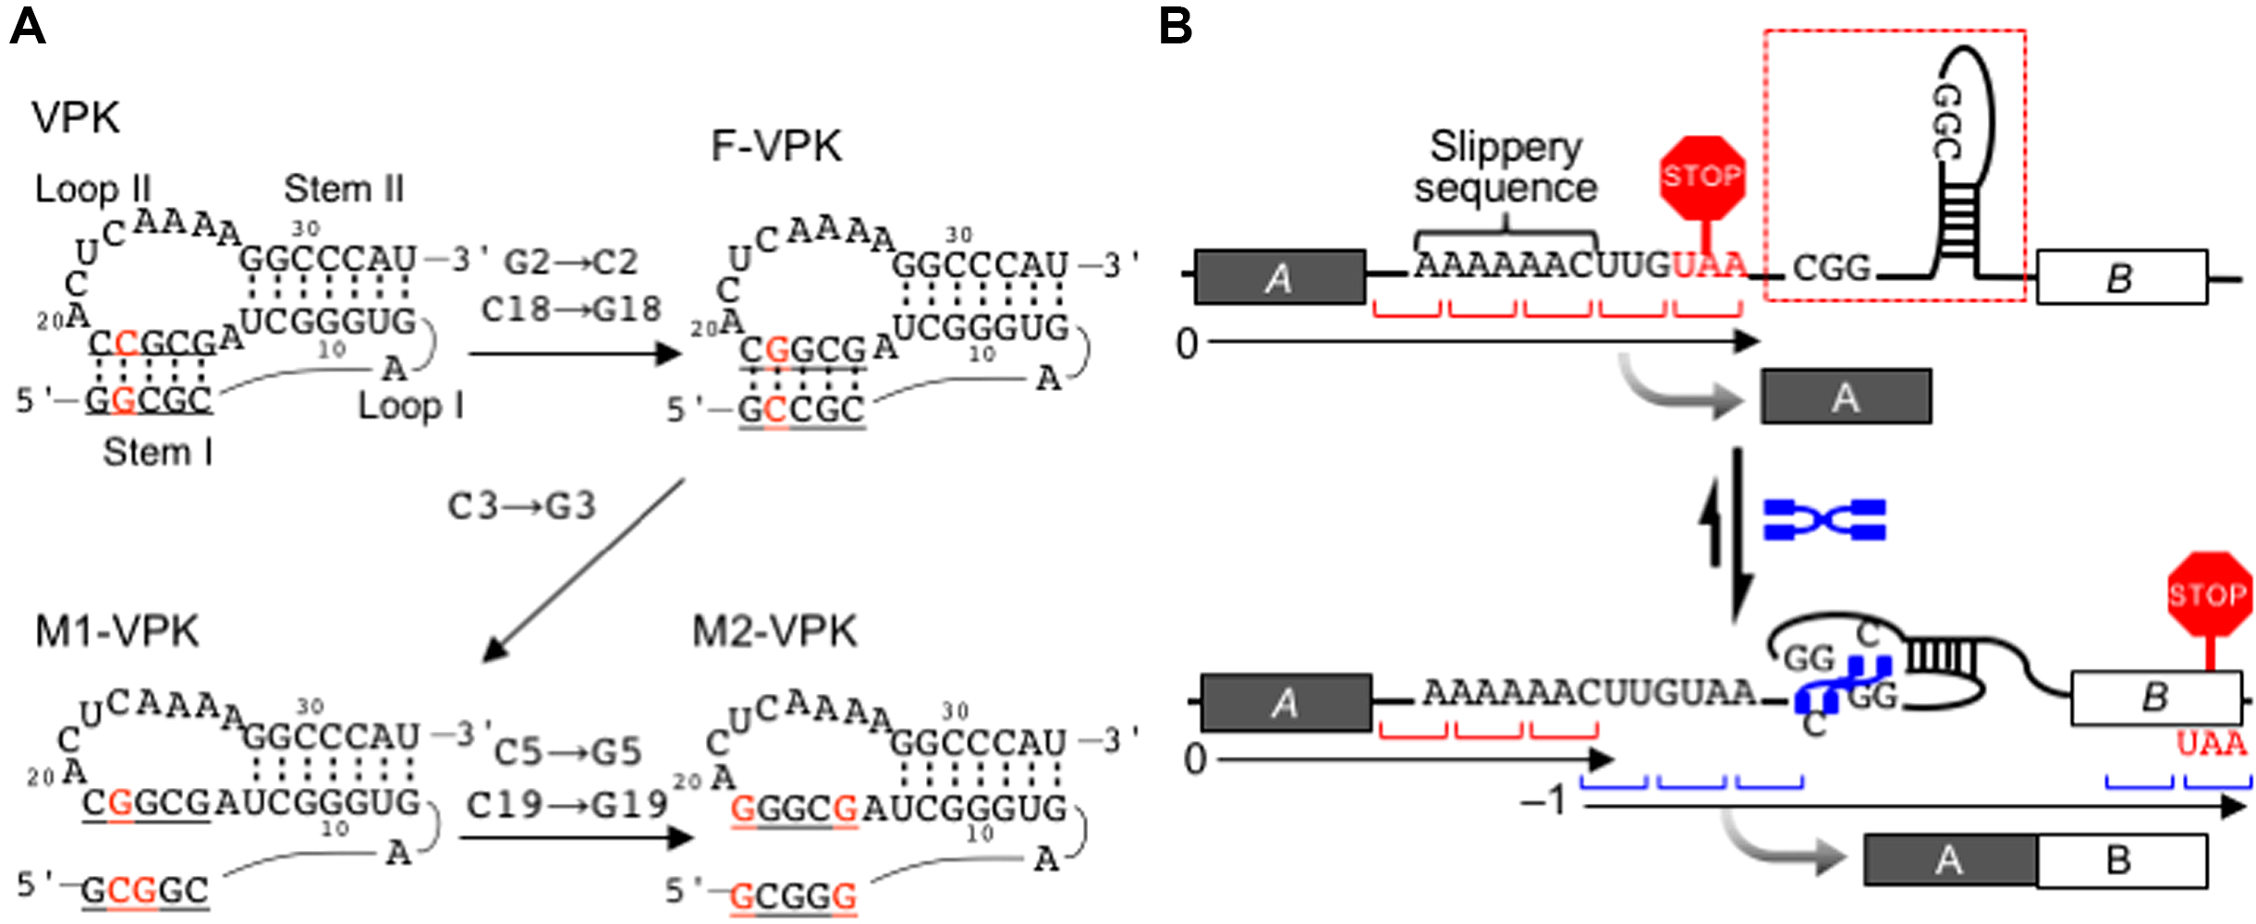
Figure 2. Design of NCTn-inducible pseudoknot sequences and the dual reporter system. (A) Sequences and predicted ...
Notes:
Figure 2. Design of NCTn-inducible pseudoknot sequences and the dual reporter system. (A) Sequences and predicted secondary structures of VPK, F-VPK, M1-VPK, and M2-VPK fragments. (B) Stabilization of the frameshifting pseudoknot by NCTn. NCTn binds to the CGG/CGG duplex to stabilize the pseudoknot structure (dashed box), which induces -1PRF.
Unless provided in the caption above, the following copyright applies to the content of this slide: © The Author(s) 2018. Published by Oxford University Press on behalf of Nucleic Acids Research.This is an Open Access article distributed under the terms of the Creative Commons Attribution Non-Commercial License (http://creativecommons.org/licenses/by-nc/4.0/), which permits non-commercial re-use, distribution, and reproduction in any medium, provided the original work is properly cited. For commercial re-use, please contact journals.permissions@oup.com

Slide 3
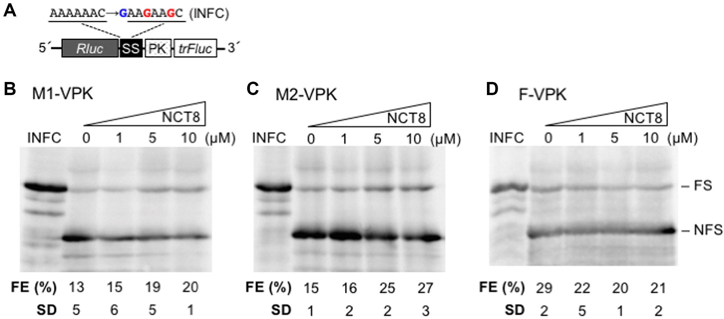
Figure 3. Western blot analysis of the NCT8 effect on the –1PRF efficiency in the in vitro RRL translation system. (A) ...
Notes:
Figure 3. Western blot analysis of the NCT8 effect on the –1PRF efficiency in the in vitro RRL translation system. (A) Schematic representation of the mRNAs used in the analysis. The mRNA construct contain M1-, M2-, or F-VPK sequence (Supplementary Figure S1, shown as PK) placed between the Rluc gene and the trFluc gene. The slippery sequence (AAAAAAC) was mutated to AAGAAGC and one nucleotide was inserted just before the slippery sequence in the corresponding in-frame controls (INFC). SS: Slippery sequence + stop codon. (B–D) Western blot analysis of the protein products obtained by in vitro translation of the mRNA construct containing (B) M1-VPK, (C) M2-VPK or (D) F-VPK sequence. Frameshifting products (FS) and non-frameshifting products (NFS) were detected with anti-Rluc antibody. FE represents the efficiency of –1PRF. Each EF value (and SD) was determined based on at least three independent experiments (Supplementary Figure S3).
Unless provided in the caption above, the following copyright applies to the content of this slide: © The Author(s) 2018. Published by Oxford University Press on behalf of Nucleic Acids Research.This is an Open Access article distributed under the terms of the Creative Commons Attribution Non-Commercial License (http://creativecommons.org/licenses/by-nc/4.0/), which permits non-commercial re-use, distribution, and reproduction in any medium, provided the original work is properly cited. For commercial re-use, please contact journals.permissions@oup.com

Slide 4
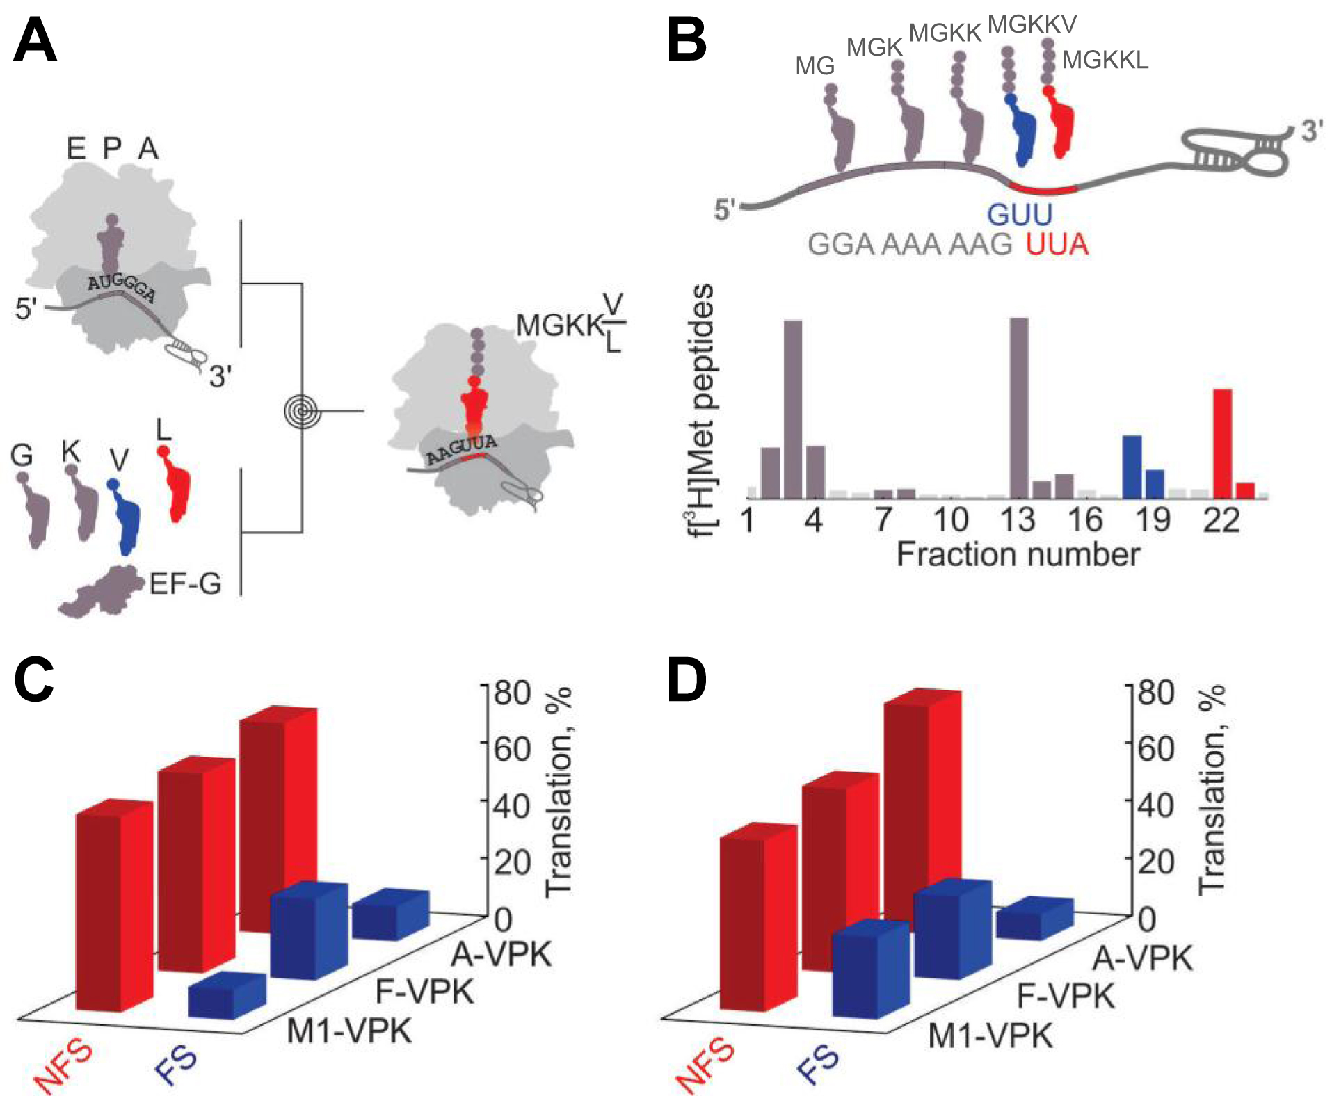
Figure 4. Effect of NCT8 on the efficiency of translation in −1 and 0 frames in the E. coli in vitro translation ...
Notes:
Figure 4. Effect of NCT8 on the efficiency of translation in −1 and 0 frames in the E. coli in vitro translation system. (A) Schematic of the experiments. Purified 70S initiation complexes were mixed with ternary complexes of EF-Tu–GTP–aatRNAs (G-tRNAG, K-tRNAK, V-tRNAV, L-tRNAL) and EF-G for 60–120 s. Reactions were quenched with KOH and products analyzed by RP HPLC, measuring [3H]Met radioactivity (Materials and Methods). (B) Example of a chromatogram for the F-VPK translation products. Monitored peptides in order of appearance on the chromatogram are fMG, fMGK, fMGKK, fMGKKV (blue) and fMGKKL (red). Cartoon (upper panel) shows the sequence of the mRNA with the slippery sequence and the stimulatory pseudoknot. −1 and 0 frame decoding results in formation of the fMGKKV and fMGKKL peptides, respectively. (C and D) FE with different mRNA variants. (C) Without NCT8. (D) In the presence of 10 μM NCT8. Data points represent the mean of at least three independent experiments. The mean ± SD values are provided in Supplementary Table S1.
Unless provided in the caption above, the following copyright applies to the content of this slide: © The Author(s) 2018. Published by Oxford University Press on behalf of Nucleic Acids Research.This is an Open Access article distributed under the terms of the Creative Commons Attribution Non-Commercial License (http://creativecommons.org/licenses/by-nc/4.0/), which permits non-commercial re-use, distribution, and reproduction in any medium, provided the original work is properly cited. For commercial re-use, please contact journals.permissions@oup.com

Slide 5
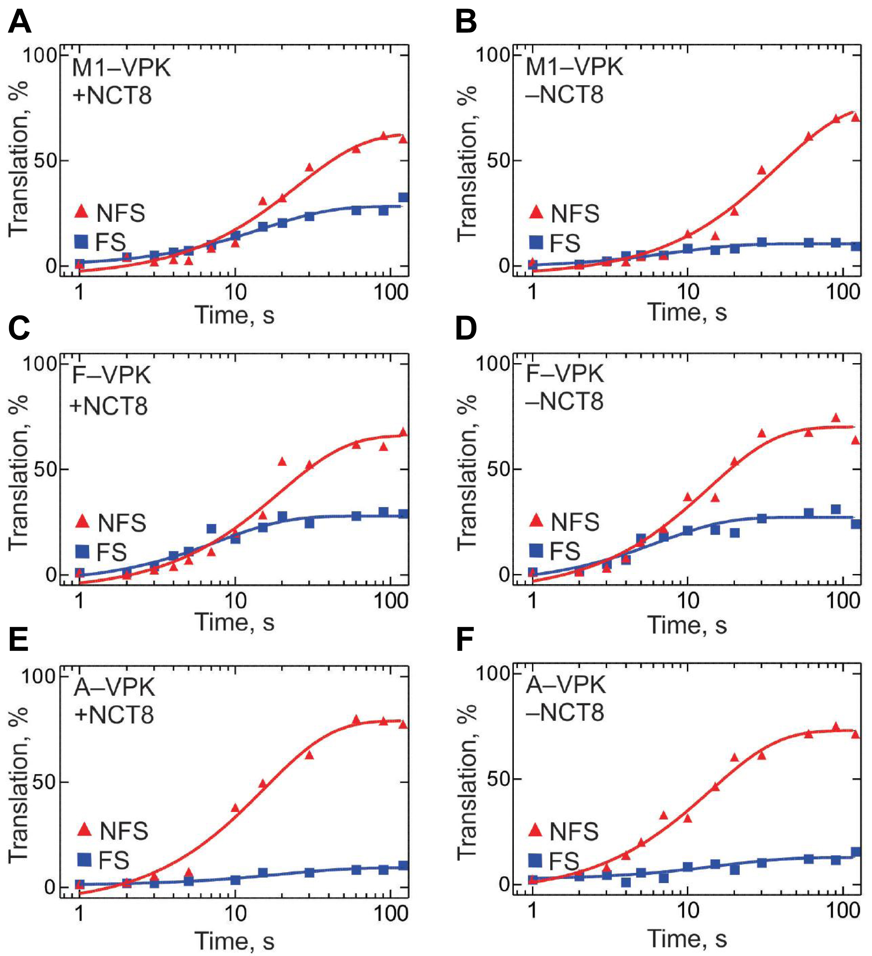
Figure 5. Time courses of translation of M1-VPK (A, B), F-VPK (C, D) and A-VPK (E, F) mRNAs in the presence (A, C, E) ...
Notes:
Figure 5. Time courses of translation of M1-VPK (A, B), F-VPK (C, D) and A-VPK (E, F) mRNAs in the presence (A, C, E) and absence (B, D, F) of NCT8 (10 μM). Purified 70S initiation complexes were mixed with ternary complexes of EF-Tu–GTP–aatRNAs (G-tRNAG, K-tRNAK, V-tRNAV, L-tRNAL) and EF-G for 1–120 s. Peptides were separated and analyzed by RP HPLC followed by scintillation counting. The points represent the mean of three independent experiments. Rates and SEM corresponding to the fits is given in Supplementary Table S2.
Unless provided in the caption above, the following copyright applies to the content of this slide: © The Author(s) 2018. Published by Oxford University Press on behalf of Nucleic Acids Research.This is an Open Access article distributed under the terms of the Creative Commons Attribution Non-Commercial License (http://creativecommons.org/licenses/by-nc/4.0/), which permits non-commercial re-use, distribution, and reproduction in any medium, provided the original work is properly cited. For commercial re-use, please contact journals.permissions@oup.com

Slide 6
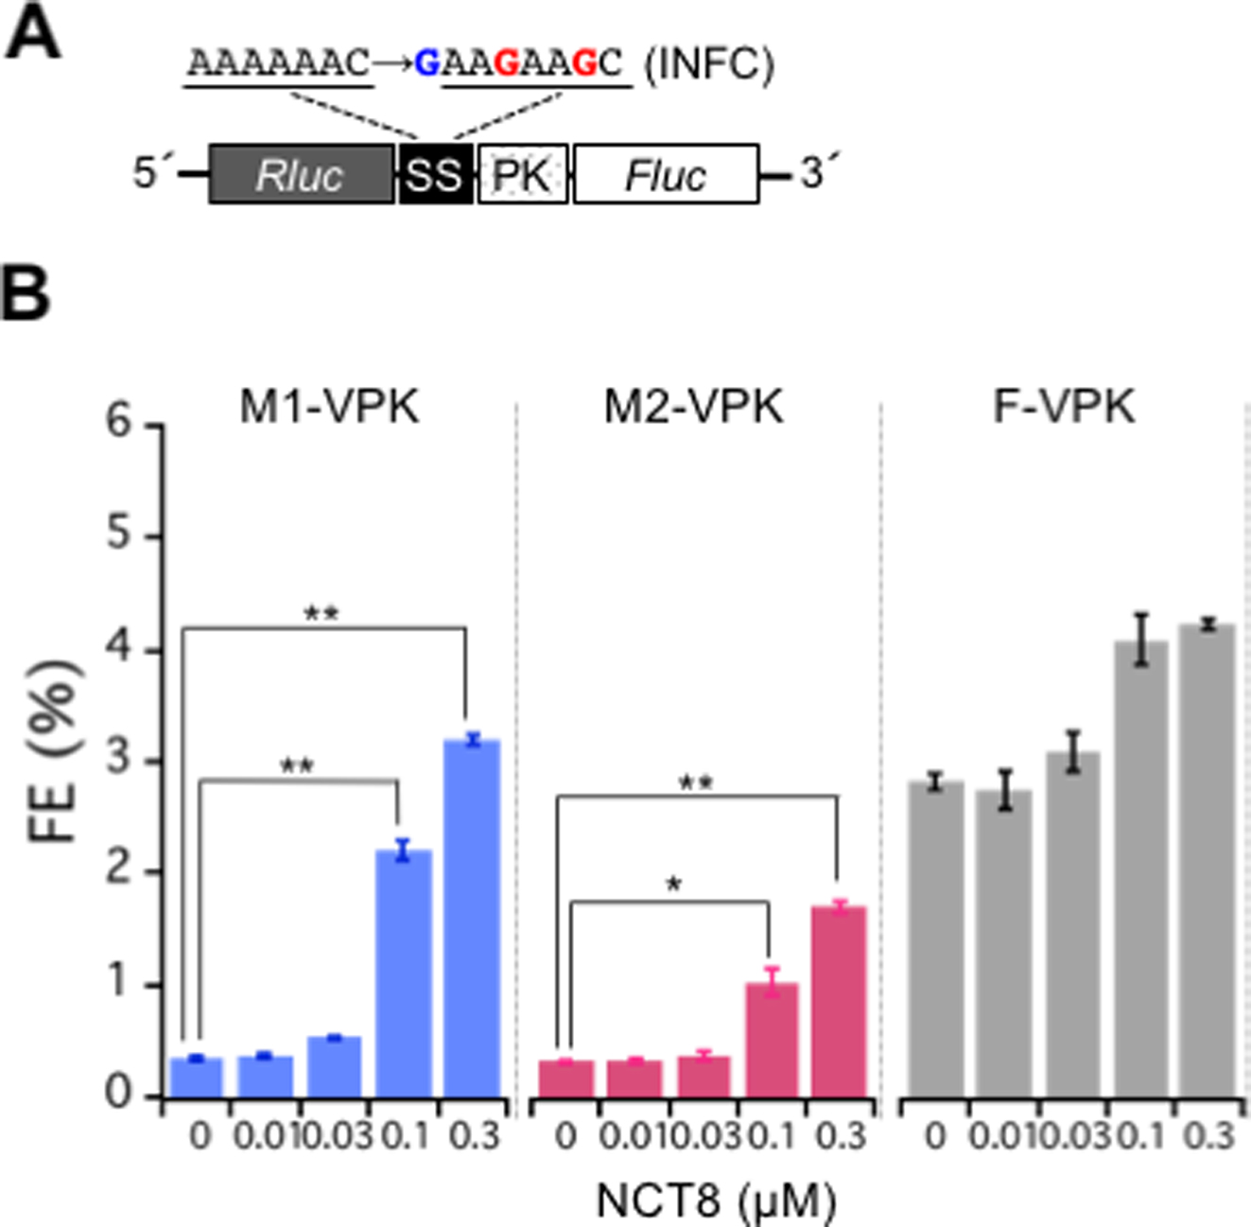
Figure 6. Effect of NCT8 on –1PRF in HeLa cells. (A) Schematic representation of the dual luciferase constructs used in ...
Notes:
Figure 6. Effect of NCT8 on –1PRF in HeLa cells. (A) Schematic representation of the dual luciferase constructs used in the experiment. The constructs contain M1-, M2- or F-VPK sequence (Supplementary Figure S1, shown as PK) placed between the Rluc gene and the Fluc gene. SS: Slippery sequence + stop codon. (B) Effect of NCT8 treatment on the production of Rluc-Fluc fusion protein. Frameshifting efficiencies (FE) were determined by dividing the Fluc/Rluc activity ratio obtained from the mutant constructs by the ratio obtained from the corresponding in-frame controls (INFC). HeLa cells were transfected with the dual luciferase constructs and incubated with NCT8 at the indicated concentrations for 24 h. Fluc and Rluc activities were measured consecutively by using dual-luciferase assays. Error bars represent the SD based on four replicates. * and ** denote P < 0.005 and P < 0.001, respectively (Student's t-test).
Unless provided in the caption above, the following copyright applies to the content of this slide: © The Author(s) 2018. Published by Oxford University Press on behalf of Nucleic Acids Research.This is an Open Access article distributed under the terms of the Creative Commons Attribution Non-Commercial License (http://creativecommons.org/licenses/by-nc/4.0/), which permits non-commercial re-use, distribution, and reproduction in any medium, provided the original work is properly cited. For commercial re-use, please contact journals.permissions@oup.com

Slide 7
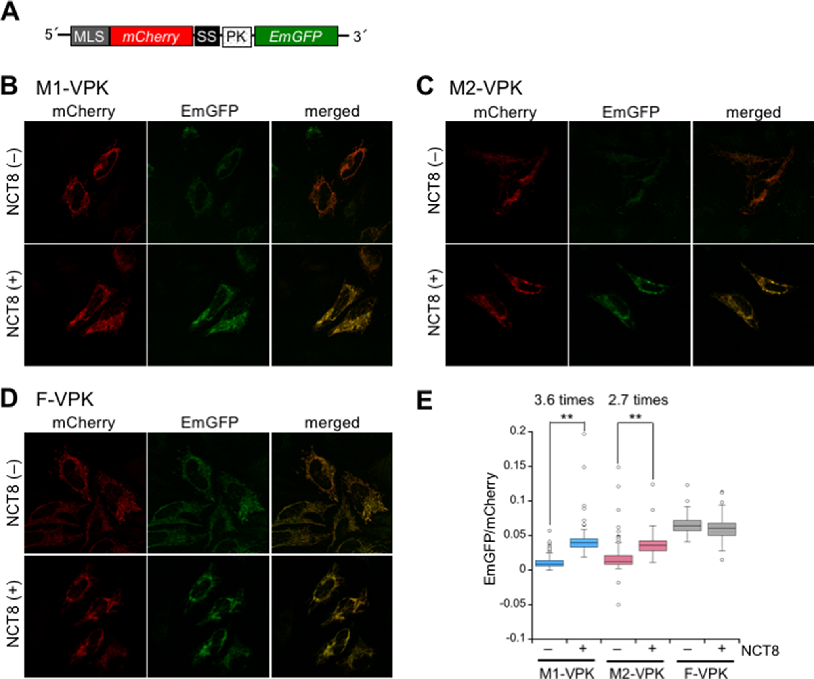
Figure 7. Detection of the proteins expressed as a result of NCT8-inducible –1PRF in live HeLa cells. (A) Schematic ...
Notes:
Figure 7. Detection of the proteins expressed as a result of NCT8-inducible –1PRF in live HeLa cells. (A) Schematic representation of the dual-fluorescence reporter construct used in the experiment. The constructs contain M1-, M2-, or F-VPK sequence (Supplementary Figure S1, indicated as PK) placed between the mCherry gene and the EmGFP gene. A mitochondrial localization signal (MLS) was fused to the N-terminus mCherry, so that the expression and localization of the fluorescent proteins could be easily detected in mitochondria. SS: Slippery sequence + stop codon. HeLa cells transfected with the dual-fluorescence reporter constructs carrying (B) M1-VPK, (C) M2-VPK and (D) F-VPK were incubated in the absence or presence of 0.1 μM NCT8 for 24 h, and the translation products were visualized using a confocal laser scanning microscope. (E) Box plot representing the distribution of the EmGFP/mCherry ratio in the mitochondria. The images in Figure 7B–D were analyzed and the intensity of each fluorescent protein was quantified using IN Cell Investigator 1.6 (GE Healthcare). Error bars represent SD based on 100 cells from each sample. ** denotes P < 0.001 (Student's t-test).
Unless provided in the caption above, the following copyright applies to the content of this slide: © The Author(s) 2018. Published by Oxford University Press on behalf of Nucleic Acids Research.This is an Open Access article distributed under the terms of the Creative Commons Attribution Non-Commercial License (http://creativecommons.org/licenses/by-nc/4.0/), which permits non-commercial re-use, distribution, and reproduction in any medium, provided the original work is properly cited. For commercial re-use, please contact journals.permissions@oup.com

