Slide 1
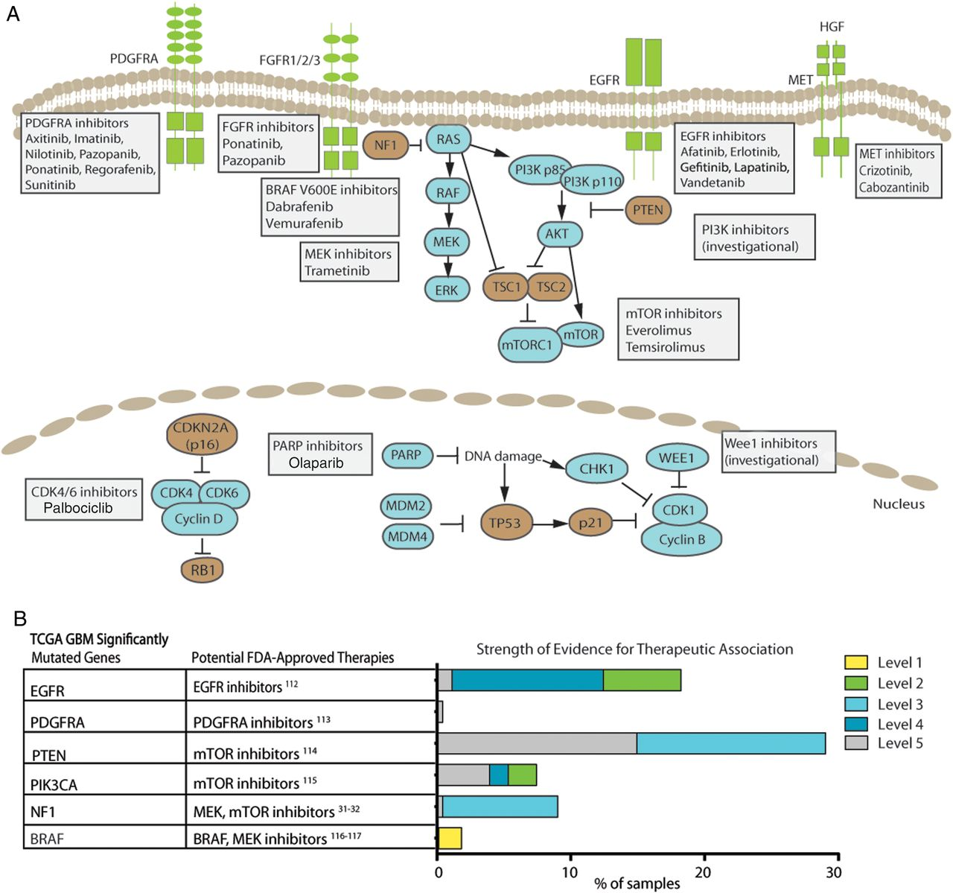
Fig. 1. Potential therapeutic implications of significantly mutated genes identified in the primary glioblastoma TCGA ...
Notes:
Fig. 1. Potential therapeutic implications of significantly mutated genes identified in the primary glioblastoma TCGA dataset. (A) Pathway representation of frequently altered pathways and selected potential therapeutic agents. (B) Table of frequently mutated genes from TCGA20 mapped to potential FDA-approved therapeutic agents. (Right) Bar chart of level of evidence for the association between an alteration and the therapeutic implication using the levels of evidence defined in Table 1.
Unless provided in the caption above, the following copyright applies to the content of this slide: © The Author(s) 2015. Published by Oxford University Press on behalf of the Society for Neuro-Oncology. All rights reserved. For permissions, please e-mail: journals.permissions@oup.com.

Slide 2
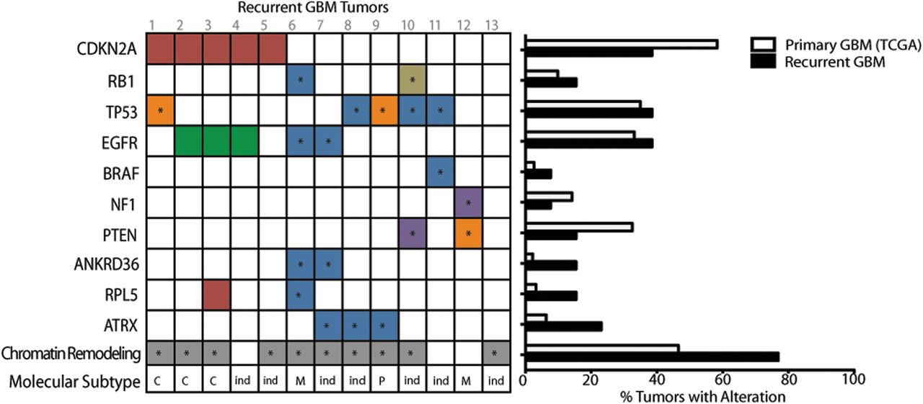
Fig. 2. Genomic alterations in recurrent glioblastoma tumors. (A) The spectrum of alterations identified within the ...
Notes:
Fig. 2. Genomic alterations in recurrent glioblastoma tumors. (A) The spectrum of alterations identified within the cohort of recurrent GBM samples was mapped against the subset of frequently altered genes previously identified in primary GBM.20 Red indicates copy number loss, green is copy number gain, an asterisk (*) Indicates nonsynonymous mutation, where missense mutations are colored blue, nonsense mutations colored purple, and frameshift mutations colored orange. Tan indicates a structural variant. Chromatin remodeling gene alterations are colored gray and include missense, nonsense and splice site mutations. The most dominant molecular subtype for each sample, based on the gene expression classifications of Verhaak et al,118 is shown. C, classical; M, mesenchymal; N, neural; P, proneural; ind, indeterminant. The bar chart indicates frequency of genomic alteration for each gene within the TCGA primary GBM dataset20 (white bars) and the recurrent GBM samples presented here (black bars).
Unless provided in the caption above, the following copyright applies to the content of this slide: © The Author(s) 2015. Published by Oxford University Press on behalf of the Society for Neuro-Oncology. All rights reserved. For permissions, please e-mail: journals.permissions@oup.com.

Slide 3
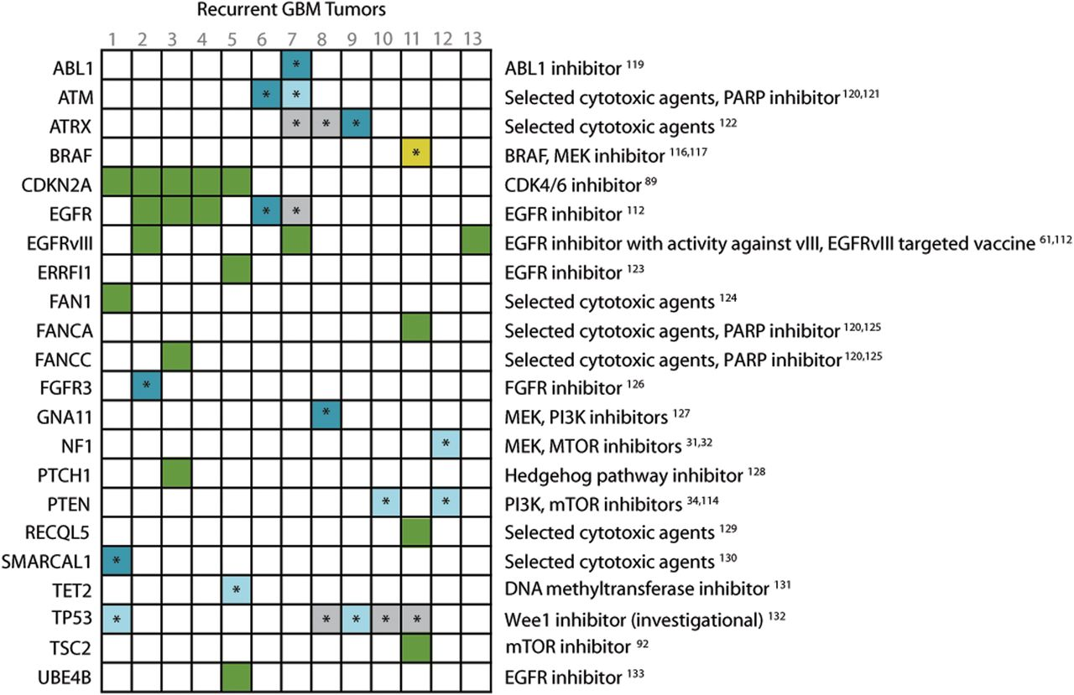
Fig. 3. Potential therapeutically actionable alterations identified in recurrent glioblastoma samples. The strength ...
Notes:
Fig. 3. Potential therapeutically actionable alterations identified in recurrent glioblastoma samples. The strength of evidence for therapeutic association for each alteration is depicted as in Fig. 1B. An asterisk (*) Indicates nonsynonymous mutation. Drug classes mapping to each alteration are shown on the right. Selection of investigational agents was limited to agents currently being tested in clinical trials for glioblastoma.
Unless provided in the caption above, the following copyright applies to the content of this slide: © The Author(s) 2015. Published by Oxford University Press on behalf of the Society for Neuro-Oncology. All rights reserved. For permissions, please e-mail: journals.permissions@oup.com.

