Slide 1
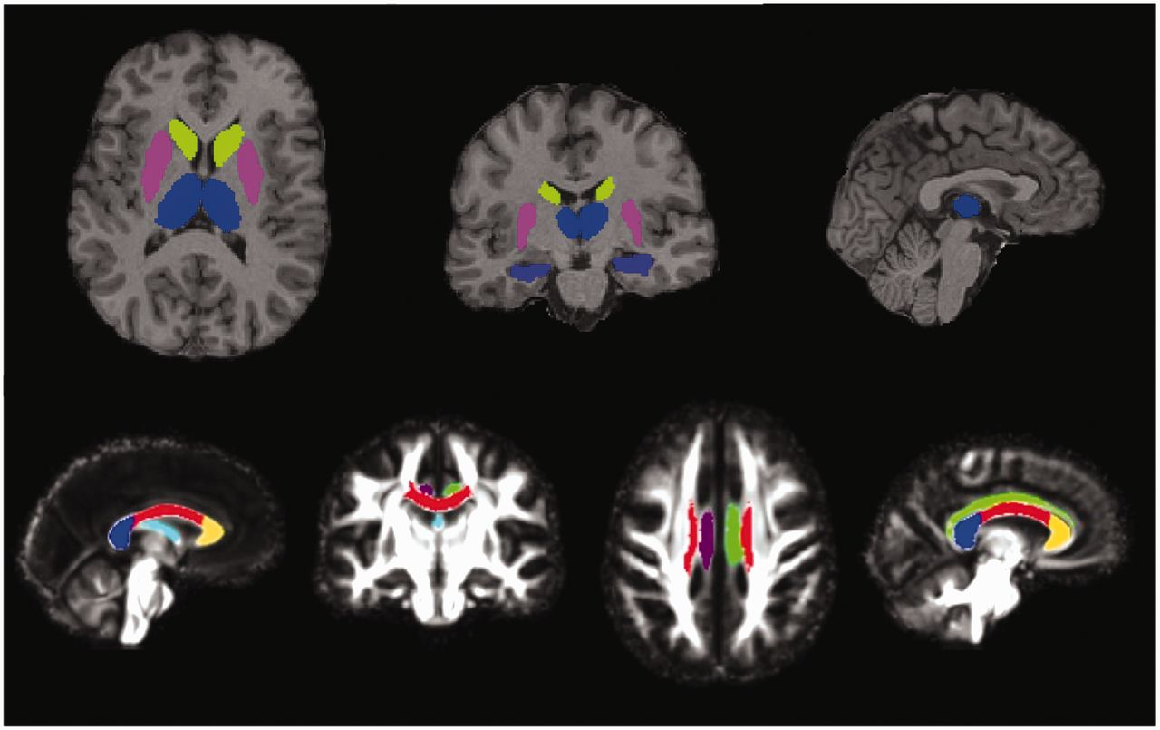
Figure 1 Regions of interest. Grey matter regions of interest (top): segmentations of thalamus (blue), caudate ...
Notes:
Figure 1 Regions of interest. Grey matter regions of interest (top): segmentations of thalamus (blue), caudate (green), putamen (pink) and hippocampus (purple) overlaid on the T1 image of a single subject. White matter tracts of interest (bottom): segmentations of the fornix (pale blue), right cingulum (purple), left cingulum (green), genu (yellow), body (red) and splenium (dark blue) of the corpus callosum, overlaid on the study-specific template.
Unless provided in the caption above, the following copyright applies to the content of this slide: © The Author (2013). Published by Oxford University Press on behalf of the Guarantors of Brain.This is an Open Access article distributed under the terms of the Creative Commons Attribution Non-Commercial License (http://creativecommons.org/licenses/by-nc/3.0/), which permits unrestricted non-commercial use, distribution, and reproduction in any medium, provided the original work is properly cited.

Slide 2
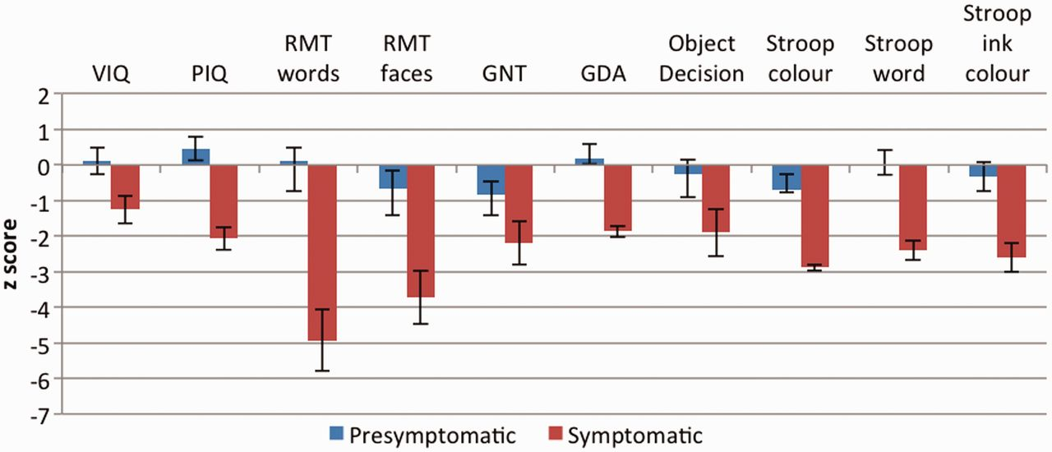
Figure 2 Mean and standard error z-scores for presymptomatic and symptomatic mutation carriers on standard ...
Notes:
Figure 2 Mean and standard error z-scores for presymptomatic and symptomatic mutation carriers on standard neuropsychological tests. GDA = Graded Difficulty Arithmetic; GNT = Graded Naming Test; PIQ = performance IQ; RMT = Recognition Memory Test; VIQ = verbal IQ.
Unless provided in the caption above, the following copyright applies to the content of this slide: © The Author (2013). Published by Oxford University Press on behalf of the Guarantors of Brain.This is an Open Access article distributed under the terms of the Creative Commons Attribution Non-Commercial License (http://creativecommons.org/licenses/by-nc/3.0/), which permits unrestricted non-commercial use, distribution, and reproduction in any medium, provided the original work is properly cited.

Slide 3
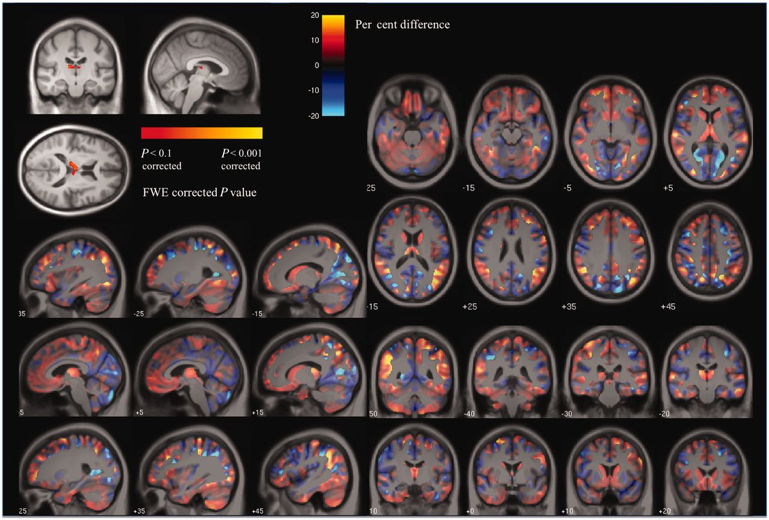
Figure 3 Voxel-based morphometry results showing (top left) areas of grey matter reduction in presymptomatic mutation ...
Notes:
Figure 3 Voxel-based morphometry results showing (top left) areas of grey matter reduction in presymptomatic mutation carriers compared with control subjects after correction for multiple comparisons at FWE < 0.1 and the effect-map for the PMC versus control group comparison. In the effect-map, regions showing reduced grey matter in the PMC group are shown in red and in control subjects in blue. Differences between the two adjusted group-means are overlaid on a mean study-specific template. Images shown in radiological convention (right on left).
Unless provided in the caption above, the following copyright applies to the content of this slide: © The Author (2013). Published by Oxford University Press on behalf of the Guarantors of Brain.This is an Open Access article distributed under the terms of the Creative Commons Attribution Non-Commercial License (http://creativecommons.org/licenses/by-nc/3.0/), which permits unrestricted non-commercial use, distribution, and reproduction in any medium, provided the original work is properly cited.

Slide 4
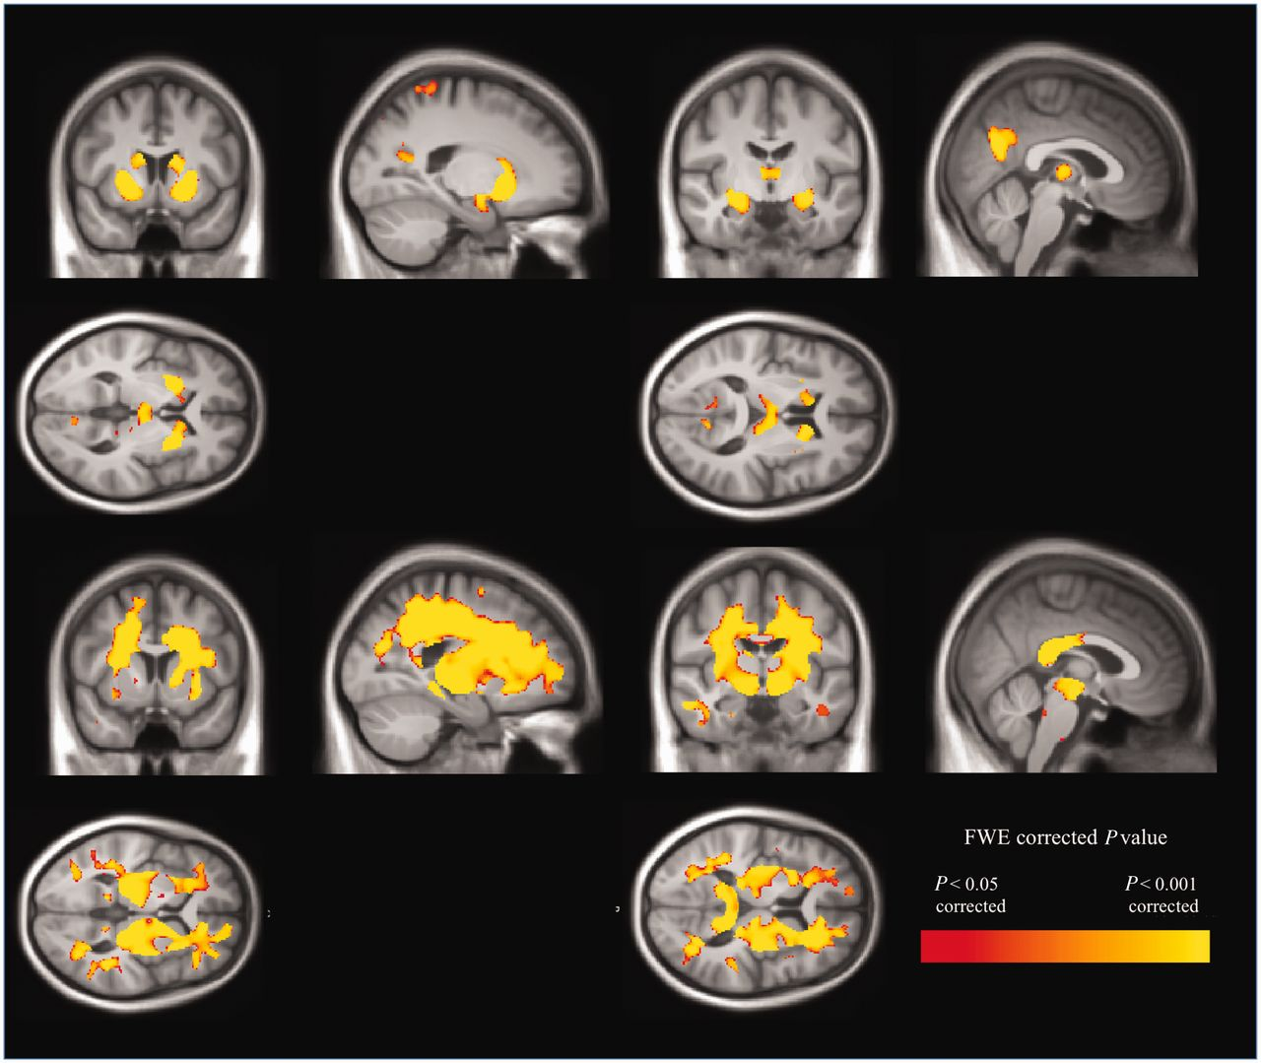
Figure 4 Voxel-based morphometry results showing (top) grey matter reduction and (bottom) white matter reduction in ...
Notes:
Figure 4 Voxel-based morphometry results showing (top) grey matter reduction and (bottom) white matter reduction in symptomatic mutation carriers compared with control subjects. Results are shown overlaid on a mean study-specific template and are FWE-corrected for multiple comparisons. Images shown in radiological convention (right on left).
Unless provided in the caption above, the following copyright applies to the content of this slide: © The Author (2013). Published by Oxford University Press on behalf of the Guarantors of Brain.This is an Open Access article distributed under the terms of the Creative Commons Attribution Non-Commercial License (http://creativecommons.org/licenses/by-nc/3.0/), which permits unrestricted non-commercial use, distribution, and reproduction in any medium, provided the original work is properly cited.

Slide 5
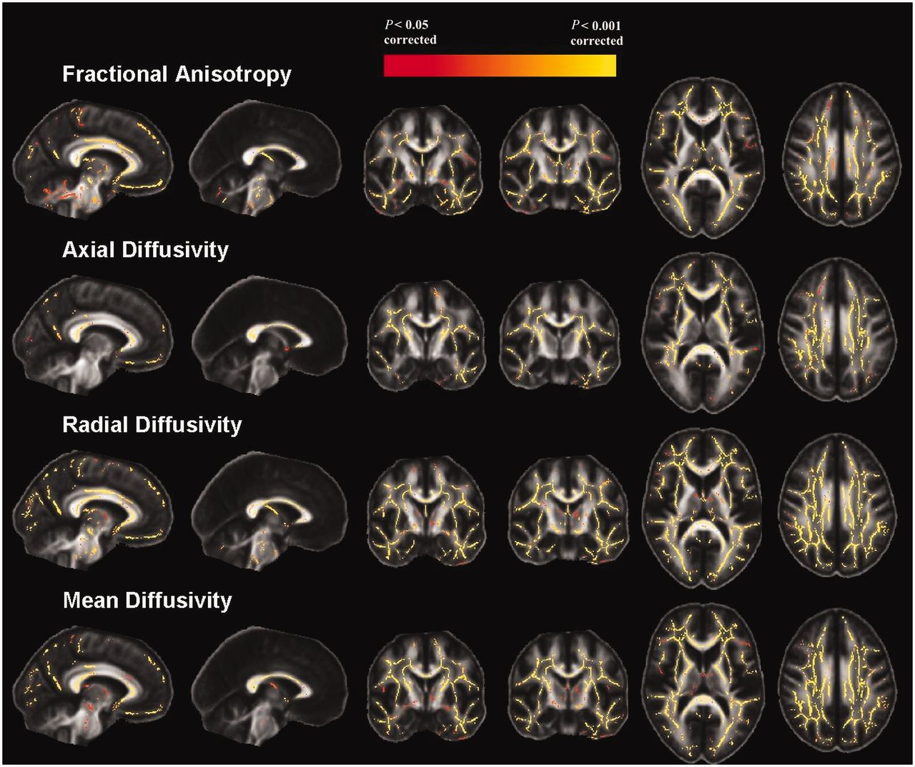
Figure 5 TBSS results demonstrating areas of significantly decreased fractional anisotropy and significantly increased ...
Notes:
Figure 5 TBSS results demonstrating areas of significantly decreased fractional anisotropy and significantly increased axial, radial and mean diffusivity in symptomatic mutation carriers compared with control subjects. Results are FWE-corrected for multiple comparisons using threshold-free cluster enhancement.
Unless provided in the caption above, the following copyright applies to the content of this slide: © The Author (2013). Published by Oxford University Press on behalf of the Guarantors of Brain.This is an Open Access article distributed under the terms of the Creative Commons Attribution Non-Commercial License (http://creativecommons.org/licenses/by-nc/3.0/), which permits unrestricted non-commercial use, distribution, and reproduction in any medium, provided the original work is properly cited.

