Slide 1
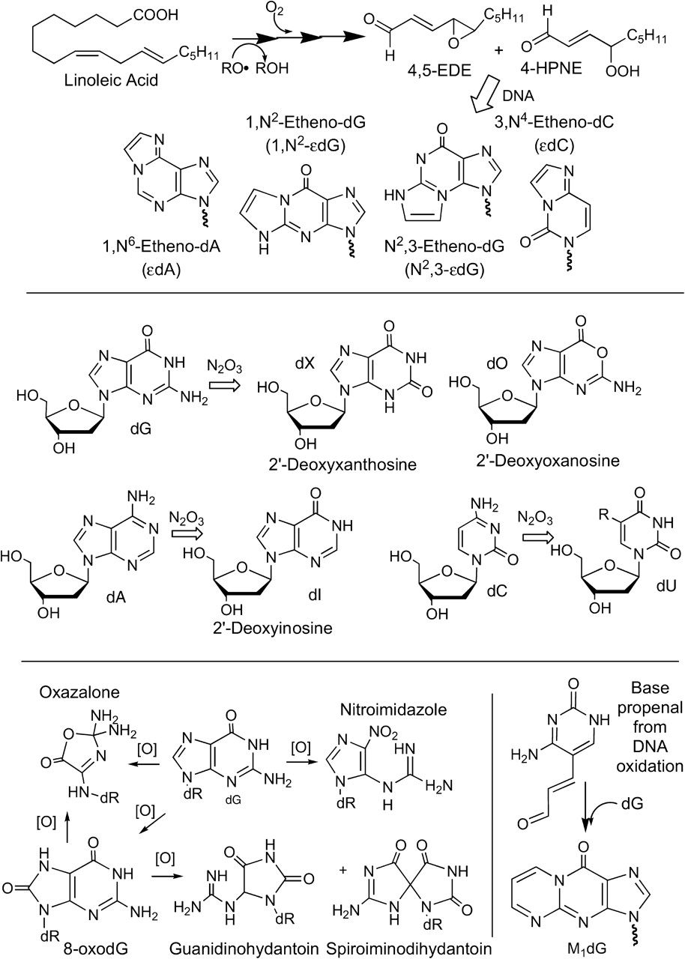
Fig. 1. Chemistry of DNA damage associated with the reactive oxygen and nitrogen species arising from NO ...
Notes:
Fig. 1. Chemistry of DNA damage associated with the reactive oxygen and nitrogen species arising from NO overproduction during inflammation.
Unless provided in the caption above, the following copyright applies to the content of this slide: © The Author 2007. Published by Oxford University Press. All rights reserved. For Permissions, please email: journals.permissions@oxfordjournals.org

Slide 2
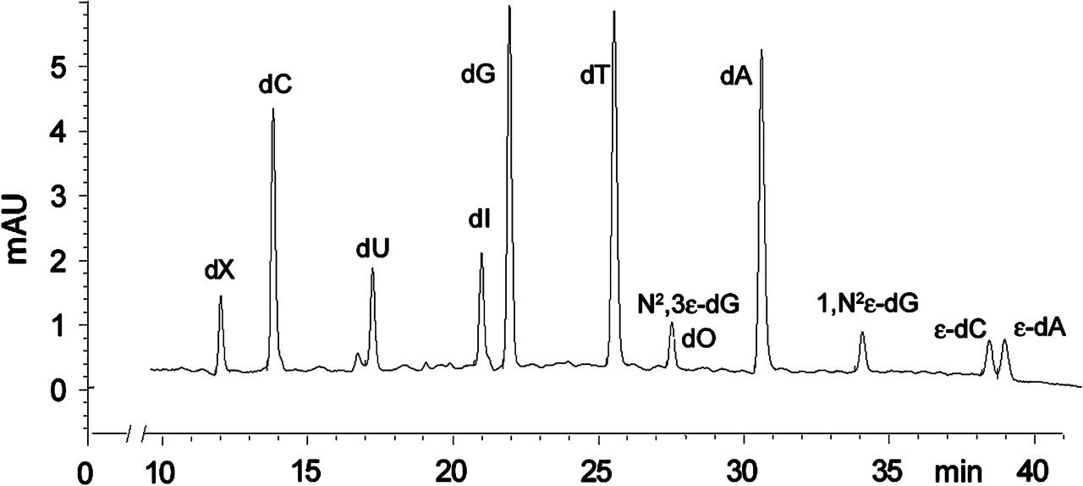
Fig. 2. Example of HPLC resolution of normal deoxynucleosides and various DNA damage products prior to LC–MS/MS ...
Notes:
Fig. 2. Example of HPLC resolution of normal deoxynucleosides and various DNA damage products prior to LC–MS/MS analysis. This chromatogram was prepared using chemical standards.
Unless provided in the caption above, the following copyright applies to the content of this slide: © The Author 2007. Published by Oxford University Press. All rights reserved. For Permissions, please email: journals.permissions@oxfordjournals.org

