Slide 1
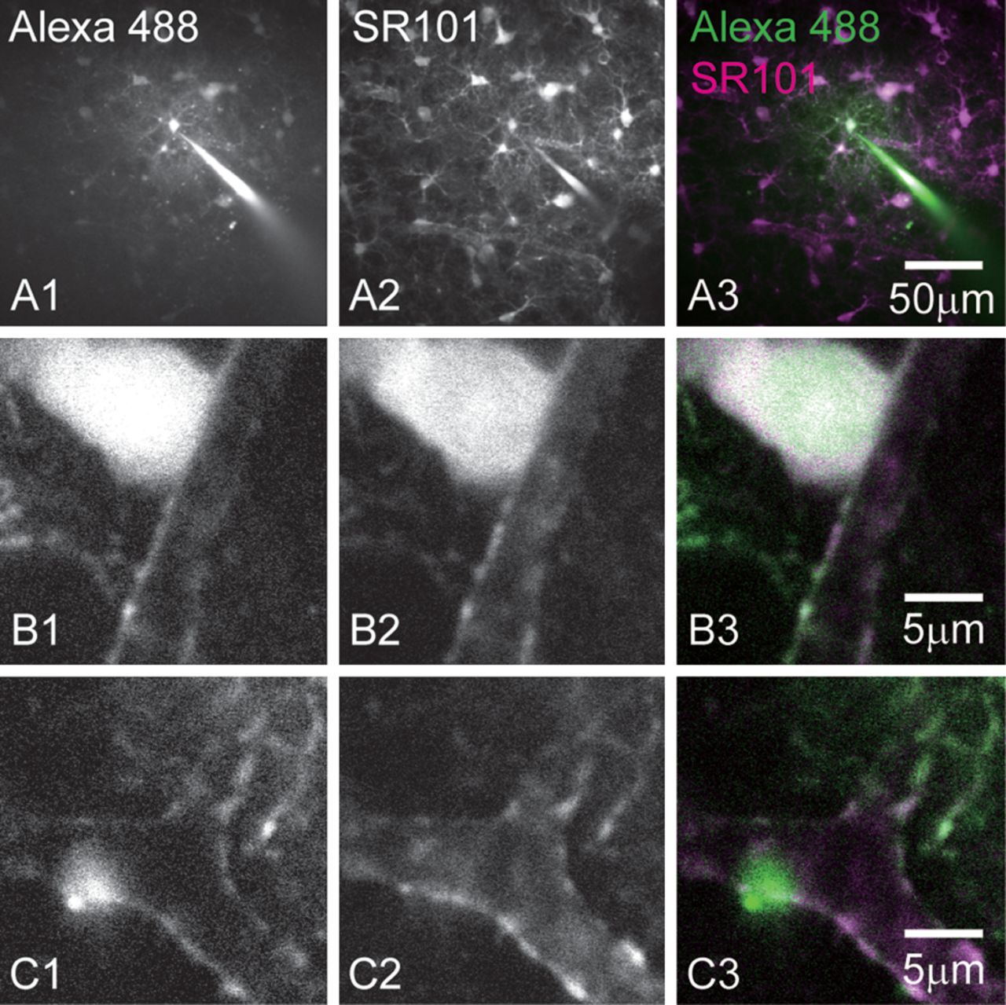
Figure 1. Astrocyte labeling with SR101. (A) A single astrocyte was intracellularly loaded with Alexa Fluor 488 (A1) in ...
Notes:
Figure 1. Astrocyte labeling with SR101. (A) A single astrocyte was intracellularly loaded with Alexa Fluor 488 (A1) in a brain slice loaded with SR101 (A2) in the bath (A1–A3, Z-stack image). Higher magnification single-plane images (B and C) revealed that the SR101-labeled structures around the blood vessel (B2, C2) were the endfeet of astrocytes loaded with Alexa Fluor 488 (B1, C1). In merged images, fluorescence signals of Alexa Fluor 488 and SR101 are shown in green and magenta, respectively (A3, B3, and C3).
Unless provided in the caption above, the following copyright applies to the content of this slide: © The Author 2012. Published by Oxford University Press. All rights reserved. For Permissions, please e-mail: journals.permissions@oup.com

Slide 2
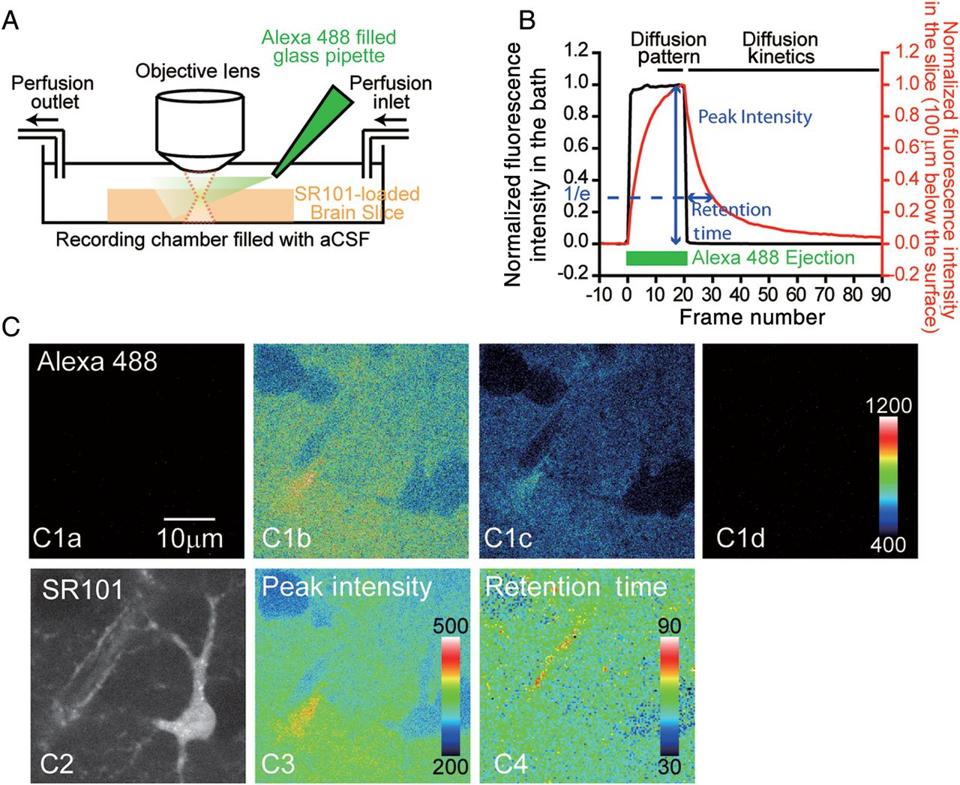
Figure 2. Two-photon diffusion analyses of the brain ECS. (A) Schematic diagram of the experiment. Three hundred ...
Notes:
Figure 2. Two-photon diffusion analyses of the brain ECS. (A) Schematic diagram of the experiment. Three hundred micrometer-thick cortical brain slices loaded with SR101 were placed in the imaging chamber, and the astrocyte endfeet located at around 100 μm below the surface were monitored. The diffusion of Alexa Fluor 488 ejected from a glass pipette placed above the slice was monitored using time-lapse imaging. (B) An example of the fluorescent intensity changes recorded in the bath and in the slice. An example of the fluorescent intensity changes recorded in the bath (black) and in the slice (100 μm below the surface, red). The fluorescence intensity changes were slowed inside the brain slice because of the hindrance of diffusion in the brain ECS. From these curves, the diffusion patterns (peak intensity) and diffusion kinetics (retention time) of Alexa Fluor 488 at each position in the imaging field were calculated. (C) The representative example of diffusion analyses of the brain ECS. Diffusion patterns of Alexa Fluor 488 at the start of the recording (C1a), at the end of Alexa Fluor 488 ejection (C1b), at 10 frames later (C1c), and at 70 frames later (C1d), in a field of view that contains an astrocyte soma and a blood vessel labeled with SR101 (C2). From these diffusion patterns of Alexa Fluor 488, the peak intensity and the retention time (in seconds) at each position can be obtained (C3 and C4, respectively).
Unless provided in the caption above, the following copyright applies to the content of this slide: © The Author 2012. Published by Oxford University Press. All rights reserved. For Permissions, please e-mail: journals.permissions@oup.com

Slide 3
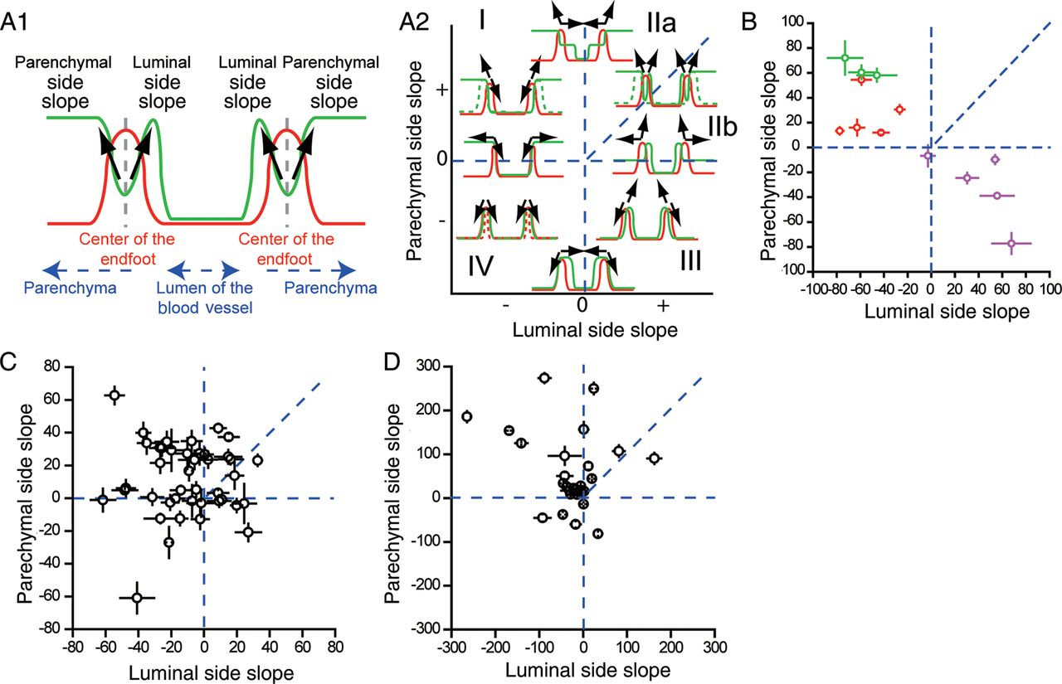
Figure 4. Heterogeneous diffusion properties at astrocyte endfeet. (A) Schematic diagram showing the relationship ...
Notes:
Figure 4. Heterogeneous diffusion properties at astrocyte endfeet. (A) Schematic diagram showing the relationship between the Alexa Fluor 488 diffusion patterns around the astrocyte endfeet and their diffusion slopes. The red and green lines indicate the intensities of the SR101-stained endfeet and the Alexa Fluor 488 signals, respectively. The black arrows indicate the slopes of Alexa Fluor 488 fluorescence intensity profiles at luminal and parenchymal sides, originating from the center of endfoot (gray dotted line; A1). In A2, each section indicates cases where the endfeet block invasion of Alexa Fluor 488 (I), partly (II), or completely (III) allows the invasion of Alexa Fluor 488, or distance between the diffusion boundary and the center of endfoot falls below the spatial resolution of the system (IV). Section II is further divided into 2 cases where the endfoot blockade is strong (IIa) or weak (IIb). Dotted lines in green and red indicate other fluorescence patterns of Alexa Fluor 488 and SR101 than shown in solid lines, which nevertheless result in the same category. (B) Repeatability of the analyses. Data obtained from multiple recordings at the same target site were plotted in the same color. The data were distributed in different regions among the different sites (green, red, and magenta), but were clustered within the same region over multiple recordings. (C) Summary of diffusion patterns of unconjugated Alexa Fluor 488. All the collected data were analyzed and plotted (n = 42). The error bars indicate the standard errors of the linear fits for the calculations of the slopes. (D) Summary of diffusion patterns of 10-kDa dextran-conjugated Alexa Fluor 488. All the collected data were analyzed and plotted (n = 30). The error bars indicate the standard errors of the linear fits for the calculations of the slopes.
Unless provided in the caption above, the following copyright applies to the content of this slide: © The Author 2012. Published by Oxford University Press. All rights reserved. For Permissions, please e-mail: journals.permissions@oup.com

Slide 4
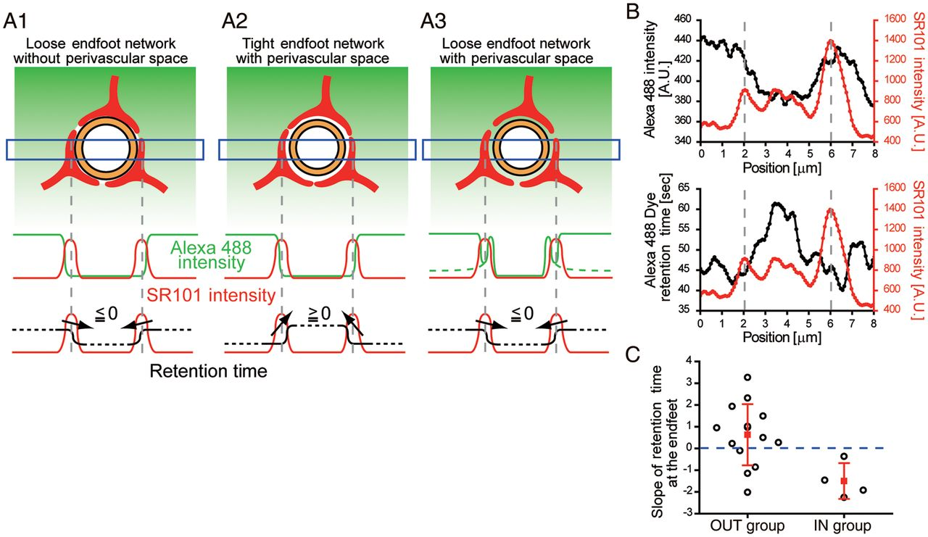
Figure 5. An astrocyte endfoot network can create a diffusion-limited space. (A) Schematic illustrations depicting 2 ...
Notes:
Figure 5. An astrocyte endfoot network can create a diffusion-limited space. (A) Schematic illustrations depicting 2 different scenarios in which dye diffusion is limited at the endfeet. When dye cannot accumulate inside the endfoot network simply because of the lack of space between the endfeet and blood vessel, despite a loose connection, the dye within this limited space will not be subjected to a diffusion barrier and, therefore, the retention time will not be longer than that outside, resulting in zero or negative slopes at the center of the endfeet (A1). In contrast, if the endfoot network is tight, any dye that manages to diffuse inside the endfoot network would be subjected to a diffusion barrier, making the dye retention time longer inside the endfoot network than outside, regardless of the space inside, giving rise to positive slopes (A2). For comparison, the case when dyes freely diffuse inside the endfoot network is also shown (A3). (B) Representative data of retention time analysis. The upper panel shows the pattern of Alexa Fluor 488 (black) and SR101 (red), and the lower panel shows the relationship between the dye retention time (black) and SR101 (red) at the corresponding region. (C) Comparison of retention time slope between different diffusion groups. Data were categorized according to the diffusion patterns as shown in Figure 4A2 (I, OUT group; III, IN group). The open circles show individual data, and the filled squares indicate the mean values of the data with whiskers showing the standard deviations in each group. The OUT group has significantly bigger slope than the IN group (P < 0.02, Mann–Whitney test; OUT, n = 14; IN, n = 4).
Unless provided in the caption above, the following copyright applies to the content of this slide: © The Author 2012. Published by Oxford University Press. All rights reserved. For Permissions, please e-mail: journals.permissions@oup.com

Slide 5
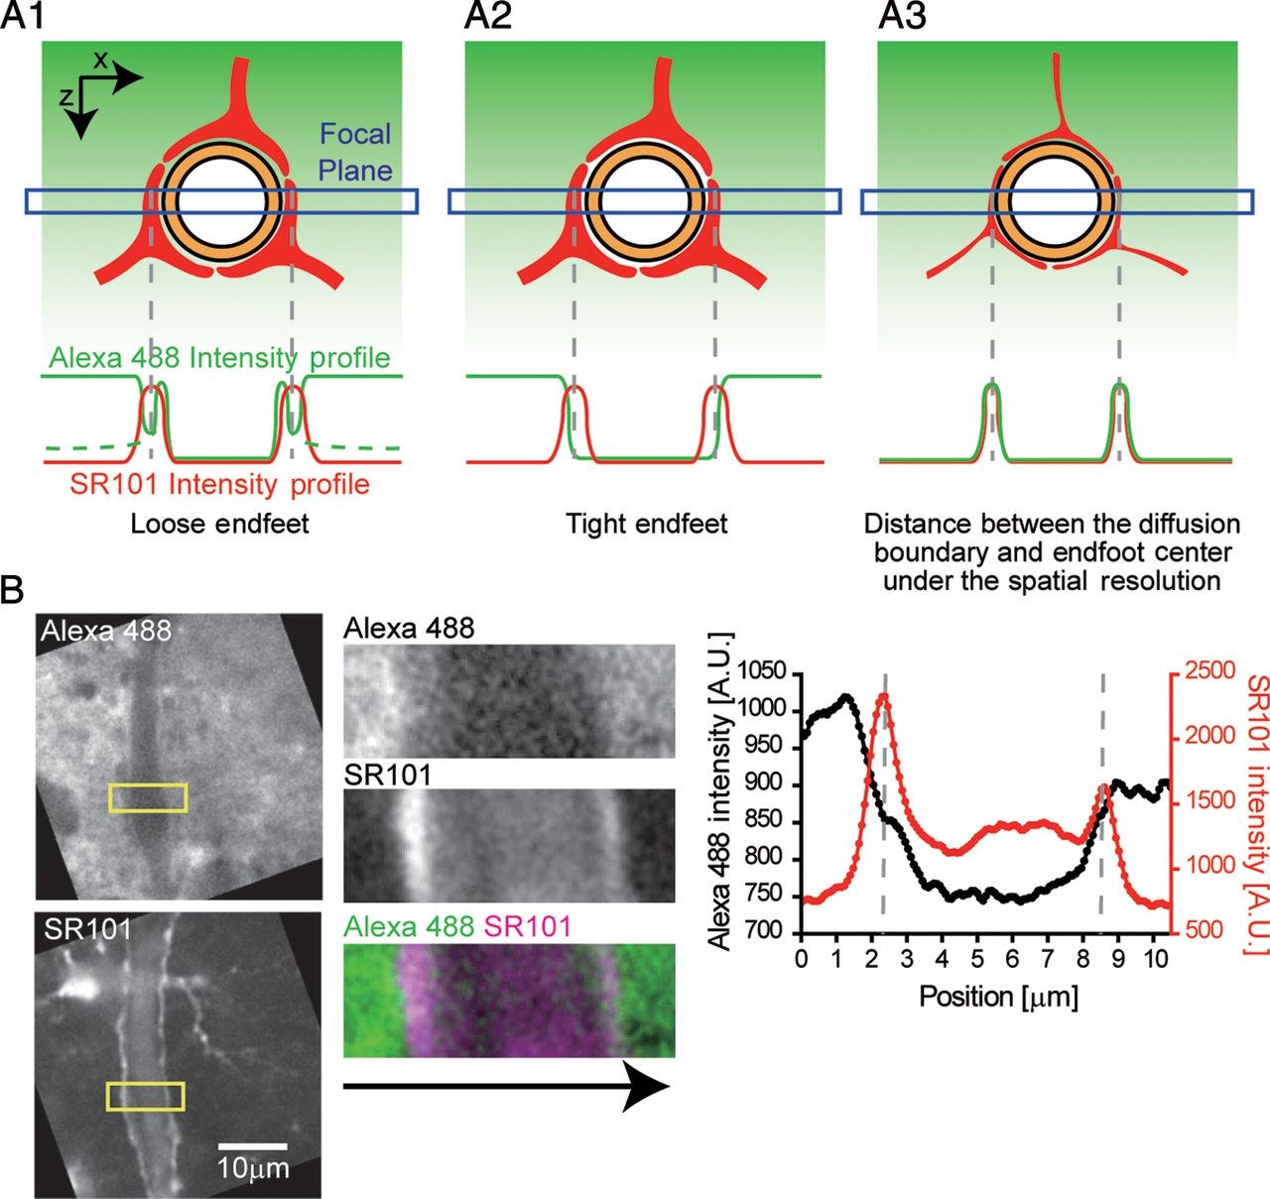
Figure 3. Two-photon diffusion analyses at astrocyte endfeet. (A) Schematics of different degrees of diffusion barrier ...
Notes:
Figure 3. Two-photon diffusion analyses at astrocyte endfeet. (A) Schematics of different degrees of diffusion barrier functions of astrocyte endfeet and resulting fluorescence intensity profiles. Three potential patterns are illustrated. Alexa Fluor 488 (green) applied from the top diffused into the brain slices and reached the endfoot network (red) surrounding the endothelial cells (orange). When the intensity profiles at the 2-photon excitation focal plane (blue box) were analyzed, these result in characteristic patterns (bottom). If the endfeet are loosely connected, a peak in Alexa Fluor 488 intensity would be visible inside the endfoot wall (A1), while such a peak would be absent if the endfeet are tight enough to block the diffusion (A2). A partial contribution of loose endfoot network as diffusion barriers results in rise of Alexa Fluor 488 fluorescence intensity outside endfoot (solid line), whereas it falls without its contribution (dotted line) in A1. If the distances between the diffusion boundary and the center of endfoot are below the spatial resolution of the system, the intensities of the Alexa Fluor 488 and SR101 signals decrease simultaneously regardless of the diffusion pattern (A3). (B) Representative example of Alexa Fluor 488 diffusion patterns at blood vessels. Diffusion patterns of Alexa Fluor 488 around the target endfeet visualized using SR101 images (left panels). The middle panels show enlarged images of the regions of interest in the left panels (yellow boxes), illustrating the pattern of Alexa Fluor 488 (green) diffusion around the astrocyte endfeet (magenta). The intensity profiles of the Alexa Fluor 488 and SR101 signals along the x-axis (arrow) were analyzed and plotted (right panel: Alexa Fluor 488, black; SR101, red).
Unless provided in the caption above, the following copyright applies to the content of this slide: © The Author 2012. Published by Oxford University Press. All rights reserved. For Permissions, please e-mail: journals.permissions@oup.com

Slide 6
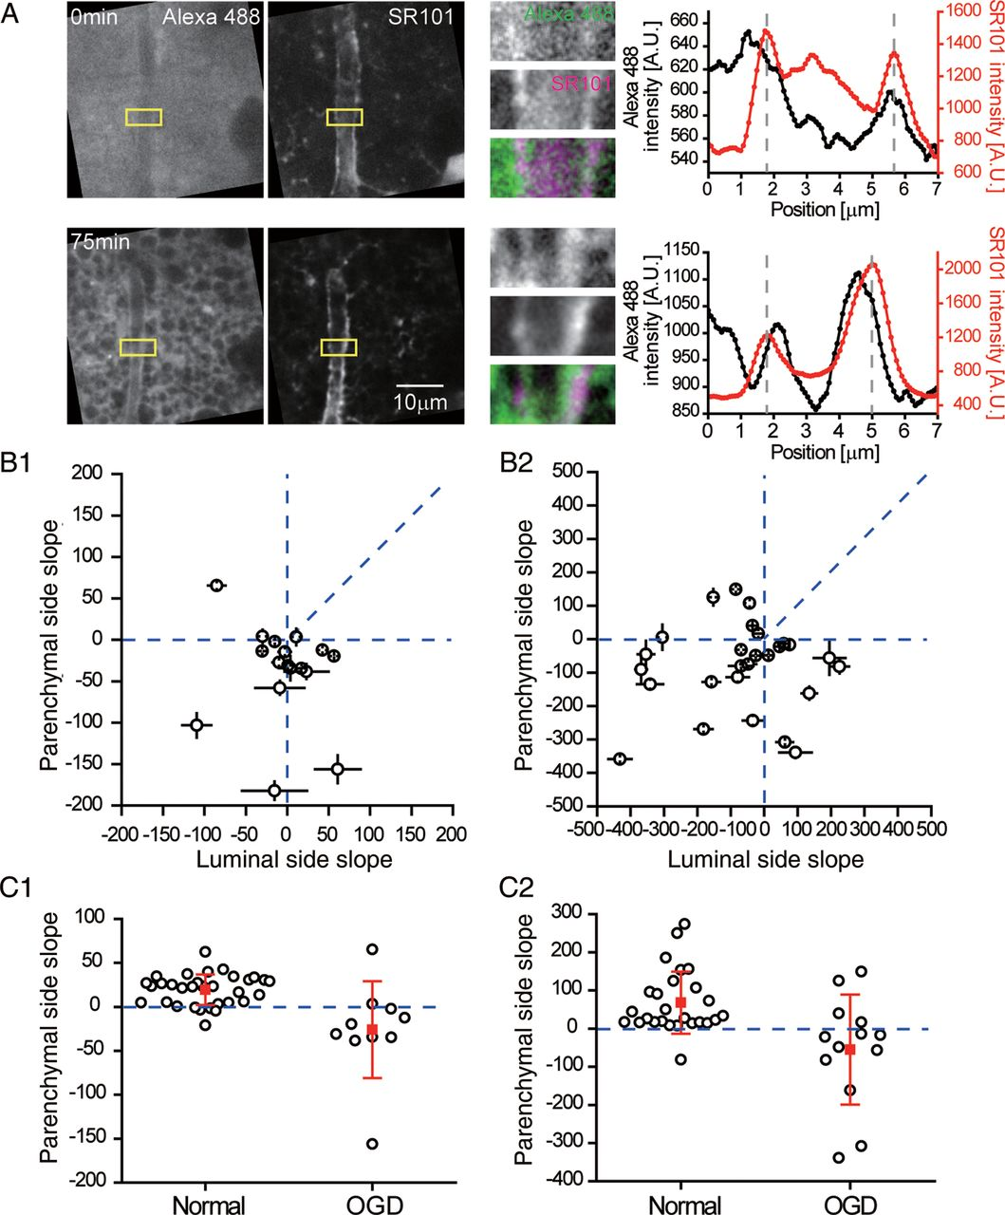
Figure 6. Severe tissue damage leads to dye permeation at astrocyte endfeet. (A) Changes in diffusion patterns upon ...
Notes:
Figure 6. Severe tissue damage leads to dye permeation at astrocyte endfeet. (A) Changes in diffusion patterns upon exposure to OGD conditions. Images of Alexa Fluor 488 and SR101 in a brain slice at 0 (under normal conditions) and 75 min (after exposure to OGD conditions) are shown (left). Intensity profiles (right) of the same area (middle panels) reveal the changes in the diffusion patterns. (B) Summary graph of Alexa Fluor 488 invasion under OGD conditions. The slopes of unconjugated (B1, n = 16) and 10-kDa dextran-conjugted (B2, n = 28) Alexa Fluor 488 diffusion were calculated and plotted. (C) Comparison of parenchymal side slopes among groups. The slopes of unconjugated (C1) and 10-kDa dextran-conjugated (C2) Alexa Fluor 488 at the parenchymal side of the endfeet were plotted. The open circles show the individual data and the filled squares indicate the mean values of the data with whiskers showing the standard deviations in each group. The OGD groups have significantly smaller parenchymal slope values than the control groups for both unconjugated Alexa Fluor 488 (C1, P < 1 × 10−3, Mann–Whitney test; normal, n = 32; OGD, n = 10) and 10-kDa dextran-conjugated Alexa Fluor 488 (C2, P < 5 × 10−3, Mann–Whitney test; normal, n = 26; OGD, n = 13).
Unless provided in the caption above, the following copyright applies to the content of this slide: © The Author 2012. Published by Oxford University Press. All rights reserved. For Permissions, please e-mail: journals.permissions@oup.com

