Slide 1
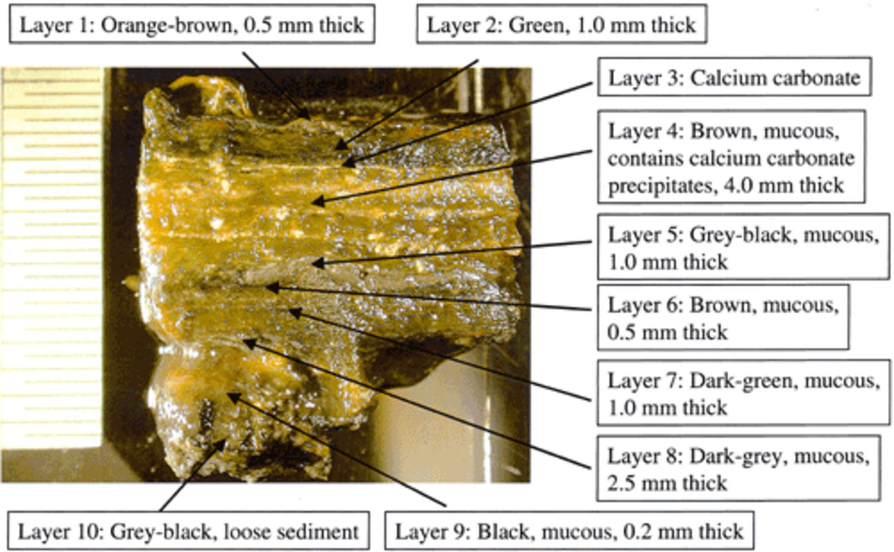
1 Photograph of a vertical cut of a Chiprana lake microbial mat. Distinct layers are clearly visible. See ...
Notes:
1 Photograph of a vertical cut of a Chiprana lake microbial mat. Distinct layers are clearly visible. See Section 3 for a microscopic description of cyanobacterial and algal morphotypes present in the respective layers.
Unless provided in the caption above, the following copyright applies to the content of this slide: © 2003 Federation of European Microbiological Societies. Published by Elsevier Science B.V. All rights reserved.

Slide 2
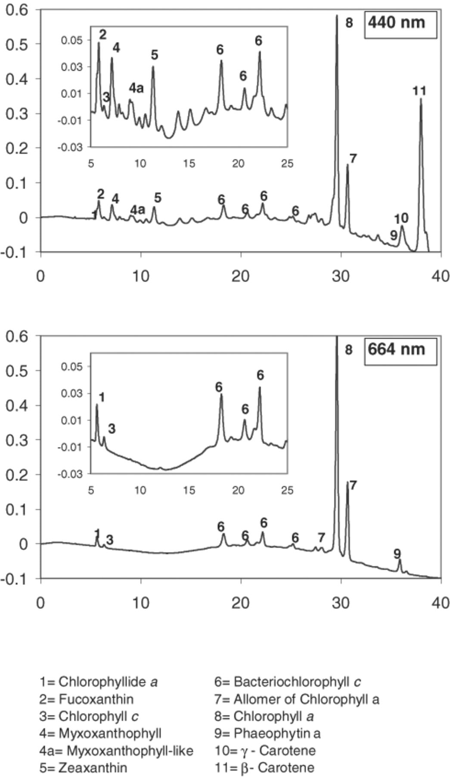
2 HPLC chromatograms of a pigment extract of the top mm of the mat sampled in October 2000. Chloroflexus-like ...
Notes:
2 HPLC chromatograms of a pigment extract of the top mm of the mat sampled in October 2000. Chloroflexus-like filamentous bacteria dominate the mat surface layer what is reflected by the presence of BChlc.
Unless provided in the caption above, the following copyright applies to the content of this slide: © 2003 Federation of European Microbiological Societies. Published by Elsevier Science B.V. All rights reserved.

Slide 3
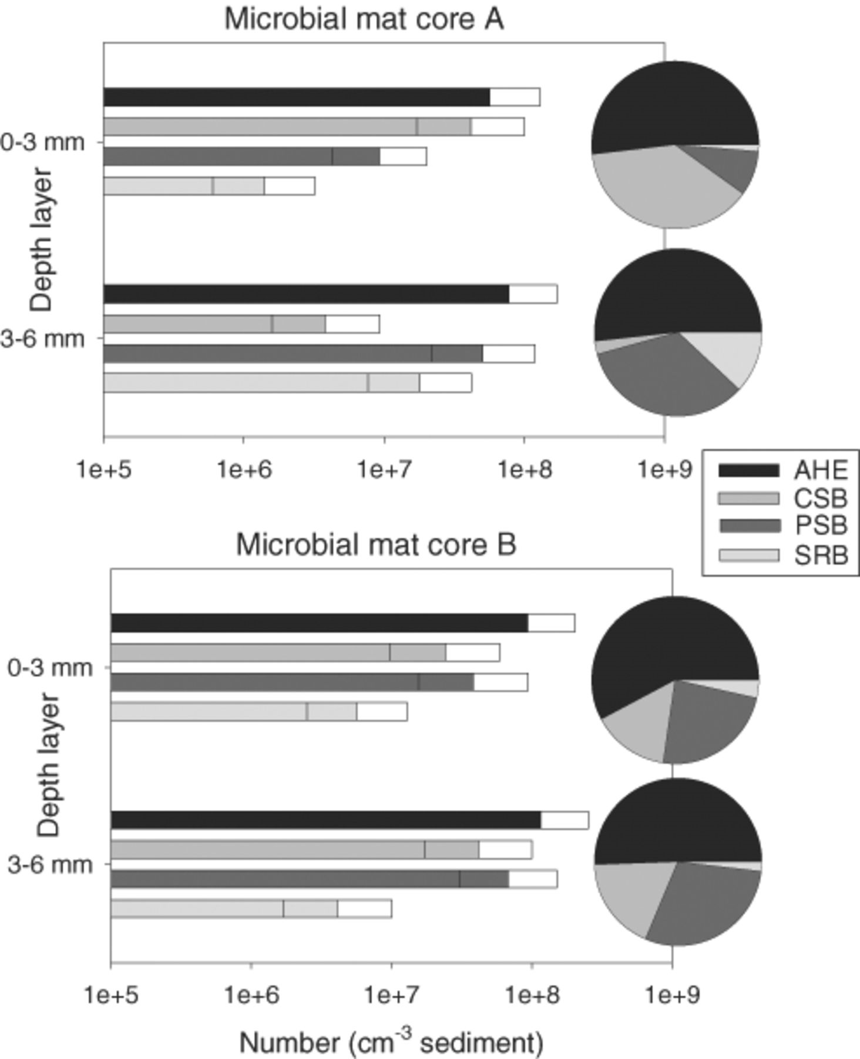
3 Most probable number estimates in duplicate cores of aerobic heterotrophic, sulfate-reducing, anoxygenic ...
Notes:
3 Most probable number estimates in duplicate cores of aerobic heterotrophic, sulfate-reducing, anoxygenic phototrophic and colorless sulfur bacteria in the photic (0–3 mm) and aphotic (3–6 mm) layers of the Chiprana lake microbial mat. Pie charts show relative abundance of estimated groups.
Unless provided in the caption above, the following copyright applies to the content of this slide: © 2003 Federation of European Microbiological Societies. Published by Elsevier Science B.V. All rights reserved.

Slide 4
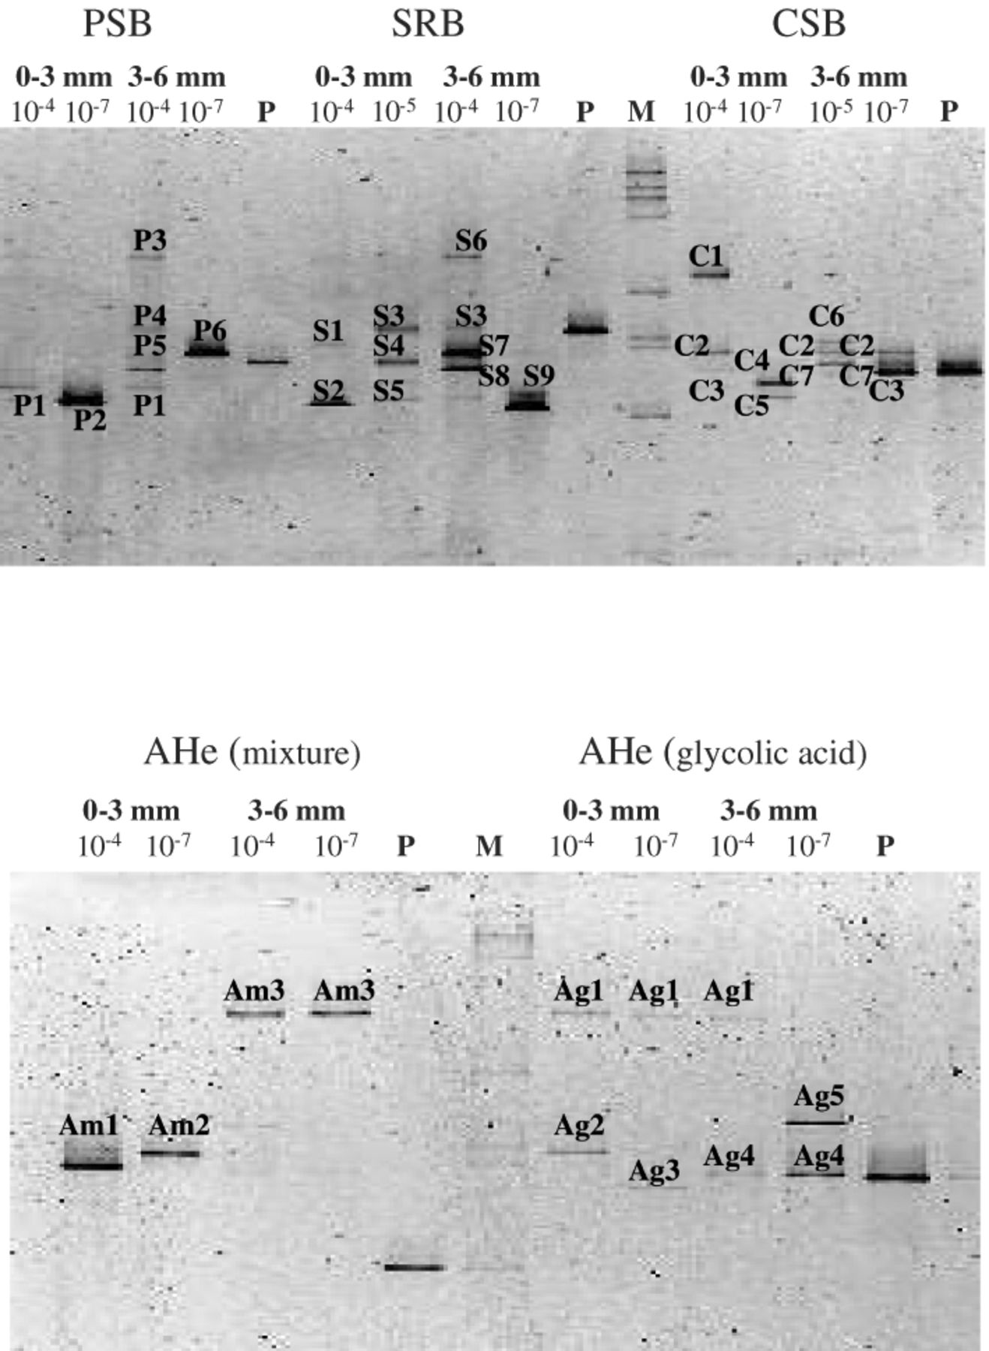
4 Negative images of DGGE separation patterns of PCR-amplified 16S rRNA gene fragments from MPN enrichment ...
Notes:
4 Negative images of DGGE separation patterns of PCR-amplified 16S rRNA gene fragments from MPN enrichment cultures. Functional group, depth layer (0–3 or 3–6 mm) and MPN dilution levels are shown above the lanes. Pc and M refer to positive controls and mass standards respectively. Distinct band (phylotypes) numbers refer to the specific functional group (P, purple sulfur bacteria; S, sulfate-reducing bacteria; C, colorless sulfur bacteria; Am, aerobic heterotrophs enriched on mixed organic substrates; Ag, aerobic heterotrophs enriched on glycolic acid) and to the distinct migration position in the gel.
Unless provided in the caption above, the following copyright applies to the content of this slide: © 2003 Federation of European Microbiological Societies. Published by Elsevier Science B.V. All rights reserved.

Slide 5
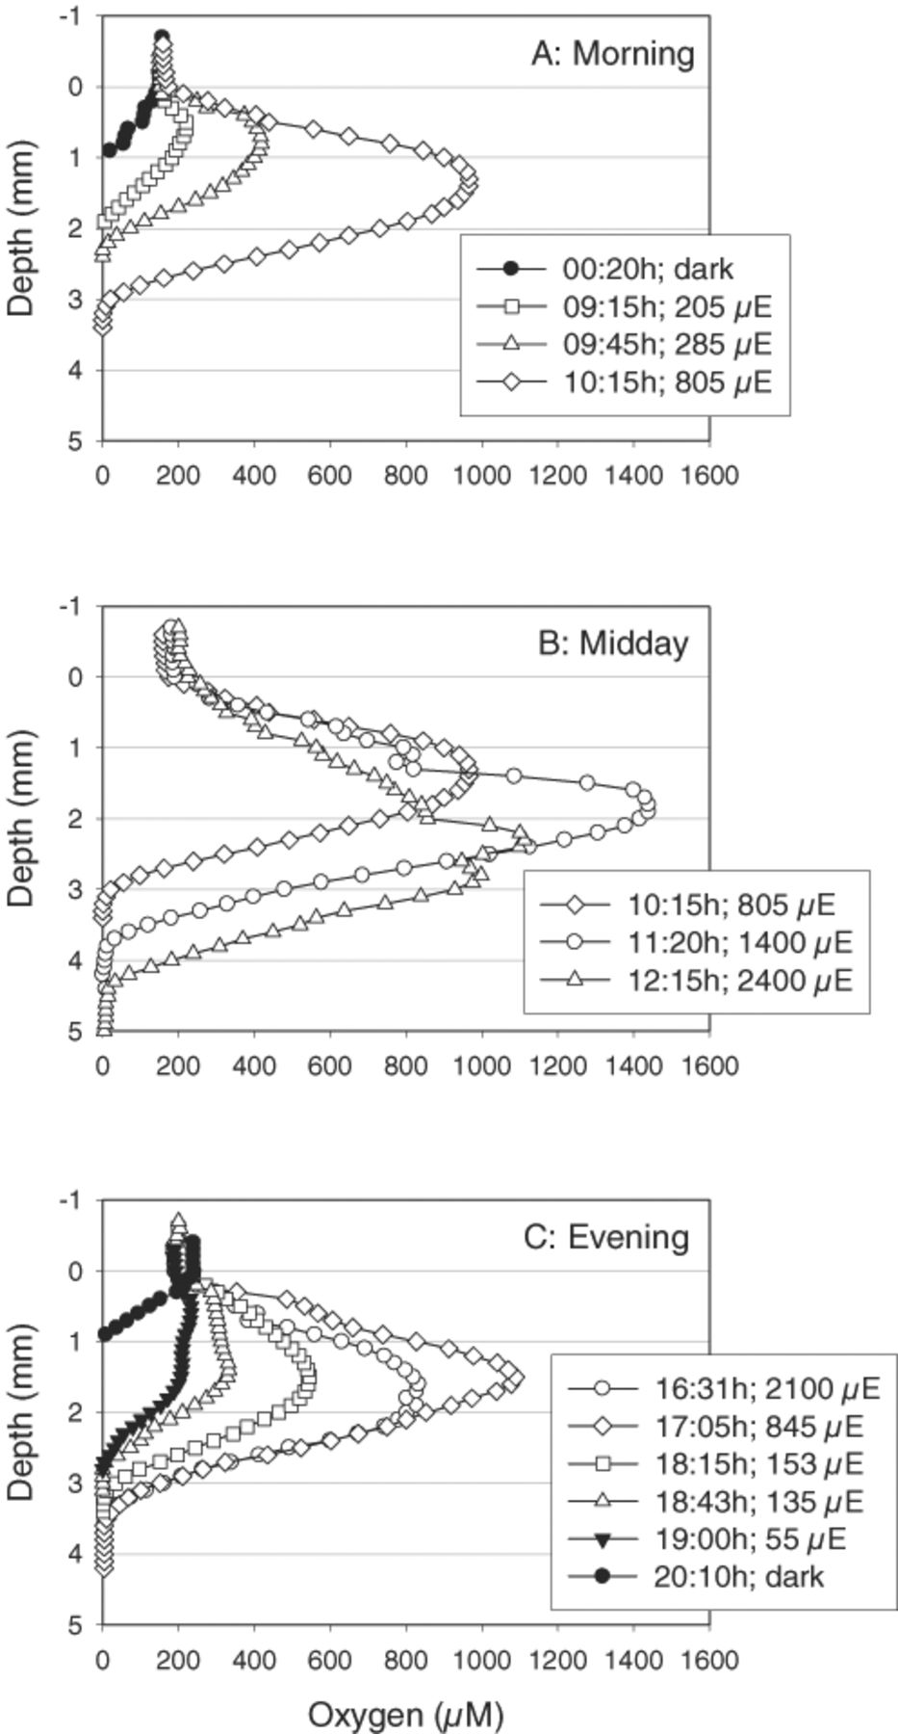
5 In situ daily dynamics of oxygen concentration in Chiprana lake microbial mat (October 2000). Midday profiles ...
Notes:
5 In situ daily dynamics of oxygen concentration in Chiprana lake microbial mat (October 2000). Midday profiles (B) show that at higher light intensities (1400 and 2400 μmol photons m−2 s−1) multiple oxygen concentration maxima occur but that the oxygen concentration in the surface layer (0–2 mm) simultaneously decreases.
Unless provided in the caption above, the following copyright applies to the content of this slide: © 2003 Federation of European Microbiological Societies. Published by Elsevier Science B.V. All rights reserved.

Slide 6
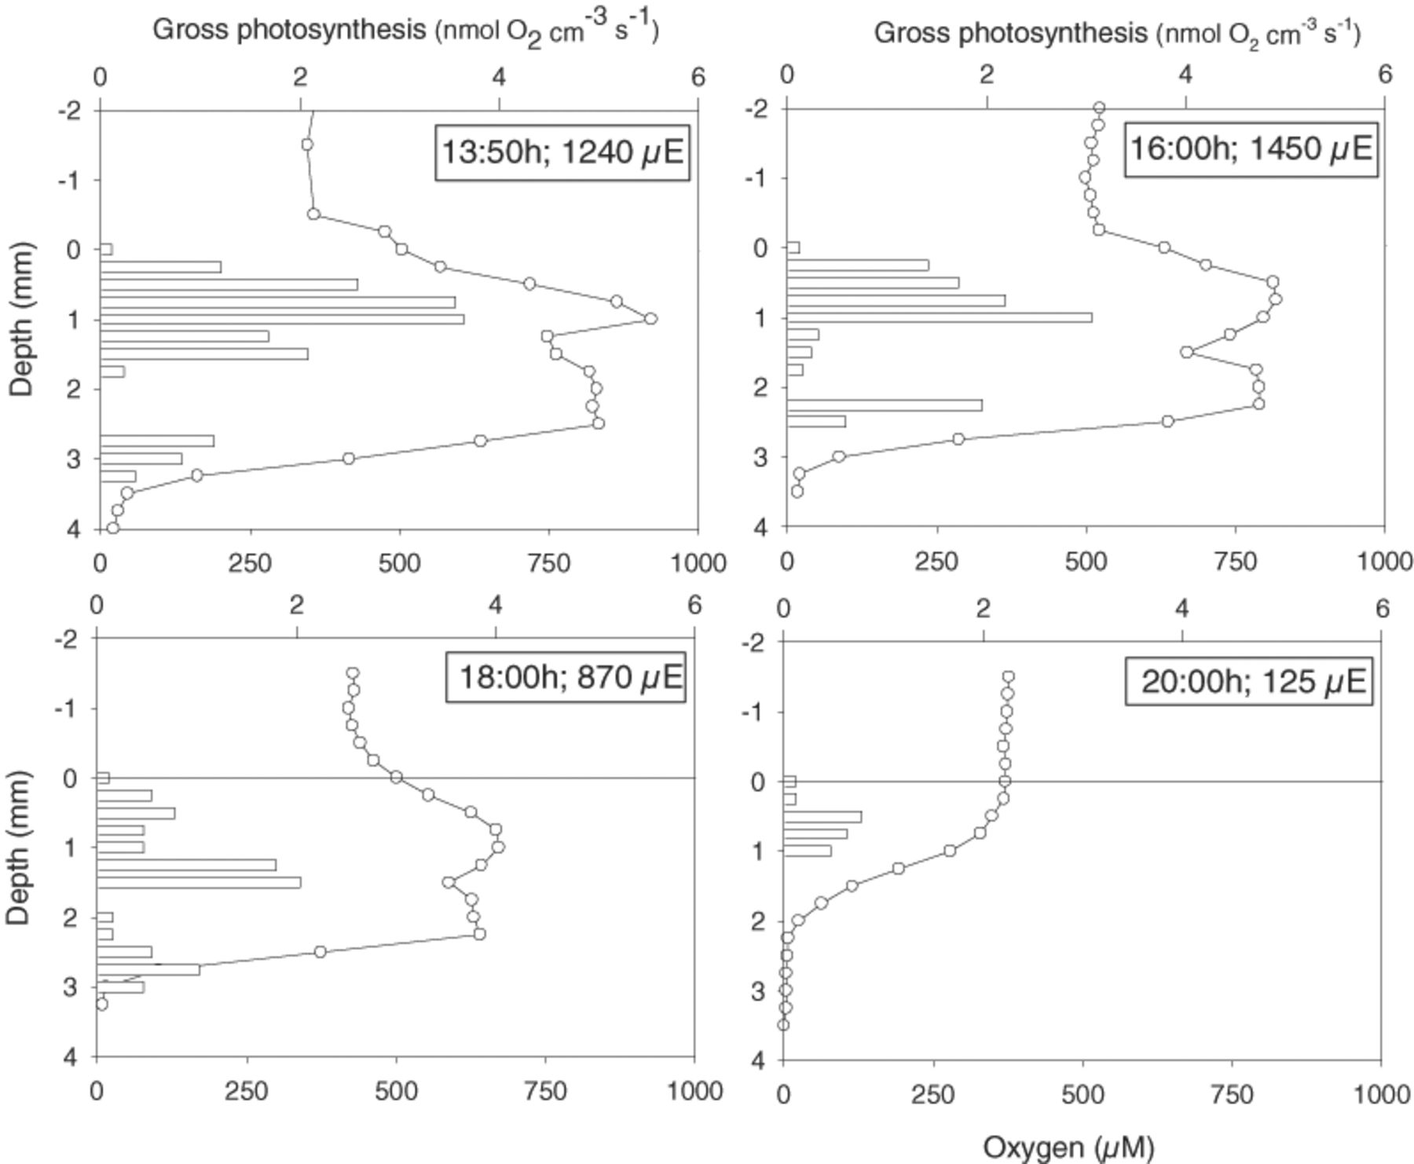
6 In situ oxygen and photosynthesis depth profiles (May 2001). Oxygen concentration maxima at higher light ...
Notes:
6 In situ oxygen and photosynthesis depth profiles (May 2001). Oxygen concentration maxima at higher light intensities coincide with photosynthesis maxima.
Unless provided in the caption above, the following copyright applies to the content of this slide: © 2003 Federation of European Microbiological Societies. Published by Elsevier Science B.V. All rights reserved.

Slide 7
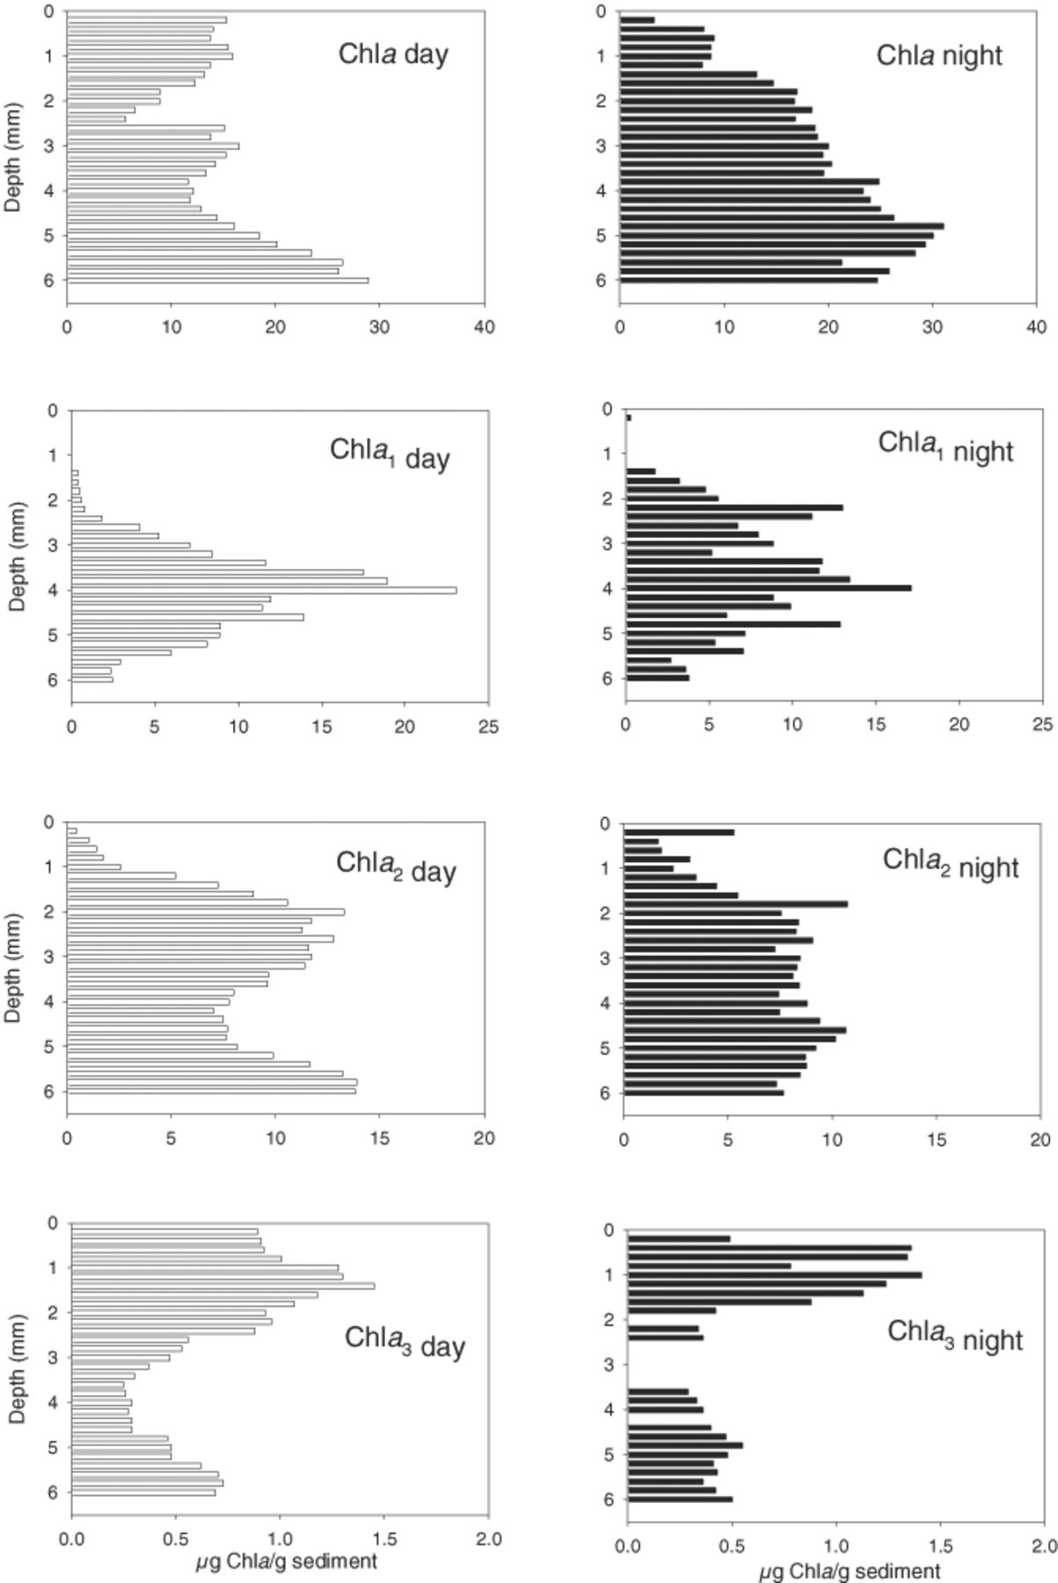
7 Day and night depth distribution of Chla and Chla allomeres (Chla₁, Chla₂ and ...
Notes:
7 Day and night depth distribution of Chla and Chla allomeres (Chla1, Chla2 and Chla3) in Chiprana lake microbial mats showing an upward shift of photopigment distribution at night.
Unless provided in the caption above, the following copyright applies to the content of this slide: © 2003 Federation of European Microbiological Societies. Published by Elsevier Science B.V. All rights reserved.

Slide 8
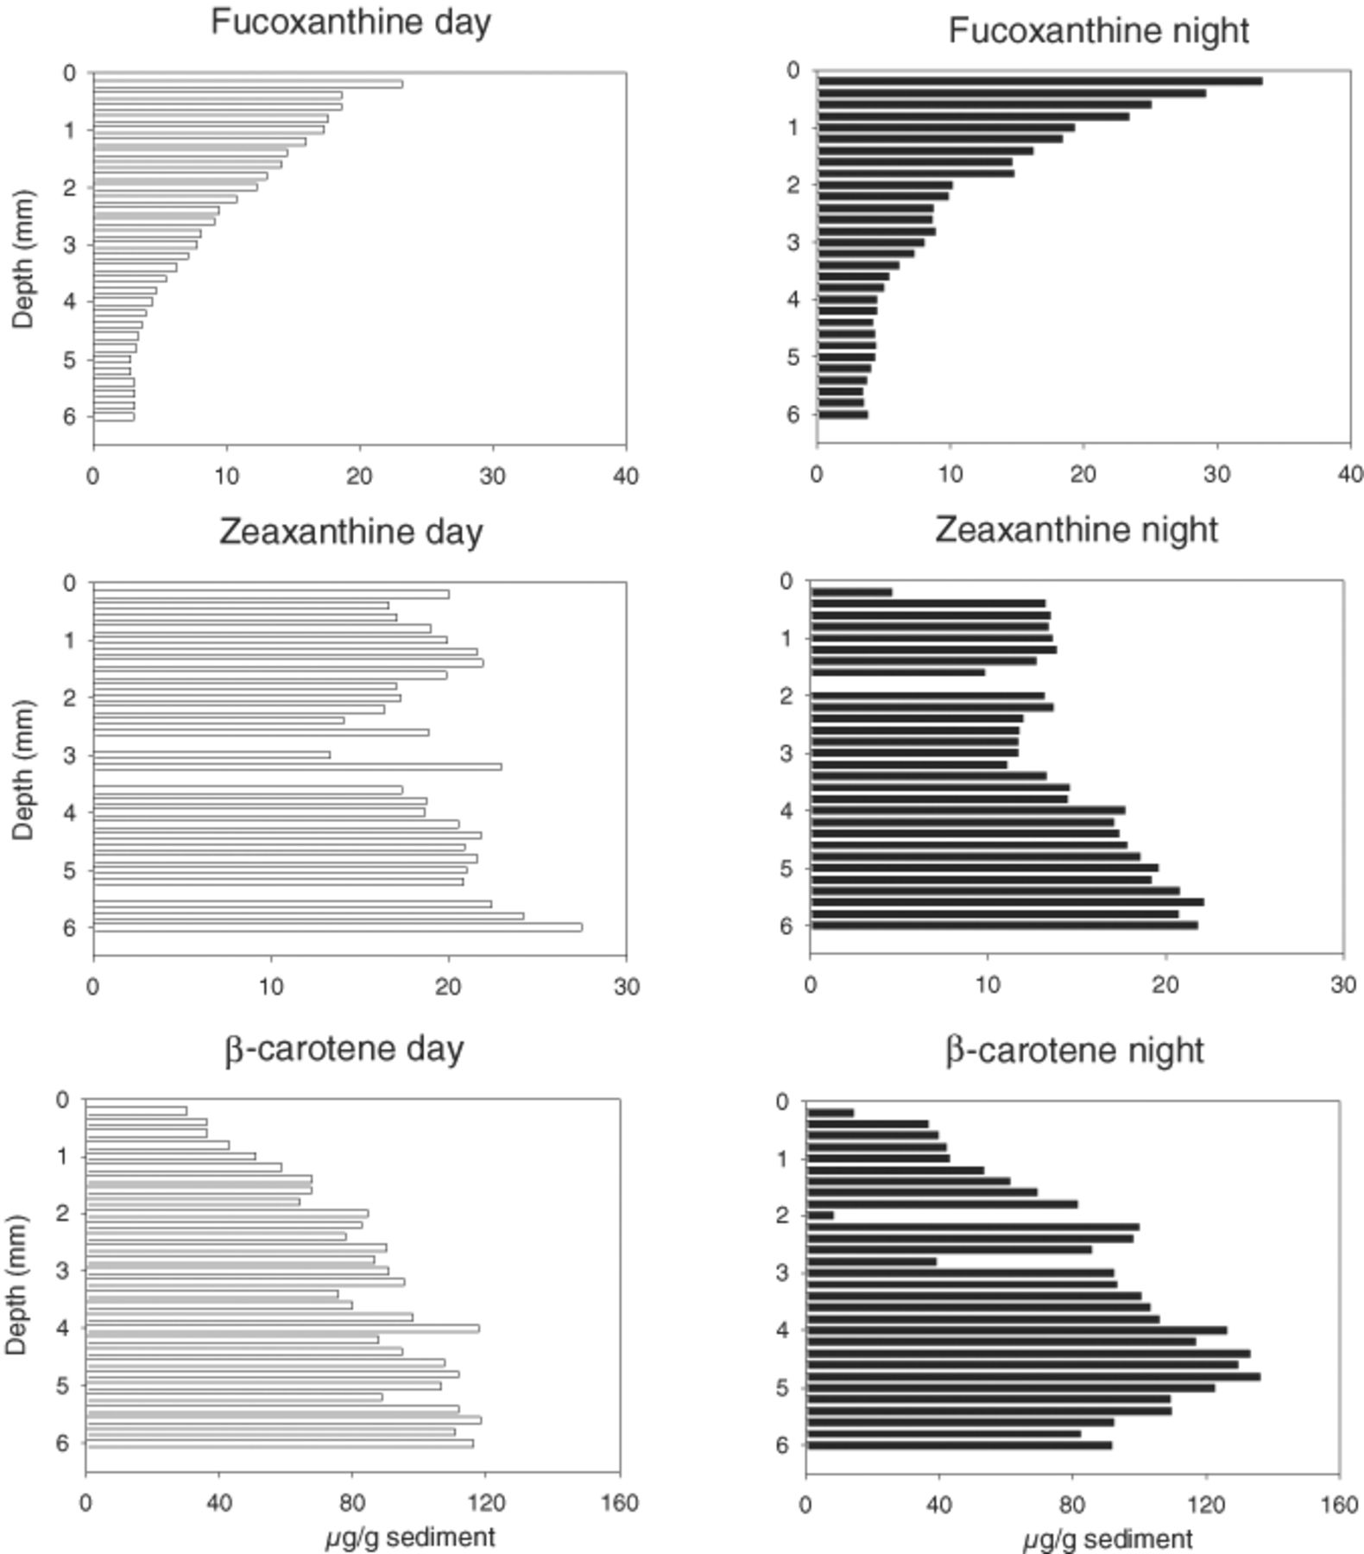
8 Day and night depth distribution of fucoxanthin, zeaxanthine and β-carotene in Chiprana lake microbial mats, ...
Notes:
8 Day and night depth distribution of fucoxanthin, zeaxanthine and β-carotene in Chiprana lake microbial mats, respective marker pigments for diatoms, cyanobacteria and phototrophic organisms.
Unless provided in the caption above, the following copyright applies to the content of this slide: © 2003 Federation of European Microbiological Societies. Published by Elsevier Science B.V. All rights reserved.

Slide 9
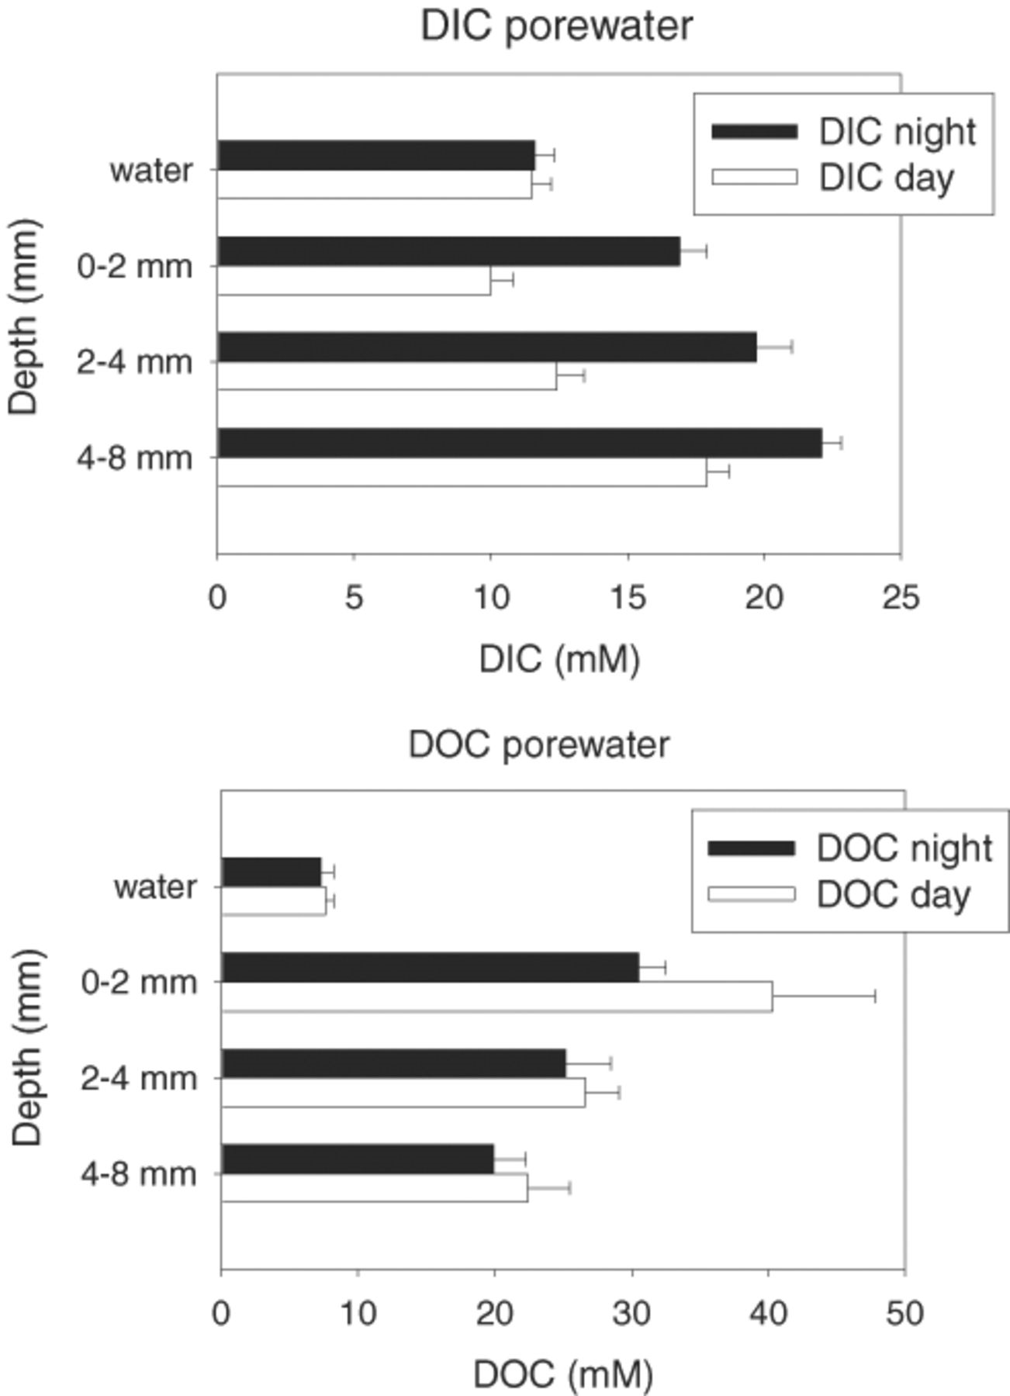
9 Day and night porewater concentrations of dissolved organic carbon (DOC) and dissolved inorganic carbon (DIC) ...
Notes:
9 Day and night porewater concentrations of dissolved organic carbon (DOC) and dissolved inorganic carbon (DIC) in Chiprana lake microbial mats. Profiles show that the 0–2 mm depth layer is reduced in DIC during the day while DOC concentrations in the mat are significantly higher than in the water column both during day and night.
Unless provided in the caption above, the following copyright applies to the content of this slide: © 2003 Federation of European Microbiological Societies. Published by Elsevier Science B.V. All rights reserved.

Slide 10
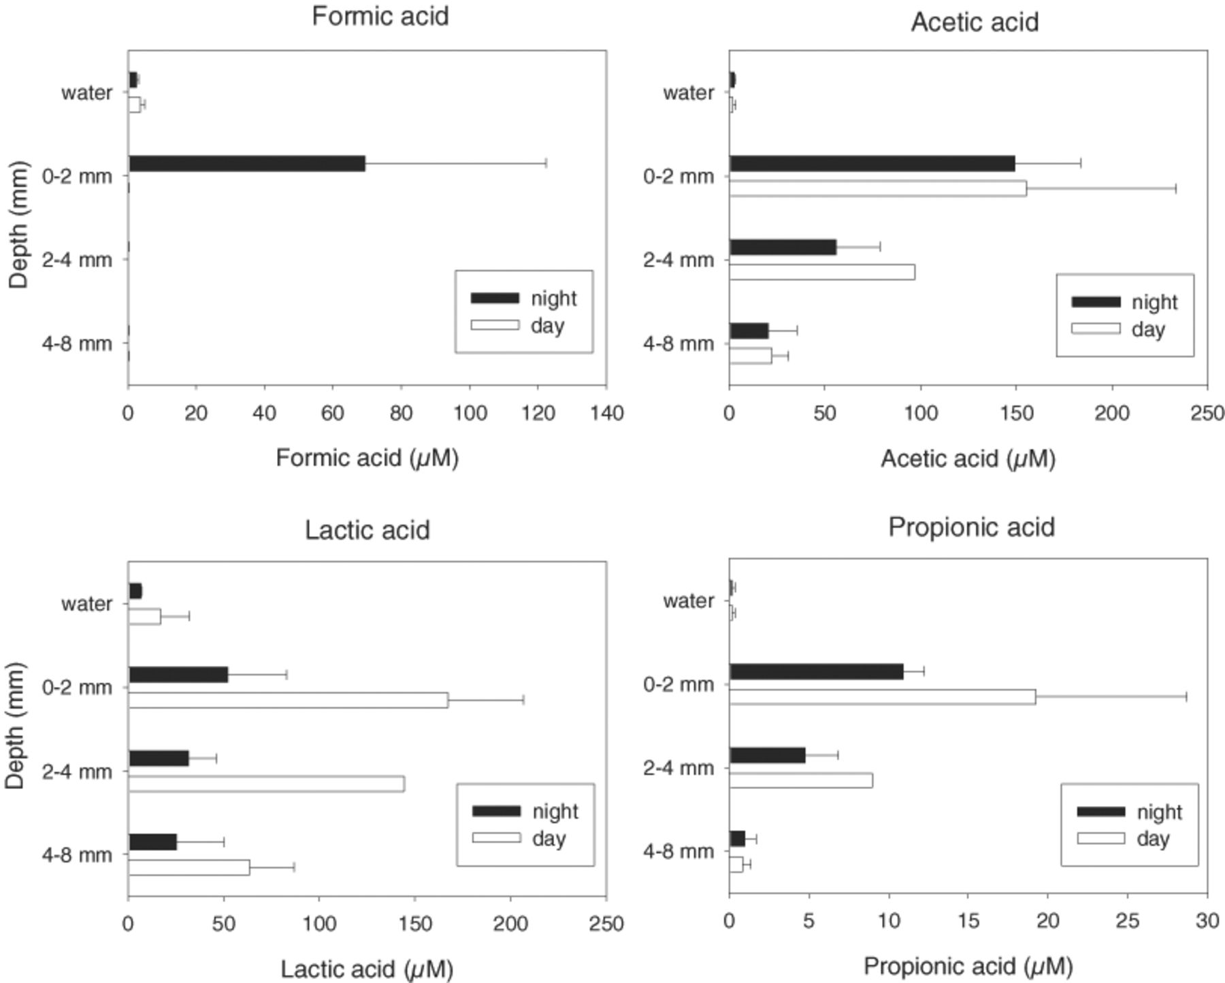
10 Day and night porewater concentrations of formic, acetic, lactic, and propionic acid. Except for formic acid, ...
Notes:
10 Day and night porewater concentrations of formic, acetic, lactic, and propionic acid. Except for formic acid, day time concentrations are higher than night time concentrations in all mat layers.
Unless provided in the caption above, the following copyright applies to the content of this slide: © 2003 Federation of European Microbiological Societies. Published by Elsevier Science B.V. All rights reserved.

