Slide 1
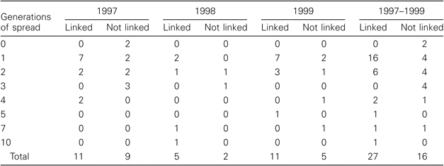
table 2. No. of chains of measles transmission of each duration (in generations) for the 43 chains involving >1 case, ...
Notes:
table 2. No. of chains of measles transmission of each duration (in generations) for the 43 chains involving >1 case, by identified link to importation. United States, 1997–1999.
Unless provided in the caption above, the following copyright applies to the content of this slide: © 2004 by the Infectious Diseases Society of America

Slide 2
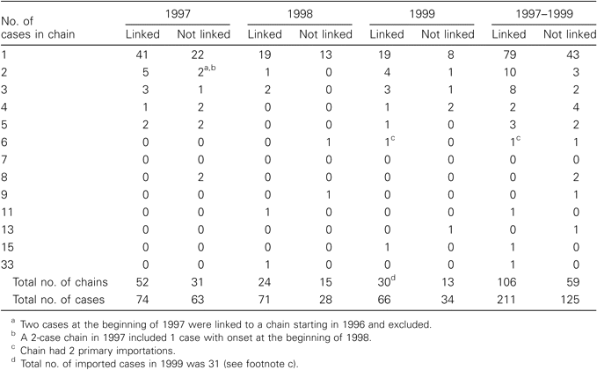
Table 1. No. of chains of measles transmission of each size, by identified link to importation. United States, ...
Notes:
Table 1. No. of chains of measles transmission of each size, by identified link to importation. United States, 1997–1999.
Unless provided in the caption above, the following copyright applies to the content of this slide: © 2004 by the Infectious Diseases Society of America

Slide 3
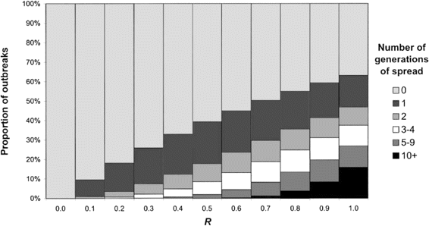
Figure 2. Expected distribution of the duration (in generations) of chains of transmission produced by an imported case ...
Notes:
Figure 2. Expected distribution of the duration (in generations) of chains of transmission produced by an imported case at different values of the effective reproduction number H.
Unless provided in the caption above, the following copyright applies to the content of this slide: © 2004 by the Infectious Diseases Society of America

Slide 4
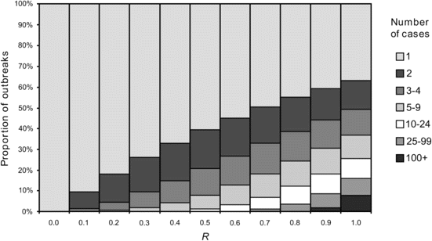
Figure 1. Expected distribution of the size of chain of transmission produced by an imported case at different values ...
Notes:
Figure 1. Expected distribution of the size of chain of transmission produced by an imported case at different values of the effective reproduction number H.
Unless provided in the caption above, the following copyright applies to the content of this slide: © 2004 by the Infectious Diseases Society of America

Slide 5
Table 3. Estimates of the reproduction number, R, for measles in the United States, according to the 3 estimation ...
Notes:
Table 3. Estimates of the reproduction number, R, for measles in the United States, according to the 3 estimation methods, 1997–1999.
Unless provided in the caption above, the following copyright applies to the content of this slide: © 2004 by the Infectious Diseases Society of America

Slide 6
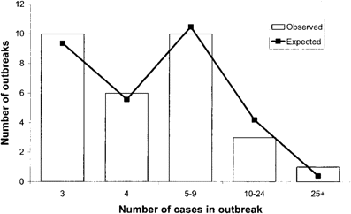
Figure 3. Frequency distribution of number of cases in chains with at least 3 cases: observed (United States. ...
Notes:
Figure 3. Frequency distribution of number of cases in chains with at least 3 cases: observed (United States. 1997–1999) and expected (R = 0.63).
Unless provided in the caption above, the following copyright applies to the content of this slide: © 2004 by the Infectious Diseases Society of America

Slide 7
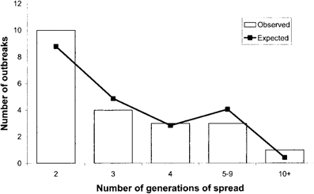
Figure 4. Frequency distribution of number of generations of spread in chains with at least two generations of spread: ...
Notes:
Figure 4. Frequency distribution of number of generations of spread in chains with at least two generations of spread: observed (United States, 1997–1999) and expected (ff = 0.63).
Unless provided in the caption above, the following copyright applies to the content of this slide: © 2004 by the Infectious Diseases Society of America

Slide 8
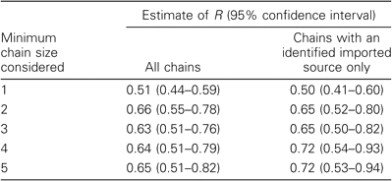
Table4. Sensitivity analyses for minimum chain size used to estimate the reproduction number, R,for measles in the ...
Notes:
Table4. Sensitivity analyses for minimum chain size used to estimate the reproduction number, R,for measles in the United States, for all chains and for only those with an identified link to importation, 1997–1999.
Unless provided in the caption above, the following copyright applies to the content of this slide: © 2004 by the Infectious Diseases Society of America

Slide 9
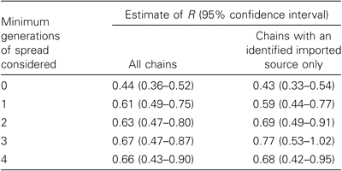
Table 5. Sensitivity analyses for minimum number of generations of spread used to estimate the reproduction number, R, ...
Notes:
Table 5. Sensitivity analyses for minimum number of generations of spread used to estimate the reproduction number, R, for measles in the United States, for all chains and for only those with an identified link to importation, 1997–1999.
Unless provided in the caption above, the following copyright applies to the content of this slide: © 2004 by the Infectious Diseases Society of America

