Slide 1
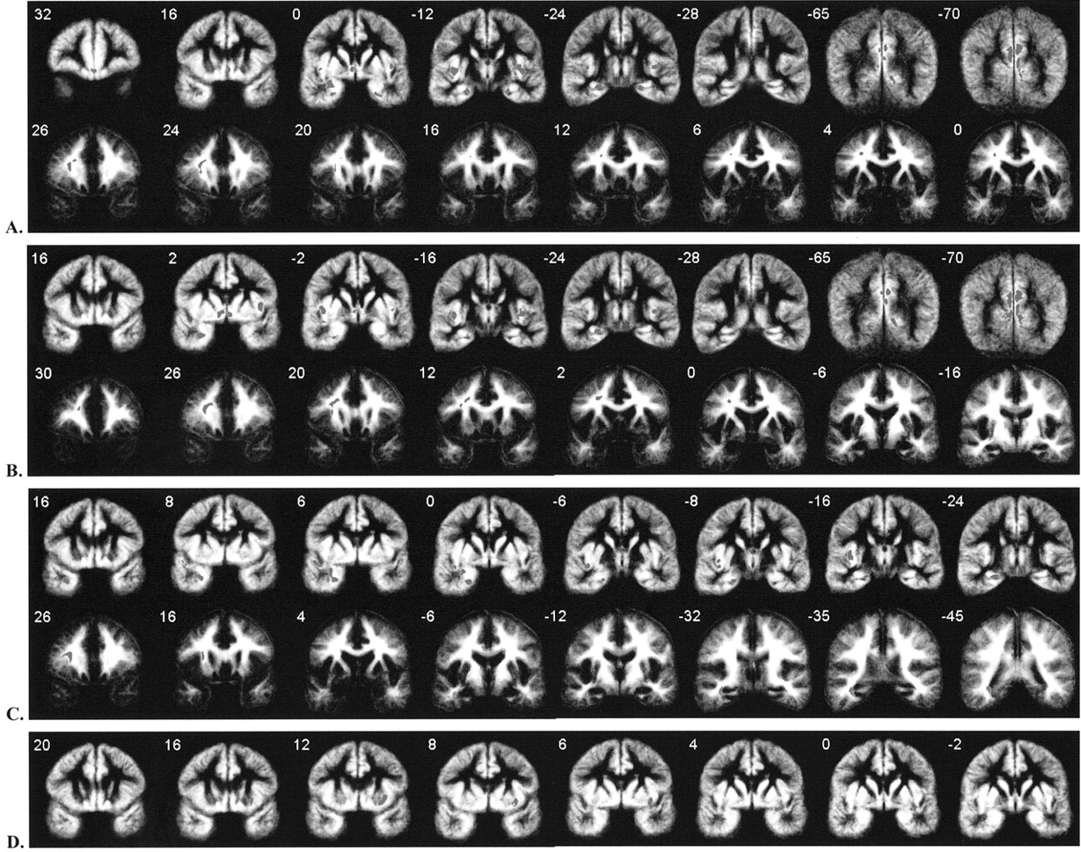
Figure 1 Brain changes in patients with schizophrenia in comparison with normal controls. Red denotes regions of ...
Notes:
Figure 1 Brain changes in patients with schizophrenia in comparison with normal controls. Red denotes regions of tissue loss and green denotes regions of tissue excess in patients. Results are displayed on averaged grey and white matter maps. Numbers refer to approximate y coordinates in the standard space of Talairach and Tournoux. Note that the particular slices displayed are those that showed the most significant differences and are not the same for each comparison. (A) Grey (upper) and white (lower) matter changes in all patients with schizophrenia compared to controls. (B) Grey (upper) and white (lower) matter changes in hallucinators compared to controls. (C) Grey (upper) and white (lower) matter changes in non-hallucinators compared to controls. (D) Grey matter changes in hallucinators compared to non-hallucinators. The left side of the image corresponds to the right side of the brain.
Unless provided in the caption above, the following copyright applies to the content of this slide: © Oxford University Press

