Slide 1
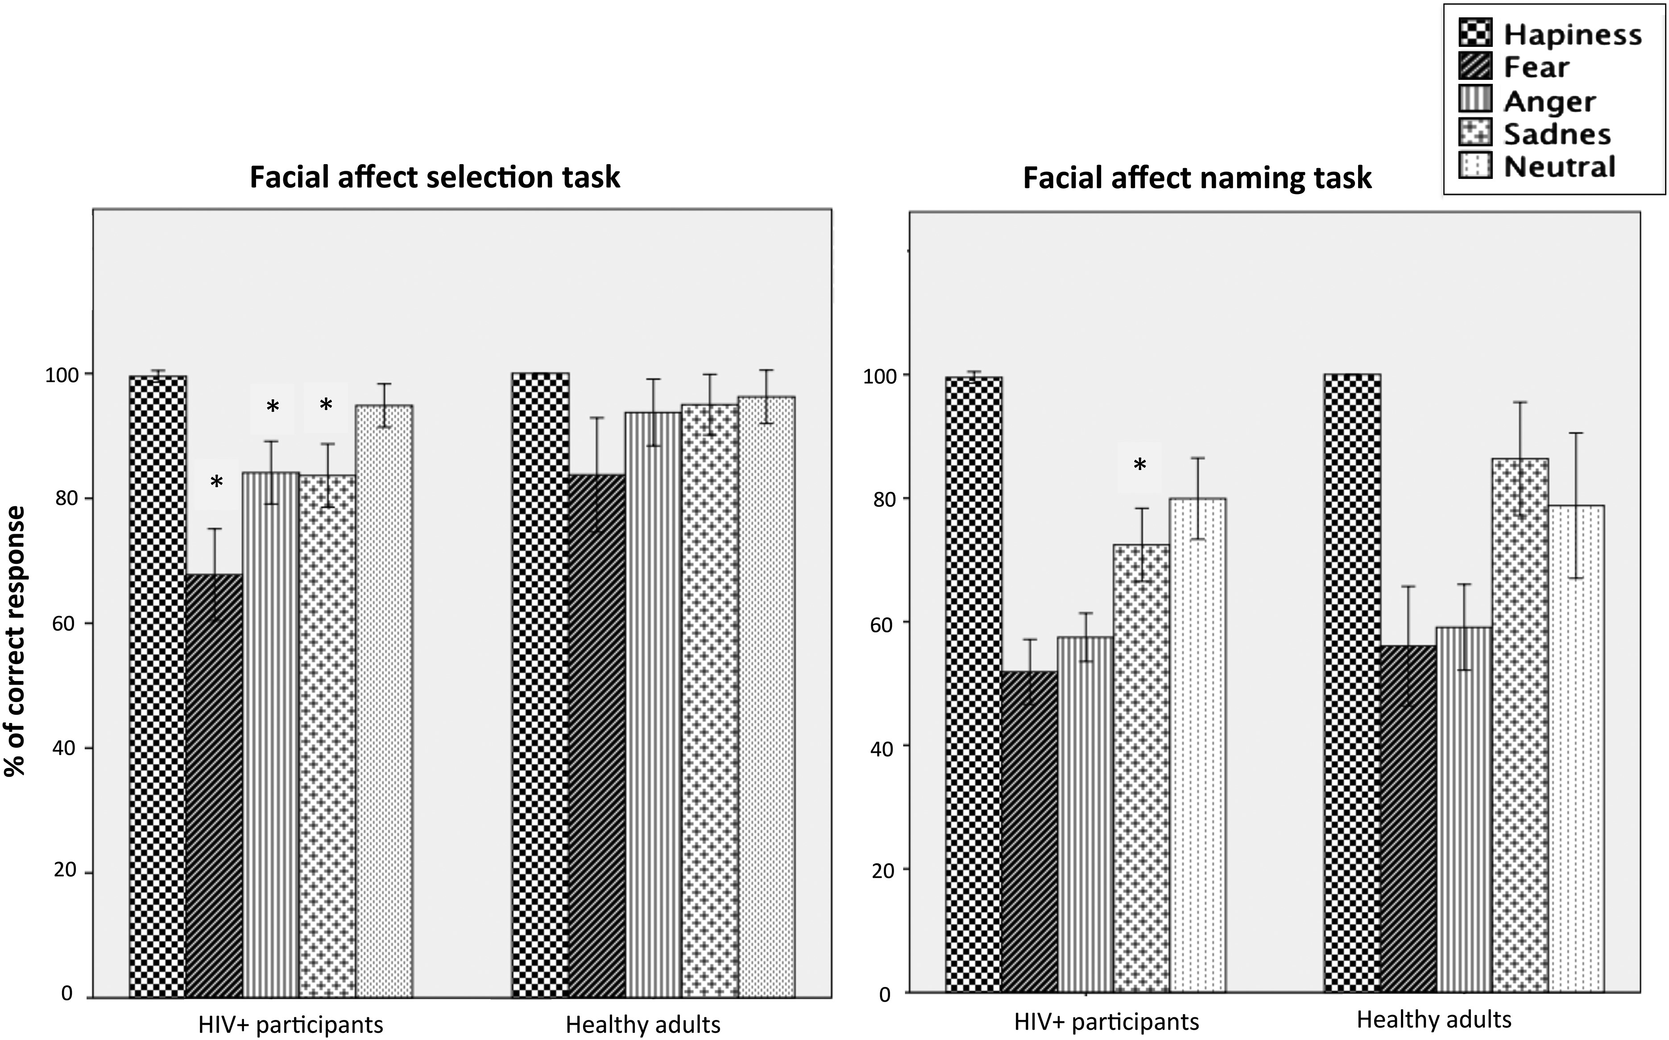
Fig. 1. The comparison between HIV+ individuals and HA participants in the percentage of correct recognition ...
Notes:
Fig. 1. The comparison between HIV+ individuals and HA participants in the percentage of correct recognition responses given for each specific emotion *Significant differences (p < .05) in distribution of correct response were calculated by Mann–Whitney U-test. Y axis represents % of correct response.
Unless provided in the caption above, the following copyright applies to the content of this slide: © The Author 2016. Published by Oxford University Press. All rights reserved. For permissions, please e-mail: journals.permissions@oup.com.

