Slide 1
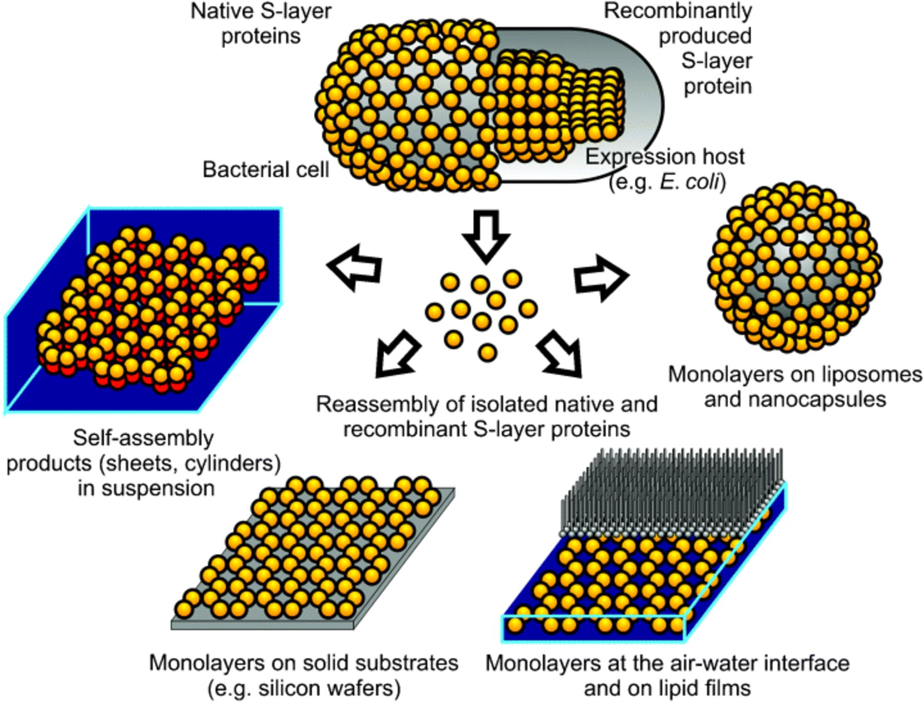
1 Schematic drawing of the recrystallization procedure of native or recombinant S-layer (fusion) proteins. ...
Notes:
1 Schematic drawing of the recrystallization procedure of native or recombinant S-layer (fusion) proteins. After isolation and disintegration, the native or recombinant proteins recrystallize either in suspension, on solid supports (optionally precoated with SCWP), at the air-water interface, on lipid-membranes or liposomes and nanocapsules. Modified after Pum (2006), Copyright (2006), with permission from Springer Verlag.
Unless provided in the caption above, the following copyright applies to the content of this slide: © 2007 Federation of European Microbiological Societies

Slide 2
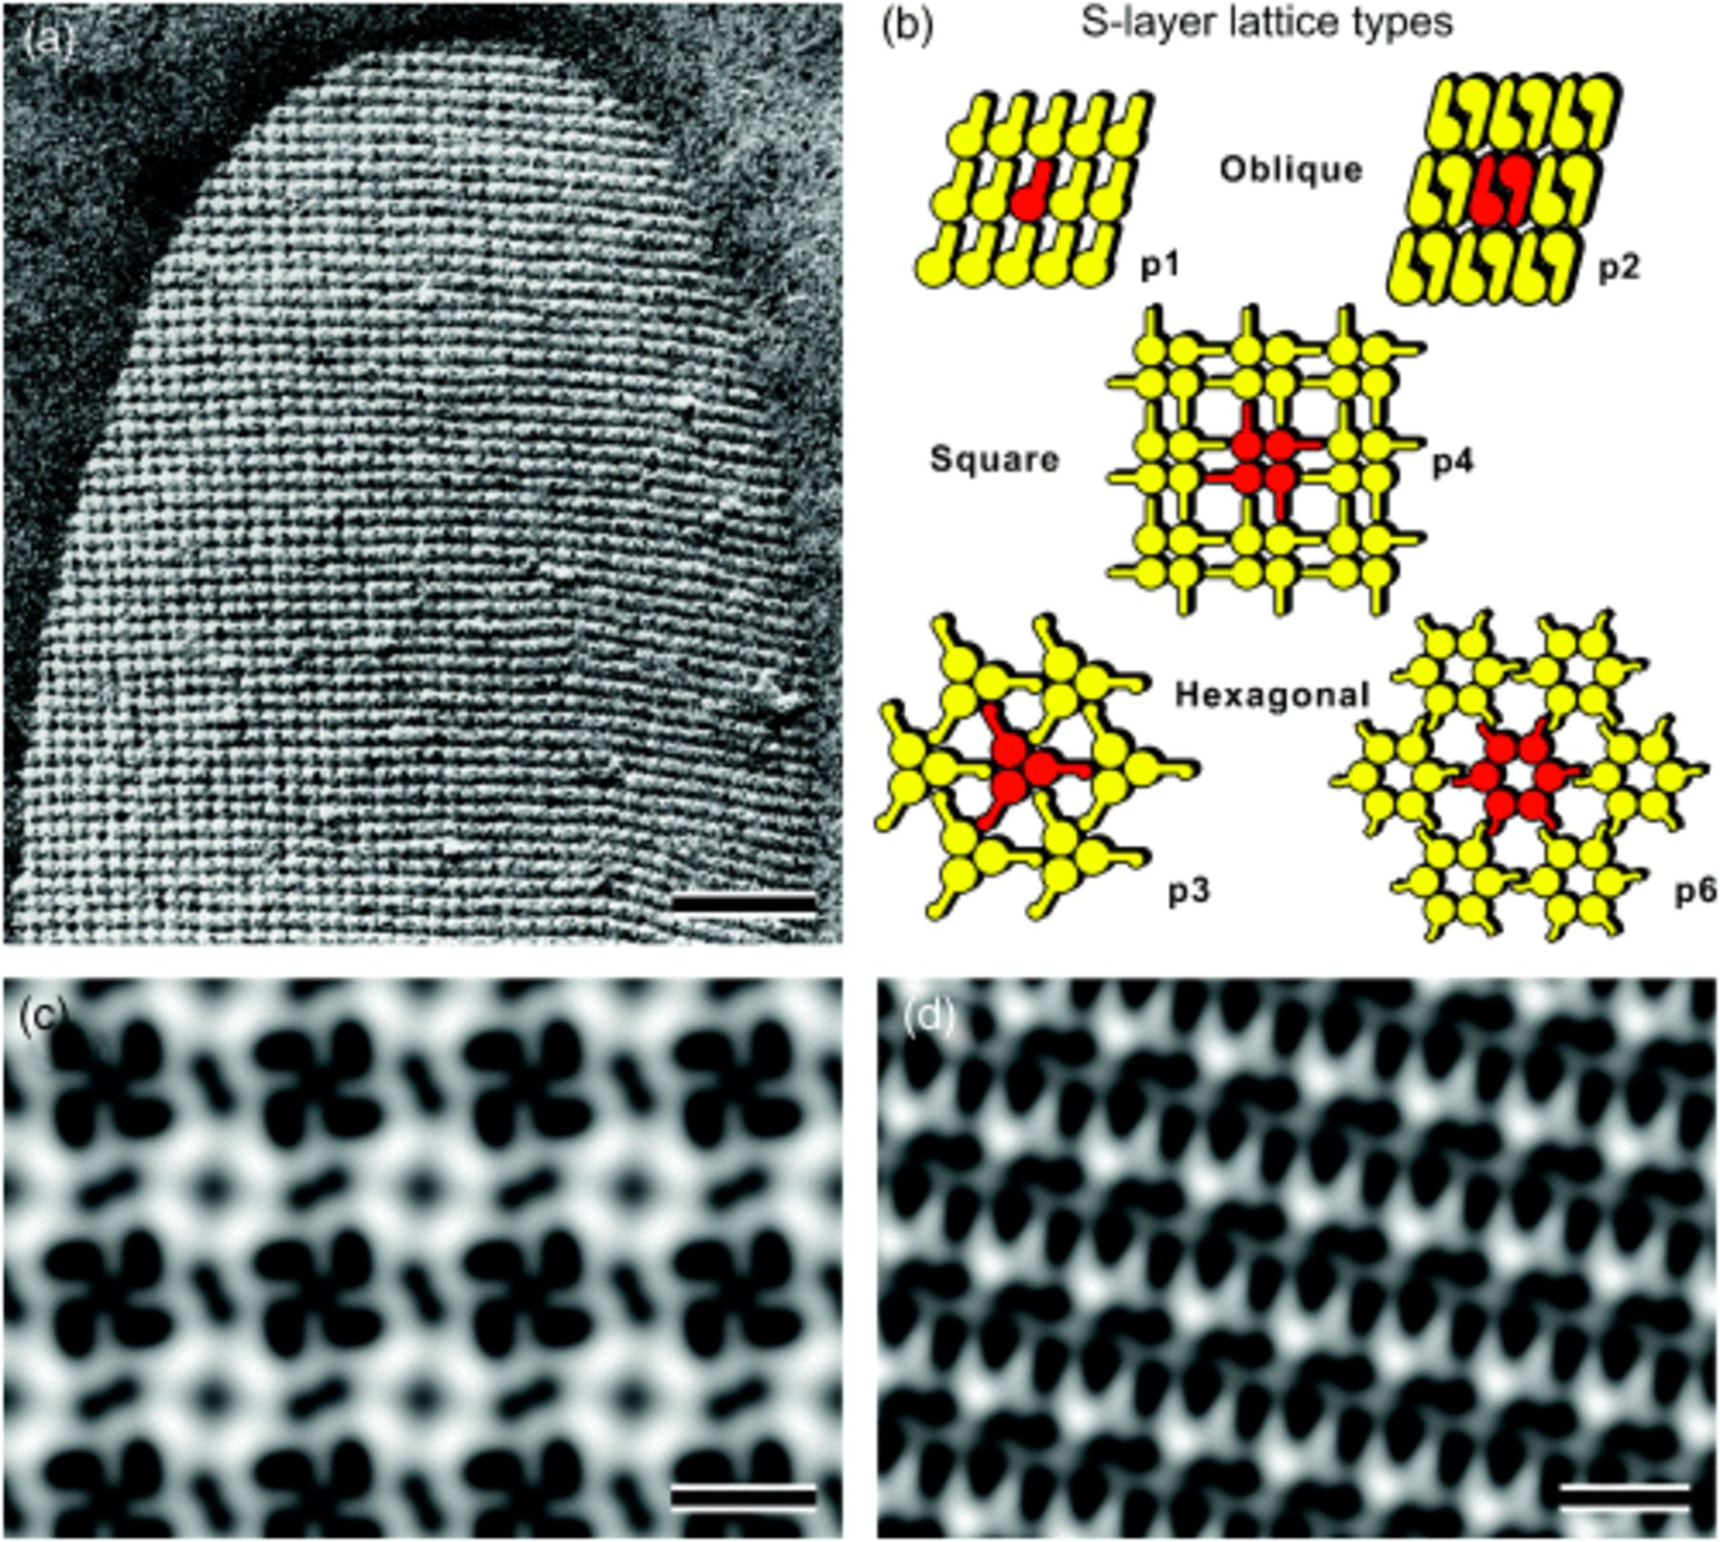
2 Electron micrograph of a freeze-etched preparation of whole cells of Bacillus sphaericus CCM 2177 revealing a ...
Notes:
2 Electron micrograph of a freeze-etched preparation of whole cells of Bacillus sphaericus CCM 2177 revealing a square S-layer lattice (a). Schematic drawings of the different S-layer lattice types. The regular arrays either show oblique (p1, p2), square (p4) or hexagonal (p3, p6) lattice symmetry. The morphological units are composed of one (p1), two (p2), three (p3), four (p4) or six (p6) identical subunits (b). Computer image reconstruction of scanning force microscopic images of the topography of the square (p4) S-layer lattice of B. sphaericus CCM 2177 (c) and the oblique (p1) S-layer lattice of Geobacillus stearothermophilus PV72/p2 (d). Bars: 100 nm in (a), 10 nm in (c) and (d).
Unless provided in the caption above, the following copyright applies to the content of this slide: © 2007 Federation of European Microbiological Societies

Slide 3
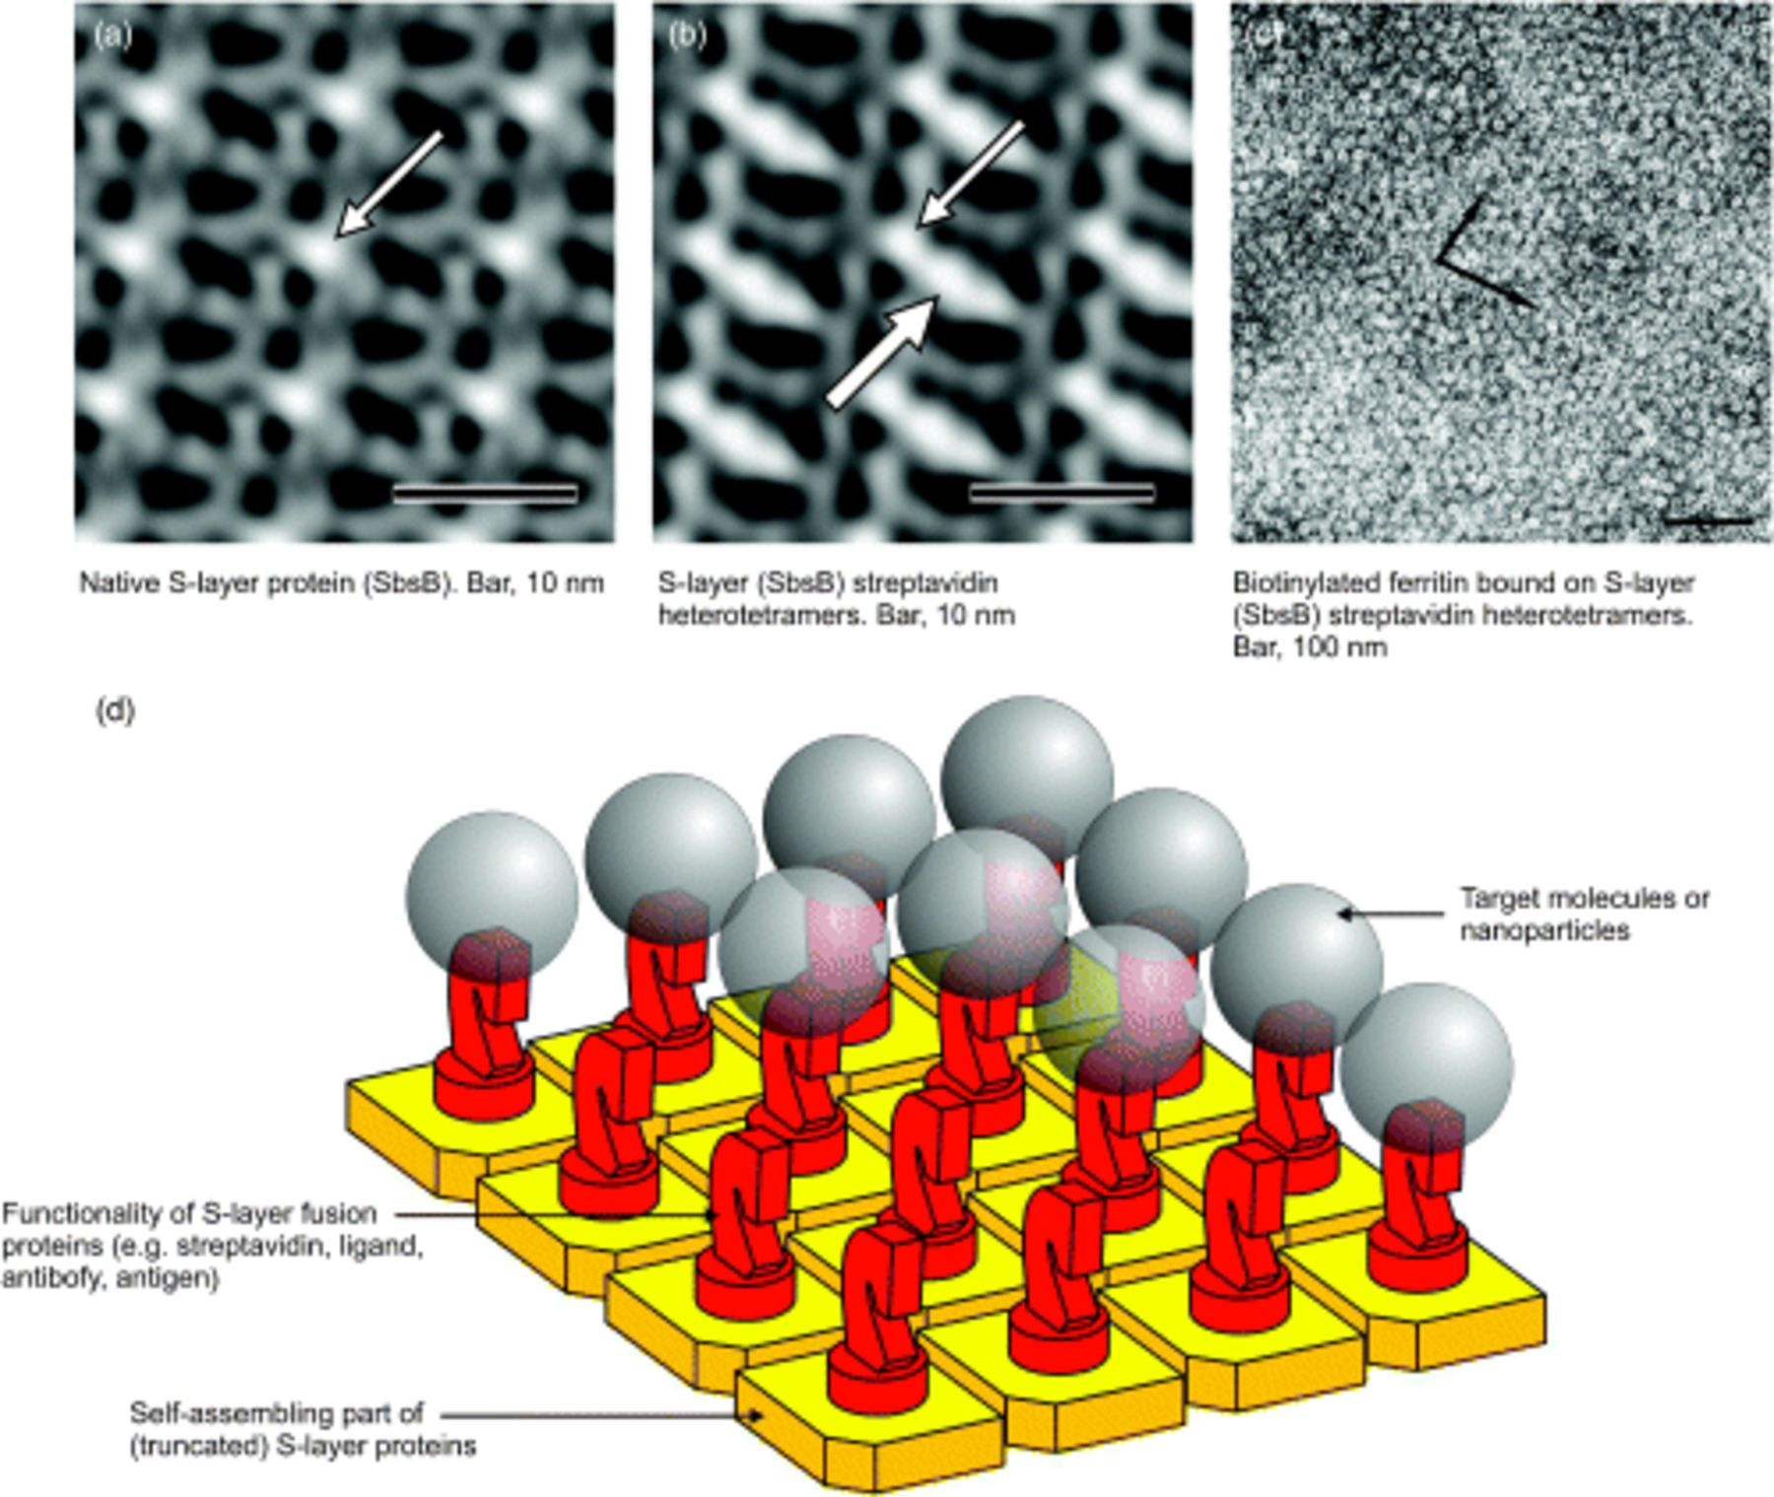
3 Digital image reconstruction from transmission electron micrographs of negatively stained preparations from ...
Notes:
3 Digital image reconstruction from transmission electron micrographs of negatively stained preparations from self-assembly products of SbsB (a) and N-terminal SbsB-streptavidin heterotetramers (b) (bars: 10 nm). The thin white arrows indicate the base vectors of the oblique p1 lattice. In the lattice of the fusion protein, streptavidin showed up as an additional protein mass (thick white arrow) attached to the N-terminal SLH-domain. Lattices generated from C-terminal SbsB-streptavidin heterotetramers were capable of binding biotinylated ferritin as a superlattice (c). The black arrows indicate the base vectors of the oblique p1 lattice (bar: 100 nm). Cartoon illustrating self-assembled S-layer-fusion proteins with target molecules or nanoparticles bound in defined spacing and orientation (d). Modified after Schuster (2006), Copyright (2006), with permission from Bentham Science Publishers Ltd.
Unless provided in the caption above, the following copyright applies to the content of this slide: © 2007 Federation of European Microbiological Societies

Slide 4
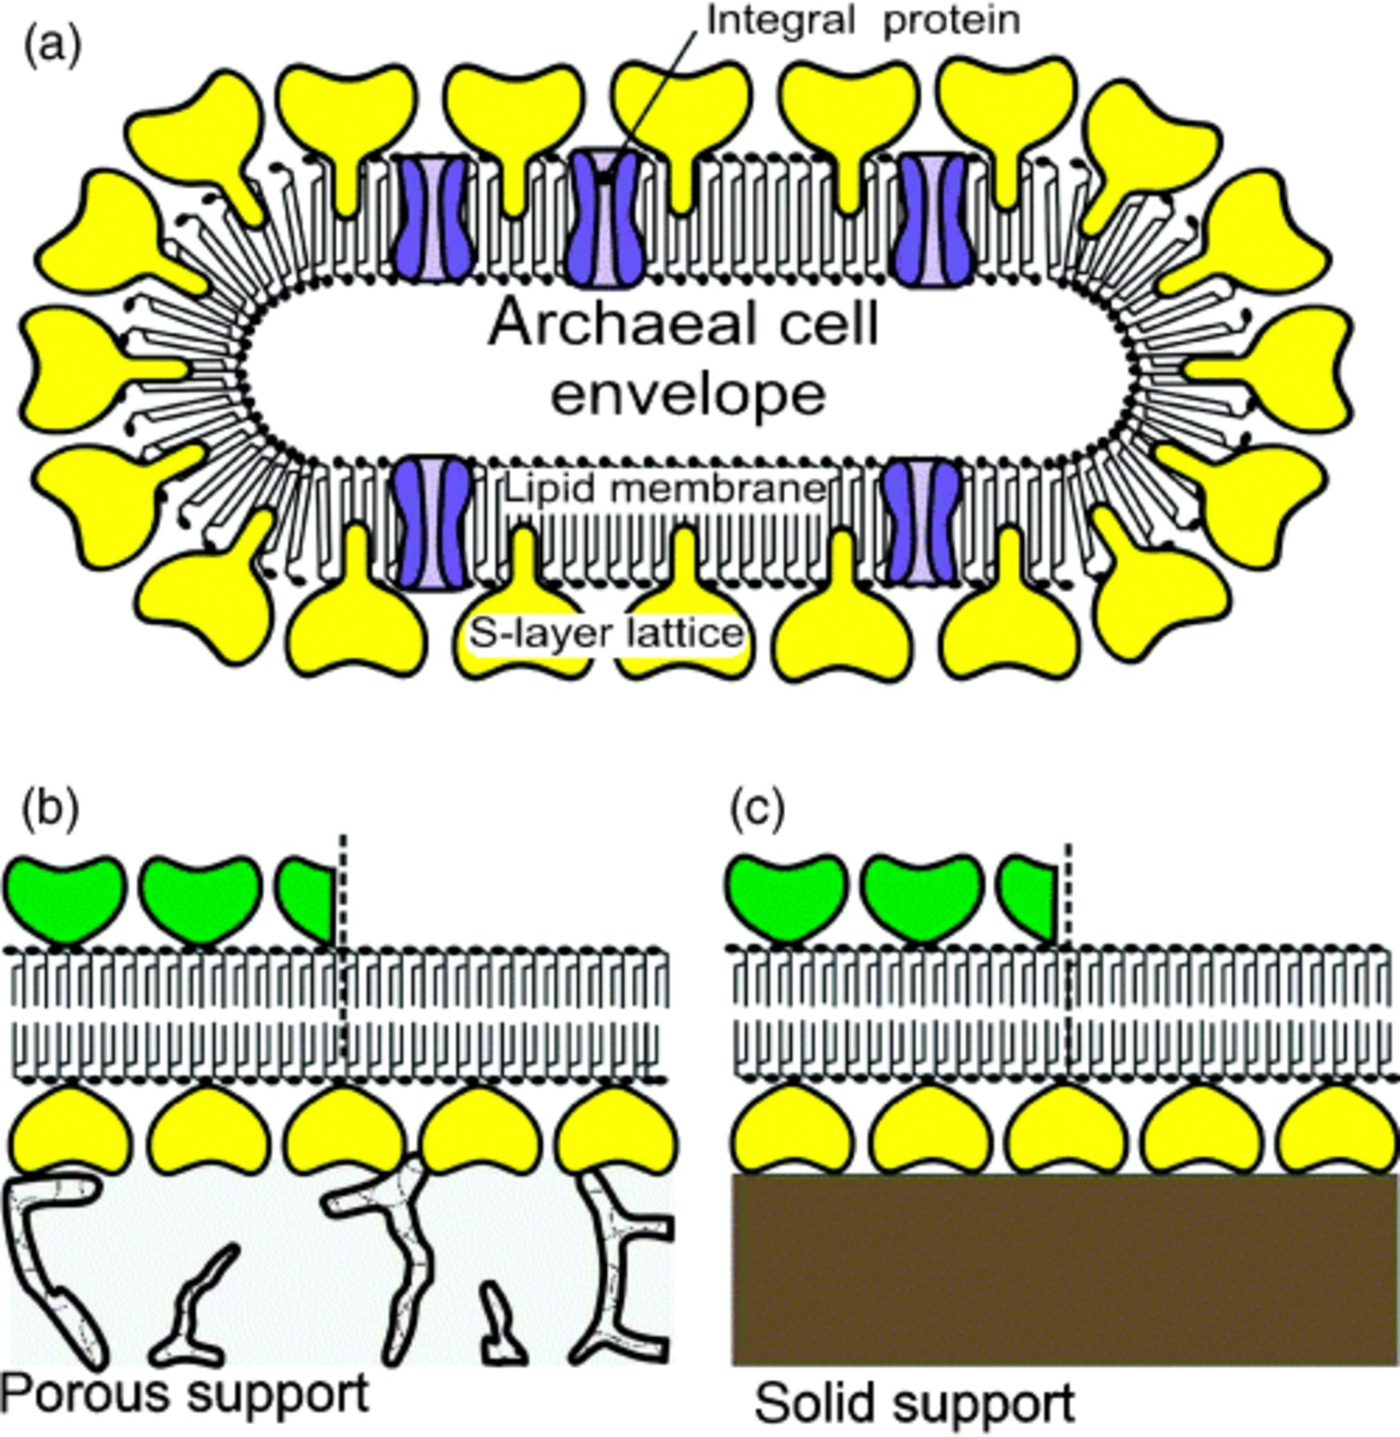
4 (a) Schematic illustration of an archaeal cell envelope structure composed of the cytoplasmic membrane with ...
Notes:
4 (a) Schematic illustration of an archaeal cell envelope structure composed of the cytoplasmic membrane with integral membrane proteins and an S-layer lattice, integrated into the cytoplasmic membrane. Modified after ref. Sleytr (2003a), Copyright (2002), with permission from Wiley-VCH. (b, c) Schematic illustrations of various S-layer-supported lipid membranes. (b) On an SUM a lipid membrane can be generated by a modified LB-technique. As a further option, a closed S-layer lattice can be attached on the external side of the SUM-supported lipid membrane (left part). (c) Solid supports can be covered by a closed S-layer lattice and subsequently lipid membranes can be generated using combinations of the LB- and Langmuir-Schaefer-technique, and vesicle fusion. As shown in C, a closed S-layer lattice can be recrystallized on the external side of the solid supported lipid membrane (left part). Modified after Sleytr (2004a), Copyright (2004), with permission from Wiley-VCH.
Unless provided in the caption above, the following copyright applies to the content of this slide: © 2007 Federation of European Microbiological Societies

Slide 5
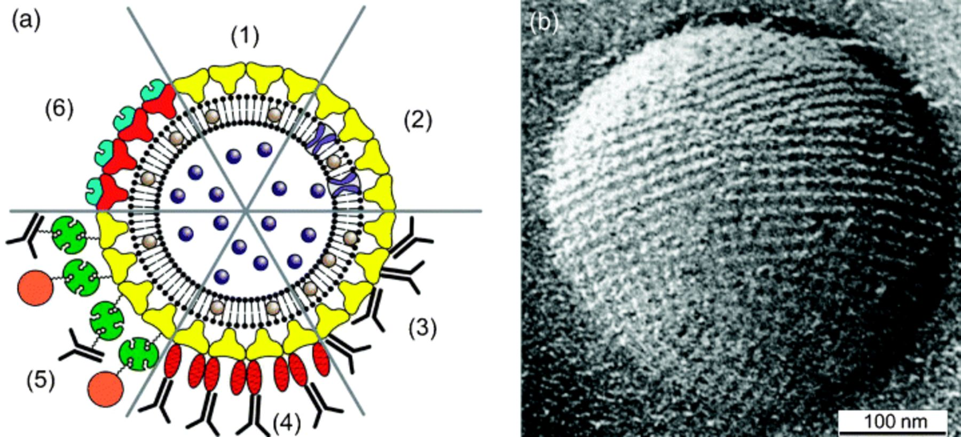
5 (a) Schematic drawing of (1) an S-liposome with entrapped functional molecules and (2) functionalized by ...
Notes:
5 (a) Schematic drawing of (1) an S-liposome with entrapped functional molecules and (2) functionalized by reconstituted integral proteins. S-liposomes can be used as immobilization matrix for functional molecules (e.g. IgG) either by direct binding (3), by immobilization via the Fc-specific ligand protein A (4), or biotinylated ligands can be bound to the S-liposome via the biotin–streptavidin system (5). (6) Alternatively, liposomes can be coated with genetically modified S-layer proteins incorporating functional domains. (b) Electron micrograph of a freeze-etched preparation of an S-liposome. Bar: 100 nm. Reprinted with permission from Sleytr (2003a), Copyright (2002) Wiley-VCH.
Unless provided in the caption above, the following copyright applies to the content of this slide: © 2007 Federation of European Microbiological Societies

