Slide 1
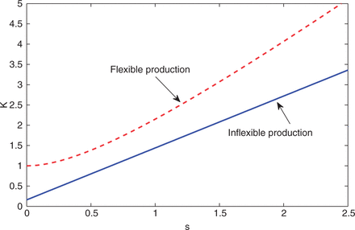
Figure 1 Average Production of Flexible and Inflexible agents, $K_{F}(s)$and$K_{I}(s)$: Because ${f}$(${b}$) is ...
Notes:
Figure 1 Average Production of Flexible and Inflexible agents, $K_{F}(s)$and$K_{I}(s)$: Because ${f}$(${b}$) is concave, flexible workers are always more productive than the average inflexible worker. Of course, in each state there is always an inflexible worker who is as productive as the flexible workers are.
Unless provided in the caption above, the following copyright applies to the content of this slide: © The Author 2013. Published by Oxford University Press on behalf of The Society for Financial Studies. All rights reserved. For Permissions, please email: journals.permissions@oup.com

Slide 2
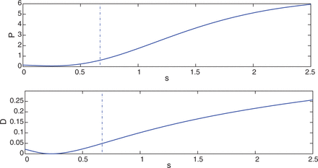
Figure 2 Value of equity (upper panel) and total dividends (lower panel) as a function of ${s}$ The vertical dashed ...
Notes:
Figure 2 Value of equity (upper panel) and total dividends (lower panel) as a function of ${s}$ The vertical dashed line marks $\bar s,$ the average value of the state variable.
Unless provided in the caption above, the following copyright applies to the content of this slide: © The Author 2013. Published by Oxford University Press on behalf of The Society for Financial Studies. All rights reserved. For Permissions, please email: journals.permissions@oup.com

Slide 3
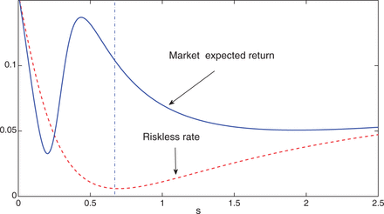
Figure 3 Expected return: Expected return on the firm’s stock (solid blue line) and the (short) risk free rate (dotted ...
Notes:
Figure 3 Expected return: Expected return on the firm’s stock (solid blue line) and the (short) risk free rate (dotted red line). The vertical dashed line marks $\bar s,$ the average value of the state variable.
Unless provided in the caption above, the following copyright applies to the content of this slide: © The Author 2013. Published by Oxford University Press on behalf of The Society for Financial Studies. All rights reserved. For Permissions, please email: journals.permissions@oup.com

Slide 4
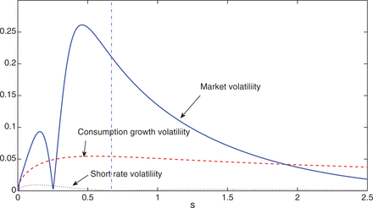
Figure 4 Volatility: The blue solid curve is firm volatility ($\frac{{V'}}{V}\sigma (s)$), the red dashed curve is ...
Notes:
Figure 4 Volatility: The blue solid curve is firm volatility ($\frac{{V'}}{V}\sigma (s)$), the red dashed curve is consumption growth volatility ($\frac{{{K_{tot'}}}}{{{V_{tot}}}}\sigma (s)$), and the grey dotted line is interest rate volatility. The vertical dashed line marks $\bar s,$ the average value of the state variable.
Unless provided in the caption above, the following copyright applies to the content of this slide: © The Author 2013. Published by Oxford University Press on behalf of The Society for Financial Studies. All rights reserved. For Permissions, please email: journals.permissions@oup.com

Slide 5
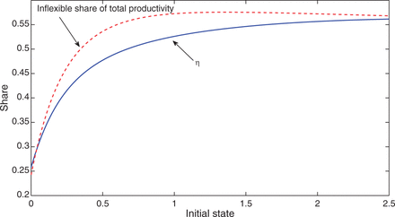
Figure 5 Sensitivity of the Equilibrium to the Initial State: The blue solid curve is the equilibrium share of wealth ...
Notes:
Figure 5 Sensitivity of the Equilibrium to the Initial State: The blue solid curve is the equilibrium share of wealth of the inflexible worker at ${t=0},$${\rm \eta},$ as a function of the initial ${s_0}.$ The red dashed curve is the inflexible agent’s aggregate share of total productivity at time 0.
Unless provided in the caption above, the following copyright applies to the content of this slide: © The Author 2013. Published by Oxford University Press on behalf of The Society for Financial Studies. All rights reserved. For Permissions, please email: journals.permissions@oup.com

Slide 6
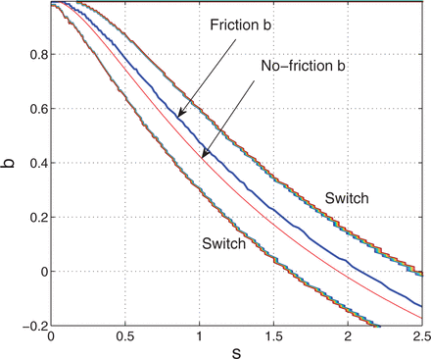
Figure 6 Switching strategy of a flexible agent who faces switching costs of 1% of net wealth: The thick blue line ...
Notes:
Figure 6 Switching strategy of a flexible agent who faces switching costs of 1% of net wealth: The thick blue line corresponds to the chosen ${b},$ as a function of ${s},$ the state in which the switch occurred. For a given ${b},$ the states within the switch-lines are states where the costs outweigh the benefits of a switch. When a switch-line is touched, the flexible agent switches to the ${b}$ (on the thick blue line) that corresponds to the current state. The thin red line is the ${b}$ chosen by a flexible agent who faces no switching costs.
Unless provided in the caption above, the following copyright applies to the content of this slide: © The Author 2013. Published by Oxford University Press on behalf of The Society for Financial Studies. All rights reserved. For Permissions, please email: journals.permissions@oup.com

