Slide 1
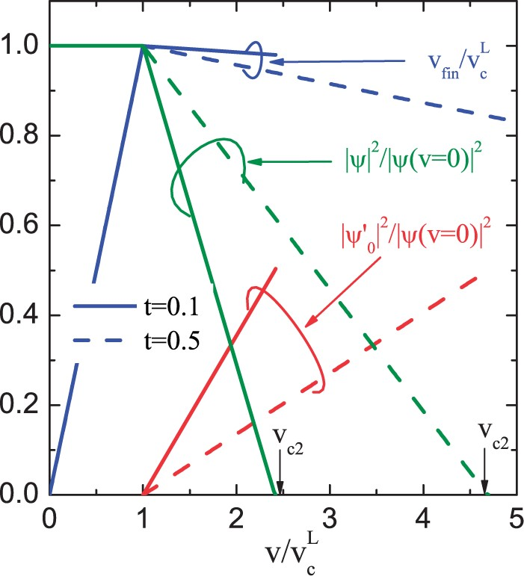
Figure 1. Condensate amplitudes |ψ|2 and |ψ′0|2, Eq. (25), and the final flow velocity vfin, Eq. (27), in superfluid ...
Notes:
Figure 1. Condensate amplitudes |ψ|2 and |ψ′0|2, Eq. (25), and the final flow velocity vfin, Eq. (27), in superfluid 4He plotted as functions of the flow velocity for various temperatures. Vertical arrows indicate vc2. Velocities are scaled by the values of the Landau critical velocities vcL(t=0.5)=59m s−1 and vcL(t=0.1)=55m s−1, and the condensates are normalized to the condensate amplitude in the superfluid at rest.
Unless provided in the caption above, the following copyright applies to the content of this slide: © The Author(s) 2017. Published by Oxford University Press on behalf of the Physical Society of Japan.This is an Open Access article distributed under the terms of the Creative Commons Attribution License (http://creativecommons.org/licenses/by/4.0/), which permits unrestricted reuse, distribution, and reproduction in any medium, provided the original work is properly cited.

