Slide 1
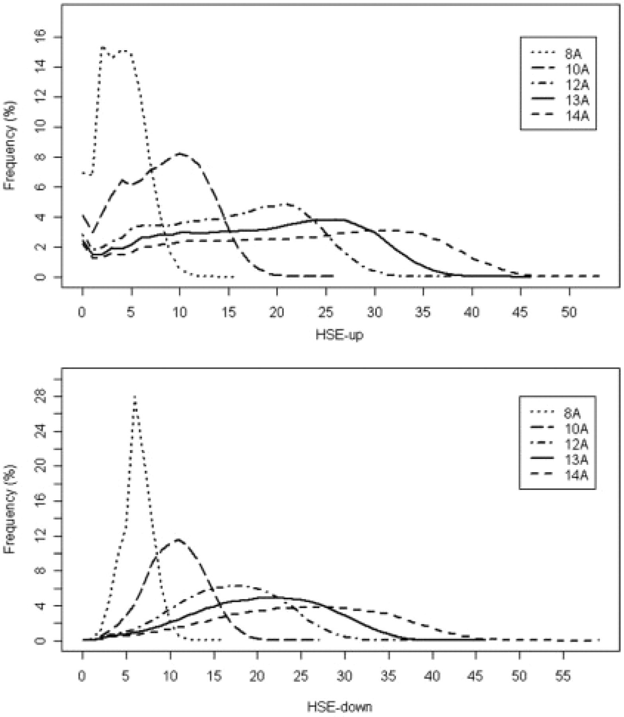
Fig. 1. The distributions of HSE-up and HSE-down measures at five different radius thresholds. The five radius ...
Notes:
Fig. 1. The distributions of HSE-up and HSE-down measures at five different radius thresholds. The five radius rd cutoffs are selected as 8Å, 10Å, 12Å, 13Å and 14Å, which are represented by dotted, dashed, dot-and-dashed, solid and short-dashed lines, respectively.
Unless provided in the caption above, the following copyright applies to the content of this slide: © The Author 2008. Published by Oxford University Press. All rights reserved. For Permissions, please email: journals.permissions@oxfordjournals.org

Slide 2
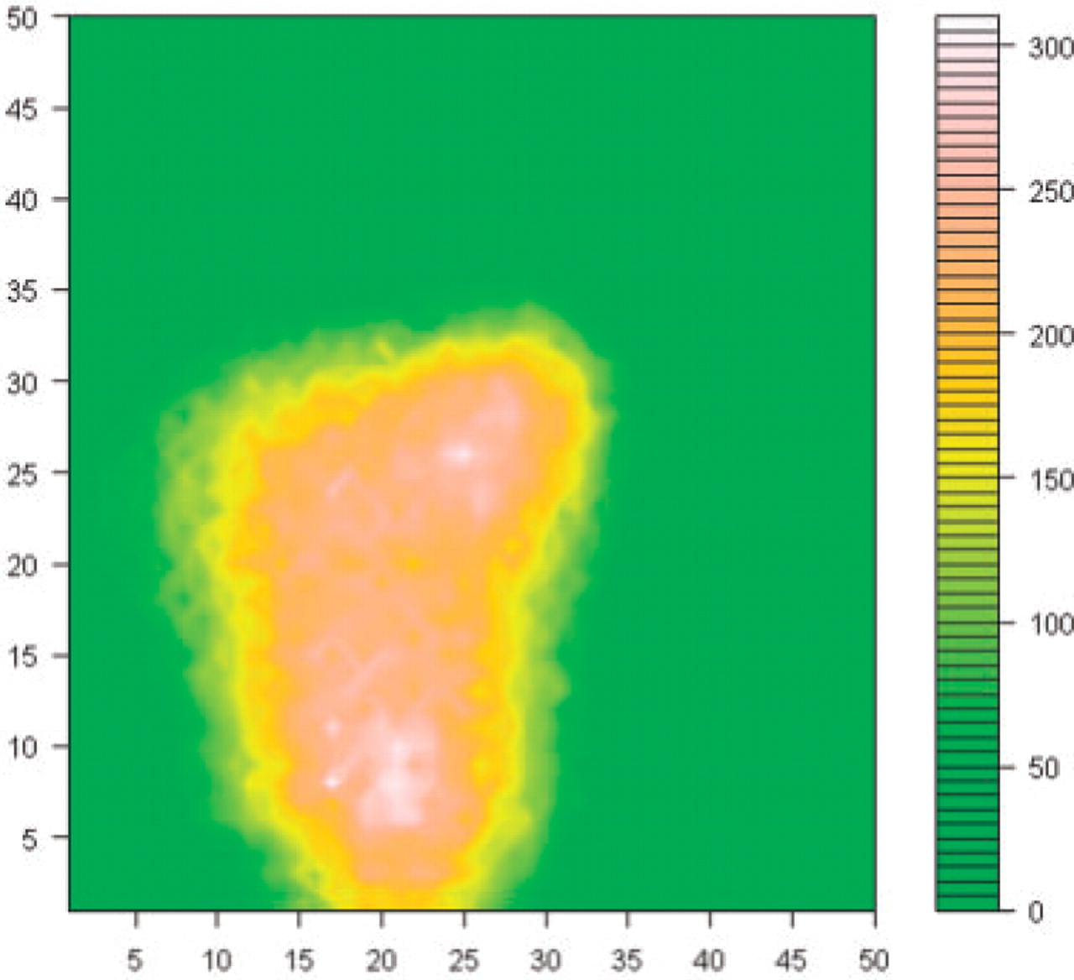
Fig. 2. Two-dimensional distribution of the HSE measures for all residues in our dataset. The x-axis and y-axis ...
Notes:
Fig. 2. Two-dimensional distribution of the HSE measures for all residues in our dataset. The x-axis and y-axis indicate the HSE-up and HSE-down measures, respectively. The values in the color legend denote the numbers of residues with the corresponding HSE measures.
Unless provided in the caption above, the following copyright applies to the content of this slide: © The Author 2008. Published by Oxford University Press. All rights reserved. For Permissions, please email: journals.permissions@oxfordjournals.org

Slide 3
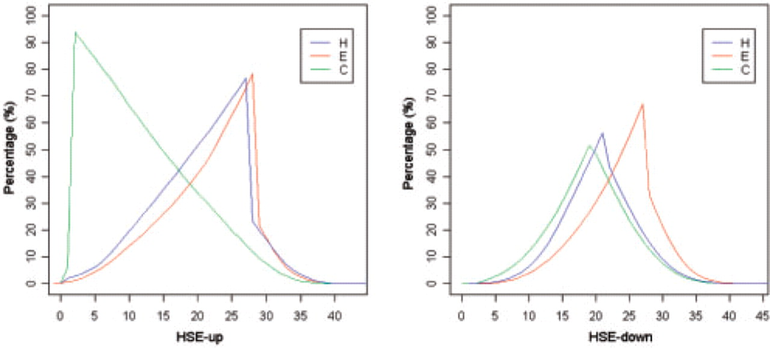
Fig. 3. The distributions of the HSE-up and HSE-down measures according to three secondary structures: α-helix (H), ...
Notes:
Fig. 3. The distributions of the HSE-up and HSE-down measures according to three secondary structures: α-helix (H), β-strand (E) and coil (C).
Unless provided in the caption above, the following copyright applies to the content of this slide: © The Author 2008. Published by Oxford University Press. All rights reserved. For Permissions, please email: journals.permissions@oxfordjournals.org

Slide 4
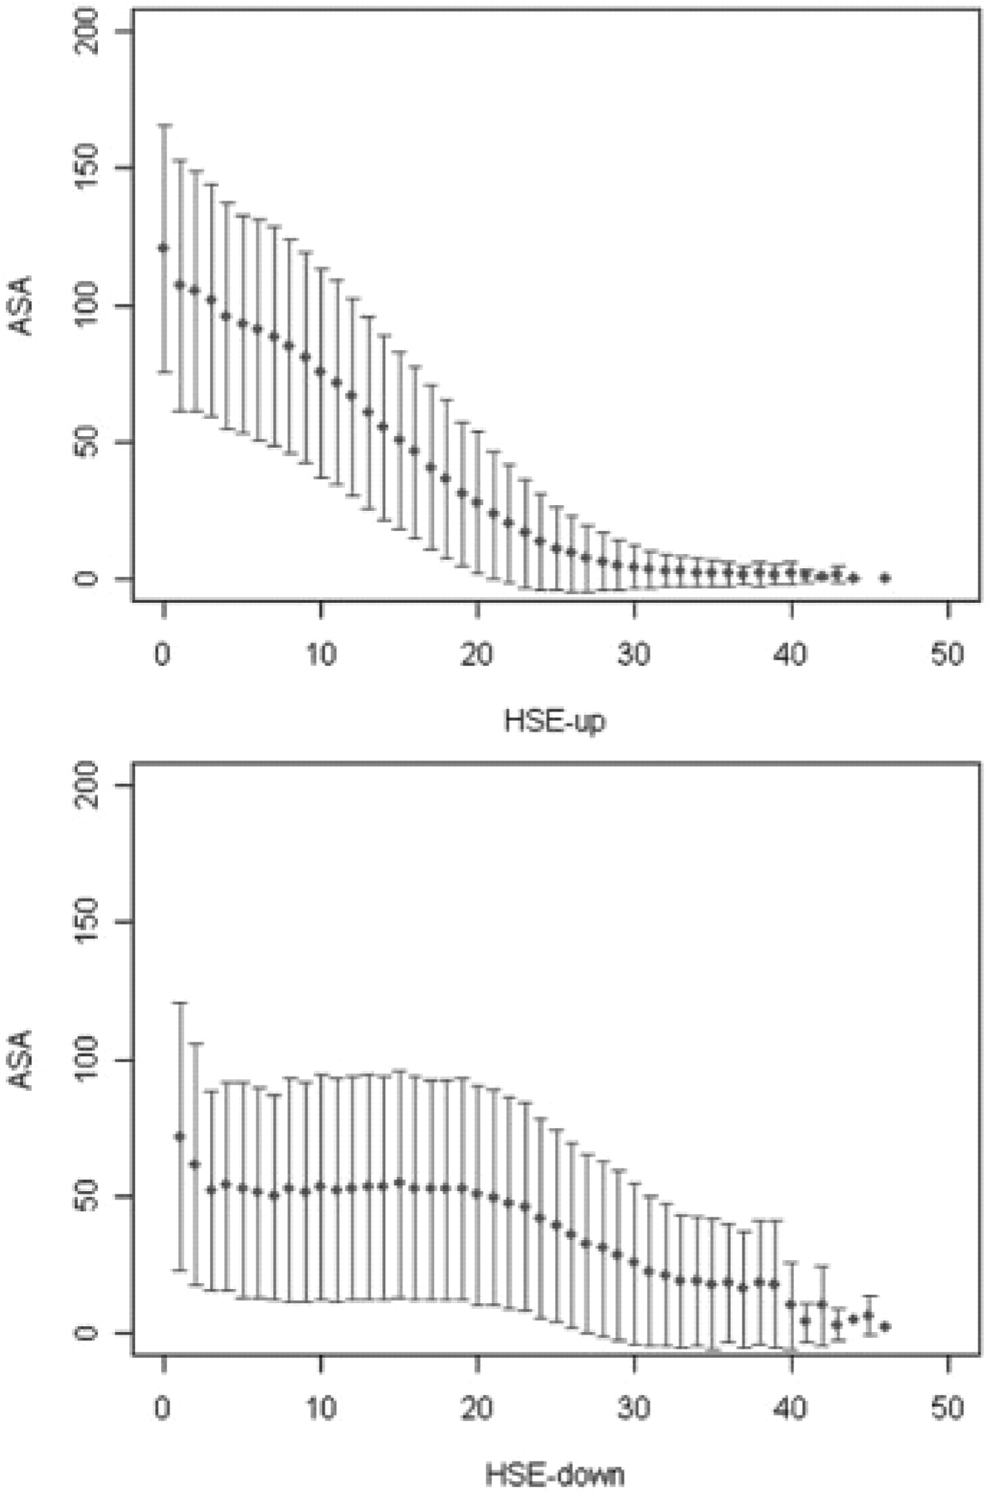
Fig. 4. The relationships between HSE-up, HSE-down and ASA. HSE-up and HSE-down values are defined with a radius ...
Notes:
Fig. 4. The relationships between HSE-up, HSE-down and ASA. HSE-up and HSE-down values are defined with a radius cutoff rd=13Å. Error bars represent the SDs.
Unless provided in the caption above, the following copyright applies to the content of this slide: © The Author 2008. Published by Oxford University Press. All rights reserved. For Permissions, please email: journals.permissions@oxfordjournals.org

Slide 5
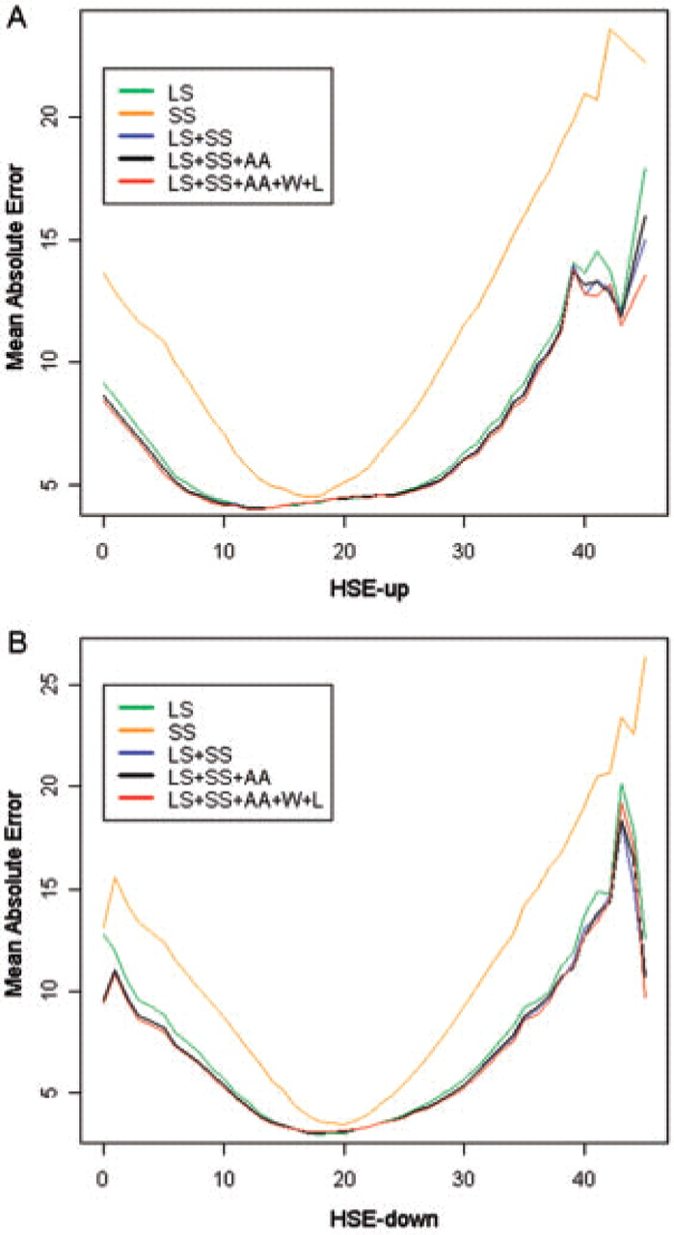
Fig. 5. The MAEs for residues of different HSE measures. A is for HSE-up while B is for HSE-down.
Notes:
Fig. 5. The MAEs for residues of different HSE measures. A is for HSE-up while B is for HSE-down.
Unless provided in the caption above, the following copyright applies to the content of this slide: © The Author 2008. Published by Oxford University Press. All rights reserved. For Permissions, please email: journals.permissions@oxfordjournals.org

Slide 6
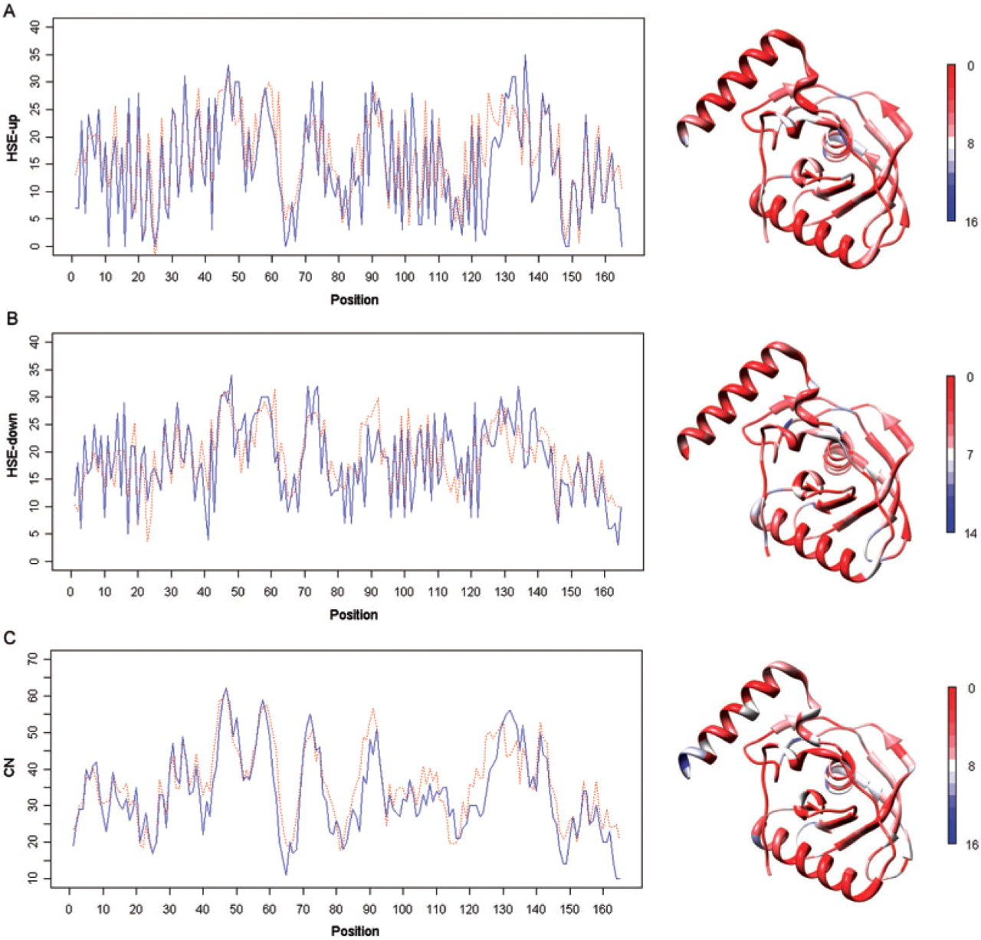
Fig. 6. The predicted and observed HSE-up, HSE-down and CN profiles for the E.coli peptide Deformylase (PDF) bound to ...
Notes:
Fig. 6. The predicted and observed HSE-up, HSE-down and CN profiles for the E.coli peptide Deformylase (PDF) bound to Formate (PDB code: 1xeo, chain A). For each subfigure, the predicted profile is at the left and the structural mapping with gradient from the best (red) to the worst prediction (blue) is at the right. The predicted and observed HSE and CN values are represented by dashed red and solid blue lines, respectively.
Unless provided in the caption above, the following copyright applies to the content of this slide: © The Author 2008. Published by Oxford University Press. All rights reserved. For Permissions, please email: journals.permissions@oxfordjournals.org

