Slide 1
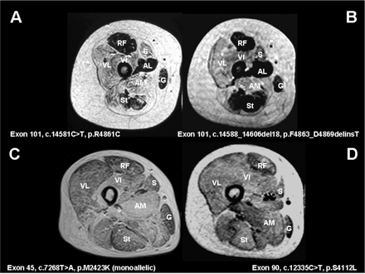
Fig. 1 Muscle MRI in RYR1-related congenital myopathies. T1-weighted MR images, transverse sections through the ...
Notes:
Fig. 1 Muscle MRI in RYR1-related congenital myopathies. T1-weighted MR images, transverse sections through the proximal thigh in an 11-year old boy (A) (case 6) and a 12-year old girl (B) (case 10) with central core disease (CCD), a 41-year old male with multi-minicore disease (MmD) and external ophthalmoplegia (C) (case 25) and a 9-year old girl with centronuclear myopathy (CNM) and external ophthalmoplegia (D) (case 16). In patients with typical CCD due to heterozygous dominant mutations affecting C-terminal exons 100–102 (A–B), there is a consistent pattern of selective muscle involvement characterized by marked increase in abnormal signal within vasti (VL, VI), sartorius (S) and adductor magnus (AM) and relative sparing of rectus femoris (RF), adductor longus (AL), gracilis (G) and semitendinosus (St). In patients with MmD and external ophthalmoplegia due to recessive RYR1 mutations (C) and CNM and external ophthalmoplegia due to a heterozygous dominant RYR1 mutation (D), there is more diffuse involvement (corresponding to more generalized weakness and wasting on clinical examination) but persistent relative sparing of the rectus femoris (RF) compared to the vastus intermedius (VI) and the gracilis (G) compared to the sartorius (S).
Unless provided in the caption above, the following copyright applies to the content of this slide: © The Author (2007). Published by Oxford University Press on behalf of the Guarantors of Brain. All rights reserved. For Permissions, please email: journals.permissions@oxfordjournals.org

Slide 2
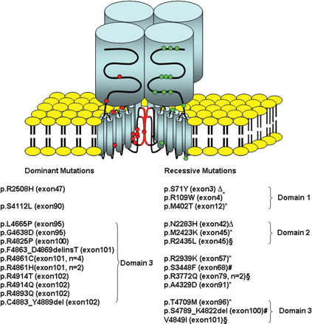
Fig. 2 Schematic representation of the skeletal muscle ryanodine receptor tetramer taken from Treves et al., 2005, ...
Notes:
Fig. 2 Schematic representation of the skeletal muscle ryanodine receptor tetramer taken from Treves et al., 2005, with permission showing the position of the dominant and recessive RYR1 mutations identified in the patients presented in this report. Dominant and recessive mutations are shown with circles in red and green, respectively. All dominant mutations, except mutations p.R2508H and p.R4112L which were associated with atypical myopathy with MH and CNM, are located in domain 3. Recessive mutations are distributed evenly throughout the gene. Monoallelically expressed mutations are marked by an asterisk; two pairs of compound heterozygous mutations are indicated by symbols ▵ and #, respectively; homozygous recessive mutations were labelled with symbol §.
Unless provided in the caption above, the following copyright applies to the content of this slide: © The Author (2007). Published by Oxford University Press on behalf of the Guarantors of Brain. All rights reserved. For Permissions, please email: journals.permissions@oxfordjournals.org

Slide 3
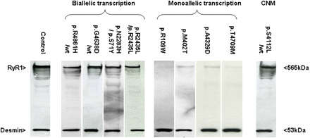
Fig. 3 The effect of RYR1 mutations on protein expression. Western blot analysis of skeletal muscle biopsies from ...
Notes:
Fig. 3 The effect of RYR1 mutations on protein expression. Western blot analysis of skeletal muscle biopsies from patients described in this study. Patients carrying mutations p.R4861H (heterozygous), p.G4638D (heterozygous), p.S71Y+p.N2283H (compound heterozygous) and p.R2435L (homozygous) with normal biallelic transcription showed normal levels of RyR1 expression as compared to control muscle. In contrast patients carrying mutations p.R109W, p.M402T, p.A4329D and p.T4709M with monoallelic transcription had dramatically decreased levels of RyR1. The patient with CNM carrying mutation p.S4112L (heterozygous) showed normal level of expression of RyR1. Desmin immunoreactivity was used as a muscle-specific loading control.
Unless provided in the caption above, the following copyright applies to the content of this slide: © The Author (2007). Published by Oxford University Press on behalf of the Guarantors of Brain. All rights reserved. For Permissions, please email: journals.permissions@oxfordjournals.org

Slide 4
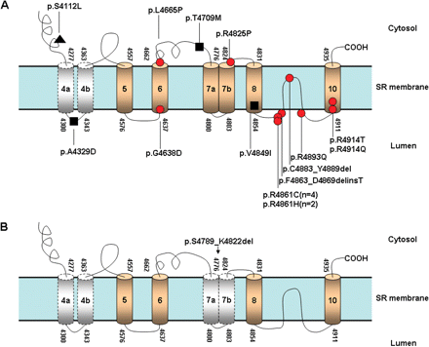
Fig. 4 Schematic diagram showing the distribution of mutations associated with congenital myopathies in the ...
Notes:
Fig. 4 Schematic diagram showing the distribution of mutations associated with congenital myopathies in the C-terminal region of RYR1. (A) Closed circles signify mutations which are dominant and are associated with the CCD phenotype •; closed squares signify mutations which are recessive and associated with the MmD phenotype ▪ and the closed triangle signifies the mutation associated with the CNM phenotype ▴. (B) A 34-amino-acid deletion p.S4789_K4822del, affecting most of the transmembrane segments M7a and M7b, did not cause any phenotype when expressed in the heterozygous state. The schematic diagram is based on the proposed model of Du's (Du et al., 2002).
Unless provided in the caption above, the following copyright applies to the content of this slide: © The Author (2007). Published by Oxford University Press on behalf of the Guarantors of Brain. All rights reserved. For Permissions, please email: journals.permissions@oxfordjournals.org

