Slide 1
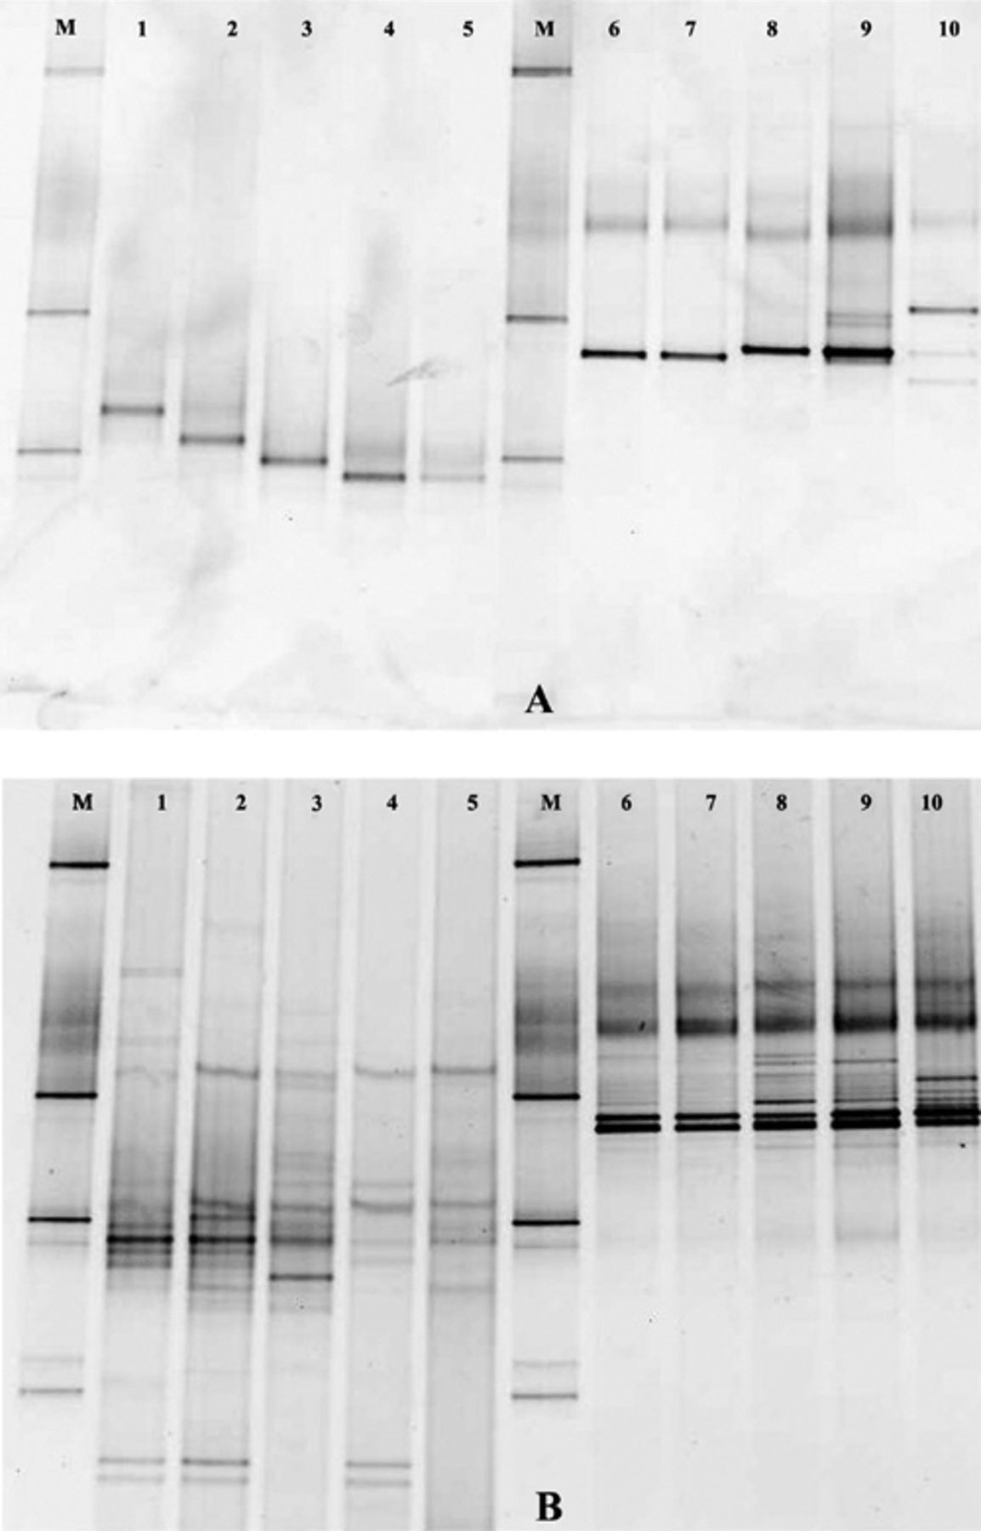
1 Evaluation of two Pseudomonas-specific PCR-DGGE systems using as targets pure culture and soil DNA. A: Pure ...
Notes:
1 Evaluation of two Pseudomonas-specific PCR-DGGE systems using as targets pure culture and soil DNA. A: Pure cultures. Lanes 1–5: amplified with the primers located in the V6/V7 region of the 16S rRNA gene; 6–10: amplified with the primers located in the V1–V3 region of the 16S rRNA gene. Lanes 1, 6: Pseudomonas sp. E102; 2, 7: P. libaniensis; 3, 8: Pseudomonas sp. SaU7; 4, 9: P. fluorescens LCSA0UT2; 5, 10: Pseudomonas sp. Fa8. B: Five soil DNA samples. Lanes 1–5: soil DNA amplified with primers located in the V6/V7 region of the 16S rRNA gene; 6–10: same samples amplified with primers located in the V1–V3 region of the 16S rRNA gene. M: marker (from top to bottom): amplicons of Enterobacter cloacae BE1, Listeria innocua ALM105, Rhizobium leguminosarum bv. trifolii R62, Arthrobacter sp., Burkholderia cepacia P2.
Unless provided in the caption above, the following copyright applies to the content of this slide: © 2003 Federation of European Microbiological Societies. Published by Elsevier Science B.V. All rights reserved.

Slide 2
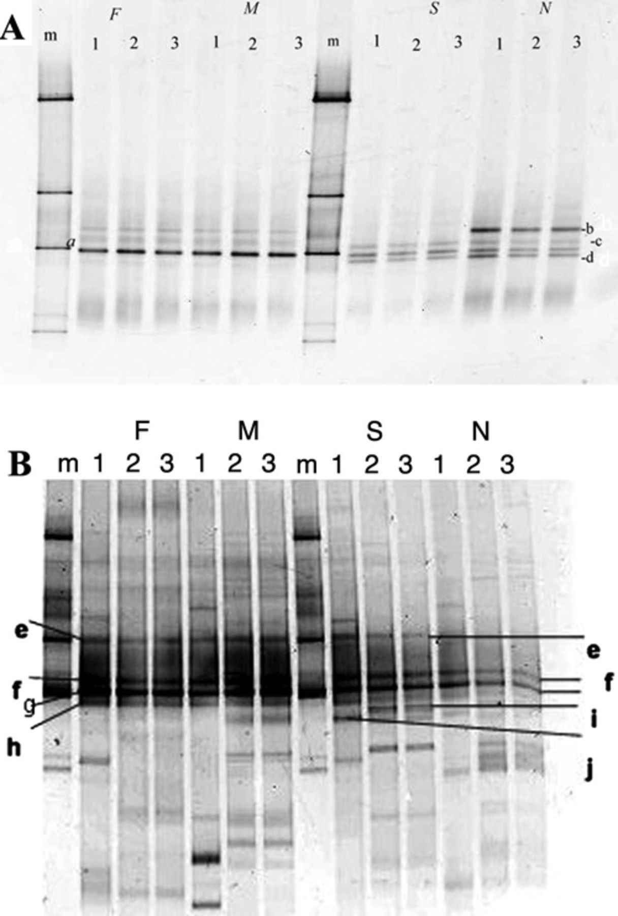
2 DGGE analysis of PCR products from DNA extracted from soil samples under different treatments (first year ...
Notes:
2 DGGE analysis of PCR products from DNA extracted from soil samples under different treatments (first year sampling): A: long-term arable land under rotation; B: permanent grassland; F: February; M: May; S: September; N: November. For every sampling three replicate plots are presented (1, 2 and 3). m: marker (from top to bottom, amplicons of Enterobacter cloacae BE1, Listeria innocua ALM105, Rhizobium leguminosarum bv. trifolii R62, Arthrobacter sp., Burkholderia cepacia P2). DGGE bands (closest hits in database): a: P. rhodesiae (99%, AY043360); b: P. fluorescens (100%, AY092072); c: P. migulae (100%, AY047218); d: P. syringae (99%, AF511511); e: P. orientalis (99%, AF064457); f: Pseudomonas sp. E102 (100%, AF451270); g: Pseudomonas sp. SaU7 (100%, AF511510); h: P. rhodesiae (98%, AY043360); i: P. putida (97%, AF094743); j: P. tolaasii (98%, AF320986).
Unless provided in the caption above, the following copyright applies to the content of this slide: © 2003 Federation of European Microbiological Societies. Published by Elsevier Science B.V. All rights reserved.

Slide 3
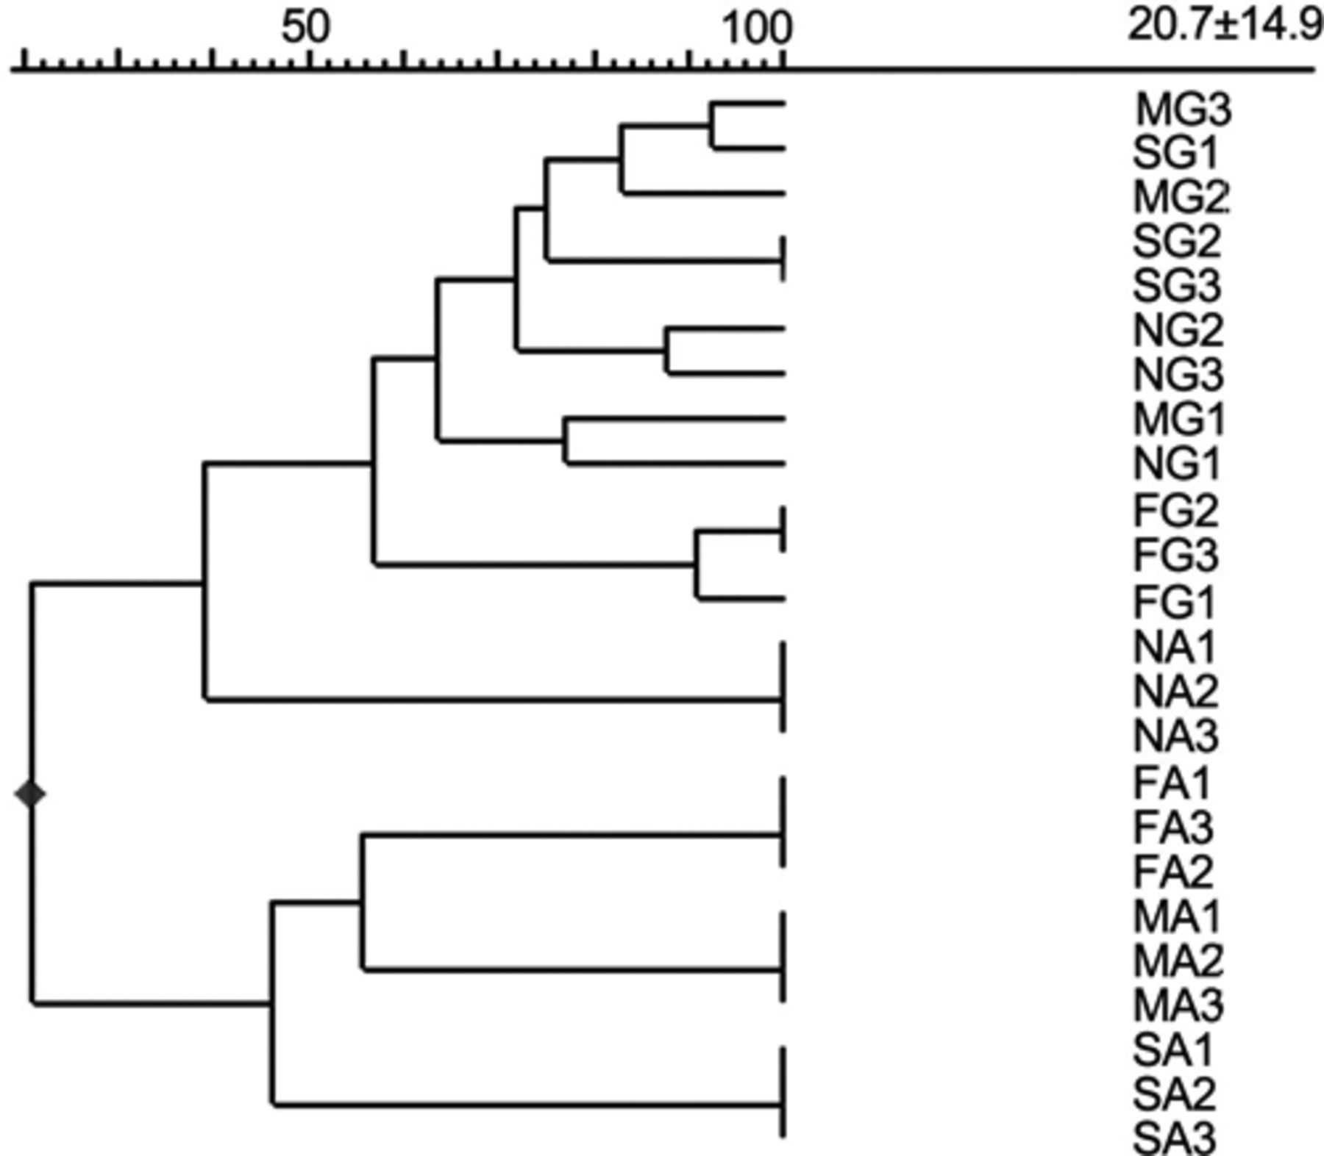
3 Dendrogram constructed with UPGMA representing the similarity between Pseudomonas-specific PCR-DGGE patterns ...
Notes:
3 Dendrogram constructed with UPGMA representing the similarity between Pseudomonas-specific PCR-DGGE patterns obtained from soil samples under different management regimes over one growing season (2000). Codes: F: February; M: May; S: September; N: November; A: arable land under rotation; G: permanent grassland; 1, 2, 3: replicates 1, 2 and 3.
Unless provided in the caption above, the following copyright applies to the content of this slide: © 2003 Federation of European Microbiological Societies. Published by Elsevier Science B.V. All rights reserved.

Slide 4
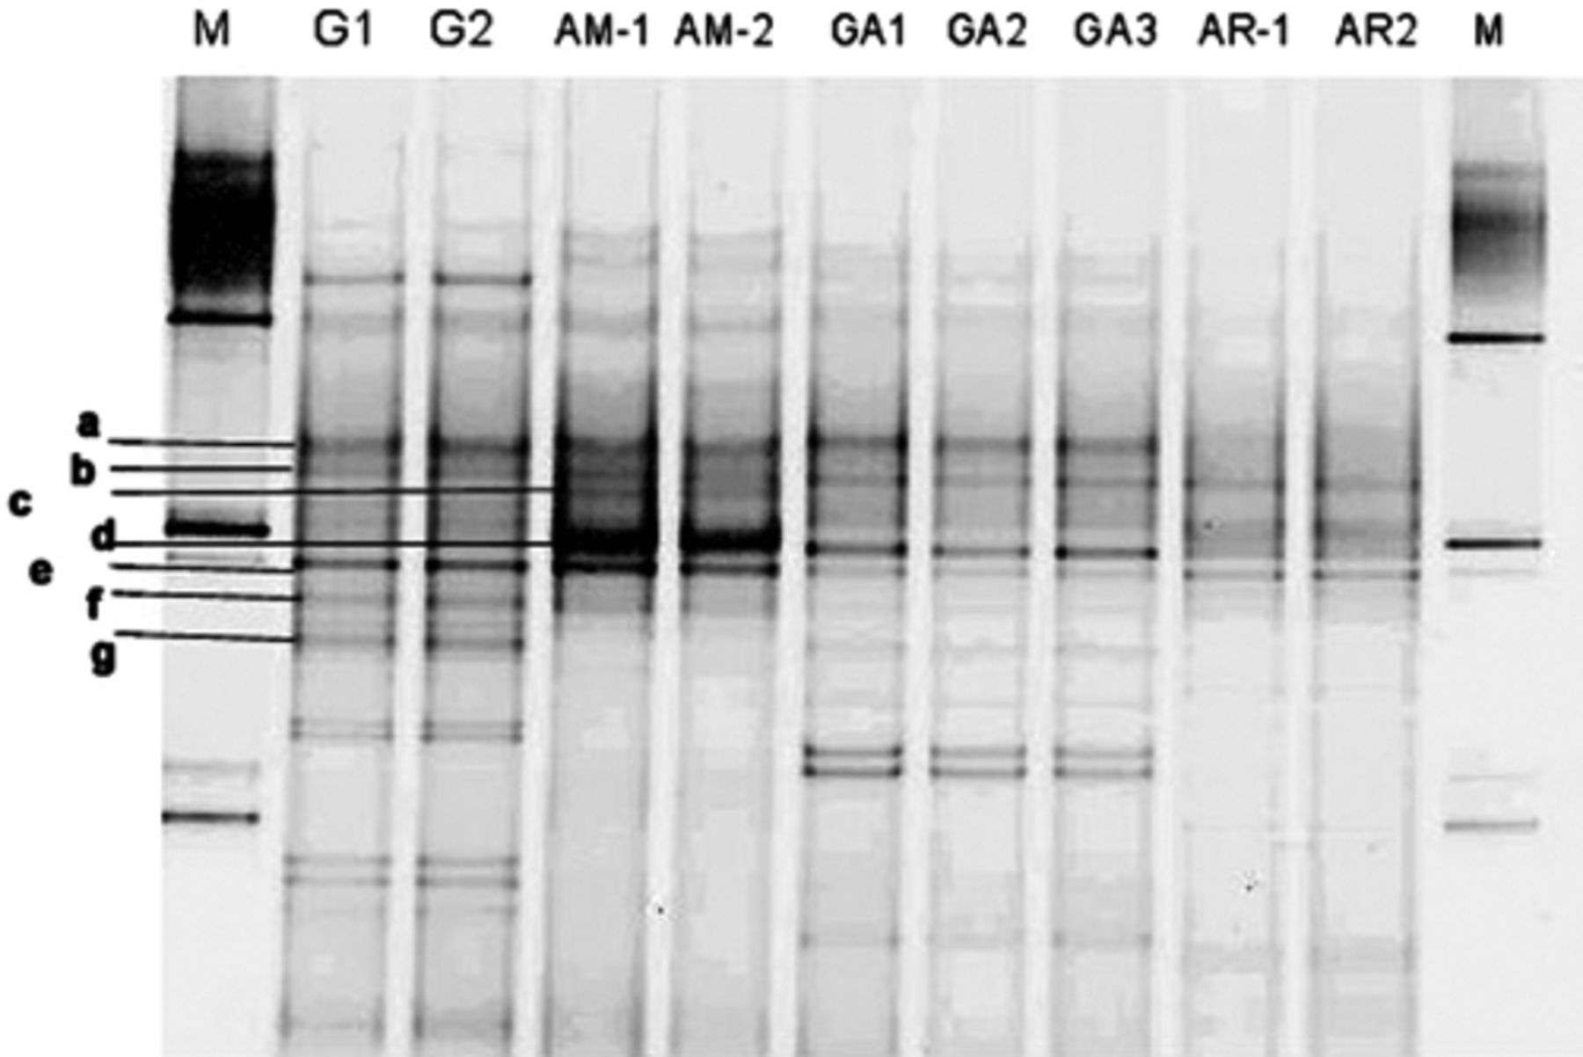
4 PCR-DGGE banding patterns representing the dominant Pseudomonas populations in soil samples under different ...
Notes:
4 PCR-DGGE banding patterns representing the dominant Pseudomonas populations in soil samples under different treatments during the second sampling year. For soil treatments see Section 2.3. Two or three replicates per treatment, numbered 1, 2 and 3, are shown. Where only two are shown, the third replicate was equal. M: Marker (from top to bottom, amplicons of Enterobacter cloacae BE1, Listeria innocua ALM105, Rhizobium leguminosarum bv. trifolii R62, Arthrobacter sp., Burkholderia cepacia P2). DGGE bands (closest hits in database shown): a: P. orientalis (99%, AF064457); b: Pseudomonas sp. E102 (100%, AF451270); c: P. libaniensis (100%, AF057645); d: Pseudomonas sp. SaU7 (100%, AF511510); e: P. fluorescens LCSA0TU2 (100%, AF506042); f: P. rhodesiae (98%, AY043360); g: P. tolaasii (98%, AF320986).
Unless provided in the caption above, the following copyright applies to the content of this slide: © 2003 Federation of European Microbiological Societies. Published by Elsevier Science B.V. All rights reserved.

Slide 5
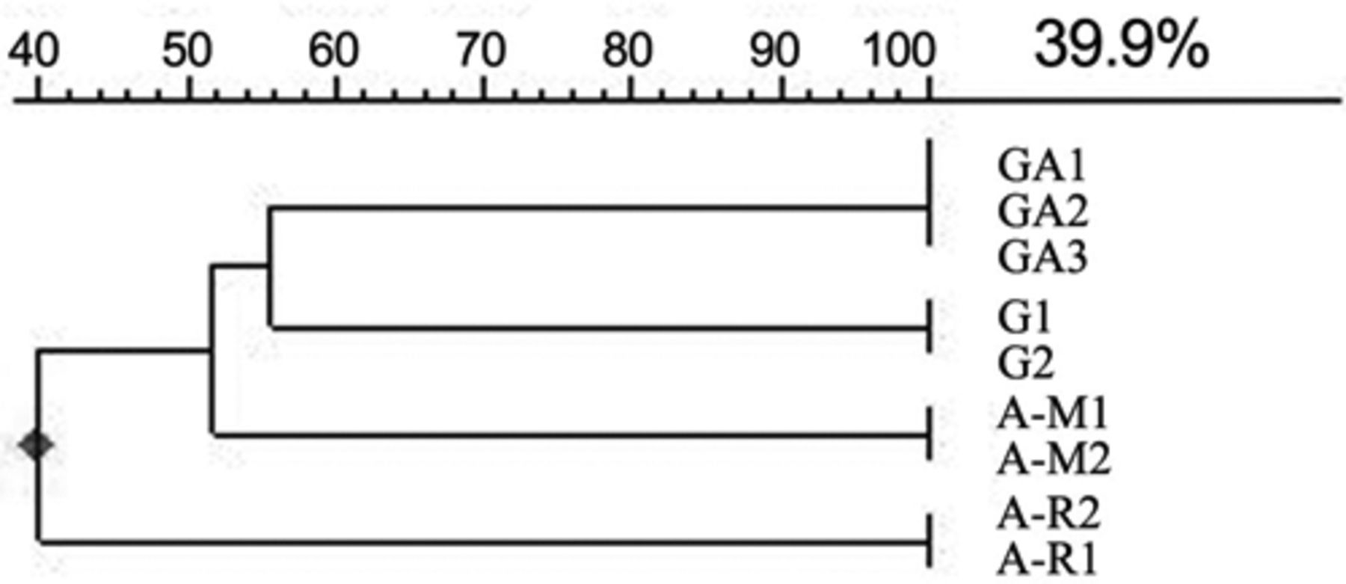
5 Dendrogram constructed with UPGMA representing the similarity between Pseudomonas-specific PCR-DGGE patterns ...
Notes:
5 Dendrogram constructed with UPGMA representing the similarity between Pseudomonas-specific PCR-DGGE patterns obtained from soil samples under different management regimes (as shown in Section 2.3). Numbers 1, 2 and 3 indicate replicates.
Unless provided in the caption above, the following copyright applies to the content of this slide: © 2003 Federation of European Microbiological Societies. Published by Elsevier Science B.V. All rights reserved.

Slide 6
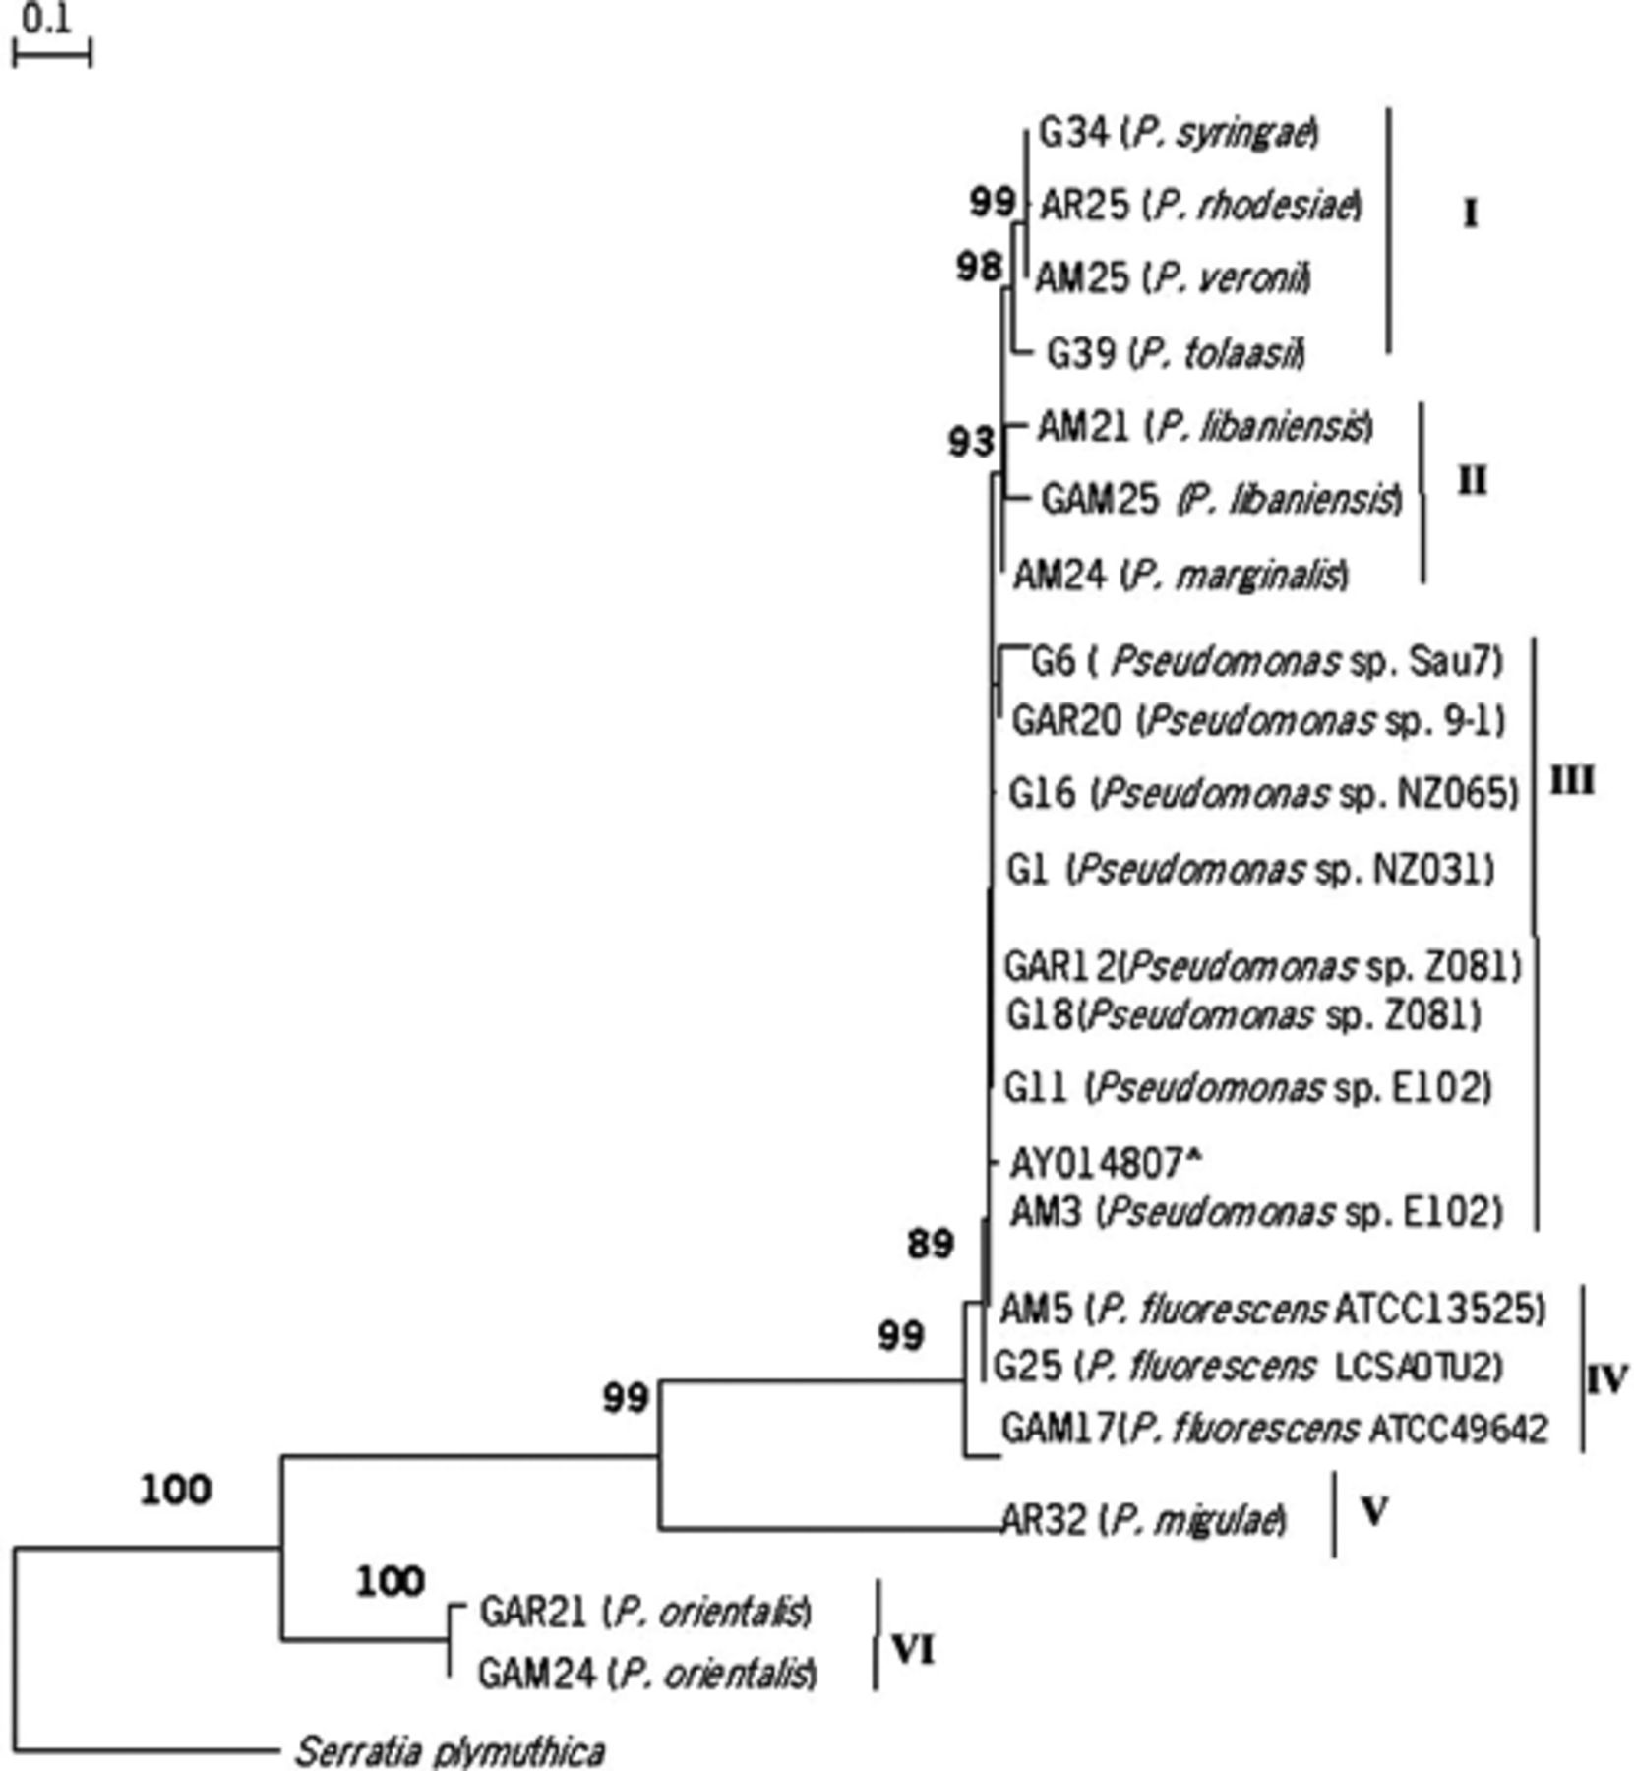
6 Neighbor-joining phylogenetic tree based on partial 16S rDNA sequences from soil-derived Pseudomonas ...
Notes:
6 Neighbor-joining phylogenetic tree based on partial 16S rDNA sequences from soil-derived Pseudomonas isolates. In parentheses, the closest hit from the database is shown (>97–100% similarity). Representatives of each group of sequences shown here: group I (4 representatives), group II (3), group III (8), group IV (3), group V (1) and group VI (2). The sequence of Serratia plymuthica was used as an outgroup. A bootstrap analysis was performed with 100 repetitions and values greater than 50% are indicated. Codes of the isolates correspond with the codes of Table 2.
Unless provided in the caption above, the following copyright applies to the content of this slide: © 2003 Federation of European Microbiological Societies. Published by Elsevier Science B.V. All rights reserved.

