Slide 1
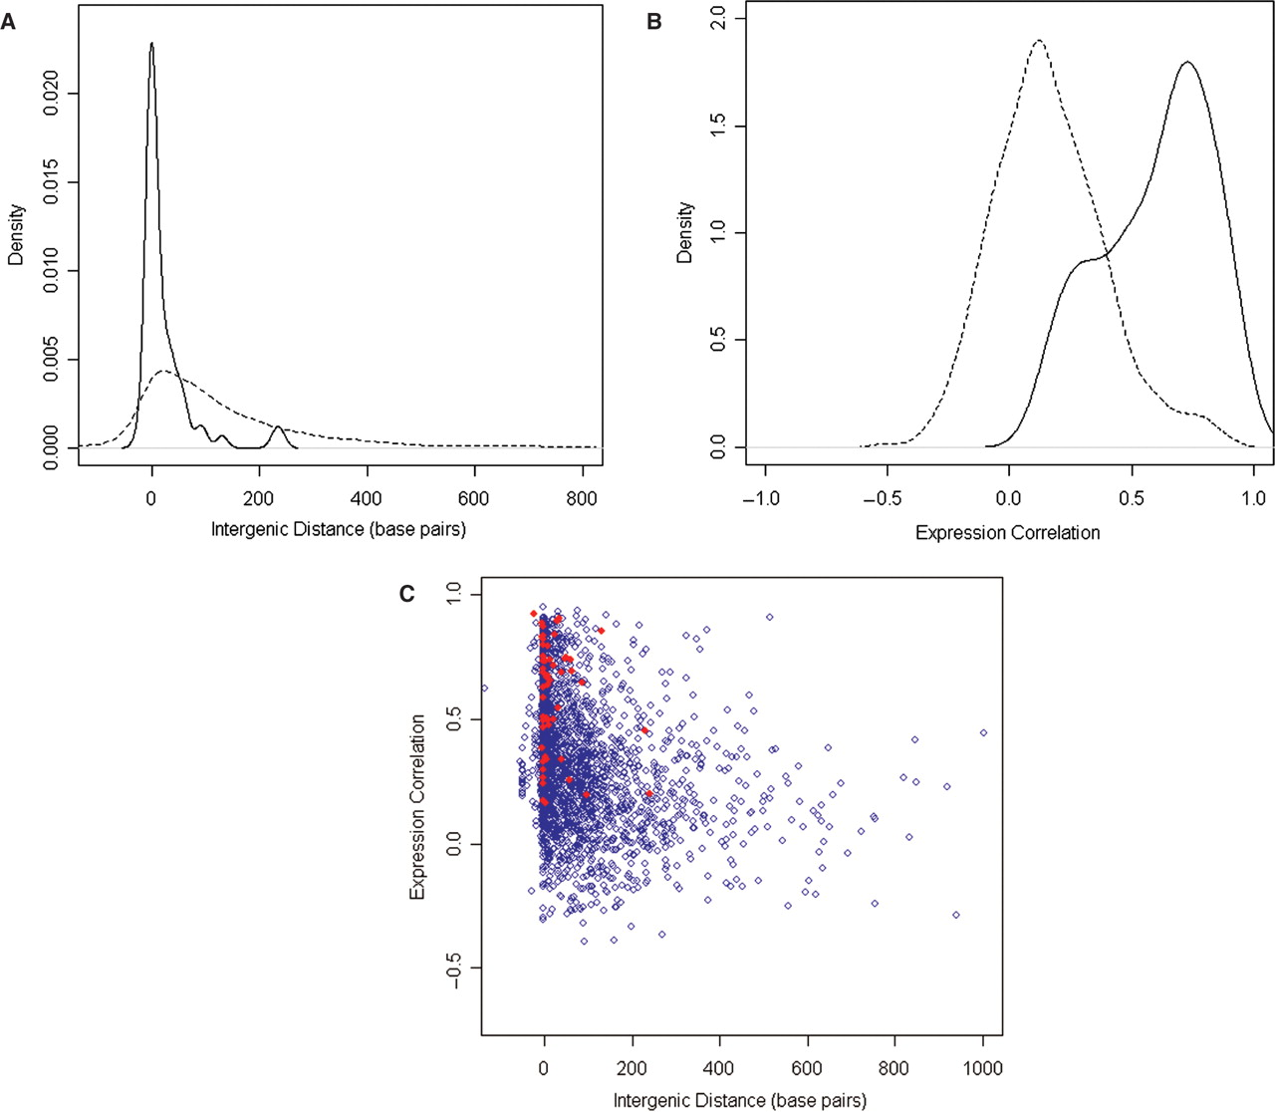
Figure 1. Density estimates of (A) intergenic distance and (B) gene expression correlation for known operon pairs ...
Notes:
Figure 1. Density estimates of (A) intergenic distance and (B) gene expression correlation for known operon pairs (solid) and non-operon pairs (dashed) using nonparametric kernel density estimates with Gaussian kernels. (C) A scatterplot showing the relationship of coexpression (vertical axis) and intergenic distance (horizontal axis) for all known operons pairs (red dots) and potential operon pairs (blue dots).
Unless provided in the caption above, the following copyright applies to the content of this slide: © 2007 The Author(s)This is an Open Access article distributed under the terms of the Creative Commons Attribution Non-Commercial License (http://creativecommons.org/licenses/by-nc/2.0/uk/) which permits unrestricted non-commercial use, distribution, and reproduction in any medium, provided the original work is properly cited.

Slide 2
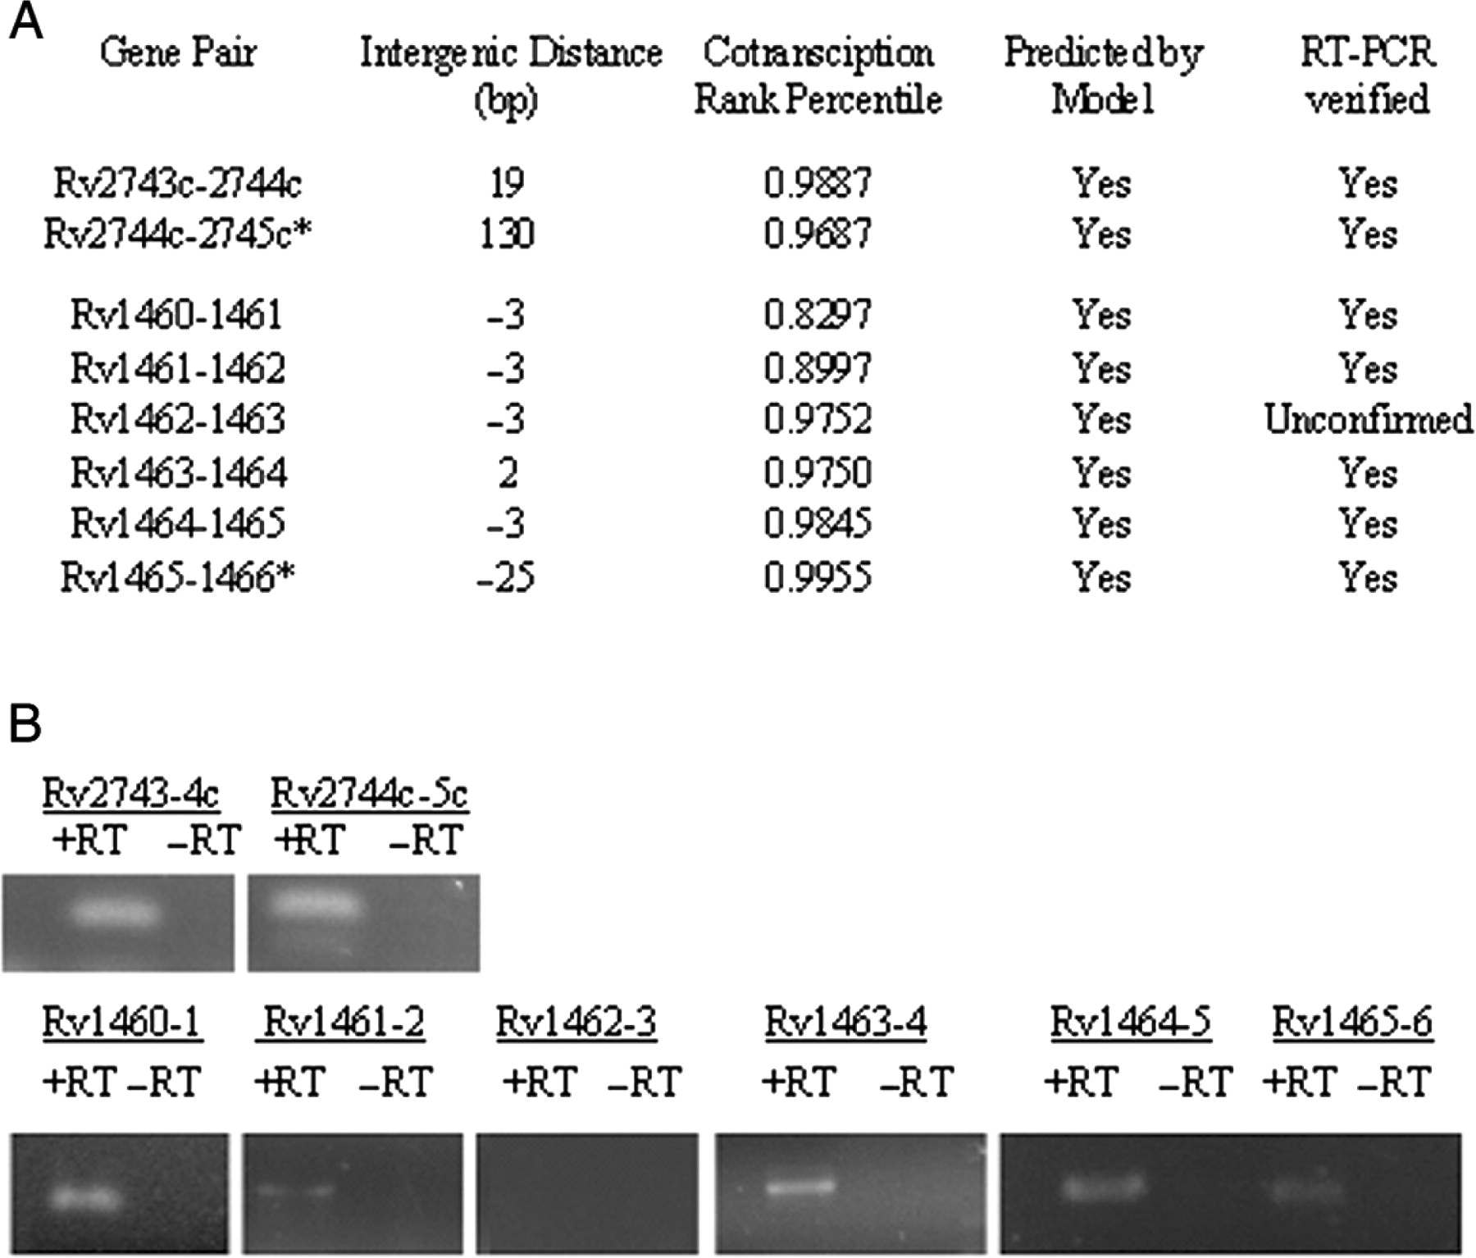
Figure 3. To further test the predictions of the model described in this work, two operons were subjected to additional ...
Notes:
Figure 3. To further test the predictions of the model described in this work, two operons were subjected to additional laboratory testing. Starting from a foundation of gene pairs we have successfully amplified in the past in our laboratory (shown with asterisk) we selected adjacent newly predicted operon pairs and tested them by RT-PCR. In the summary table of results (A), gene pairs without an asterisk are therefore new results. For each gene pair, the intergenic distance, coexpression rank percentile and model prediction are shown. The final column indicates whether we have successfully verified that the gene pair coexists on a single RNA molecule by RT-PCR as described in the Materials and Methods section. Panel B shows some of the associated gel image data. Specifically, of the six newly predicted operon pairs tested, we were able to confirm all but one by generating a PCR fragment. The lone exception (Rv1462-Rv1463) may indicate (i) they are not cotranscribed as predicted, (ii) we have not currently (but may eventually) amplify a fragment which bridges this pair by RT-PCR or (iii) other factors are at work which could confound RT-PCR. As a result, we have labeled Rv1462-Rv1463 ‘unconfirmed’ in the table.
Unless provided in the caption above, the following copyright applies to the content of this slide: © 2007 The Author(s)This is an Open Access article distributed under the terms of the Creative Commons Attribution Non-Commercial License (http://creativecommons.org/licenses/by-nc/2.0/uk/) which permits unrestricted non-commercial use, distribution, and reproduction in any medium, provided the original work is properly cited.

Slide 3
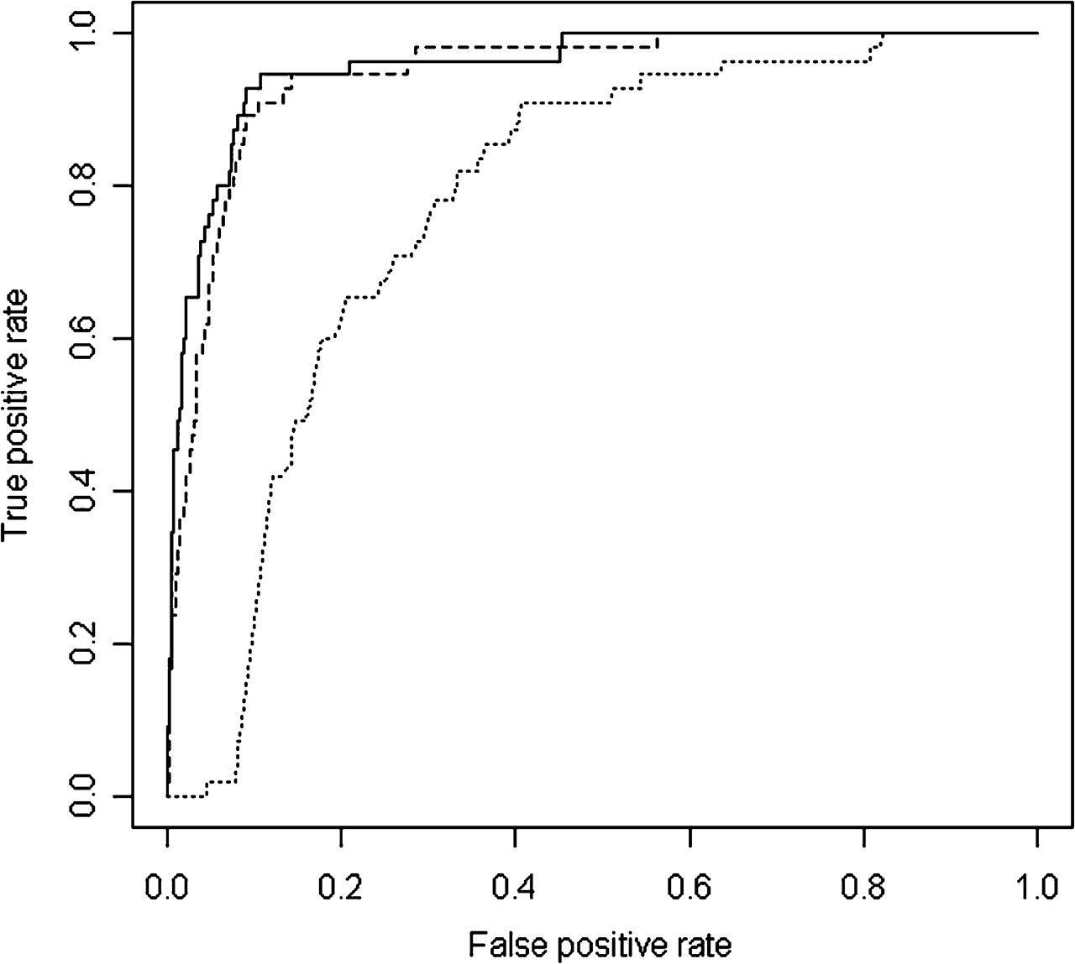
Figure 2. ROC curves comparing three predictive models. The best model shown (Model A; solid line) uses intergenic ...
Notes:
Figure 2. ROC curves comparing three predictive models. The best model shown (Model A; solid line) uses intergenic distance and coexpression data from oligo and amplicon microarrays, while the next best model (Model B; dashed line) uses intergenic distance and coexpression data from only oligo microarrays and the poorest performing model (Model C; dotted line) uses only intergenic distance.
Unless provided in the caption above, the following copyright applies to the content of this slide: © 2007 The Author(s)This is an Open Access article distributed under the terms of the Creative Commons Attribution Non-Commercial License (http://creativecommons.org/licenses/by-nc/2.0/uk/) which permits unrestricted non-commercial use, distribution, and reproduction in any medium, provided the original work is properly cited.

