Slide 1
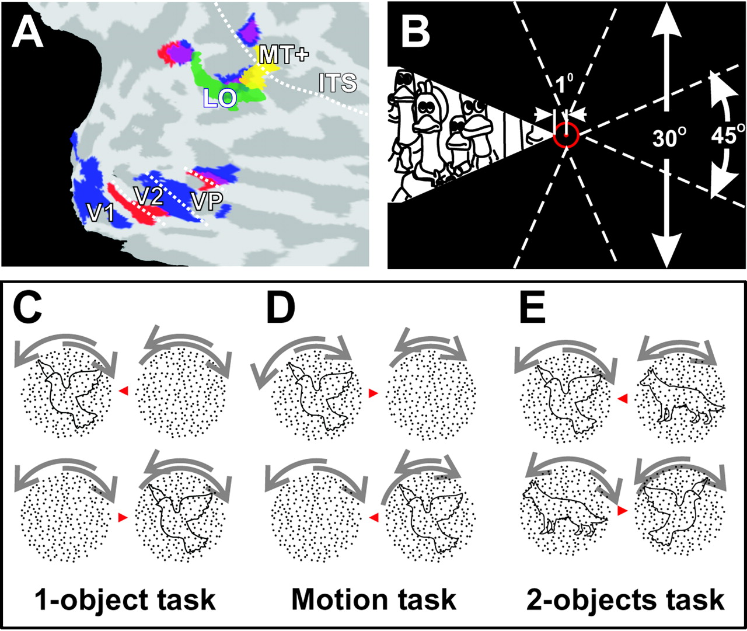
Figure 1. Experimental setup. (A) Areas LO and MT+ superimposed onto the right hemisphere of a virtually flattened ...
Notes:
Figure 1. Experimental setup. (A) Areas LO and MT+ superimposed onto the right hemisphere of a virtually flattened brain. Activation produced by the object localizer (intact objects versus scrambled) defines area LO (shown in green). Activation produced by the motion localizer (motion vs. stationary) defines area MT+ (shown in yellow). Activation produced by the animated movie within a wedge-shaped aperture shown either to the left (blue) or above (red) of fixation can be used to define the borders of areas V1, V2 and VP in the lower right occipital cortex. ITS: inferior temporal sulcus. (B) In experiment 1a subjects watched scenes from an animated movie in a wedge-shaped aperture either left, right, above or below the central fixation point. (C–E) Examples of stimuli used in experiment 2. Outlines of animal shapes and rotating random dot patterns were presented in the left and/or right visual hemifield. (C) In the 1-object task subjects attended to single outlines of animal shapes on the left (top row), or on the right (bottom row) while rotating random dot patterns appeared on both sides. (D) The motion task presented the same stimuli but subjects attended to the moving dots located opposite to the object (i.e. the dots on the right in the top row and on the left in the bottom row. (E) In the 2-object task objects and motion appeared on both sides. Subjects attended to the object on the left (top row) or on the right (bottom row).
Unless provided in the caption above, the following copyright applies to the content of this slide: Cerebral Cortex V 15 N 3 © Oxford University Press 2004; all rights reserved

Slide 2
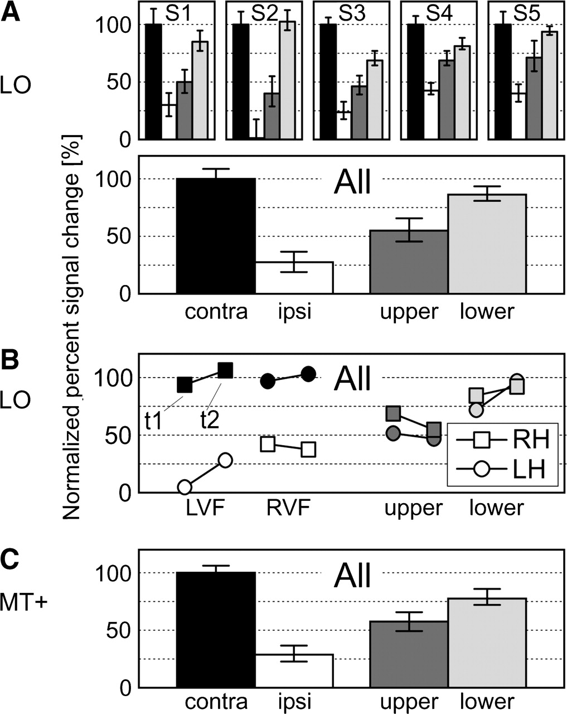
Figure 2. Normalized percent signal changes from experiment 1a. (A) Data for five subjects (averaged across epochs and ...
Notes:
Figure 2. Normalized percent signal changes from experiment 1a. (A) Data for five subjects (averaged across epochs and hemispheres) and the group averages for LO. BOLD response was recorded for contra- and ipsilateral, upper or lower visual field stimulation. Error bars represent standard errors (subject data) or averaged standard errors (group data). (B) Group averages for LO separately for the first and second half of the experiment (t1 and t2) and hemispheres (RH, right hemisphere; LH, left hemisphere). Contra- and ipsilateral data are sorted by the absolute visual field location of the aperture: LVF, left visual field; RVF, right visual field. (C) Average data for MT+. Same conventions as in (A), lower panel.
Unless provided in the caption above, the following copyright applies to the content of this slide: Cerebral Cortex V 15 N 3 © Oxford University Press 2004; all rights reserved

Slide 3
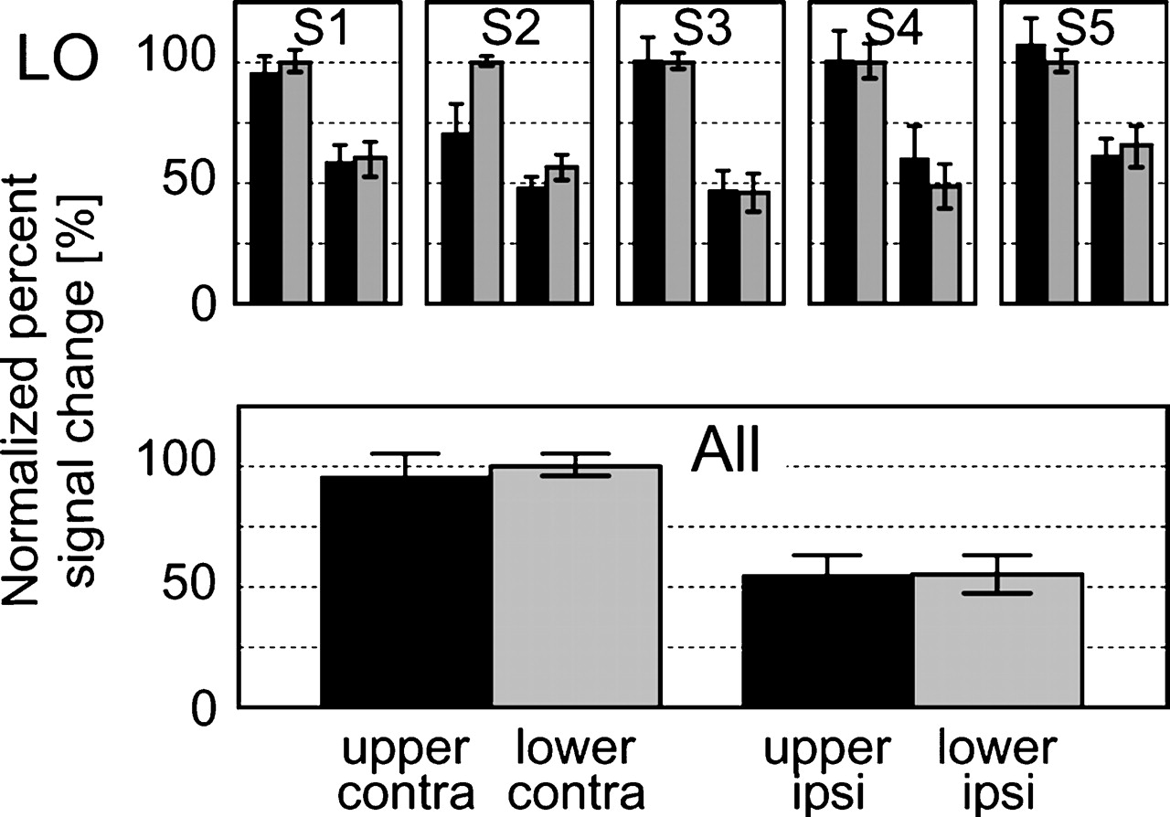
Figure 3. Normalized percent signal changes from experiment 1b. Data for five subjects (averaged across epochs and ...
Notes:
Figure 3. Normalized percent signal changes from experiment 1b. Data for five subjects (averaged across epochs and hemispheres) and the group averages for LO. BOLD response was recorded for upper and contralateral, lower and contralateral, upper and ipsilateral or lower and ipsilateral visual field stimulation. Error bars represent standard errors (subject data) or averaged standard errors (group data).
Unless provided in the caption above, the following copyright applies to the content of this slide: Cerebral Cortex V 15 N 3 © Oxford University Press 2004; all rights reserved

Slide 4
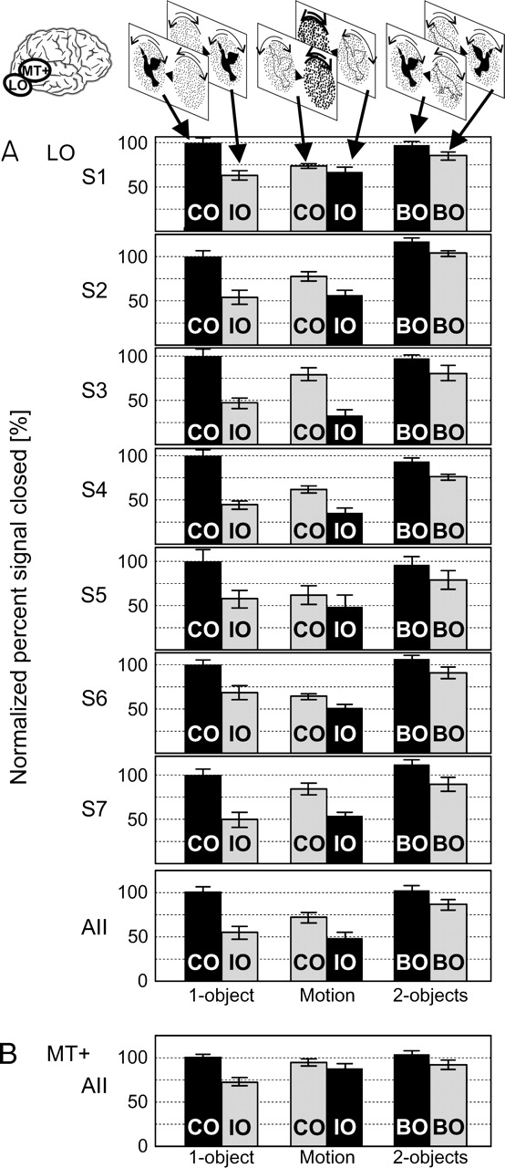
Figure 4. Normalized percent signal changes for experiment 2. (A) Group averages for LO. (B) Group averages for MT+. At ...
Notes:
Figure 4. Normalized percent signal changes for experiment 2. (A) Group averages for LO. (B) Group averages for MT+. At the top of panel A, examples of the six conditions are shown from the perspective of the right hemisphere (actual data are collapsed across hemispheres). 1-object task, motion task, 2-objects task. CO: object presented contralaterally, IO: object presented ipsilaterally, BO: objects presented bilaterally. Black bars indicate that the side contralateral to the respective hemisphere was attended; gray bars indicate that the ipsilateral side was attended. Error bars represent averaged standard errors.
Unless provided in the caption above, the following copyright applies to the content of this slide: Cerebral Cortex V 15 N 3 © Oxford University Press 2004; all rights reserved

Slide 5
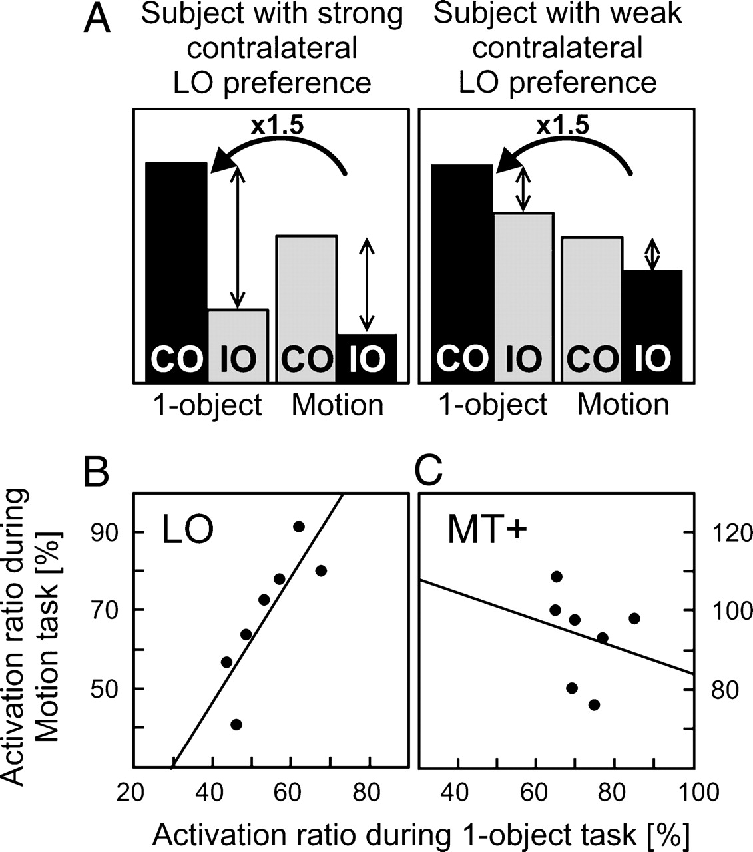
Figure 5. Differences of BOLD signal elicited by contralateral versus ipsilateral object position in experiment 2. (A) ...
Notes:
Figure 5. Differences of BOLD signal elicited by contralateral versus ipsilateral object position in experiment 2. (A) BOLD responses in two hypothetical subjects. A multiplicative influence of attention (here, ×1.5) would preserve the contralateral preference in LO so that subjects demonstrating either strong or weak contralateral preference in LO would do so in both the 1-object task and in the motion task. (B, C) Ratios of activation elicited by ipsilateral versus contralateral object position in experiment 2. Plotted are the data from seven subjects for the motion task as a function of the data for the 1-object task for LO (B) and for MT+ (C).
Unless provided in the caption above, the following copyright applies to the content of this slide: Cerebral Cortex V 15 N 3 © Oxford University Press 2004; all rights reserved

