Slide 1
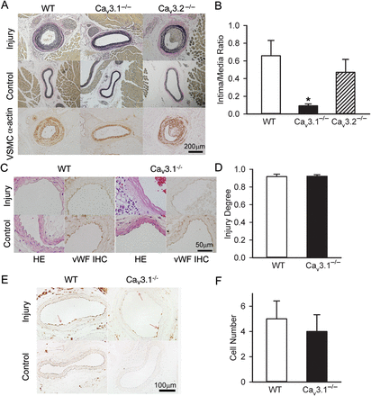
Figure 1 Ca_{v}3.1 was required for wire injury-induced neointimal formation. (A) Elastic and smooth muscle ...
Notes:
Figure 1 Cav3.1 was required for wire injury-induced neointimal formation. (A) Elastic and smooth muscle α-actin staining of control and injured carotid arteries from wild-type (WT), Cav3.1−/−, and Cav3.2−/− mice subjected to wire injury for 2 weeks. (B) Quantitation of intima/media (I/M) ratio of carotid arteries that were injured for 2 weeks. The I/M ratio (0.092 ± 0.022) of Cav3.1−/− mice was significantly lower compared with those of wild-type and Cav3.2−/− mice (0.659 ± 0.172 and 0.471 ± 0.146, respectively, *P = 0.021, n = 7 for each group). (C) H & E and von Willebrand factor immunohistochemical (vWF IHC) staining of control and injured carotid arteries from wild-type and Cav3.1−/− mice subjected to wire injury for 24 h. (D) Similar vascular injury degree in wild-type and Cav3.1−/− mice (0.914 ± 0.030 and 0.906 ± 0.020, respectively, P = 0.817, n = 6 for each group). (E) Sections of control and injured carotid arteries stained for pan-leucocytes (anti-CD45) from wild-type and Cav3.1−/− mice subjected to wire injury for 1 week. (F) Quantitation of CD45 positive cells from carotid arteries of wild-type and Cav3.1−/− mice (5.0 ± 1.4 and 4.0 ± 1.3, respectively, P = 0.616, n = 7 for each group) subjected to wire injury for 1 week.
Unless provided in the caption above, the following copyright applies to the content of this slide: Published on behalf of the European Society of Cardiology. All rights reserved. © The Author 2012. For permissions please email: journals.permissions@oup.com.

Slide 2
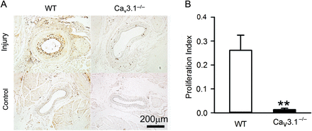
Figure 2 Reduced neointimal VSMCs proliferation in Ca_{v}3.1^{−/−} mice. (A) BrdU staining of control ...
Notes:
Figure 2 Reduced neointimal VSMCs proliferation in Cav3.1−/− mice. (A) BrdU staining of control and injured carotid arteries from wild-type and Cav3.1−/− mice subjected to wire injury for 2 weeks. (B) Proliferation index of injured carotid arteries from wild-type and Cav3.1−/− mice (0.261 ± 0.063 and 0.013 ± 0.006, respectively) subjected to wire injury for 2 weeks. Proliferation index = BrdU positive cell number/total cell number in neointima and media. n = 7 for each group. **P = 0.008, compared with the wild-type group.
Unless provided in the caption above, the following copyright applies to the content of this slide: Published on behalf of the European Society of Cardiology. All rights reserved. © The Author 2012. For permissions please email: journals.permissions@oup.com.

Slide 3
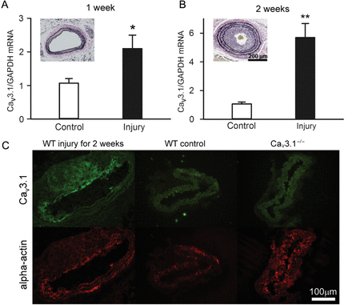
Figure 3 Upregulation of Ca_{v}3.1 mRNA and protein during neointimal formation. (A) RT­–qPCR analysis of the ...
Notes:
Figure 3 Upregulation of Cav3.1 mRNA and protein during neointimal formation. (A) RT­–qPCR analysis of the expression of Cav3.1 in carotid arteries after 1 week and 2 weeks of wire injury in wild-type mice. n = 3 for each group. Each set of experiments contained four carotid arteries. *P = 0.028, **P = 0.001 compared with the control group. Inset shows elastic staining of injured carotid arteries from wild-type mice subjected to wire injury. (B) Sections of carotid arteries stained for Cav3.1 and smooth muscle α-actin from injured wild-type, control wild-type, and Cav3.1−/− mice.
Unless provided in the caption above, the following copyright applies to the content of this slide: Published on behalf of the European Society of Cardiology. All rights reserved. © The Author 2012. For permissions please email: journals.permissions@oup.com.

Slide 4
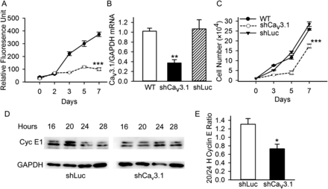
Figure 4 Deficiency of Ca_{v}3.1 reduced VSMC proliferation. (A) Reduced proliferation rate in ...
Notes:
Figure 4 Deficiency of Cav3.1 reduced VSMC proliferation. (A) Reduced proliferation rate in Cav3.1−/− VSMCs compared with wild-type VSMCs. The cell proliferation rate was determined using a CyQUANT cell proliferation assay. n = 4 for each group. ***P<0.001, compared with the wild-type group. (B) Knockdown of Cav3.1 by shRNA for Cav3.1 (shCav3.1) but not control shRNA for luciferase (shLuc) reduced the Cav3.1 mRNA in rat VSMCs. n = 4 for each group. ** P = 0.001, compared with the wild-type and shLuc groups. (C) Reduced cell proliferation rate in shCav3.1-treated VSMCs. The cell proliferation rate was determined by cell counting. n = 3 for each group. ***P < 0.001, compared with the wild-type and shLuc groups. (D) Western blot for cyclin E from shLuc- and shCav3.1-treated VSMCs at the indicated times after 10% FBS stimulation. (E) Reduced ratio of cyclin E levels between 20 and 24 h (20/24 h) in shCav3.1-treated VSMCs. n = 3 for both groups. *P = 0.029, compared with the shLuc group.
Unless provided in the caption above, the following copyright applies to the content of this slide: Published on behalf of the European Society of Cardiology. All rights reserved. © The Author 2012. For permissions please email: journals.permissions@oup.com.

Slide 5
Figure 5 Calmodulin agonist CALP1 increased cell proliferation in Ca_{v}3.1 knockdown VSMCs. CALP1 (10 μmol/L) ...
Notes:
Figure 5 Calmodulin agonist CALP1 increased cell proliferation in Cav3.1 knockdown VSMCs. CALP1 (10 μmol/L) had no effect on the cell proliferation rate of wild-type (A) and shLuc-treated (B) VSMCs. (C) CALP1 (10 μmol/L) increased the cell proliferation rate of shCav3.1-treated VSMCs. The cell proliferation rate was measured using a CyQUANT cell proliferation assay. n = 4 for each group. ***P < 0.001, compared with the shCav3.1-treated group.
Unless provided in the caption above, the following copyright applies to the content of this slide: Published on behalf of the European Society of Cardiology. All rights reserved. © The Author 2012. For permissions please email: journals.permissions@oup.com.

Slide 6
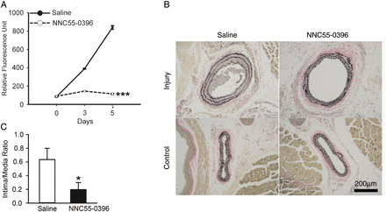
Figure 6 NNC55-0396, a T-channel blocker, reduced VSMC proliferation and neointimal formation in wild-type mice. (A) ...
Notes:
Figure 6 NNC55-0396, a T-channel blocker, reduced VSMC proliferation and neointimal formation in wild-type mice. (A) Reduced proliferation rate in NNC55-0396 (5 μmol/L)-treated VSMCs compared with saline-treated VSMCs. n = 3 for each group. ***P < 0.001, compared with the saline-treated group. (B) Elastic staining of injured carotid arteries from saline- and NNC55-0396-treated wild-type mice subjected to wire injury for 2 weeks. Saline (0.9%) or NNC55-0396 (1 mg) was delivered subcutaneously by an osmotic minipump after artery injury for 1 week. (C) NNC55-0396 treatment reduced the intima/media (I/M) ratio of wild-type carotid arteries that were injured for 2 weeks. The I/M ratios of saline- and NNC55-0396-treated groups were 0.635 ± 0.163 (n = 5) and 0.198 ± 0.100 (n = 6), respectively. *P = 0.042, compared with the saline-treated group.
Unless provided in the caption above, the following copyright applies to the content of this slide: Published on behalf of the European Society of Cardiology. All rights reserved. © The Author 2012. For permissions please email: journals.permissions@oup.com.

