Slide 1
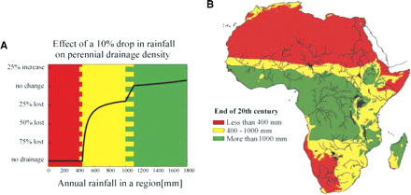
Figure 5 Rainfall and drainage regimes in Africa Notes: The intermediate regime (lightest shade) is unstable in the ...
Notes:
Figure 5 Rainfall and drainage regimes in Africa Notes: The intermediate regime (lightest shade) is unstable in the sense that a reduction in rainfall leads to a proportionately larger reduction in drainage and river flows.Source: From De Wit and Stankiewicz (2006). Reprinted with permission from AAAS.
Unless provided in the caption above, the following copyright applies to the content of this slide: © Oxford University Press 2008

Slide 2
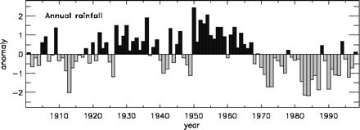
Figure 4 Annual rainfall anomalies representing the region 10–20°N; 25°W–30°E, roughly corresponding to the Sahelian ...
Notes:
Figure 4 Annual rainfall anomalies representing the region 10–20°N; 25°W–30°E, roughly corresponding to the Sahelian zone Source: Brooks (2004).
Unless provided in the caption above, the following copyright applies to the content of this slide: © Oxford University Press 2008

Slide 3
Figure 3 The alternation of La Niña (below the line) and El Niño (above the line) events Notes: The Multivariate ENSO ...
Notes:
Figure 3 The alternation of La Niña (below the line) and El Niño (above the line) events Notes: The Multivariate ENSO Index is based on six variables measured across the Pacific. Source: Available at http://www.cdc.noaa.gov/people/klaus.wolter/MEI/
Unless provided in the caption above, the following copyright applies to the content of this slide: © Oxford University Press 2008

Slide 4
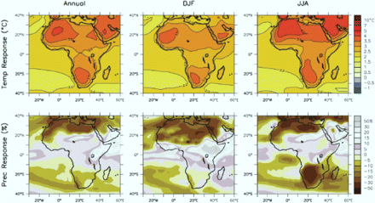
Figure 2 Temperature and rainfall projections for Africa; change from 1980–99 to 2080–99 for Intergovernmental Panel ...
Notes:
Figure 2 Temperature and rainfall projections for Africa; change from 1980–99 to 2080–99 for Intergovernmental Panel on Climate Change (IPCC) scenario A1B, averaged over 21 Atmosphere-Ocean General Circulation Models (annual average (left), December–February (centre), June–August (right)) Source: IPCC (2007, Figure 11.2, ch. 11, p. 869).
Unless provided in the caption above, the following copyright applies to the content of this slide: © Oxford University Press 2008

Slide 5
Figure 1 African annual mean temperature anomalies °C for the past 100 years Source: Hulme et al. (2001).
Notes:
Figure 1 African annual mean temperature anomalies °C for the past 100 years Source: Hulme et al. (2001).
Unless provided in the caption above, the following copyright applies to the content of this slide: © Oxford University Press 2008

Slide 6
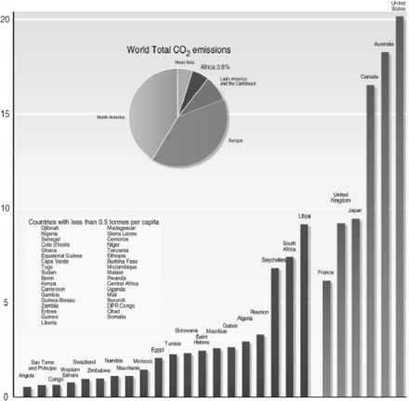
Figure 6 CO₂ emissions per capita, 2002 (tonnes) Source: UN Statistics Common Database; designer: Hugo ...
Notes:
Figure 6 CO2 emissions per capita, 2002 (tonnes) Source: UN Statistics Common Database; designer: Hugo Ahlenius, UNEP/GRID-Arendal. Available at http://maps.grida.no/go/graphic/emissions_of_carbon_dioxide_in_africa_and_selected_oecd_countries
Unless provided in the caption above, the following copyright applies to the content of this slide: © Oxford University Press 2008

Slide 7
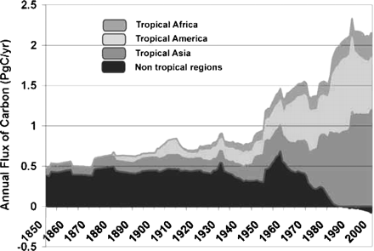
Figure 7 Annual emissions of carbon from changes in land use Notes: Vertical axis is gigatonnes carbon (1 Pg of C = 1 ...
Notes:
Figure 7 Annual emissions of carbon from changes in land use Notes: Vertical axis is gigatonnes carbon (1 Pg of C = 1 GT of C). One gigatonne of carbon is 3.67 GT of CO2. Source: Houghton (2005).
Unless provided in the caption above, the following copyright applies to the content of this slide: © Oxford University Press 2008

