Slide 1
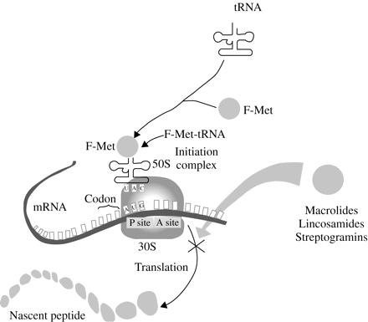
Figure 1 The mode of action of macrolides. Reproduced from Antimicrobial Resistance in Bacteria of Animal Origin (Ed ...
Notes:
Figure 1 The mode of action of macrolides. Reproduced from Antimicrobial Resistance in Bacteria of Animal Origin (Ed FM Aarestrup). Washington DC: ASM Press, 2005, with permission.157
Unless provided in the caption above, the following copyright applies to the content of this slide: © The Author 2006. Published by Oxford University Press on behalf of the British Society for Antimicrobial Chemotherapy. All rights reserved. For Permissions, please e-mail: journals.permissions@oxfordjournals.org

Slide 2
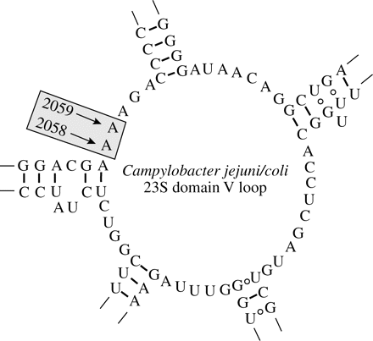
Figure 2 Secondary structure of the peptidyl-transferase loop in domain V of the C. jejuni/coli 23S rRNA. Positions ...
Notes:
Figure 2 Secondary structure of the peptidyl-transferase loop in domain V of the C. jejuni/coli 23S rRNA. Positions 2058 and 2059 (based on E. coli numbering) refer to the location of the mutations associated with erythromycin resistance.
Unless provided in the caption above, the following copyright applies to the content of this slide: © The Author 2006. Published by Oxford University Press on behalf of the British Society for Antimicrobial Chemotherapy. All rights reserved. For Permissions, please e-mail: journals.permissions@oxfordjournals.org

Slide 3
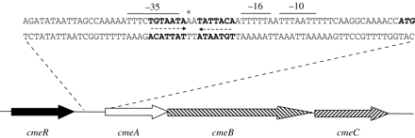
Figure 3 Genomic organization of the operon coding for CmeABC efflux system and features of the intergenic region ...
Notes:
Figure 3 Genomic organization of the operon coding for CmeABC efflux system and features of the intergenic region between cmeR-cmeABC. ORFs are indicated by boxed arrows. The start codon (ATG) of cmeA gene is in bold italics, and the sequences that form the inverted repeats are highlighted in bold and indicated by dashed arrows. The predicted −10, −16, and −35 regions of PcmeABC are overlined. The nucleotide deleted in a laboratory-selected efflux mutant, showing an over-expression of CmeABC efflux system, is indicated by an asterisk. Reproduced from Antimicrob Agents Chemother 2005; 49: 1067–75, with permission.125
Unless provided in the caption above, the following copyright applies to the content of this slide: © The Author 2006. Published by Oxford University Press on behalf of the British Society for Antimicrobial Chemotherapy. All rights reserved. For Permissions, please e-mail: journals.permissions@oxfordjournals.org

