Slide 1
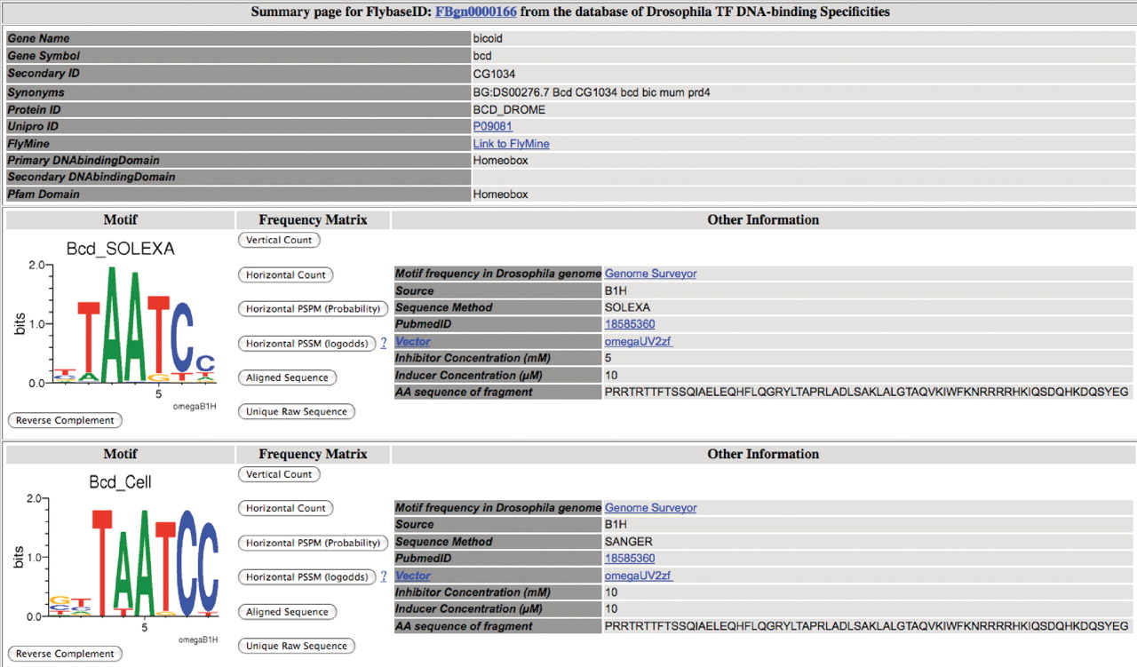
Figure 2. Screen shot of bicoid summary page within FlyFactorSurvey. (top) Header information for each factor contains ...
Notes:
Figure 2. Screen shot of bicoid summary page within FlyFactorSurvey. (top) Header information for each factor contains identification information, the type(s) of DNA binding domains found within the gene and links to factor information in Flybase ( 36 ), Unipro ( 40 ) and FlyMine ( 33 ). (bottom) Recognition motifs determined for the factor through different methods, under different conditions or assayed via different sequencing methods are displayed in independent panels. Each panel displays the recognition motif as a Sequence logo ( 35 ) and download buttons to obtain count, position-specific probability (PSPM) or position-specific scoring (PSSM) matrices. The other information panel summarizes the methods used to select and sequence the factor binding sites. For motifs determined using the B1H system, the expression vector and the selection conditions are indicated where different stringencies can result in motifs with different complexity. In this example, only two of the four bicoid motif panels within the database are shown; these panels illustrate that the increased inhibitor concentration used in the selection to generate the lower panel resulted in a more stringent motif. For each individual motif, a direct link is provided to view the relative frequency of the motif in the Drosophila genome using Genome Surveyor (see Figure 3 ).
Unless provided in the caption above, the following copyright applies to the content of this slide: © The Author(s) 2010. Published by Oxford University Press.This is an Open Access article distributed under the terms of the Creative Commons Attribution Non-Commercial License (http://creativecommons.org/licenses/by-nc/2.5), which permits unrestricted non-commercial use, distribution, and reproduction in any medium, provided the original work is properly cited.

Slide 2
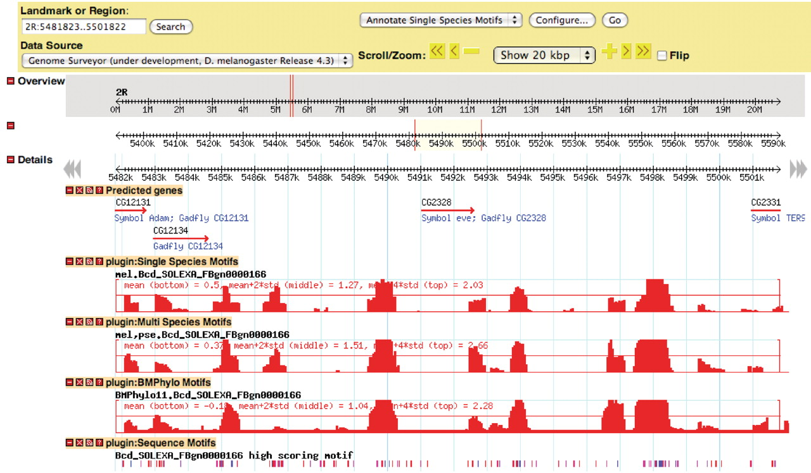
Figure 3. Screen shot of Genome Surveyor interface directly linked from the Bcd_SOLEXA motif within the FFS database. ...
Notes:
Figure 3. Screen shot of Genome Surveyor interface directly linked from the Bcd_SOLEXA motif within the FFS database. The relative enrichment (profile) of this motif in 500 bp windows surrounding the eve locus is represented as a Z score relative to the genome-wide average. Three different motif profiles are shown: Single species ( D. melanogaster ), Multi species ( D. melanogaster and D. pseudoobscura ) and BMPhylo (11 Drosophila species). BMPhylo motif tracks have been previously described ( 11 ). Individual high scoring sequence motif matches are also shown at bottom. This tool provides a rapid assessment of the overrepresentation of any motif in the database within the Drosophila genome and additional functions such as combined motif searches ( 24 ).
Unless provided in the caption above, the following copyright applies to the content of this slide: © The Author(s) 2010. Published by Oxford University Press.This is an Open Access article distributed under the terms of the Creative Commons Attribution Non-Commercial License (http://creativecommons.org/licenses/by-nc/2.5), which permits unrestricted non-commercial use, distribution, and reproduction in any medium, provided the original work is properly cited.

Slide 3
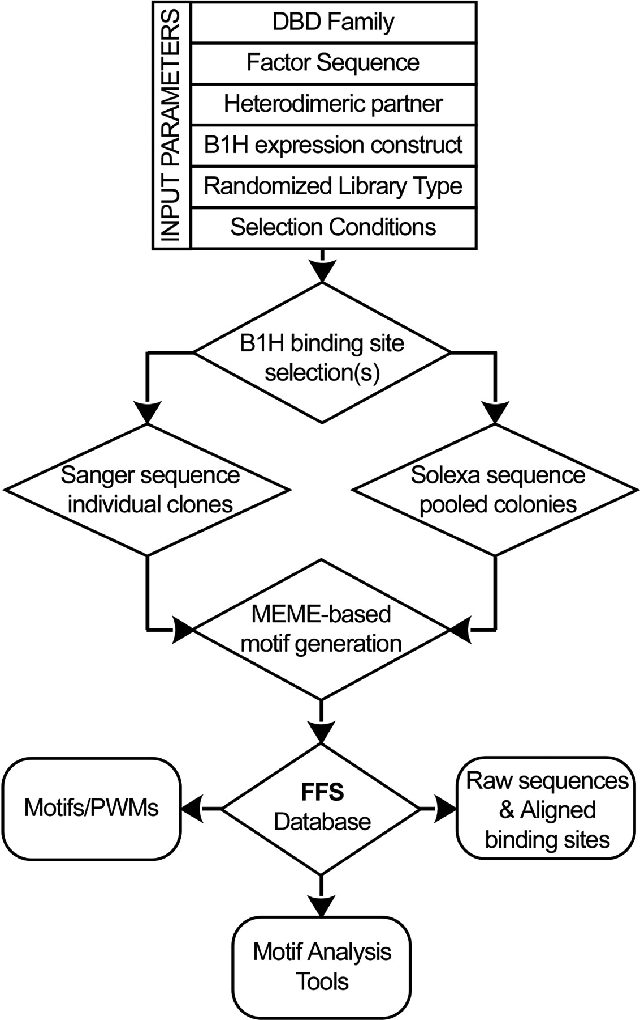
Figure 1. Schematic of data flow into the FlyFactorSurvey (FFS) database. The majority of motifs present in the ...
Notes:
Figure 1. Schematic of data flow into the FlyFactorSurvey (FFS) database. The majority of motifs present in the database originate from B1H binding site selections. Information on the factor constructs and selection conditions is captured within the database for each motif generated. Clones from each selection are sequenced either individually via Sanger sequencing or as a pooled population via SOLEXA sequencing, and binding site motifs are identified from these sequences using MEME ( 39 ). The FFS database provides users with access to published and unpublished motif information on our characterized Drosophila TFs as well as links to tools to mine our database of motifs and utilize these motifs for searches within the Drosophila genome.
Unless provided in the caption above, the following copyright applies to the content of this slide: © The Author(s) 2010. Published by Oxford University Press.This is an Open Access article distributed under the terms of the Creative Commons Attribution Non-Commercial License (http://creativecommons.org/licenses/by-nc/2.5), which permits unrestricted non-commercial use, distribution, and reproduction in any medium, provided the original work is properly cited.

