Slide 1
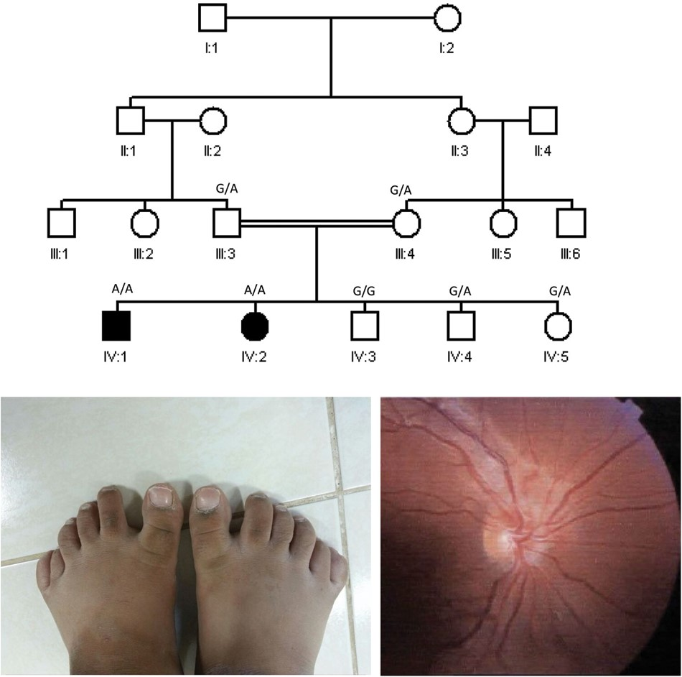
Figure 1. Identification of a BBS family that maps to a novel locus. Pedigree of the family showing the consanguineous ...
Notes:
Figure 1. Identification of a BBS family that maps to a novel locus. Pedigree of the family showing the consanguineous nature and the presence of two affected children (upper panel). The genotypes for the IFT27 mutation are shown for each member. Representative images of polydactyly (lower left panel) and the fundus changes (lower right panel) (fundus picture of the right eye showing attenuated retinal vessels, pale optic disc, macular atrophy and diffuse RPE changes) are shown. The family did not consent to show facial photos.
Unless provided in the caption above, the following copyright applies to the content of this slide: © The Author 2014. Published by Oxford University Press. All rights reserved. For Permissions, please email: journals.permissions@oup.com

Slide 2
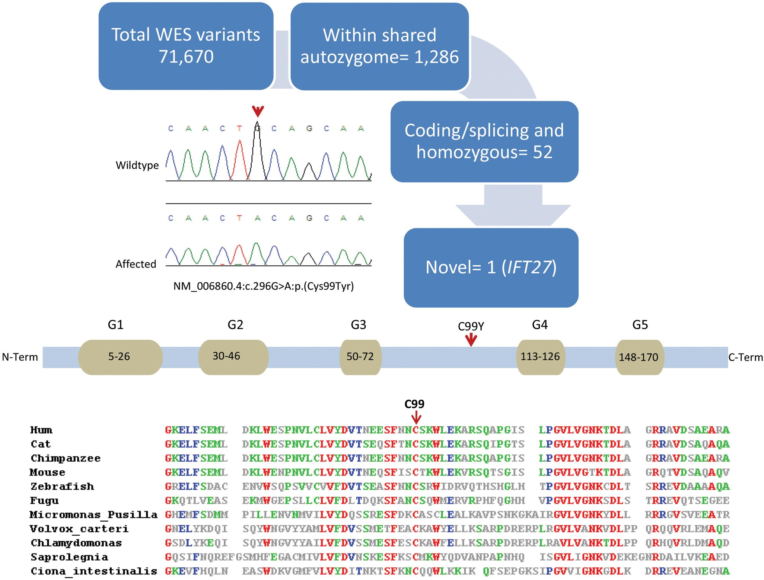
Figure 2. WES identifies IFT27 as a novel BBS locus. Upper panel shows the workflow of iterative filtering of WES ...
Notes:
Figure 2. WES identifies IFT27 as a novel BBS locus. Upper panel shows the workflow of iterative filtering of WES variants. Note that the only variant that remains after filtering is the variant in IFT27, and its sequence chromatogram is shown along with the normal control for comparison. The middle panel shows a carton of the protein structure. The lower panel shows multi-species alignment to highlight the strong conservation of the affected residue.
Unless provided in the caption above, the following copyright applies to the content of this slide: © The Author 2014. Published by Oxford University Press. All rights reserved. For Permissions, please email: journals.permissions@oup.com

Slide 3
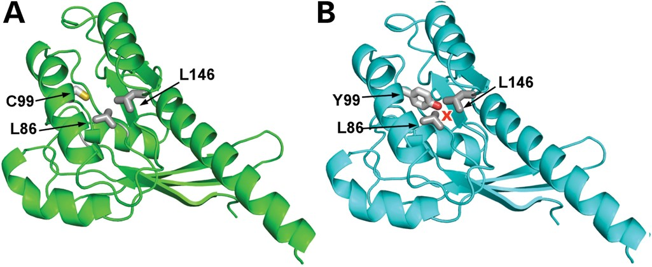
Figure 3. 3D rendering of homology modeled IFT27 structure. C99 is located in the core of the molecule and can ...
Notes:
Figure 3. 3D rendering of homology modeled IFT27 structure. C99 is located in the core of the molecule and can potentially engage in stabilizing interactions to highly conserved Leu residues nearby (A). The C99Y mutation would result in a much larger side chain (Cys to Tyr) that may cause steric clashes with the conserved leucine side chains (B), potentially causing destabilization of the protein structure.
Unless provided in the caption above, the following copyright applies to the content of this slide: © The Author 2014. Published by Oxford University Press. All rights reserved. For Permissions, please email: journals.permissions@oup.com

Slide 4
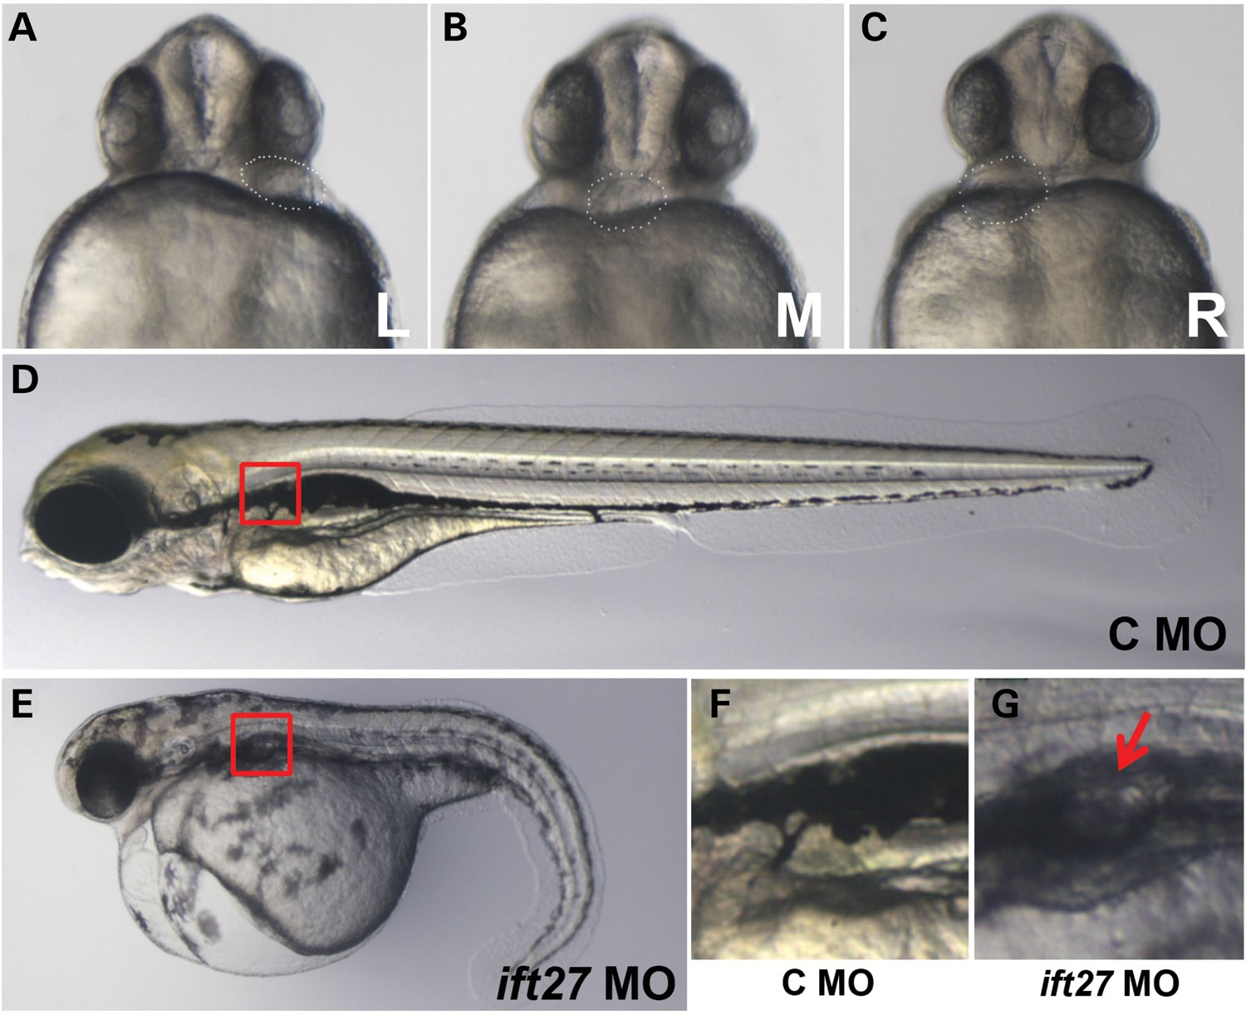
Figure 4. Phenotypes of ift27 morphants. (A–C) Laterality as shown by heart position at 1 dpf. Embryos are shown in ...
Notes:
Figure 4. Phenotypes of ift27 morphants. (A–C) Laterality as shown by heart position at 1 dpf. Embryos are shown in ventral views. L: left sided; M: middle; R: right sides. (D) An embryo injected with a control morpholino against ift27 with mismatched bases (C MO) at 3 dpf. (E) An ift27 morphant (ift27 MO) at 3 dpf. (F and G) Enlarged view of boxed regions in D and E, respectively. Red arrow points to a kidney cyst.
Unless provided in the caption above, the following copyright applies to the content of this slide: © The Author 2014. Published by Oxford University Press. All rights reserved. For Permissions, please email: journals.permissions@oup.com

Slide 5
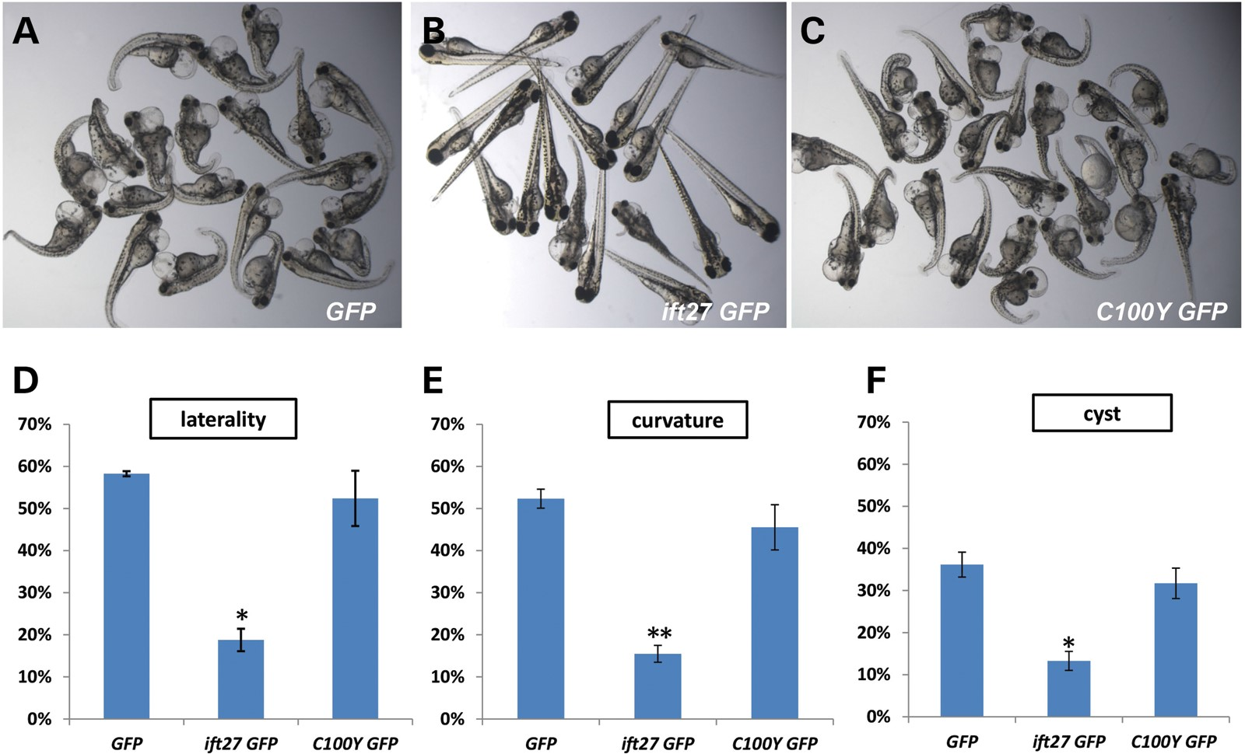
Figure 5. C100Y is a loss-of-function allele. (A–C) Group pictures of 4 dpf embryos co-injected with ift27 MO and GFP ...
Notes:
Figure 5. C100Y is a loss-of-function allele. (A–C) Group pictures of 4 dpf embryos co-injected with ift27 MO and GFP mRNA (A, GFP), ift27 MO and ift27 GFP mRNA (B, ift27 GFP) and ift27 MO and ift27 C100Y GFP mRNA (C, C100Y GFP); (D–F) Graphs showing the efficacy of ift27 GFP or ift27 C100Y GFP in rescuing laterality defects (D, combined percentage of middle and right-sided heart), body curvature (E) and kidney cysts (F) observed in ift27 morphants from three independent experiments. Error bars show standard deviation. *P < 0.05; **P < 0.01.
Unless provided in the caption above, the following copyright applies to the content of this slide: © The Author 2014. Published by Oxford University Press. All rights reserved. For Permissions, please email: journals.permissions@oup.com

Slide 6
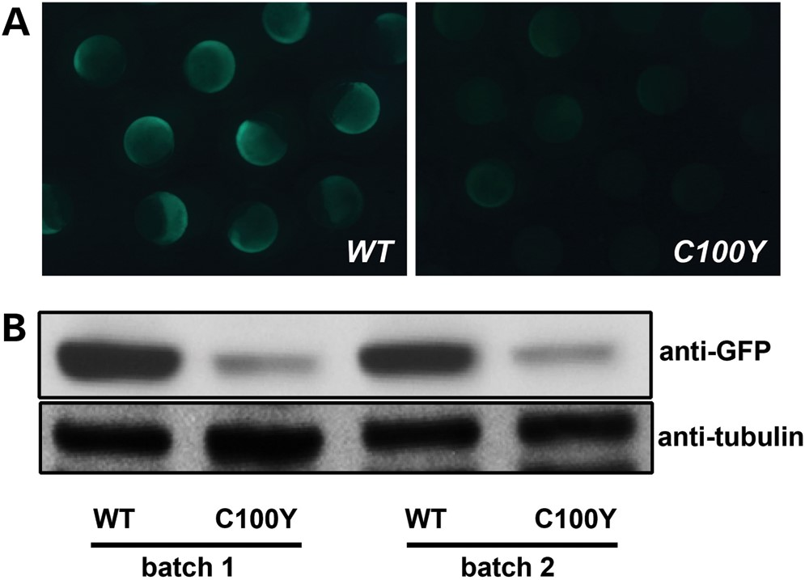
Figure 6. C100Y substitution affects the stability of Ift27. (A) GFP signal in 7.5-h post-fertilization embryos ...
Notes:
Figure 6. C100Y substitution affects the stability of Ift27. (A) GFP signal in 7.5-h post-fertilization embryos injected with ift27 GFP (WT) or ift27 C100Y GFP (C100Y) mRNA. (B) Western blot showing the level of Ift27-GFP (WT) or Ift27 C100Y GFP (C100Y) in whole embryo lysates. Embryos were injected with two independent batches of mRNAs. Tubulin was used as a loading control.
Unless provided in the caption above, the following copyright applies to the content of this slide: © The Author 2014. Published by Oxford University Press. All rights reserved. For Permissions, please email: journals.permissions@oup.com

Slide 7
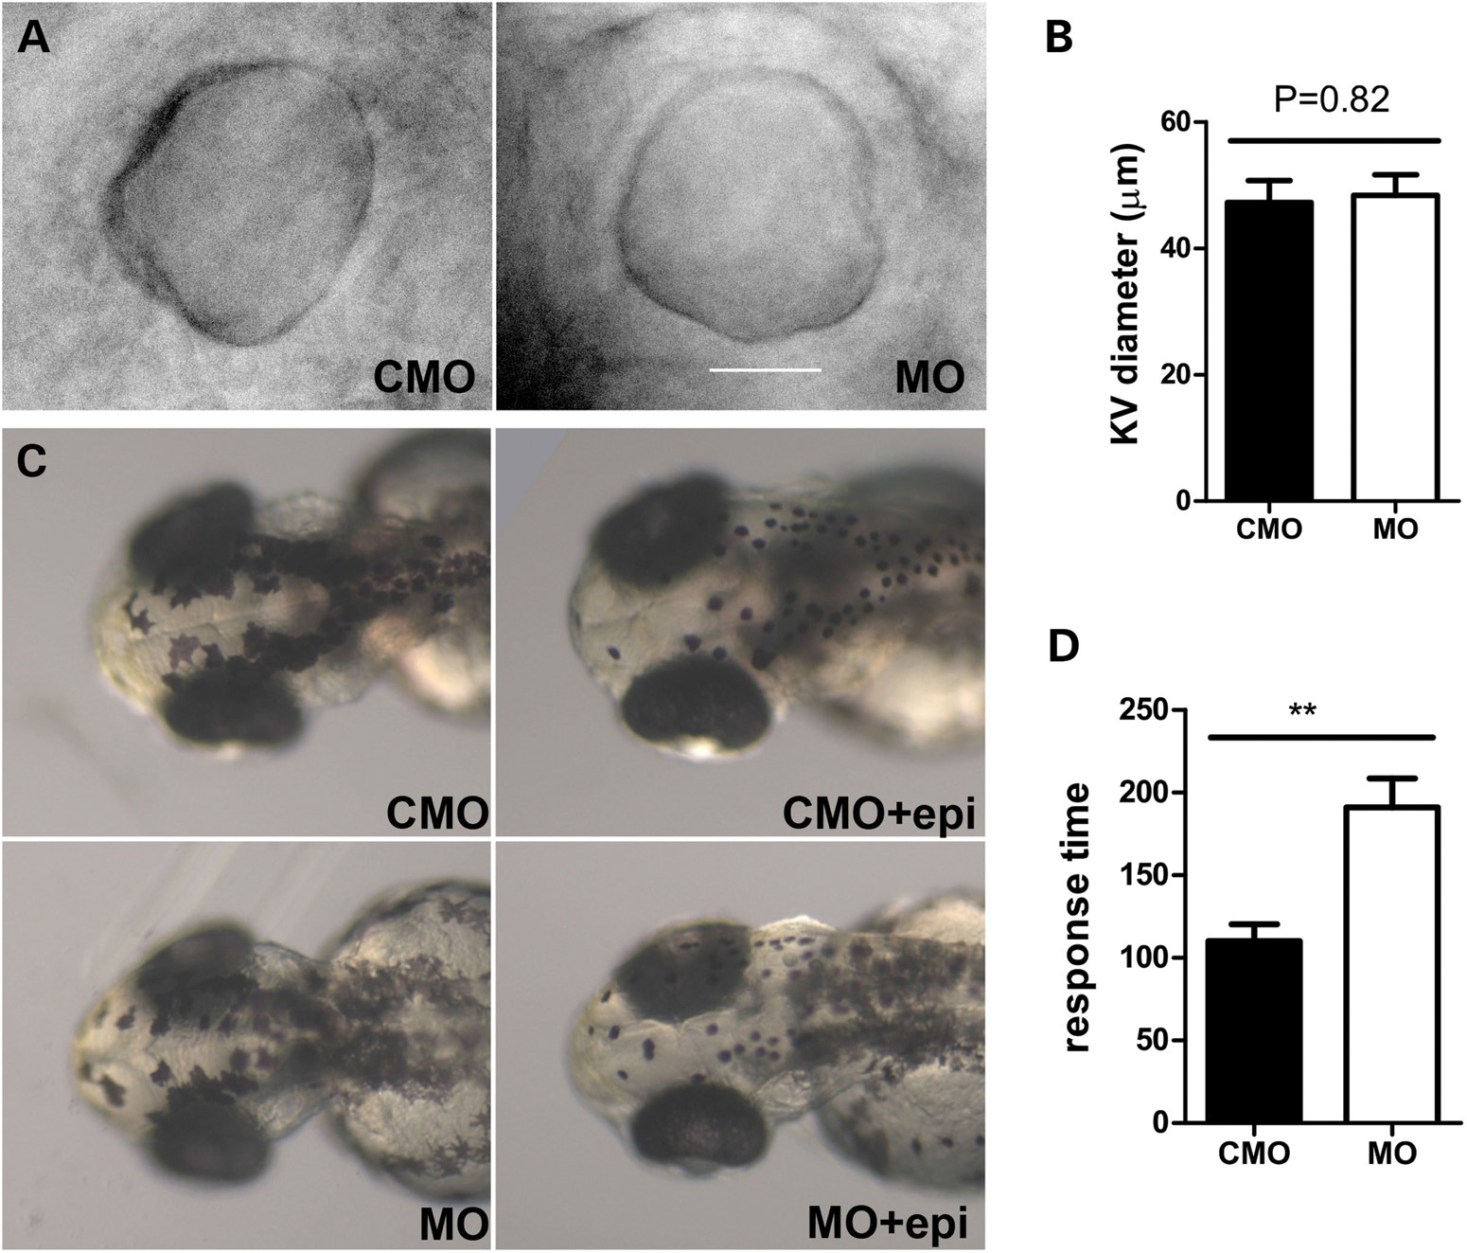
Figure 7. ift27 is dispensable for KV morphogenesis but is involved in the retrograde transport of melanosomes in ...
Notes:
Figure 7. ift27 is dispensable for KV morphogenesis but is involved in the retrograde transport of melanosomes in response to epinephrine. (A) Morphology of KV. (B). Statistical analysis of KV diameter in control morphants (n = 10) and ift27 morphants (n = 12). (C). Embryos with and without epinephrine treatment showing the morphology of melanocytes. (D) Statistical analysis of response time in seconds to epinephrine treatment in control (n = 10) and ift27 morphants (n = 13). Scale bar in A: 20 μm. CMO: embryos injected with a control morpholino with mismatched bases; MO, ift27 morphant; epi, epinephrine treatment; **P = 0.0014.
Unless provided in the caption above, the following copyright applies to the content of this slide: © The Author 2014. Published by Oxford University Press. All rights reserved. For Permissions, please email: journals.permissions@oup.com

