Slide 1
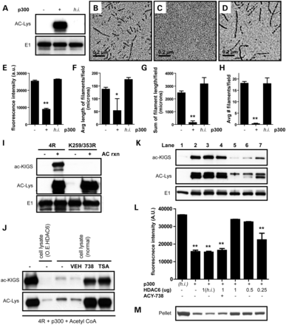
Figure 1. HDAC6 deacetylates KIGS motifs and modulates tau filament assembly. (A) Acetyl CoA and recombinant tau were ...
Notes:
Figure 1. HDAC6 deacetylates KIGS motifs and modulates tau filament assembly. (A) Acetyl CoA and recombinant tau were incubated in the absence or presence of active or h.i. p300. Only tau incubated with active p300 showed acetylation by immunoblot. (B–D) EM revealed that tau readily forms filaments in the absence of p300 (B), but addition of active p300 to the reaction completely prevents tau filament formation (C). The addition of h.i.p300 has no impact on the ability of tau to assemble into filaments (D). (E) Quantitation of thioflavin S intensity also confirms that acetylation of tau with active p300 decreases tau polymerization (F = 351.8, P < 0.0001). (F–H) Quantitation of EM analysis demonstrated that acetylation decreased the average length of tau filaments per field (F = 5, P = 0.01) (F), the sum of filament length per field (F = 26.7, P < 0.0001) (G) and the average number of filaments per field (F = 43.4, P < 0.0001) (H). (I) To characterize our novel antibody (ac-KIGS), recombinant 4R or mutant K259/353R tau protein was acetylated and evaluated by immunoblot, confirming specificity of ac-KIGS for acetylated K259/353. (J) 4R tau was acetylated, following the reaction, and incubated with HEK-293T cell lysates either overexpressing HDAC6 or expressing endogenous levels of HDAC6 (normal). In addition, where noted, vehicle (DMSO), ACY-738 or TSA was added along with the cell lysate, and reactions evaluated by immunoblot. (K) Recombinant tau was incubated with h.i. p300 (lane 1) or active p300 (lanes 2–7). Following acetylation, h.i. (lane 3) or active HDAC6 (lanes 4–7), and ACY-738 (lane 4) were added as indicated, and reactions were assessed by immunoblot. (L) Tau polymerization induced by dextran sulfate was detected by thioflavin S. (M) Pelleting analysis was utilized to confirm aggregation. All data are presented as mean ± SEM. Scale bar in (B)–(D) is equal to 0.2 μm. **P < 0.001, *P < 0.05.
Unless provided in the caption above, the following copyright applies to the content of this slide: © The Author 2013. Published by Oxford University Press.This is an Open Access article distributed under the terms of the Creative Commons Attribution License (http://creativecommons.org/licenses/by/3.0/), which permits unrestricted reuse, distribution, and reproduction in any medium, provided the original work is properly cited.

Slide 2
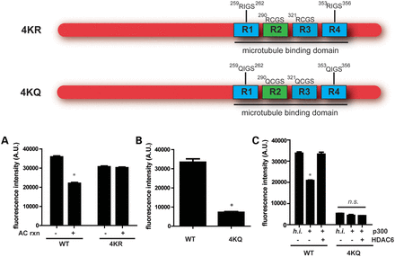
Figure 2. Acetylation of KXGS motifs regulates tau assembly. (A) WT or K259/290/321/353R (4KR) mutant proteins were ...
Notes:
Figure 2. Acetylation of KXGS motifs regulates tau assembly. (A) WT or K259/290/321/353R (4KR) mutant proteins were acetylated and incubated with dextran sulfate to promote polymerization, which was detected by thioflavin S. (B) WT or K259/290/321/353Q (4KQ) mutant proteins were incubated with dextran sulfate, and tau assembly was detected with thioflavin S. (C) WT or 4KQ proteins were acetylated and incubated with HDAC6 where indicated. Dextran sulfate was used to promote tau polymerization, which was detected by thioflavin S. All data are presented as mean ± SEM. *P < 0.001.
Unless provided in the caption above, the following copyright applies to the content of this slide: © The Author 2013. Published by Oxford University Press.This is an Open Access article distributed under the terms of the Creative Commons Attribution License (http://creativecommons.org/licenses/by/3.0/), which permits unrestricted reuse, distribution, and reproduction in any medium, provided the original work is properly cited.

Slide 3
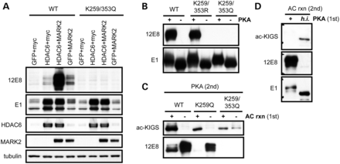
Figure 3. Acetylation and phosphorylation compete to modify KXGS motifs. (A) HeLa cells were cotransfected with either ...
Notes:
Figure 3. Acetylation and phosphorylation compete to modify KXGS motifs. (A) HeLa cells were cotransfected with either 4R or K259/353Q tau, along with GFP, myc vector, HDAC6 or MARK2 as indicated, and cell lysates evaluated by immunoblot. (B) Recombinant 4R, K259/353R or K259/353Q mutant tau protein was phosphorylated by PKA, and evaluated by immunoblotting. (C) WT, K259Q or K259/353Q mutant tau protein was first incubated in the presence or absence of p300, and subsequently phosphorylated with PKA. (D) WT tau protein was first incubated in the presence of active or h.i. PKA, and subsequently acetylated with p300.
Unless provided in the caption above, the following copyright applies to the content of this slide: © The Author 2013. Published by Oxford University Press.This is an Open Access article distributed under the terms of the Creative Commons Attribution License (http://creativecommons.org/licenses/by/3.0/), which permits unrestricted reuse, distribution, and reproduction in any medium, provided the original work is properly cited.

Slide 4
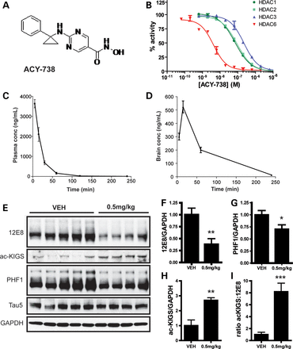
Figure 4. Selective HDAC6 inhibition decreases p-tau levels in vivo. (A) Structure of ACY-738. (B) Specificity of ...
Notes:
Figure 4. Selective HDAC6 inhibition decreases p-tau levels in vivo. (A) Structure of ACY-738. (B) Specificity of ACY-738 for HDAC6 in comparison to HDAC1-3 was assessed. (C and D) Non-transgenic mice were injected with ACY-738 (10 mg/kg), and drug levels were assessed in plasma (C) and brain (D) (n = 3). (E) FVB non-transgenic mice were injected subcutaneously for 3 days with ACY-738 (0.5 mg/kg; n = 4–5 mice/group). Brains were collected 1 h after the last injection, and tau levels analyzed by immunoblotting. Blots are representative of three-independent experiments. (F) Quantitation of 12E8 immunoreactivity revealed a significant decrease in mice treated with 0.5 mg/kg ACY-738 (t = 3.3; P = 0.01). (G) Quantitation of PHF1 immunoreactivity normalized to GAPDH revealed a significant decrease in ACY-738-treated mice (t = 2.3; P = 0.05). (H) A significant increase in ac-KIGS immunoreactivity was detected in mice injected with ACY-738 (t = 3.7; P = 0.008). (I) The ratio of ac-KIGS to 12E8 is significantly elevated by ACY-738 treatment (t = 5.38; P = 0.001). All data are presented as mean ± SEM. *P ≤ 0.05, **P ≤ 0.01, ***P ≤ 0.001.
Unless provided in the caption above, the following copyright applies to the content of this slide: © The Author 2013. Published by Oxford University Press.This is an Open Access article distributed under the terms of the Creative Commons Attribution License (http://creativecommons.org/licenses/by/3.0/), which permits unrestricted reuse, distribution, and reproduction in any medium, provided the original work is properly cited.

Slide 5
Figure 5. Progressive hypoacetylation of KXGS motifs in rTg4510 mice. (A) Levels of ac-KIGS, 12E8 and total human tau ...
Notes:
Figure 5. Progressive hypoacetylation of KXGS motifs in rTg4510 mice. (A) Levels of ac-KIGS, 12E8 and total human tau (E1) immunoreactivity were evaluated by immunoblotting brain lysates of rTg4510 mice at 3, 6.5 and 11 months of age. Recombinant tau (rTau) that was acetylated in vitro served as a positive control for the ac-KIGS antibody. (B) Quantitation of ac-KIGS normalized to total tau levels (E1) demonstrated a significant decrease in this tau species with age (F = 22.1, P = 0.002). (C) Quantitation of 12E8 immunoreactivity normalized to total tau levels (E1) revealed a significant increase with aging (F = 92.3, P < 0.0001). All data are presented as mean ± SEM. *P < 0.05, **P < 0.01, ***P < 0.001.
Unless provided in the caption above, the following copyright applies to the content of this slide: © The Author 2013. Published by Oxford University Press.This is an Open Access article distributed under the terms of the Creative Commons Attribution License (http://creativecommons.org/licenses/by/3.0/), which permits unrestricted reuse, distribution, and reproduction in any medium, provided the original work is properly cited.

Slide 6
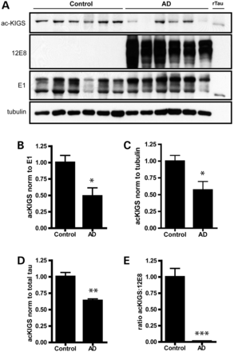
Figure 6. KIGS motifs are hypoacetylated and hyperphosphorylated in AD. (A) Levels of ac-KIGS, 12E8 and total human tau ...
Notes:
Figure 6. KIGS motifs are hypoacetylated and hyperphosphorylated in AD. (A) Levels of ac-KIGS, 12E8 and total human tau (E1) were assessed in frontal cortex from patients with AD compared to control cases. Recombinant tau (rTau) was acetylated in vitro and utilized as a positive control for the ac-KIGS antibody. (B and C) ac-KIGS levels were significantly decreased in AD when normalized to total tau (B; t = 3.1, P = 0.01), as well as when normalized to tubulin (C; t = 2.9, P = 0.02). (D) MSD sandwich immunoassays were performed to measure ac-KIGS in brain homogenates. Results from the ac-KIGS immunoassay were normalized to results from the total tau assay, which again revealed a decrease in ac-KIGS tau in AD (t = 5.3, P = 0.0003). (E) 12E8 levels were also measured by MSD immunoassay, and the ratio of ac-KIGS to 12E8 is significantly decreased in AD (t = 7.5, P < 0.0001). All data are presented as mean ± SEM. *P < 0.05, **P < 0.001, ***P < 0.0001.
Unless provided in the caption above, the following copyright applies to the content of this slide: © The Author 2013. Published by Oxford University Press.This is an Open Access article distributed under the terms of the Creative Commons Attribution License (http://creativecommons.org/licenses/by/3.0/), which permits unrestricted reuse, distribution, and reproduction in any medium, provided the original work is properly cited.

Slide 7
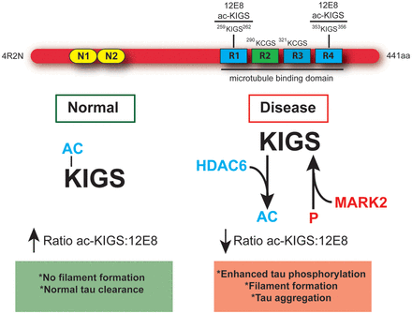
Figure 7. Hypoacetylation of tau's KXGS motifs increases vulnerability to hyperphosphorylation in disease. Schematic ...
Notes:
Figure 7. Hypoacetylation of tau's KXGS motifs increases vulnerability to hyperphosphorylation in disease. Schematic diagram depicting full-length (4R2N) tau containing a KXGS motif in each of the four microtubule-binding domain repeats, and illustrating the epitope recognized by the antibodies 12E8 and ac-KIGS. Under normal conditions, acetylation of KIGS disrupts the motif and prevents recognition by the kinase MARK2. This results in a high ac-KIGS:12E8 ratio, normal tau clearance and no filament formation. In disease, hyperactivity of HDAC6 leads to decreased acetylation of KXGS motifs, exposing this motif and increasing susceptibility to phosphorylation by MARK2. This results in a low ac-KIGS:12E8 ratio, enhanced priming of tau for hyperphosphorylation by other kinases, and ultimately leading to tau filament assembly and aggregation.
Unless provided in the caption above, the following copyright applies to the content of this slide: © The Author 2013. Published by Oxford University Press.This is an Open Access article distributed under the terms of the Creative Commons Attribution License (http://creativecommons.org/licenses/by/3.0/), which permits unrestricted reuse, distribution, and reproduction in any medium, provided the original work is properly cited.

