Slide 1
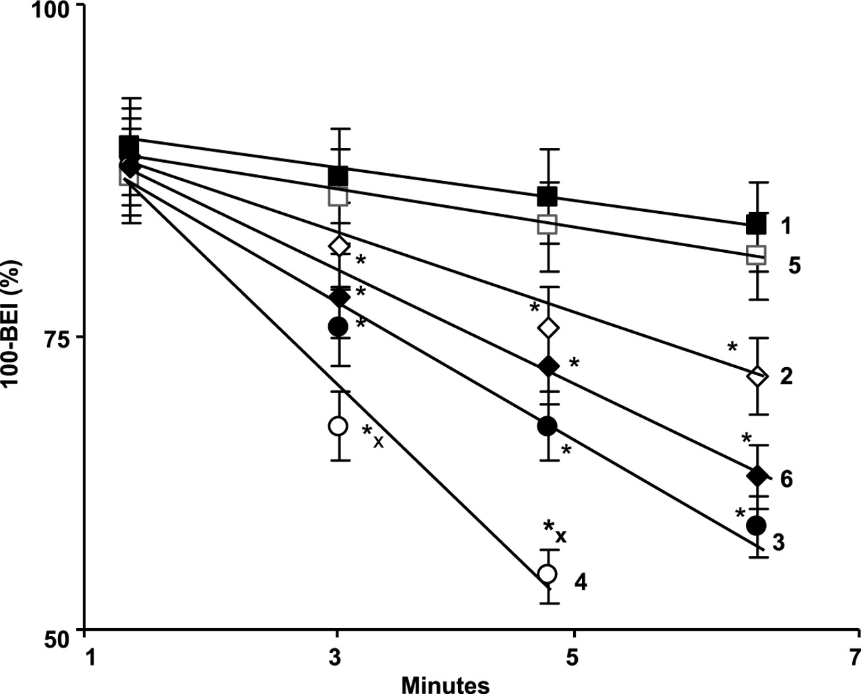
Fig. 1 Efflux of [ ¹⁴ C]sucrose from the brain microinjected with an mixture consisting of [ ...
Notes:
Fig. 1 Efflux of [ 14 C]sucrose from the brain microinjected with an mixture consisting of [ 14 C]sucrose and [ 3 H]carboxyl-inulin. Plot 1: control WC rats; plot 2: Et rats at 1 h after saline injection; plot 3: WC-LPS rats at 1h after LPS exposure; plot 4: Et-LPS rats at 1 h after LPS exposure; plot 5: WC-LPS rats at 48 h after LPS exposure; and plot 6: Et-LPS rats at 48 h after LPS exposure. Values are mean ± SD, n = 5.
Unless provided in the caption above, the following copyright applies to the content of this slide: Copyright © The Author 2007. Published by Oxford University Press on behalf of the Medical Council on Alcohol.

Slide 2
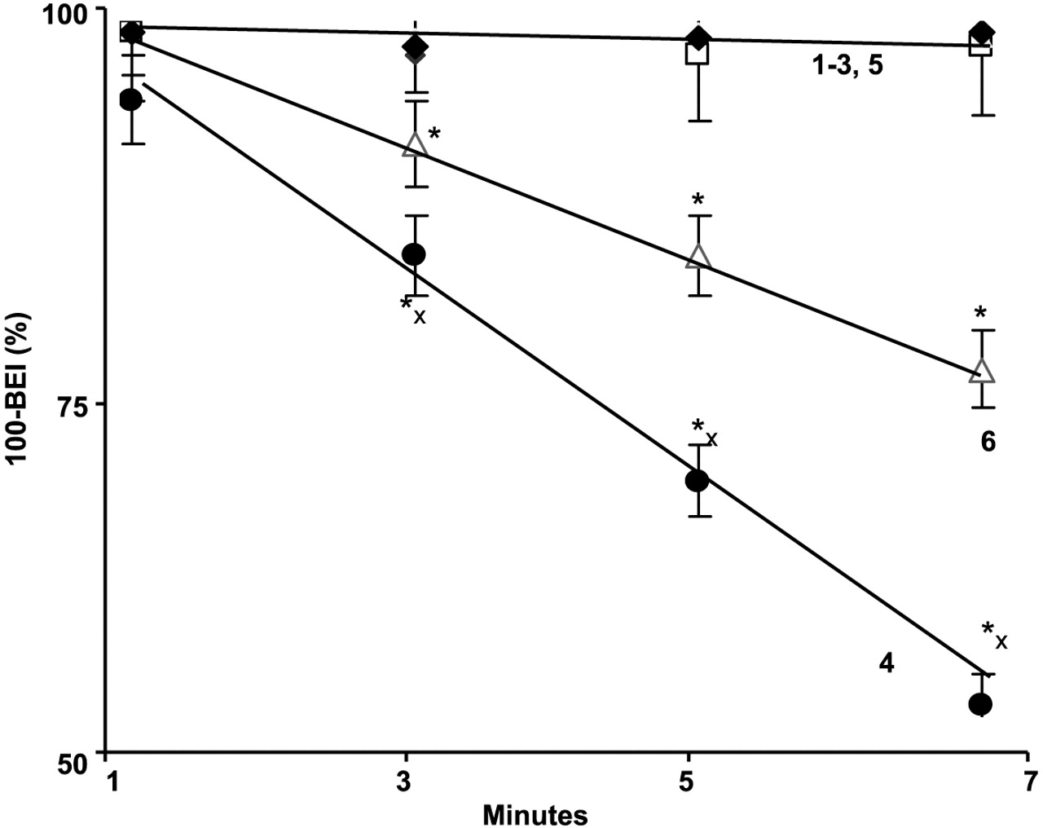
Fig. 2 Time-course of change in (100-BEI%) values in rats microinjected with [ ¹⁴ C]dextran and [ ...
Notes:
Fig. 2 Time-course of change in (100-BEI%) values in rats microinjected with [ 14 C]dextran and [ 3 H]carboxyl-inulin. * : Significantly ( P < 0.05) different when compared with corresponding control values; and x: significant when compared with corresponding 48 h values. Plot 1: control WC rats; plot 2: alcohol-drinking Et rats; plot 3: water-drinking WC-LPS rats; and plot 4: ethanol-drinking Et-LPS rats. * : Significant when compared with pre-LPS values; and x: significant when compared with corresponding WC-LPS values. Values are mean ± SD, n = 5.
Unless provided in the caption above, the following copyright applies to the content of this slide: Copyright © The Author 2007. Published by Oxford University Press on behalf of the Medical Council on Alcohol.

Slide 3
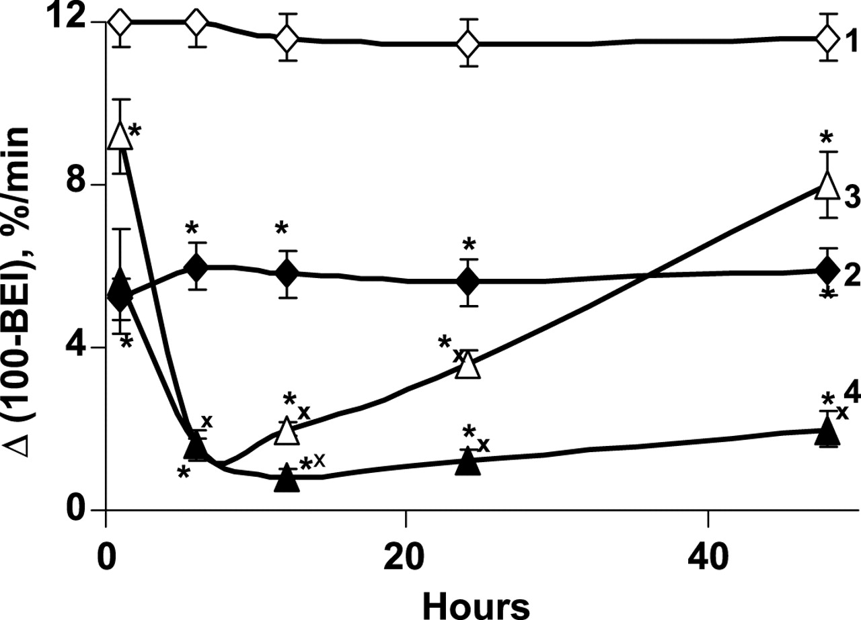
Fig. 3 Time-course of change in (100-BEI %) values in rats microinjected with [ ¹⁴ C]sucrose and [ ...
Notes:
Fig. 3 Time-course of change in (100-BEI %) values in rats microinjected with [ 14 C]sucrose and [ 3 H]carboxyl-inulin. * : Significantly ( P < 0.05) different when compared with corresponding control values; and x: significant when compared with corresponding 48 h values. Plot 1: Control WC rats; plot 2: alcohol-drinking Et rats; plot 3: water-drinking WC-LPS rats; and plot 4: ethanol-drinking Et-LPS rats. * :Significant when compared with pre-LPS values; and x: significant when compared with corresponding WC-LPS values. Values are mean SD, n = 5.
Unless provided in the caption above, the following copyright applies to the content of this slide: Copyright © The Author 2007. Published by Oxford University Press on behalf of the Medical Council on Alcohol.

Slide 4
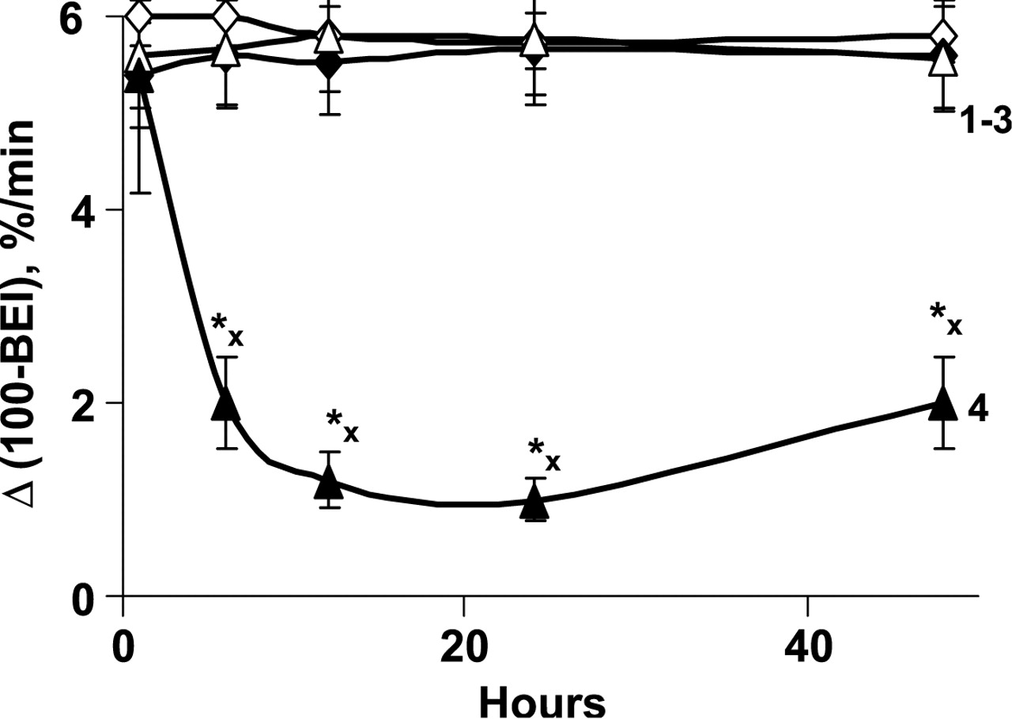
Fig. 4 Time-course of change in (100-BEI %) values in rats microinjected with [ ¹⁴ C]dextran and [ ...
Notes:
Fig. 4 Time-course of change in (100-BEI %) values in rats microinjected with [ 14 C]dextran and [ 3 H]carboxyl-inulin. * : Significantly ( P < 0.05) different when compared with corresponding control values; and x: significant when compared with corresponding 48 h values. Plot 1: control WC rats; plot 2: alcohol-drinking Et rats; plot 3: water-drinking WC-LPS rats; and plot 4: ethanol-drinking Et-LPS rats. * : Significant when compared with pre-LPS values; and x: significant when compared with corresponding WC-LPS values. Values are mean ± SD, n = 5.
Unless provided in the caption above, the following copyright applies to the content of this slide: Copyright © The Author 2007. Published by Oxford University Press on behalf of the Medical Council on Alcohol.

Slide 5
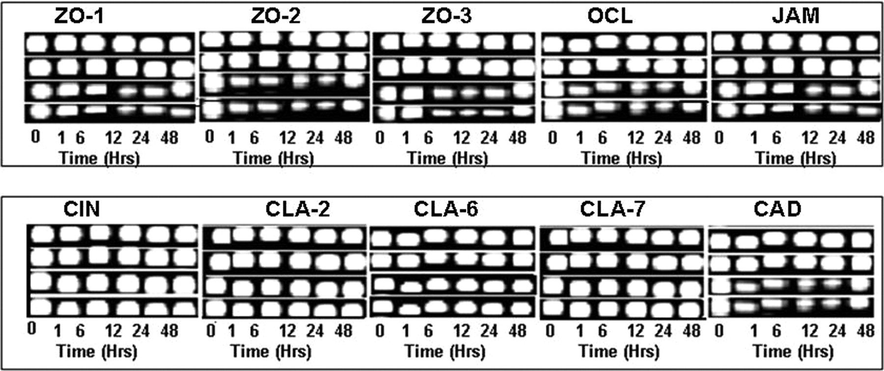
Fig. 5 RT–PCR analysis of the BBB tight junction proteins mRNA levels. ZO: zonula occludens; OCL: occludin; JAM: ...
Notes:
Fig. 5 RT–PCR analysis of the BBB tight junction proteins mRNA levels. ZO: zonula occludens; OCL: occludin; JAM: junctional adhesion molecule; CIN: cingulin; CLA: claudin; and CAD: cadherin.
Unless provided in the caption above, the following copyright applies to the content of this slide: Copyright © The Author 2007. Published by Oxford University Press on behalf of the Medical Council on Alcohol.

Slide 6
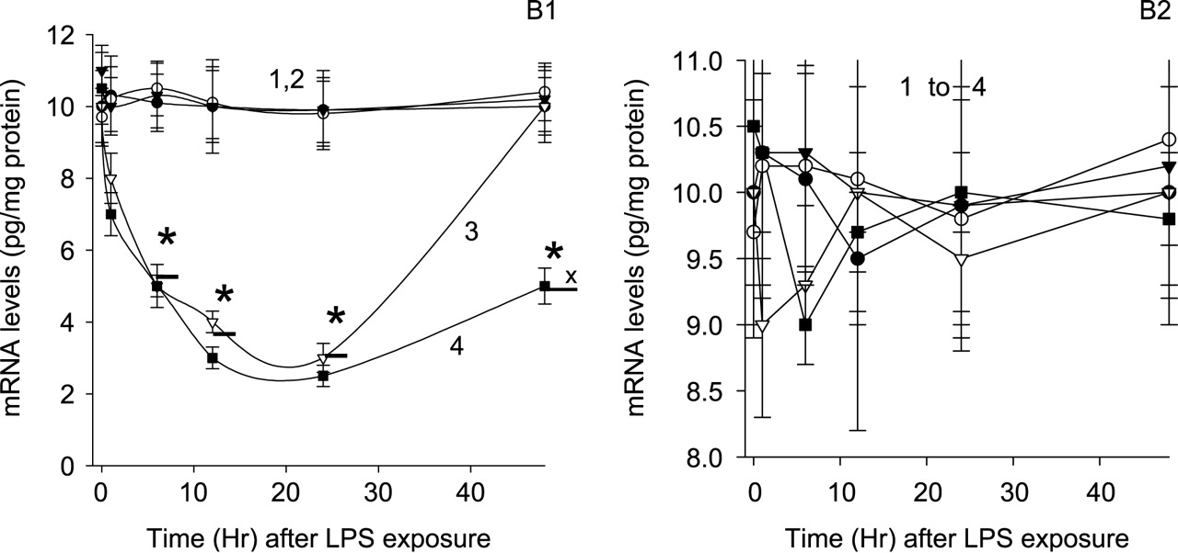
Fig. 6 Quantitative analysis of mRNAs encoding the tight junction protein levels by using real-time PCR. (A) mRNA ...
Notes:
Fig. 6 Quantitative analysis of mRNAs encoding the tight junction protein levels by using real-time PCR. (A) mRNA levels of ZO-1 representing the tight junction proteins whose expressions were affected by LPS exposure. (B) mRNA levels of CIN representing the tight junction proteins whose expressions were not affected by LPS exposure. Plot 1: control WC rats; plot 2: alcohol-drinking Et rats; plot 3: water-drinking WC-LPS rats; and plot 4: ethanol-drinking Et-LPS rats. * : Significant when compared with corresponding WC-LPS values. Values are mean ± SD, n = 5.
Unless provided in the caption above, the following copyright applies to the content of this slide: Copyright © The Author 2007. Published by Oxford University Press on behalf of the Medical Council on Alcohol.

Slide 7
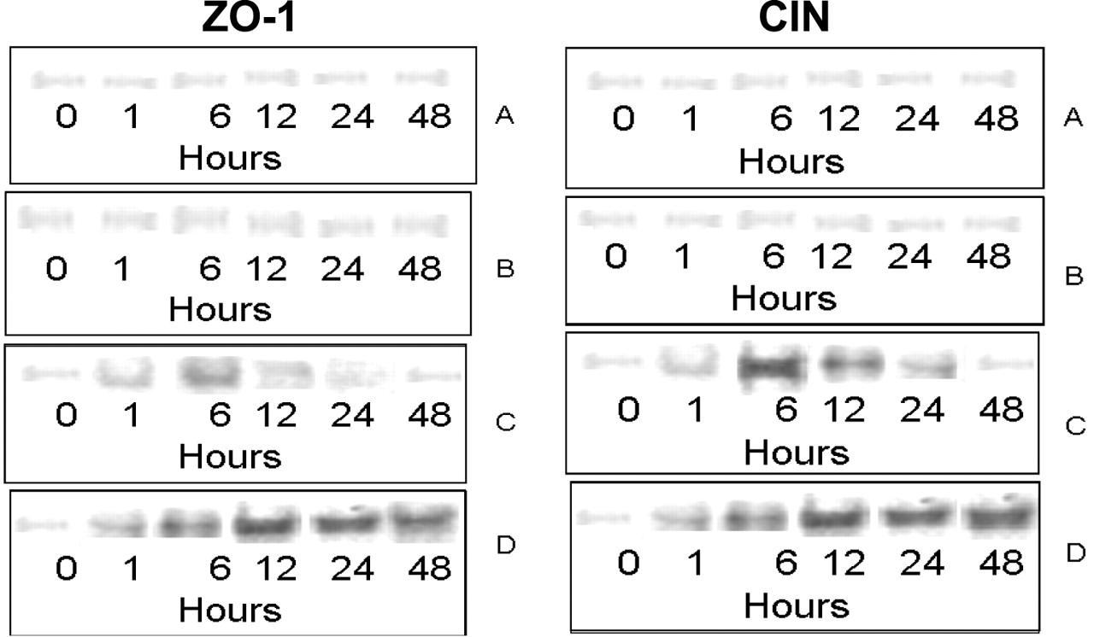
Fig. 7 Screening of phosphorylation tight junction proteins ZO-1 representing the tight junction proteins whose ...
Notes:
Fig. 7 Screening of phosphorylation tight junction proteins ZO-1 representing the tight junction proteins whose expression were affected and Fig. 6B shows phosphorylation of CIN representing the tight junction proteins whose expressions were not affected by LPS exposure. Lane A: control WC rats; lane B: alcohol-drinking Et rats; lane C: water-drinking WC-LPS rats; and lane D: ethanol-drinking Et-LPS rats. * : Significant when compared with corresponding WC-LPS values.
Unless provided in the caption above, the following copyright applies to the content of this slide: Copyright © The Author 2007. Published by Oxford University Press on behalf of the Medical Council on Alcohol.

Slide 8
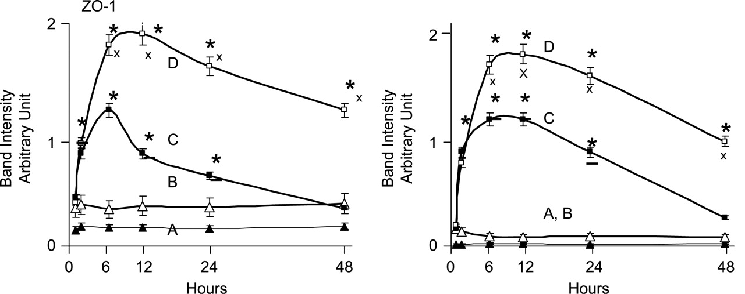
Fig. 8 Intensity of the bands representing ZO-1 and CIN phosphorylation. ZO-1 represents the tight junction ...
Notes:
Fig. 8 Intensity of the bands representing ZO-1 and CIN phosphorylation. ZO-1 represents the tight junction proteins whose expressions were affected and CIN represents the tight junction proteins whose expressions were not affected by LPS drinking. Lane A: control WC rats; lane B: alcohol-drinking Et rats; lane C: water-drinking WC-LPS rats; and lane D: ethanol-drinking Et-LPS rats. * : Significant when compared with corresponding WC-LPS values. * : Significant when compared with corresponding WC-LPS values. Values are mean ± SD, n = 5.
Unless provided in the caption above, the following copyright applies to the content of this slide: Copyright © The Author 2007. Published by Oxford University Press on behalf of the Medical Council on Alcohol.

Slide 9
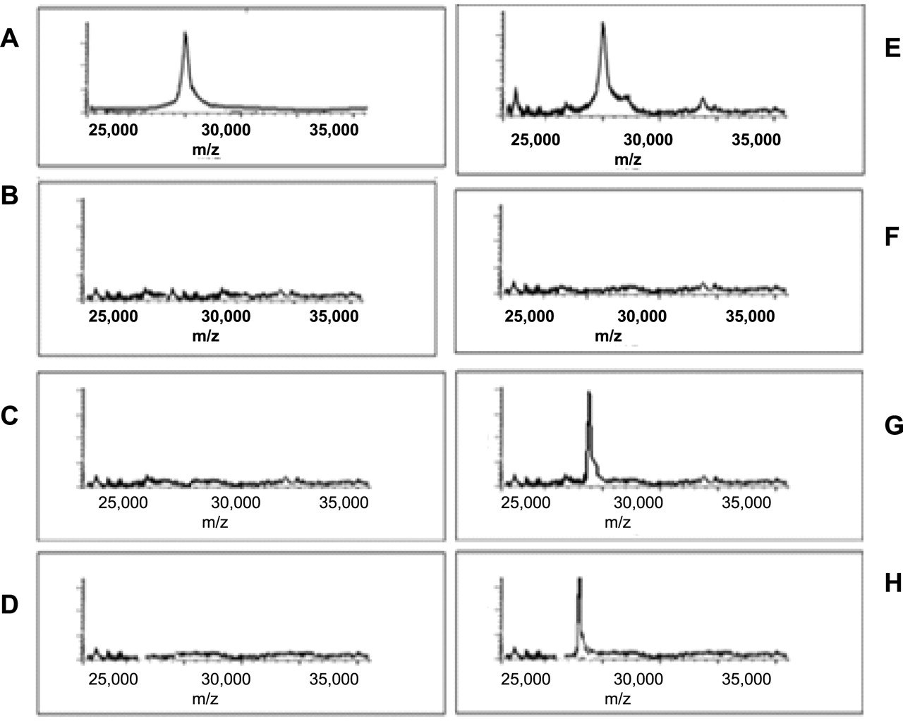
Fig. 9 Analysis of LPS in the brain endothelial cells and neurons isolated from rats subjected to an i.p. injection ...
Notes:
Fig. 9 Analysis of LPS in the brain endothelial cells and neurons isolated from rats subjected to an i.p. injection of LPS. (A) Spiked standard, (B) neurons from WC rats, (C) neurons from WC-LPS rats, (D) neurons from Et rats, (E) plasma from WC-LPS rats, (F) endothelial cells from WC rats, (G) endothelial cells from WC-LPS, and (H) endothelial cells from Et-LPS rats.
Unless provided in the caption above, the following copyright applies to the content of this slide: Copyright © The Author 2007. Published by Oxford University Press on behalf of the Medical Council on Alcohol.

Slide 10
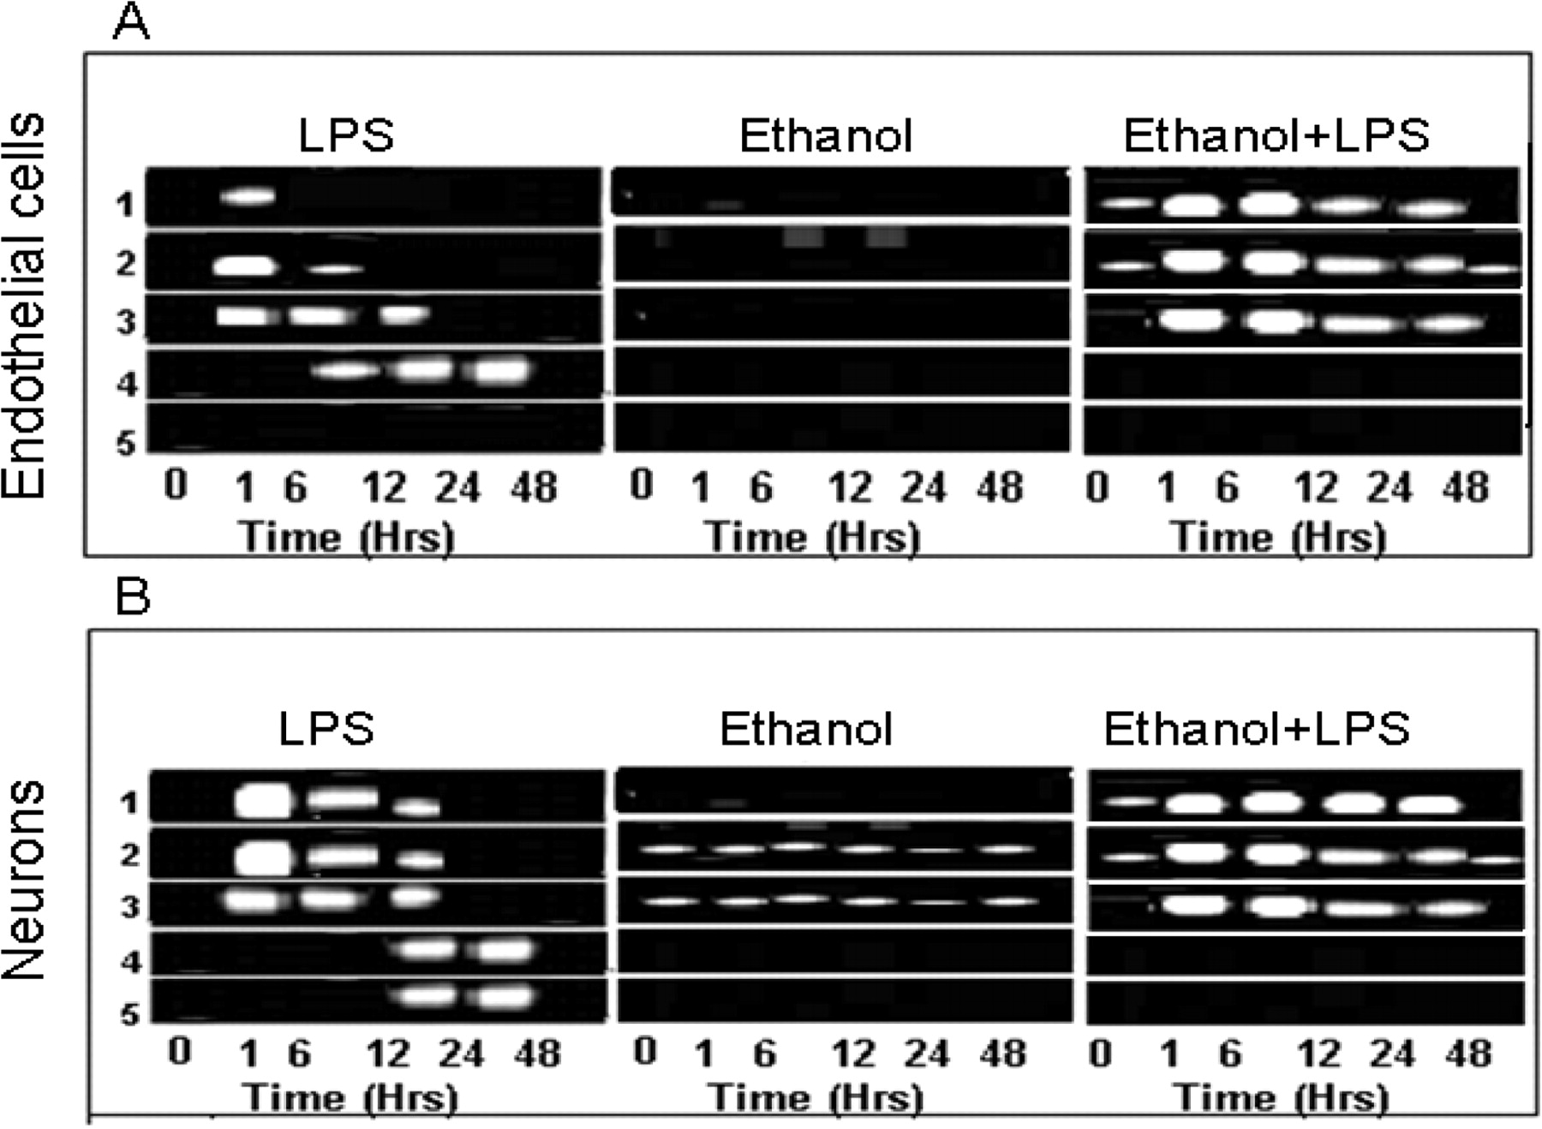
Fig. 10 (A and B) RT–PCR analysis of mRNAs encoding iNOS, TNFα, IL-1β, IL-10, and CASPASE-8 in endothelial cells and ...
Notes:
Fig. 10 (A and B) RT–PCR analysis of mRNAs encoding iNOS, TNFα, IL-1β, IL-10, and CASPASE-8 in endothelial cells and neurons isolated from the brain of control and alcohol-drinking rats subjected to a single LPS injection.
Unless provided in the caption above, the following copyright applies to the content of this slide: Copyright © The Author 2007. Published by Oxford University Press on behalf of the Medical Council on Alcohol.

Slide 11
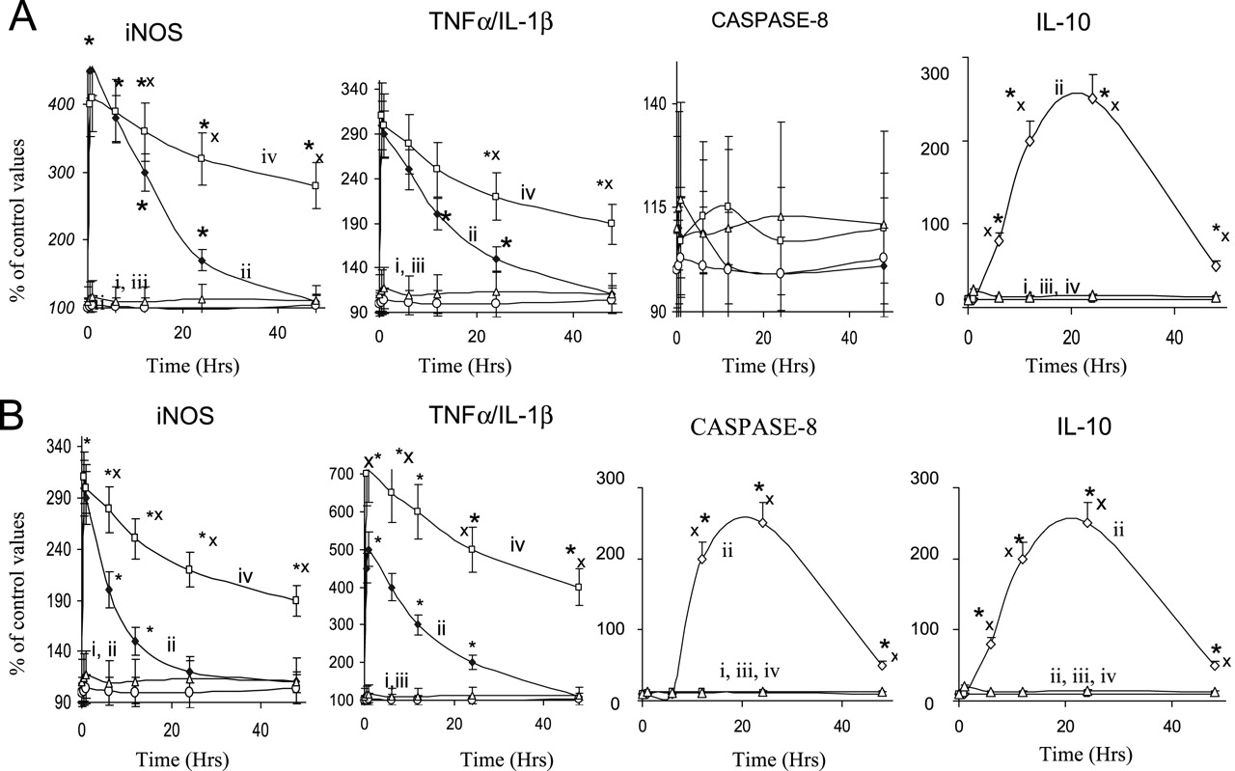
Fig. 11 Quantitative analysis of mRNAs encoding iNOS, TNFα, IL-1β, IL-10, and CASPASE-8 using real-time PCR ...
Notes:
Fig. 11 Quantitative analysis of mRNAs encoding iNOS, TNFα, IL-1β, IL-10, and CASPASE-8 using real-time PCR analysis. i: Control WC rats; ii: WC-LPS rats; iii: Et rats; and iv: Et-LPS rats. * : Significant when compared with the ‘zero’th values. x: significant when compared with corresponding WC-LPS values. Values are mean ± SD, n = 5.
Unless provided in the caption above, the following copyright applies to the content of this slide: Copyright © The Author 2007. Published by Oxford University Press on behalf of the Medical Council on Alcohol.

Slide 12
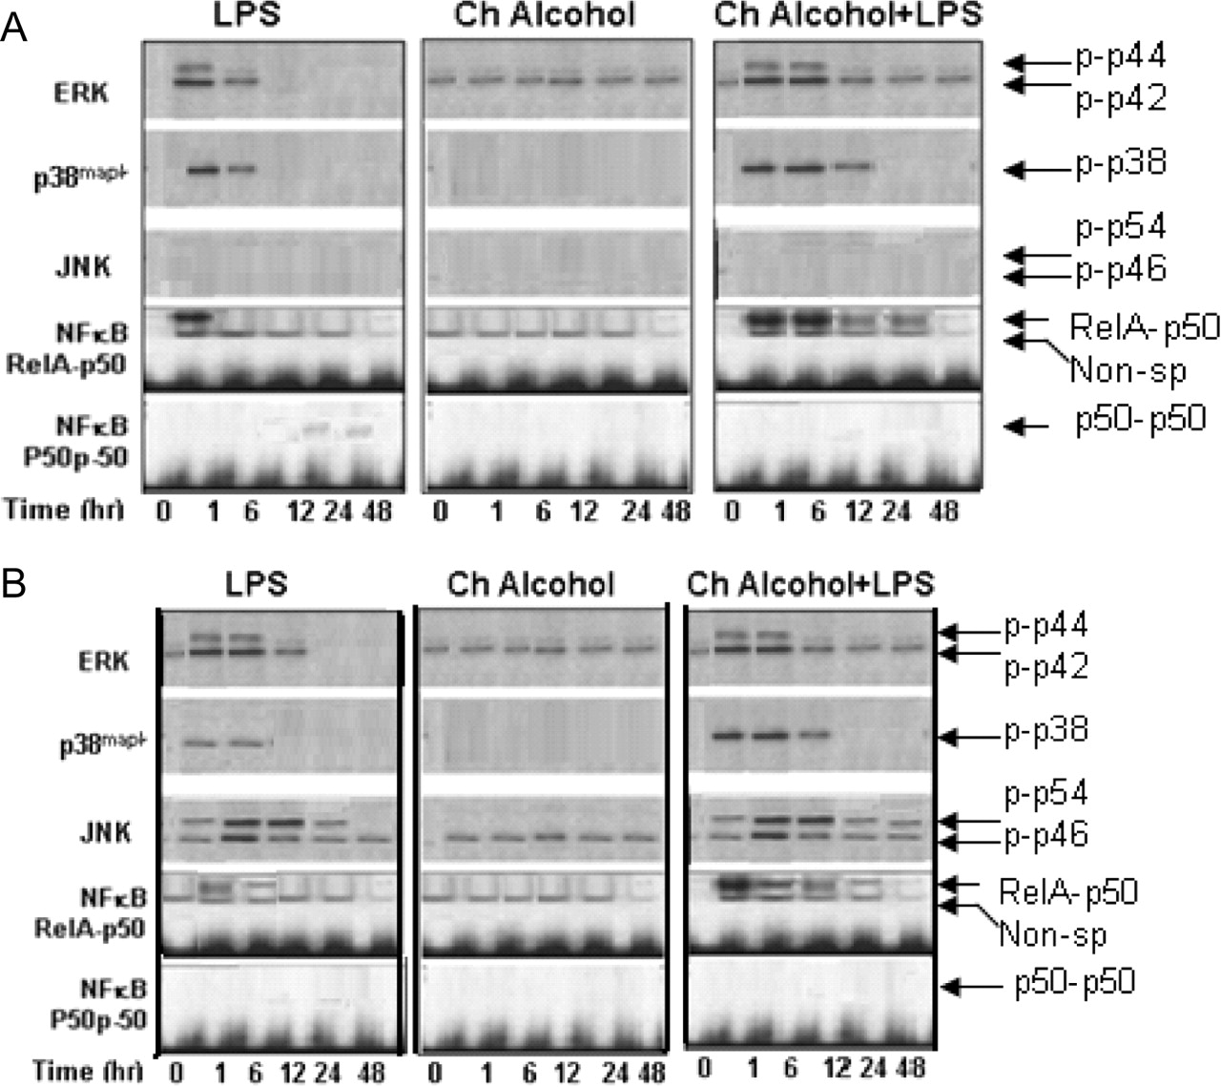
Fig. 12 Phosphorylation of ERK p42/p44, p38 ^{mapk} , and JNK p54/p46 phosphorylation and activation of NFκB ...
Notes:
Fig. 12 Phosphorylation of ERK p42/p44, p38 mapk , and JNK p54/p46 phosphorylation and activation of NFκB dimers RelA-p50 and p50-p50 in brain endothelial cells (A) and neurons (B).
Unless provided in the caption above, the following copyright applies to the content of this slide: Copyright © The Author 2007. Published by Oxford University Press on behalf of the Medical Council on Alcohol.

Slide 13
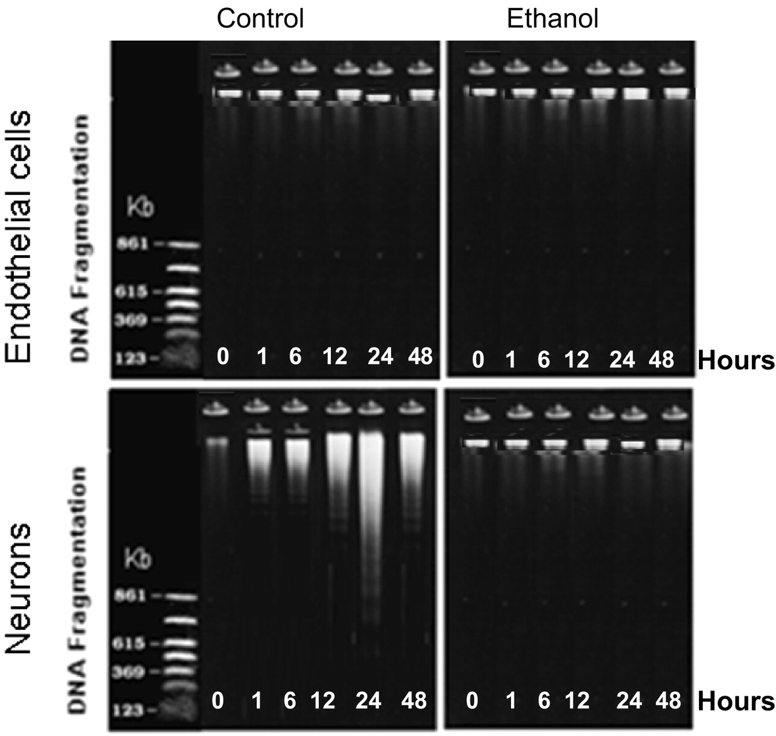
Fig. 13 DNA ladder assay for detection of apoptosis in neurons and endothelial cells.
Notes:
Fig. 13 DNA ladder assay for detection of apoptosis in neurons and endothelial cells.
Unless provided in the caption above, the following copyright applies to the content of this slide: Copyright © The Author 2007. Published by Oxford University Press on behalf of the Medical Council on Alcohol.

Slide 14
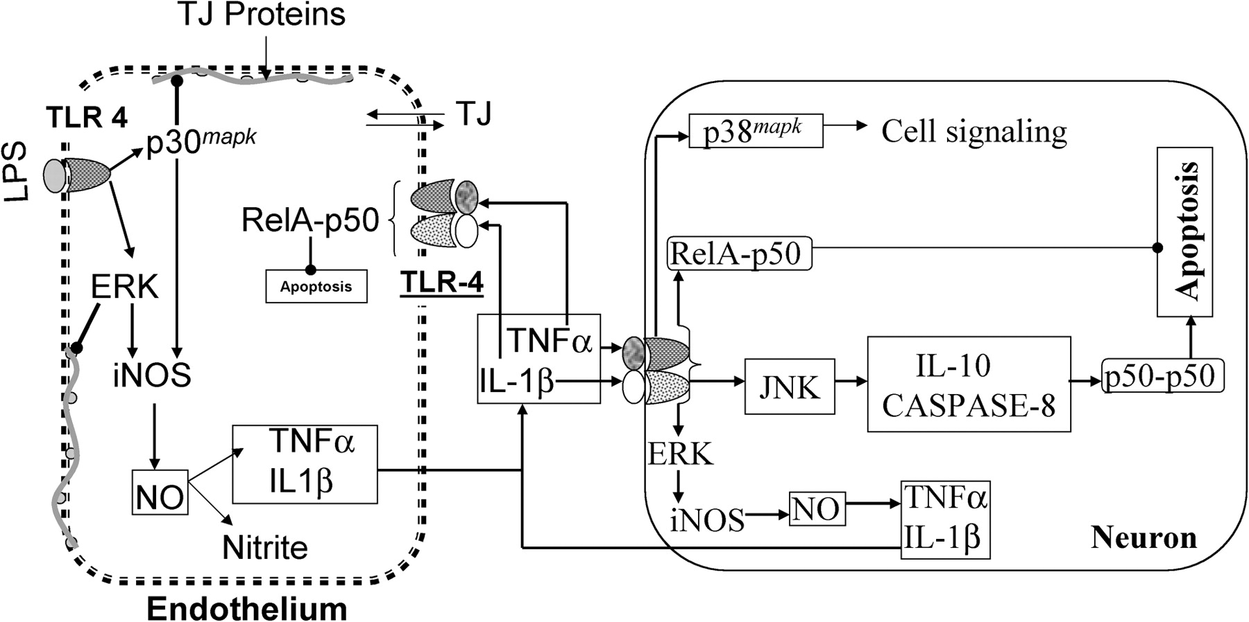
Fig. 14 A unified hypothesis for effects of chronic alcohol drinking on LPS-mediated BBB abnormality and ensuing ...
Notes:
Fig. 14 A unified hypothesis for effects of chronic alcohol drinking on LPS-mediated BBB abnormality and ensuing neuronal toxicity. LPS binds to the TLR-4 and phosphorylates ERK and p38 mapk in endothelial cells and ERK, JNK, and p38 mapk in neurons, and (2) activates NFκB dimer, RelA-p50, in both cell types. Phosphorylated ERK and p38 mapk disrupts the BBB tight junction by phosphorylating the BBB proteins and/or reducing their expression. RelA-p50 activation induces expression of iNOS, TNFα, and IL-1β that induce inflammation and suppress apoptosis, while either JNK activation or the pro-inflammatory cytokines activate the NFκB dimer, p50-p50 that suppresses inflammation and induces apoptosis. Neurons from LPS-injected rats exhibited, but endothelial cells from LPS-injected rats did not exhibit apoptotic cells. Endothelial cells from ethanol-drinking rats upregulated the pro-inflammatory effects, but suppressed the anti-inflammatory and apoptotic effects of LPS.
Unless provided in the caption above, the following copyright applies to the content of this slide: Copyright © The Author 2007. Published by Oxford University Press on behalf of the Medical Council on Alcohol.

