Slide 1
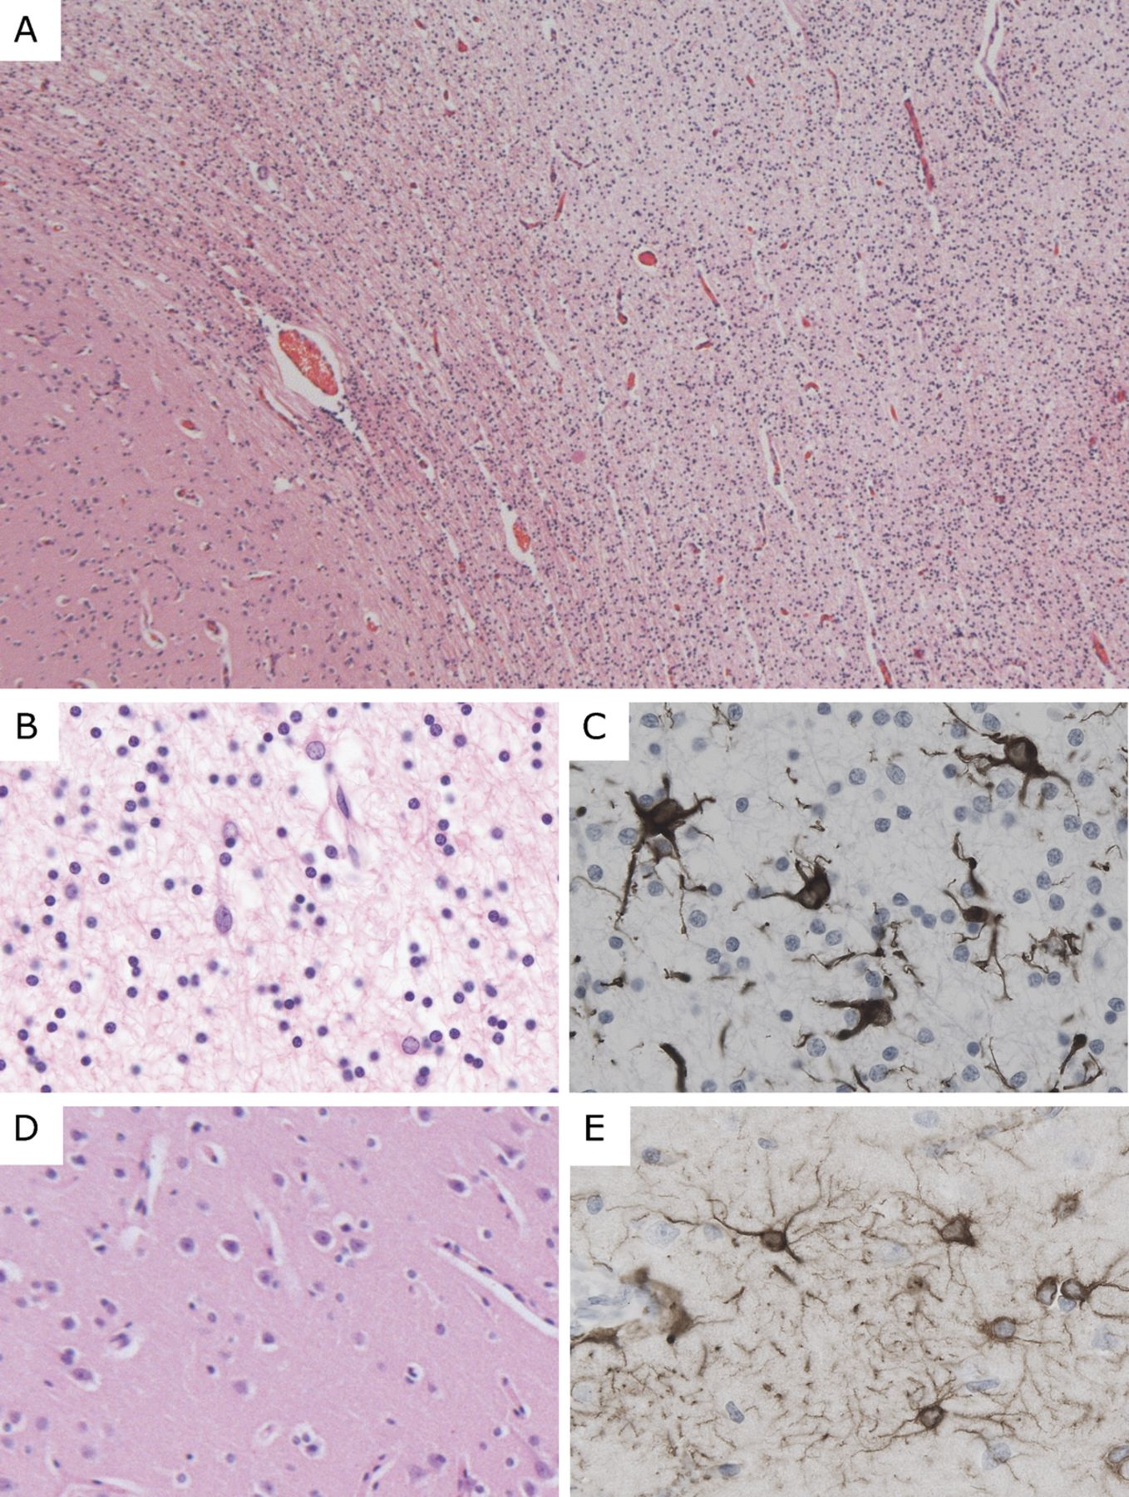
FIGURE 1. General neuropathologic features of vanishing white matter disease. (A) Low-power magnification hematoxylin ...
Notes:
FIGURE 1. General neuropathologic features of vanishing white matter disease. (A) Low-power magnification hematoxylin and eosin staining of the white matter (right side of field) from the frontal lobe of Patient VWM367 shows tissue rarefaction and increased cellular density. The U-fibers appear relatively preserved; the overlying cortex is normal. (B, C) At higher magnification, white matter astrocytes display abnormal morphology with coarse blunt processes. (D, E) The cortical architecture and morphology of cortical astrocytes are normal. (A, B, D) Hematoxylin and eosin; (C, E) immunohistochemistry for glial fibrillary acidic protein. Original magnifications: (A) 25×; (B-E) 200×.
Unless provided in the caption above, the following copyright applies to the content of this slide: Copyright © 2011 by the American Association of Neuropathologists, Inc.

Slide 2
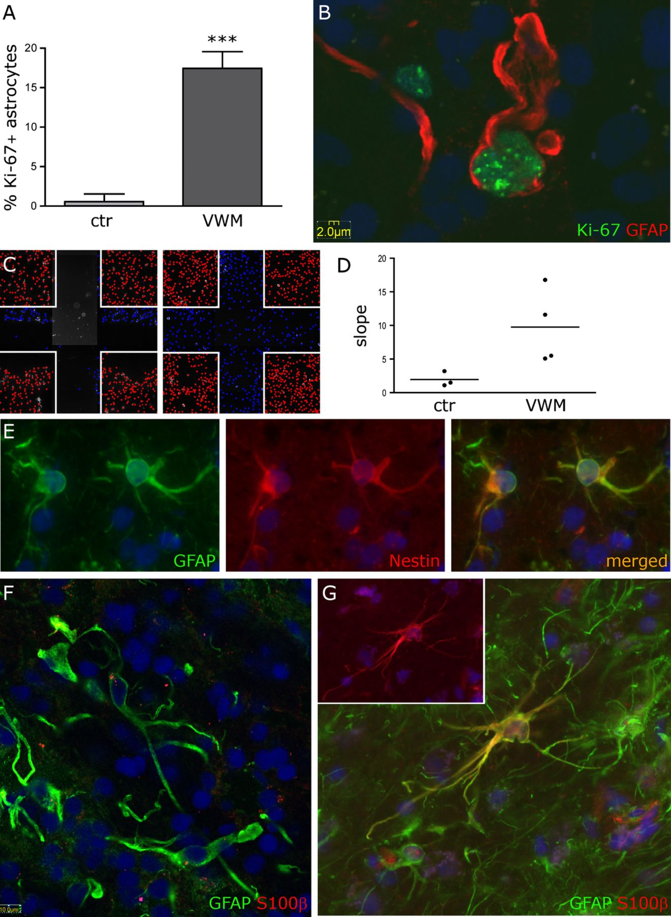
FIGURE 2. Vanishing white matter disease (VWM) astrocytes proliferate actively but do not reach full maturity. (A) ...
Notes:
FIGURE 2. Vanishing white matter disease (VWM) astrocytes proliferate actively but do not reach full maturity. (A) There are significantly higher numbers of Ki-67-positive astrocytes in the white matter of VWM patients than in controls (n = 5 patients, 3 controls; p < 0.0001; bars = SD). (B) Double stain for glial fibrillary acidic protein (GFAP) and Ki-67 shows cells with incomplete separation of the nucleus and abnormal morphology with blunt processes (Patient VWM3). (C) Scratch-wound assays of Control 5 (left panel) and Patient VWM44 (right panel) show increased proliferation of primary cultured astrocytes in the scratch 48 hours after administration of a mechanical stress. Nuclei of the proliferating cells inside the scratch area are blue. Nuclei of the unstressed cells outside this area are red; their net number is not changed versus controls. (D) The slope of proliferation in the scratch area; the individual net values are indicated as dots (n = 4 patients, 3 controls; p = 0.06; the lack of significance is due to the large variance of cell growth among the different VWM patients versus controls). (E, F) GFAP-positive astrocytes from VWM patients express the intermediate filament nestin (Patient VWM99) (E) and are S100β-negative (F) (Patient VWM3), suggesting that they are immature. (G) Astrocytes from controls show normal morphology with fine arborizations and both nuclear and cytoplasmic S100β-immunoreactivity (Control 2; single S100β staining in inset). Nuclei are stained with DAPI (blue) in all panels. Original magnifications: (B, F) bars indicate 2 and 10 μm, respectively; original magnifications: (E, G) 400×.
Unless provided in the caption above, the following copyright applies to the content of this slide: Copyright © 2011 by the American Association of Neuropathologists, Inc.

Slide 3
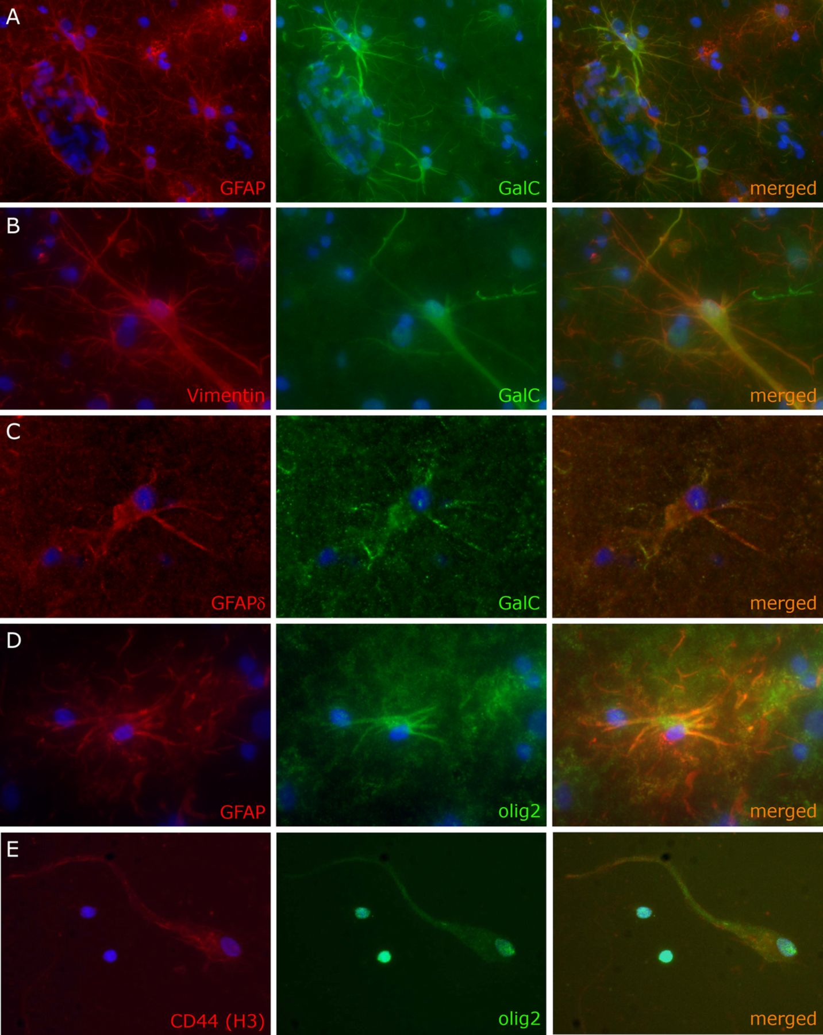
FIGURE 3. Vanishing white matter disease (VWM) astrocytes express oligodendrocytic lineage-specific proteins. (A, B) ...
Notes:
FIGURE 3. Vanishing white matter disease (VWM) astrocytes express oligodendrocytic lineage-specific proteins. (A, B) Double stain for glial fibrillary acidic protein (GFAP) (A; Patient VWM3) or vimentin (B; Patient VWM99) and galactocerebroside (GalC) show dysmorphic astrocytes with homogeneous cytoplasmic GalC immunoreactivity extending far into the processes. (C) In astrocytes from VWM patients, GalC colocalizes with other astrocytic lineage-specific markers, including GFAPδ (Patient VWM44). (D) GFAP-positive cells with astrocyte morphology also express olig2 with a cytoplasmic immunoreactivity pattern (Patient VWM80). (E) Primary culture of sorted glial progenitors shows a cell with both nuclear and cytoplasmically translocated olig2 and morphology and CD44-immunoreactivity, consistent with an astrocyte progenitor; 2 oligodendrocyte lineage-committed cells only express nuclear olig2 (Patient VWM576). In all panels, the nuclei are stained with DAPI (blue). Original magnifications: (A, E) 200×; (B-D) 400×.
Unless provided in the caption above, the following copyright applies to the content of this slide: Copyright © 2011 by the American Association of Neuropathologists, Inc.

Slide 4
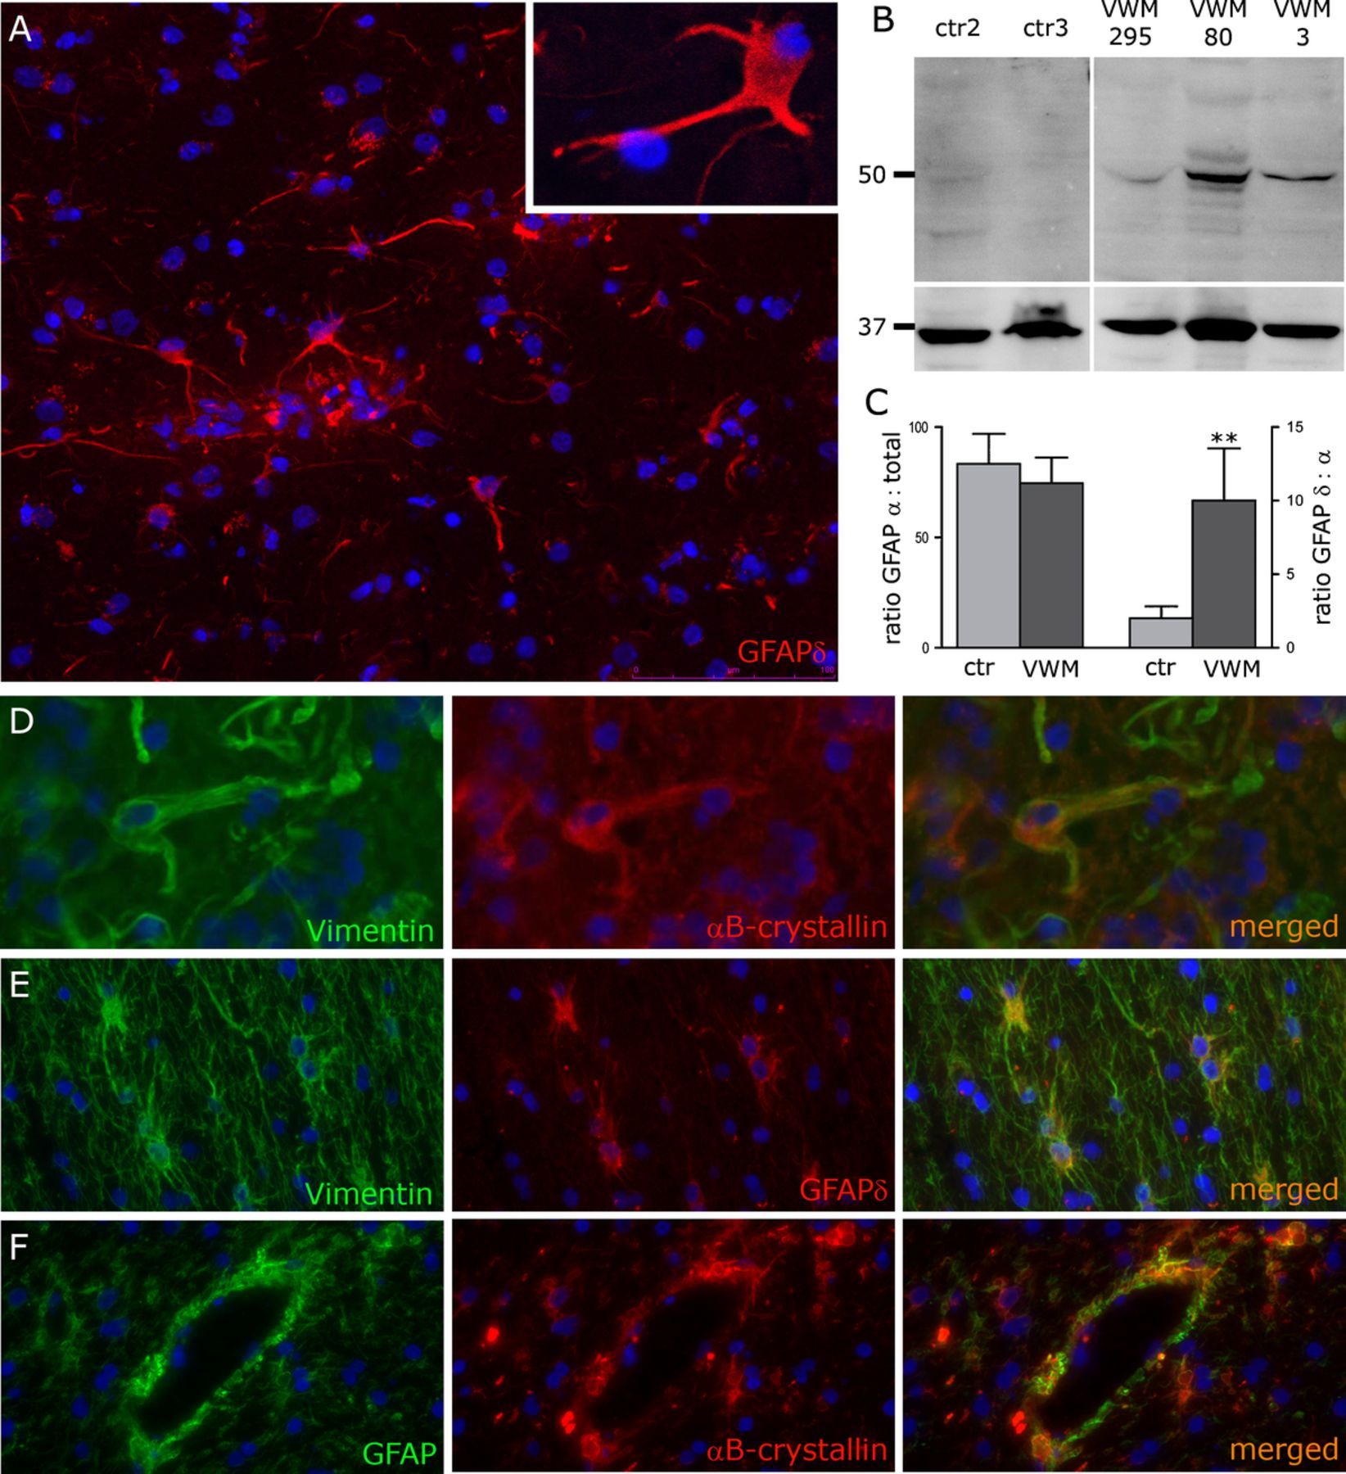
FIGURE 4. Vanishing white matter disease (VWM) astrocytes overexpress glial fibrillary acidic protein δ (GFAPδ) and ...
Notes:
FIGURE 4. Vanishing white matter disease (VWM) astrocytes overexpress glial fibrillary acidic protein δ (GFAPδ) and αB-crystallin. (A) Dysmorphic astrocytes in the white matter of a VWM patient (VWM3) are strongly GFAPδ-positive. Immunoreactivity extends far into the processes (inset). (B) Higher amounts of GFAPδ are detected by Western blot of white matter lysates from 3 VWM patients versus age-matched nonneurologic controls. The upper blot shows GFAPδ (49 kd) and the lower blot, the loading control glyceraldehyde-3-phosphate dehydrogenase (GAPDH) (37 kd). (C) Quantitative PCR of the same patients and controls confirms that GFAPδ expression is significantly increased at the mRNA level (p = 0.005, error bars = SD). The abundance of the mRNA transcripts of the predominant isoform GFAPα is comparable (p = 0.4). (D) Dysmorphic VWM astrocytes also overexpress αB-crystallin, shown colocalizing with the astrocytic marker vimentin (Patient VWM3). (E, F) Similar GFAPδ (E) and αB-crystallin (F) expression is found in the white matter of the Alexander disease (AXD) patient, with strong perivascular αB-crystallin immunoreactivity consistent with Rosenthal fibers (F). Note the normal morphology of AXD astrocytes (E). In all pictures, nuclei are stained with DAPI (blue). Original magnifications: (A, E, F) 200×; (A, inset) 630×; (D) 400×.
Unless provided in the caption above, the following copyright applies to the content of this slide: Copyright © 2011 by the American Association of Neuropathologists, Inc.

Slide 5
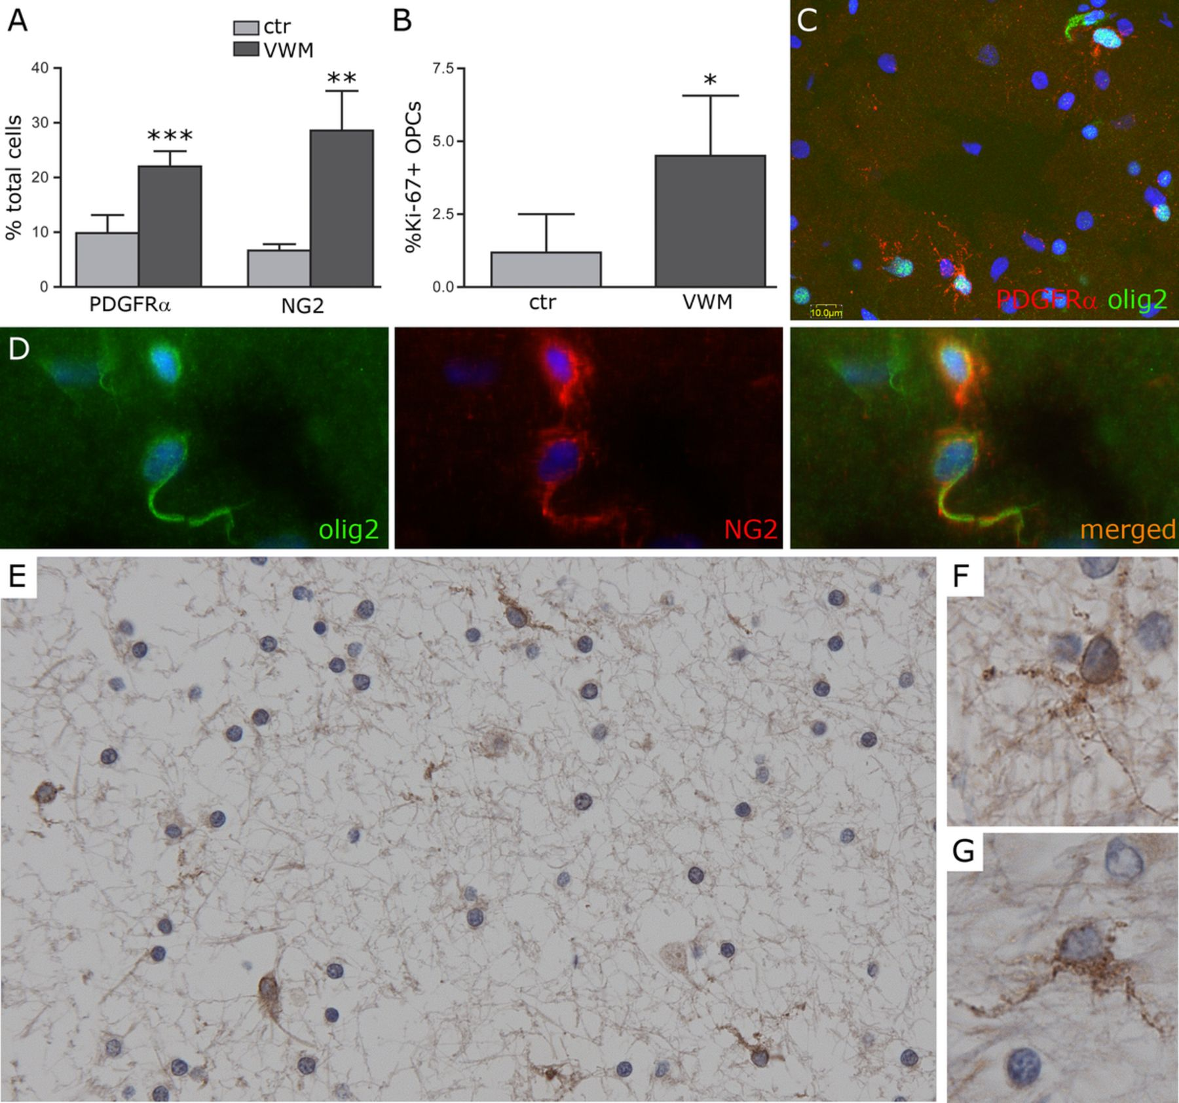
FIGURE 5. Increased density of oligodendrocyte progenitor cells (OPCs) in the white matter of Vanishing white matter ...
Notes:
FIGURE 5. Increased density of oligodendrocyte progenitor cells (OPCs) in the white matter of Vanishing white matter (VWM) patients. (A) There are higher numbers of OPCs in the white matter of VWM patients versus controls as revealed by both platelet-derived growth factor α (PDGFRα) (p < 0.0001) and NG2 immunoreactivity (p = 0.001) (n = 5 patients, 3 controls; bars = SD). (B) Cell counts of Ki-67-positive OPCs show increased proliferation in VWM patients versus nonneurologic controls (p = 0.01) (n = 5 patients, 3 controls; bars = SD). (C-G) Both PDGFRα and NG2 antibodies identify cells with nuclear olig2-positivity (C, Patient VWM295; D, Patient VWM99) and little cytoplasm with multiple short branches (E-G, Patient VWM367; PDGFRα). The olig2 antibody also labels cells with cytoplasmic immunoreactivity (uppermost cell in C; lower cell in D). These cells are presumablyimmature astrocytes. Nuclei in (C) and (D) are stained with DAPI (blue). Original magnifications: (C) see bar; (E) 200×; (D, F, G) 400×.
Unless provided in the caption above, the following copyright applies to the content of this slide: Copyright © 2011 by the American Association of Neuropathologists, Inc.

