Slide 1
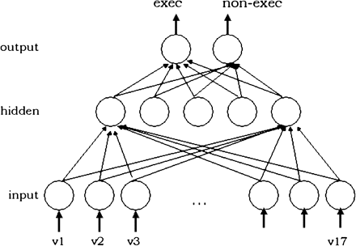
Figure 1. Network Architecture
Notes:
Figure 1. Network Architecture
Unless provided in the caption above, the following copyright applies to the content of this slide: International Journal of Law and Information Technology Vol. 16 No. 1 © Oxford University Press 2007; all rights reserved

