Slide 1
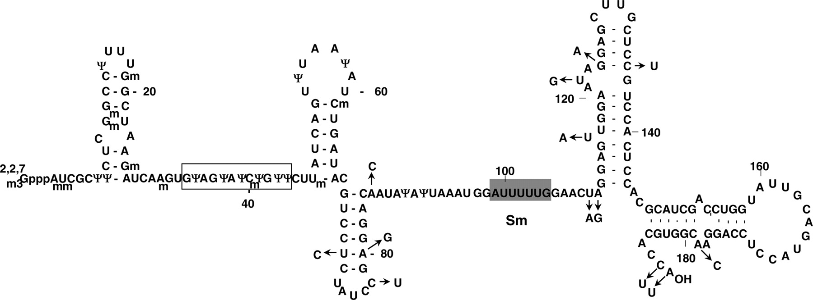
Figure 1 Primary and secondary structure of human and Xenopus U2 snRNA. Pseudouridines (Ψ) and 2′- O -methyl groups ...
Notes:
Figure 1 Primary and secondary structure of human and Xenopus U2 snRNA. Pseudouridines (Ψ) and 2′- O -methyl groups (m) are indicated. The gray box depicts the Sm binding site, and the open box highlights the branch site recognition sequence and its 3′-adjacent sequence (collectively referred to as the branch site recognition region). Arrows indicate the nucleotide differences in Xenopus U2 snRNA.
Unless provided in the caption above, the following copyright applies to the content of this slide: © 2006 The Author(s).This is an Open Access article distributed under the terms of the Creative Commons Attribution Non-Commercial License (http://creativecommons.org/licenses/by-nc/2.0/uk/) which permits unrestricted non-commercial use, distribution, and reproduction in any medium, provided the original work is properly cited.

Slide 2
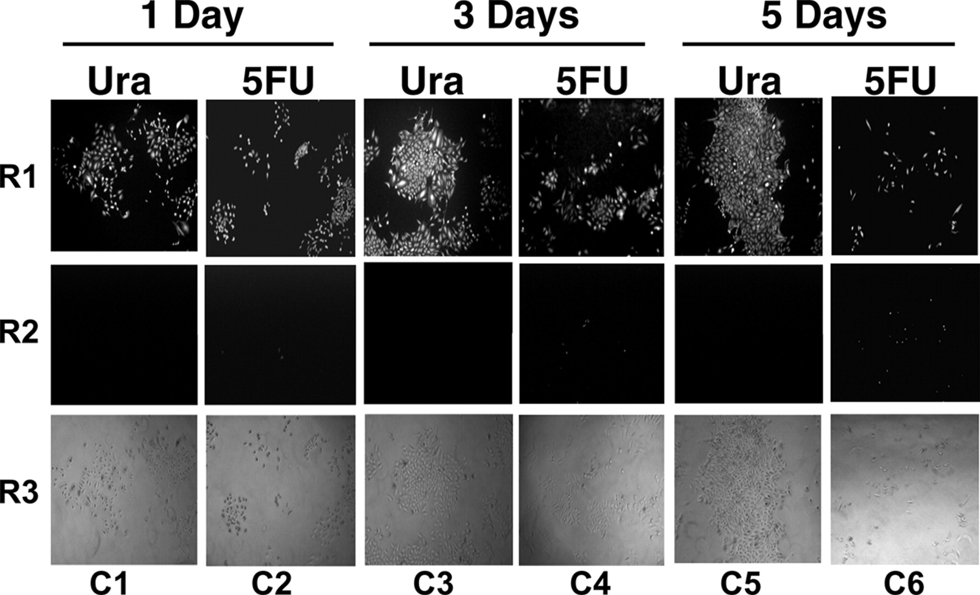
Figure 2 Images of HeLa cells treated with either uracil or 5FU. HeLa cells were cultured in medium containing either ...
Notes:
Figure 2 Images of HeLa cells treated with either uracil or 5FU. HeLa cells were cultured in medium containing either 10 μM uracil (C1, C3 and C5) or 10 μM 5FU (C2, C4 and C6) for 1 day (C1 and C2), 3 days (C3 and C4) or 5 days (C5 and C6). After incubation, the cells were stained with fluorescein diacetate for live cells (R1) or propidium iodide dye for damaged/dead cells (R2). Row 3 (R3) shows the phase images.
Unless provided in the caption above, the following copyright applies to the content of this slide: © 2006 The Author(s).This is an Open Access article distributed under the terms of the Creative Commons Attribution Non-Commercial License (http://creativecommons.org/licenses/by-nc/2.0/uk/) which permits unrestricted non-commercial use, distribution, and reproduction in any medium, provided the original work is properly cited.

Slide 3
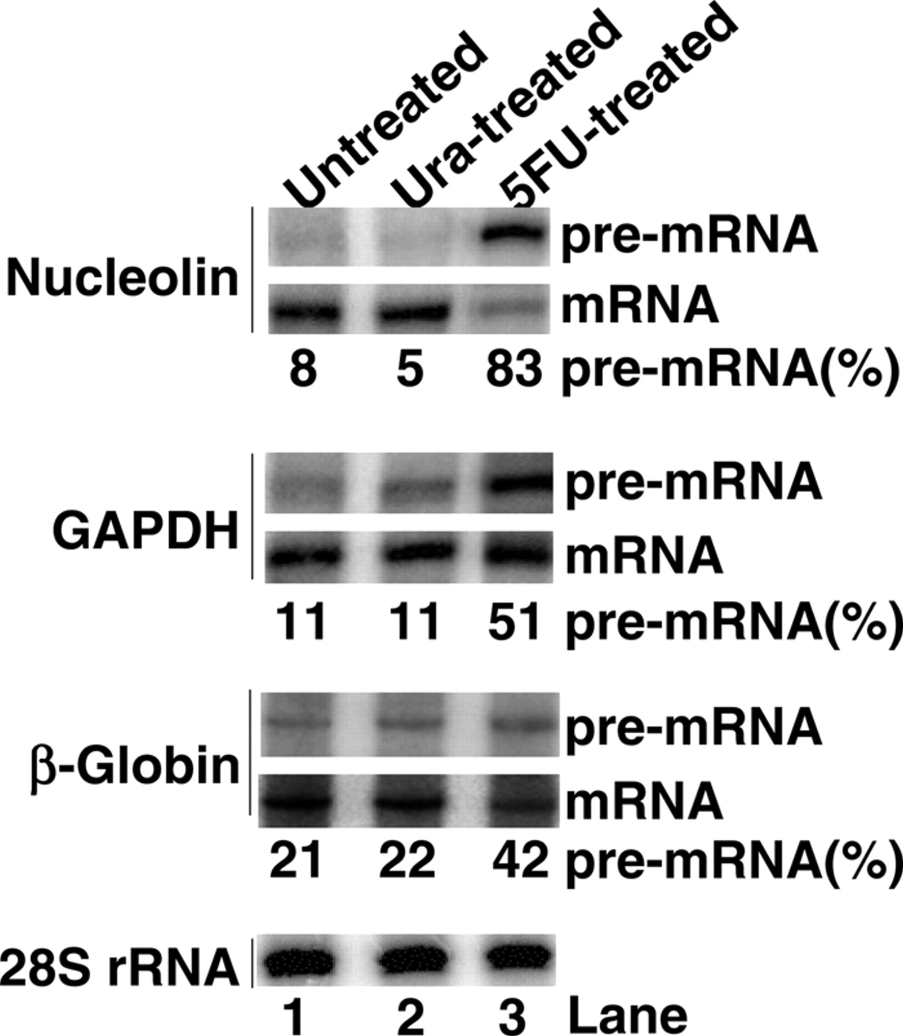
Figure 3 The levels of pre-mRNA and mRNA in uracil- or 5FU-treated cells. After a 5-day incubation in the appropriate ...
Notes:
Figure 3 The levels of pre-mRNA and mRNA in uracil- or 5FU-treated cells. After a 5-day incubation in the appropriate medium, HeLa cells were harvested, and pre-mRNA and mRNA levels were assessed, in the same reaction, by RT–PCR (see Materials and Methods). Total RNA used for RT–PCR was isolated either from control HeLa cells (regular medium, lane 1), 10 μM uracil-treated HeLa cells (lane 2), or from 10 μM 5FU–treated HeLa cells (lane 3). The pre-mRNA/mRNA levels of nucleolin, GAPDH and β-globin are shown; 28S rRNA served as the loading control––under the conditions used, i.e. low-dose 5FU, rRNA levels were not affected (or no difference was detected) ( 43 ). The percentage of pre-mRNA [pre-mRNA/(pre-mRNA + mRNA)] for each of the three genes is shown at the bottom of each panel. The RT–PCR experiments were repeated twice, and the results were almost identical.
Unless provided in the caption above, the following copyright applies to the content of this slide: © 2006 The Author(s).This is an Open Access article distributed under the terms of the Creative Commons Attribution Non-Commercial License (http://creativecommons.org/licenses/by-nc/2.0/uk/) which permits unrestricted non-commercial use, distribution, and reproduction in any medium, provided the original work is properly cited.

Slide 4
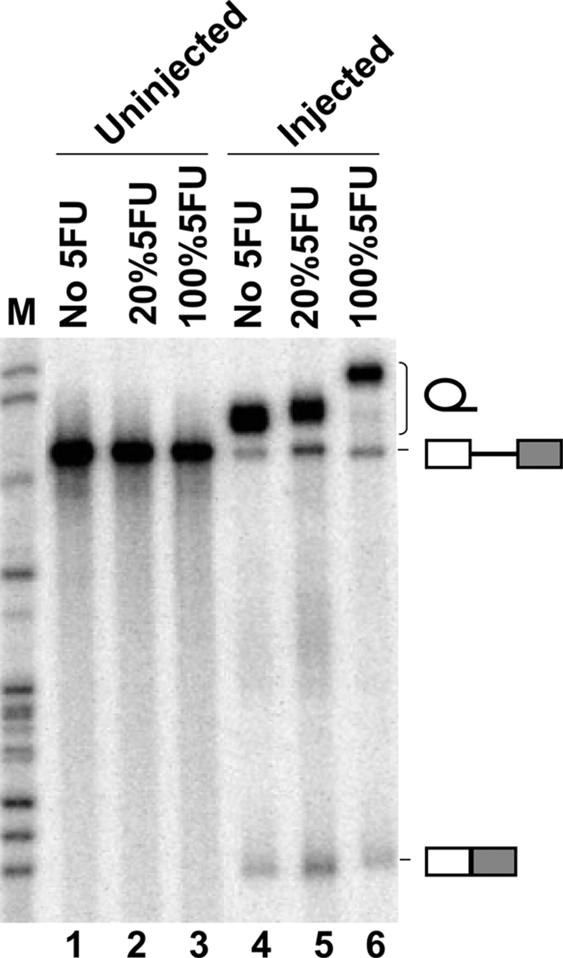
Figure 4 Splicing of pre-mRNA containing 5FU. Uniformly ³² P-radiolabeled standard adenovirus pre-mRNAs ...
Notes:
Figure 4 Splicing of pre-mRNA containing 5FU. Uniformly 32 P-radiolabeled standard adenovirus pre-mRNAs containing different levels of 5FU were separately injected into Xenopus oocytes, and their splicing activity was monitored by electrophoresis on denaturing gels. The percentage of 5FU in the pre-mRNA (relative to uridine) is shown above each lane. The migration positions of pre-mRNA and the spliced products (lariat intron at the top, the mature spliced mRNA at the bottom) are indicated schematically to the right.
Unless provided in the caption above, the following copyright applies to the content of this slide: © 2006 The Author(s).This is an Open Access article distributed under the terms of the Creative Commons Attribution Non-Commercial License (http://creativecommons.org/licenses/by-nc/2.0/uk/) which permits unrestricted non-commercial use, distribution, and reproduction in any medium, provided the original work is properly cited.

Slide 5
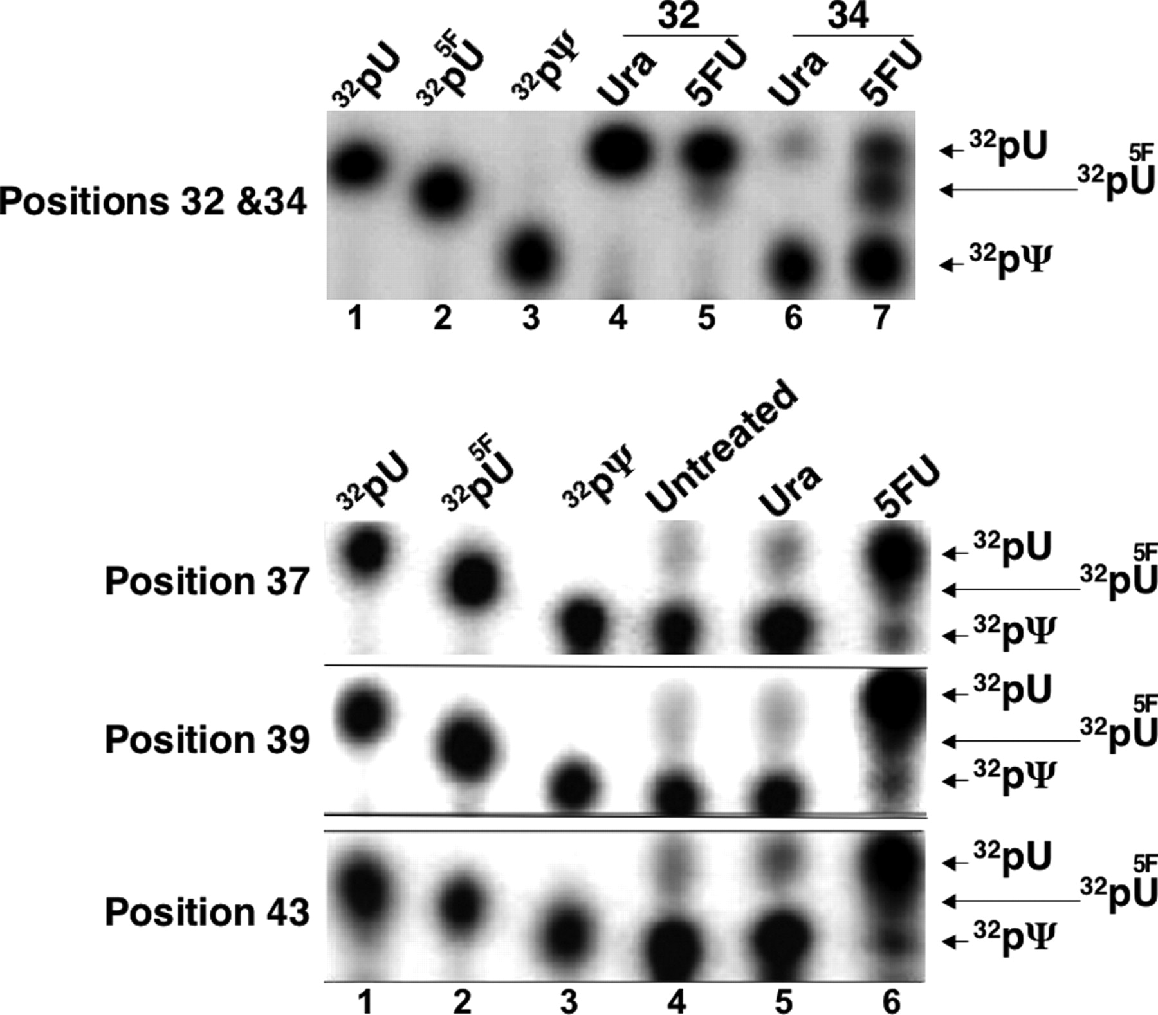
Figure 5 Incorporation of 5FU into U2 snRNA at natural pseudouridylation sites in vivo . U2 snRNA was isolated from ...
Notes:
Figure 5 Incorporation of 5FU into U2 snRNA at natural pseudouridylation sites in vivo . U2 snRNA was isolated from HeLa cells that had been treated with uracil or 5FU (or untreated) for 5 days. 5FU incorporation and pseudouridylation at natural uridine/pseudouridine sites were subsequently assayed (see Materials and Methods). Shown are the final TLC (thin layer chromatography) analyses of the nucleotides at several such sites (positions 32, 34, 37, 39 and 43). The developing solution for TLC was isobutyric acid:ammonium:water (50:1:29, v/v/v). All but position 32 (a natural uridine site) are natural pseudouridine sites. In the top panel (panel Positions 32 and 34), cells were treated with 1 mM uracil (lanes 4 and 6) or 1 mM 5FU (lanes 5 and 7) and positions 32 (lanes 4 and 5) and 34 (lanes 6 and 7) were analyzed. In the other panels (panels Positions 37, 39 and 43), cells were treated with 10 μM uracil (lanes 5) or 10 μM 5FU (lane 6), or were not treated (lane 4). Lanes 1, 2 and 3 are controls in which the 32 P-labeled nucleoside 5′-mono-phosphate, 32 pU, 32 p 5F U or 32 pΨ, respectively, was analyzed. The migration positions of pU, p 5F U and pΨ are indicated on the right.
Unless provided in the caption above, the following copyright applies to the content of this slide: © 2006 The Author(s).This is an Open Access article distributed under the terms of the Creative Commons Attribution Non-Commercial License (http://creativecommons.org/licenses/by-nc/2.0/uk/) which permits unrestricted non-commercial use, distribution, and reproduction in any medium, provided the original work is properly cited.

Slide 6
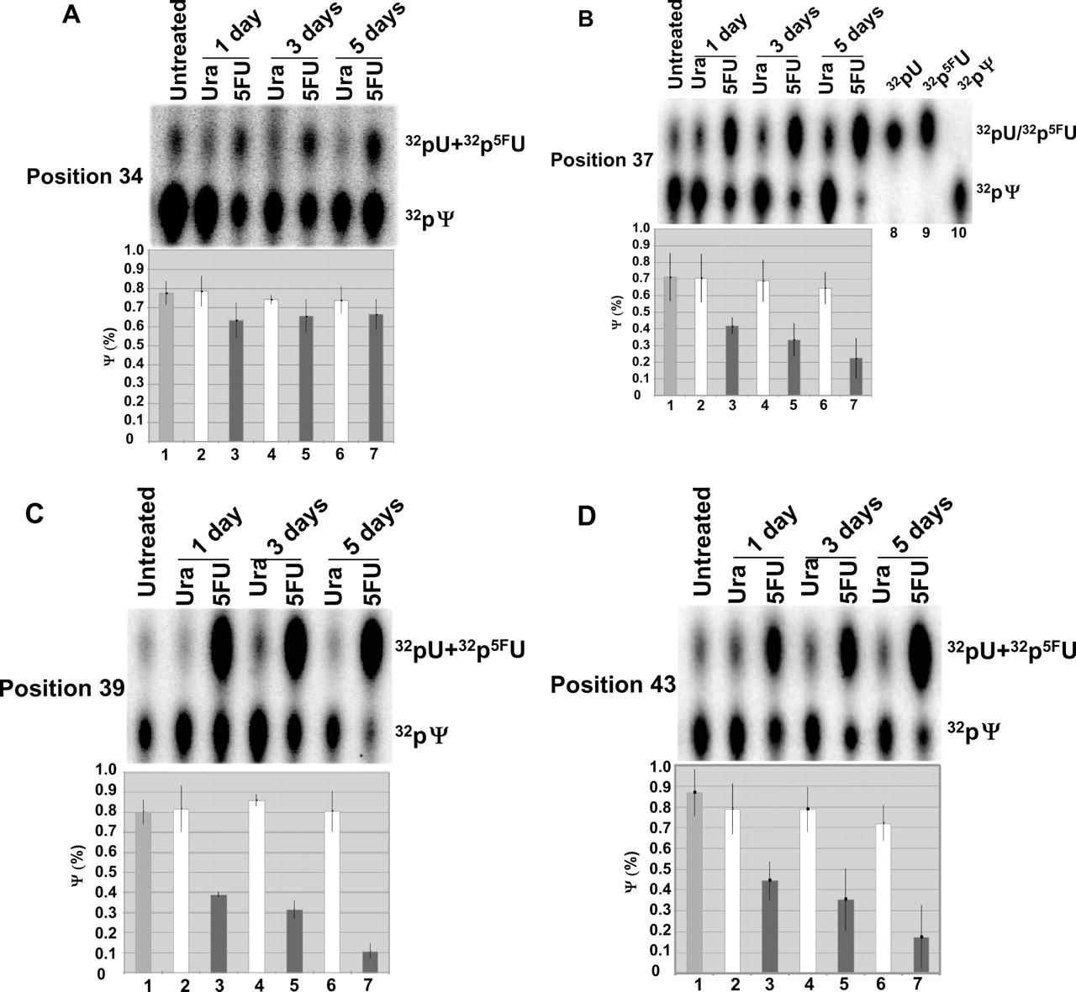
Figure 6 Quantification of pseudouridylation of U2 snRNA at natural pseudouridylation sites. Shown are measurements ...
Notes:
Figure 6 Quantification of pseudouridylation of U2 snRNA at natural pseudouridylation sites. Shown are measurements of pseudouridylation at four natural pseudouridylation sites, positions 34 (panel A ), 37 (panel B ), 39 (panel C ) and 43 (panel D ). Experiments were carried out exactly as in Figure 5, except that the developing solution for TLC was HCl:water:isopropanol (15:15:70, v/v/v), and that cells were analyzed at three different time points of culturing, i.e. 1 day (lanes 2 and 3), 3 days (lanes 4 and 5) and 5 days (lanes 6 and 7). Lane 1 is a control in which U2 snRNA was isolated from cells cultured in regular medium for 3 h (untreated). In lanes 2, 4 and 6, U2 snRNA isolated from uracil-treated cells was analyzed. In lanes 3, 5 and 7, U2 snRNA isolated from 5FU-treated cells was analyzed. Lanes 8, 9 and 10 in panel B are controls in which the 32 P-labeled nucleoside 5′-mono-phosphate, 32 pU, 32 p5FU or 32 pΨ, respectively, was analyzed. The positions of pU, p 5F U and pΨ are indicated to the right. Pseudouridylation at every position was repeated at least twice, and was quantified, as shown at the bottom of each panel. The percentage of pseudouridylation was calculated using the formula: pΨ/(pU + p 35 U + pΨ). The white bars, black bars and grey bars depict the percentage of U2 pseudouridylation in uracil-treated cells, 5FU-treated cells and untreated cells, respectively. The standard deviation (SD) is also indicated.
Unless provided in the caption above, the following copyright applies to the content of this slide: © 2006 The Author(s).This is an Open Access article distributed under the terms of the Creative Commons Attribution Non-Commercial License (http://creativecommons.org/licenses/by-nc/2.0/uk/) which permits unrestricted non-commercial use, distribution, and reproduction in any medium, provided the original work is properly cited.

Slide 7
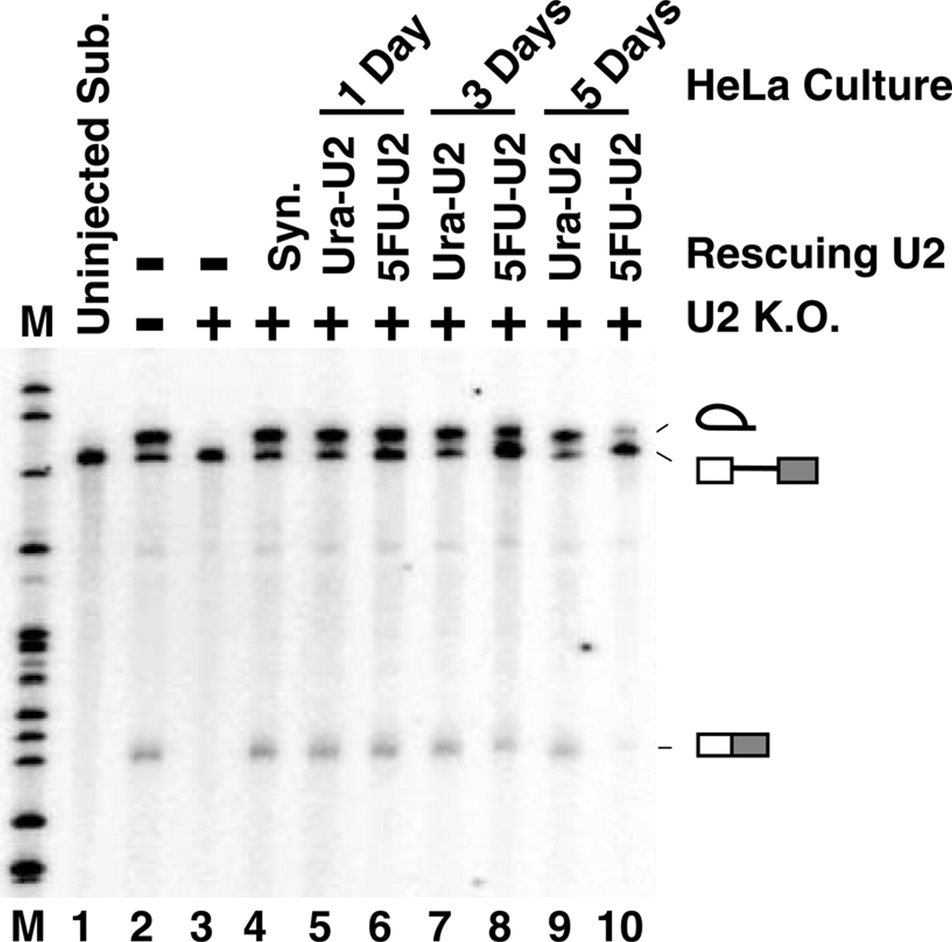
Figure 7 Functional reconstitution of splicing in Xenopus oocytes. U2 snRNA isolated from HeLa cells was injected ...
Notes:
Figure 7 Functional reconstitution of splicing in Xenopus oocytes. U2 snRNA isolated from HeLa cells was injected into U2-depleted Xenopus oocytes. After a 16-h reconstitution, the oocytes were then injected with 32 P-uniformly radiolabeled adenovirus pre-mRNA. The total nuclear RNA was isolated, 10 min after pre-mRNA injection, and assayed for splicing on a denaturing gel. Reconstitution was carried out with U2 snRNA isolated from cells that had been pre-treated with uracil (lanes 5, 7 and 9) or 5FU (lane 6, 8 and 10) for 1 day (lanes 5 and 6), 3 days (lane 7 and 8) or 5 days (lanes 9 and 10). Lanes 3 and 4 are controls where U2-depleted oocytes were reconstituted for 16 h with no RNA or with the in vitro transcribed U2 snRNA, respectively. In lane 2, 32 P-radiolabeled pre-mRNA was directly injected into U2 mock–depleted oocytes, and no exogenous U2 was supplemented. Lane 1 represents the uninjected adenovirus pre-mRNA. Lane M is a size marker of MspI-digested pBR322 DNA. The positions of unspliced pre-mRNA and spliced products—the lariat intron (top band) and mature mRNA (lower band)—are indicated schematically.
Unless provided in the caption above, the following copyright applies to the content of this slide: © 2006 The Author(s).This is an Open Access article distributed under the terms of the Creative Commons Attribution Non-Commercial License (http://creativecommons.org/licenses/by-nc/2.0/uk/) which permits unrestricted non-commercial use, distribution, and reproduction in any medium, provided the original work is properly cited.

