Slide 1
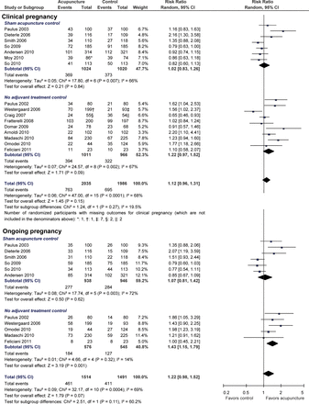
Figure 1 Effects of acupuncture on clinical pregnancy, ongoing pregnancy and live birth outcomes. The centres of the ...
Notes:
Figure 1 Effects of acupuncture on clinical pregnancy, ongoing pregnancy and live birth outcomes. The centres of the squares represent estimates from individual trials, the centres of the quadrilaterals represent pooled estimates and the horizontal lines represent 95% CIs.
Unless provided in the caption above, the following copyright applies to the content of this slide: © The Author 2013. Published by Oxford University Press on behalf of the European Society of Human Reproduction and Embryology. All rights reserved. For Permissions, please email: journals.permissions@oup.com

Slide 2
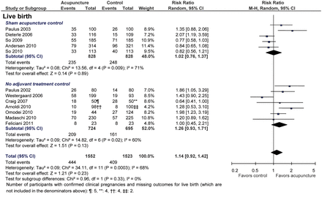
Figure 1 Continued.
Notes:
Figure 1 Continued.
Unless provided in the caption above, the following copyright applies to the content of this slide: © The Author 2013. Published by Oxford University Press on behalf of the European Society of Human Reproduction and Embryology. All rights reserved. For Permissions, please email: journals.permissions@oup.com

Slide 3
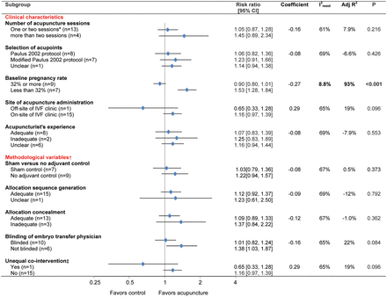
Figure 2 Meta-regression subgroup analyses for the primary outcome (i.e. clinical pregnancy). The quadrilaterals ...
Notes:
Figure 2 Meta-regression subgroup analyses for the primary outcome (i.e. clinical pregnancy). The quadrilaterals represent pooled estimates from the trials included in the given subgroup. The estimated regression coefficient from each model was obtained by a weighted least squares meta-regression with RR of pregnancy as the dependent variable, using the modification to the variance of the estimated coefficient suggested by Knapp and Hartung (2003), and supported by Higgins and Thompson (2004). values indicate the proportion of the residual variation that is attributable to between-study heterogeneity. The adjusted R2 values indicate the proportion of between-study variance explained by the covariate. The P-values for test of interaction indicate whether the observed differences in results of trials within a given subgroup are compatible with chance alone. *The So 2010 trial was the only trial that used only one acupuncture treatment session. The Westergaard 2006 trial had two acupuncture treatment arms, one arm received two sessions and the other arm received three, and these arms were grouped separately for this subgroup analysis. †Incomplete outcome data were also prespecified as a methodological subgroup variable, but no trial had a high risk of bias due to incomplete outcome data for the clinical pregnancy outcome. ‡Only the Craig et al. trial was judged to have a co-intervention that was applied unequally across treatment group. Namely, in this trial, which evaluated off-site acupuncture, patients in the acupuncture group only were required to drive to and from the off-site acupuncturist's office both before and after the embryo transfer procedure.
Unless provided in the caption above, the following copyright applies to the content of this slide: © The Author 2013. Published by Oxford University Press on behalf of the European Society of Human Reproduction and Embryology. All rights reserved. For Permissions, please email: journals.permissions@oup.com

Slide 4
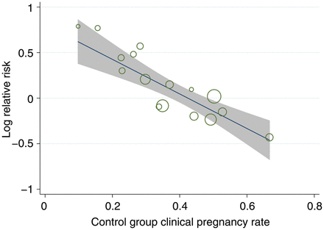
Figure 3 Meta-regression with baseline clinical pregnancy rate as single continuous covariate. Outcome was RR of ...
Notes:
Figure 3 Meta-regression with baseline clinical pregnancy rate as single continuous covariate. Outcome was RR of clinical pregnancy. Circle size represents weight each study was given in the meta-regression analysis. For this meta-regression, the adjusted R2 = 90% and the .
Unless provided in the caption above, the following copyright applies to the content of this slide: © The Author 2013. Published by Oxford University Press on behalf of the European Society of Human Reproduction and Embryology. All rights reserved. For Permissions, please email: journals.permissions@oup.com

Slide 5
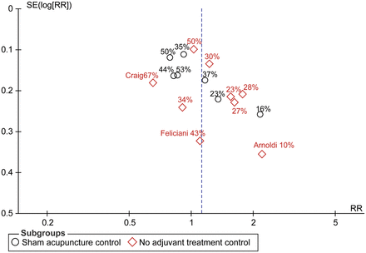
Figure 4 Funnel plot of trials meeting inclusion criteria. The intervention effect estimated from individual trials is ...
Notes:
Figure 4 Funnel plot of trials meeting inclusion criteria. The intervention effect estimated from individual trials is plotted on the horizontal scale and a measure of the standard error of the intervention effect is plotted on the vertical axis. The control group success rate is included for each trial on the plot. The Egger test P-value for funnel plot asymmetry is 0.032.
Unless provided in the caption above, the following copyright applies to the content of this slide: © The Author 2013. Published by Oxford University Press on behalf of the European Society of Human Reproduction and Embryology. All rights reserved. For Permissions, please email: journals.permissions@oup.com

Slide 6
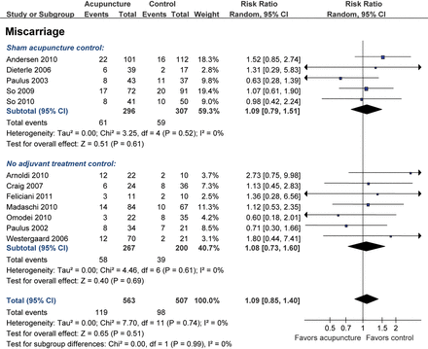
Figure 5 Effects of acupuncture on spontaneous abortion outcome. The centres of the squares represent estimates from ...
Notes:
Figure 5 Effects of acupuncture on spontaneous abortion outcome. The centres of the squares represent estimates from individual trials, the centres of the quadrilaterals represent pooled estimates, and the horizontal lines represent 95% CIs.
Unless provided in the caption above, the following copyright applies to the content of this slide: © The Author 2013. Published by Oxford University Press on behalf of the European Society of Human Reproduction and Embryology. All rights reserved. For Permissions, please email: journals.permissions@oup.com

