Slide 1
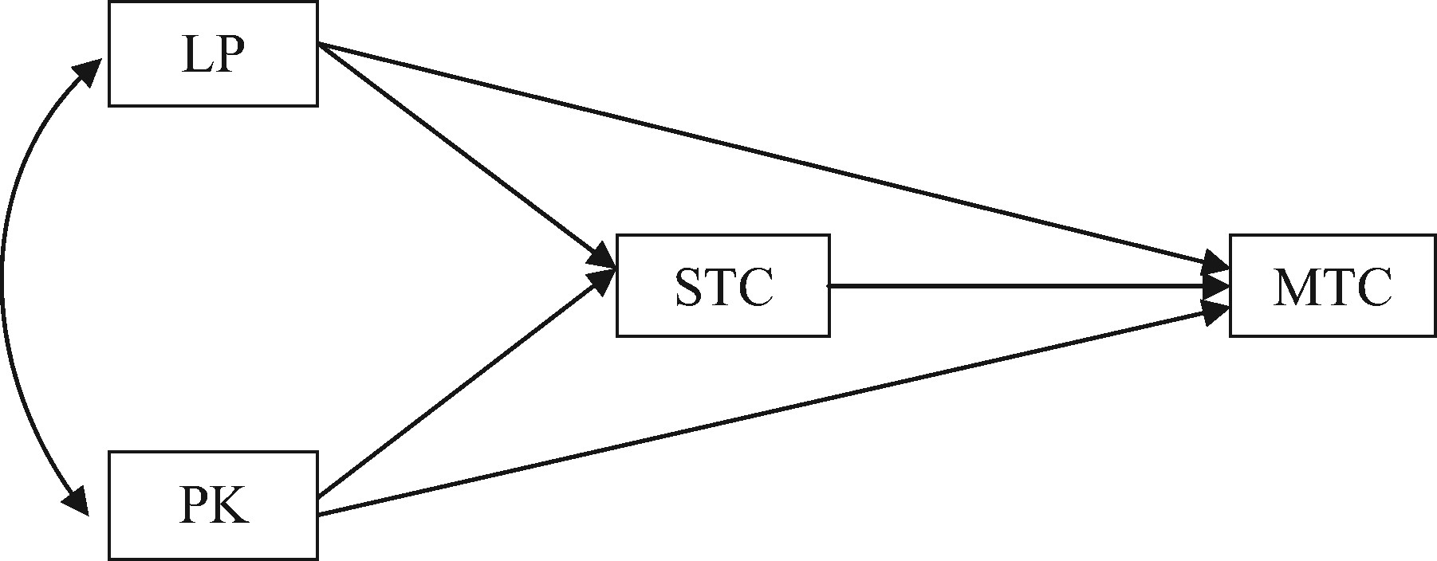
Figure 1: A Hypothesized Model of LP, PK, Single-Text Comprehension, and Multiple-Texts Comprehension. Note: N = 207; ...
Notes:
Figure 1: A Hypothesized Model of LP, PK, Single-Text Comprehension, and Multiple-Texts Comprehension. Note: N = 207; STC = Single-Text Comprehension; MTC = Multiple-Texts Comprehension
Unless provided in the caption above, the following copyright applies to the content of this slide: © Oxford University Press 2017This article is published and distributed under the terms of the Oxford University Press, Standard Journals Publication Model (https://academic.oup.com/journals/pages/open_access/funder_policies/chorus/standard_publication_model)

Slide 2
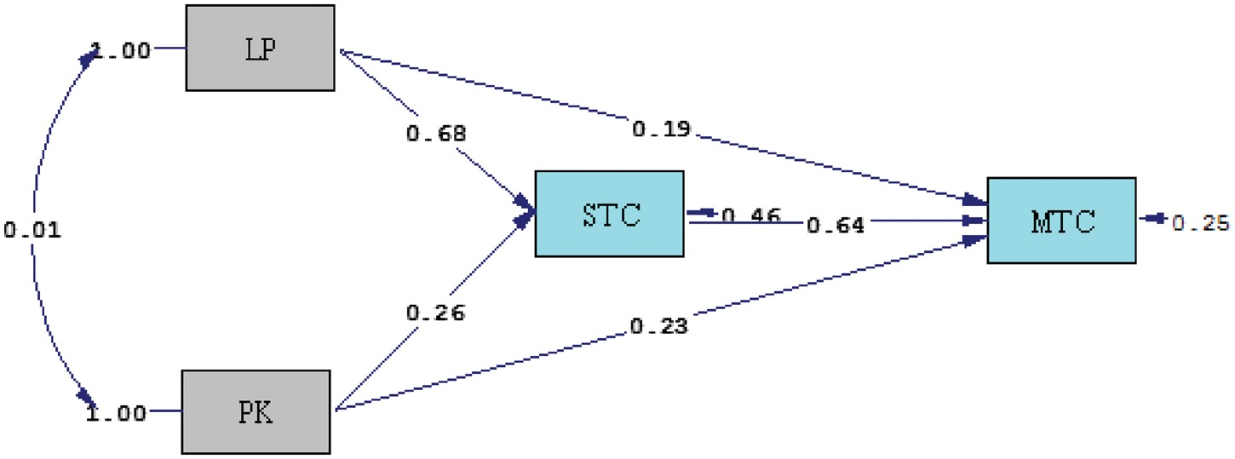
Figure 2: The Structural Model of LP, PK, Single-Text Comprehension, and Multiple-Texts Comprehension. Note: N = 207; ...
Notes:
Figure 2: The Structural Model of LP, PK, Single-Text Comprehension, and Multiple-Texts Comprehension. Note: N = 207; STC = Single-Text Comprehension; MTC = Multiple-Texts Comprehension
Unless provided in the caption above, the following copyright applies to the content of this slide: © Oxford University Press 2017This article is published and distributed under the terms of the Oxford University Press, Standard Journals Publication Model (https://academic.oup.com/journals/pages/open_access/funder_policies/chorus/standard_publication_model)

